Slide 1
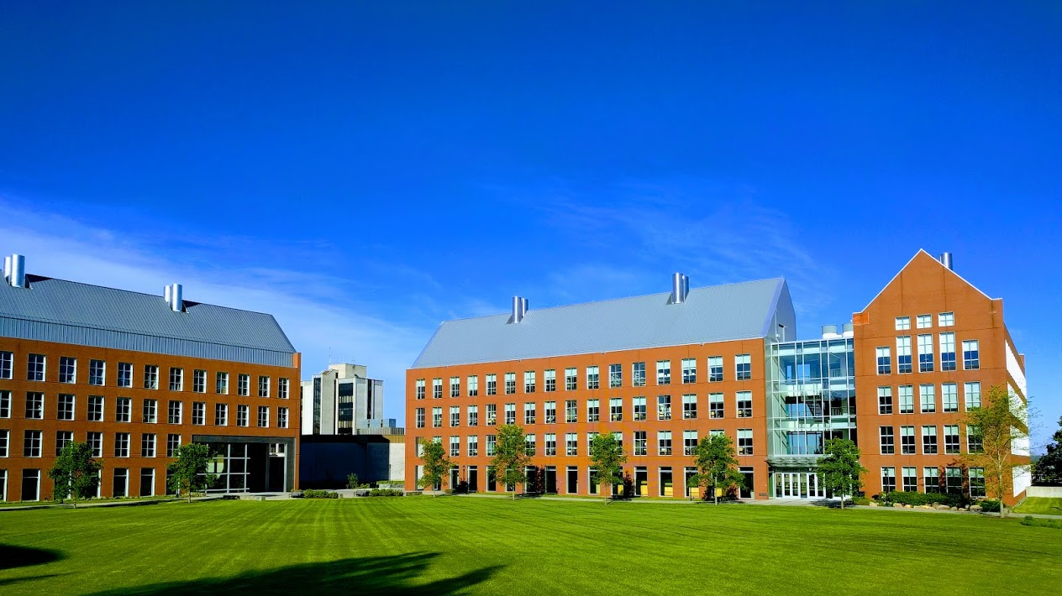

Mechanisms underlying spatial interaction in the oral microbiota
Matthew M. Ramsey, PhD
University of Rhode Island

Slide 2
We must understand mechanisms of interaction between commensals to exploit them for our benefit.
My laboratory studies interactions within supragingival plaque (for now)
How do we choose the right ones?

Slide 3
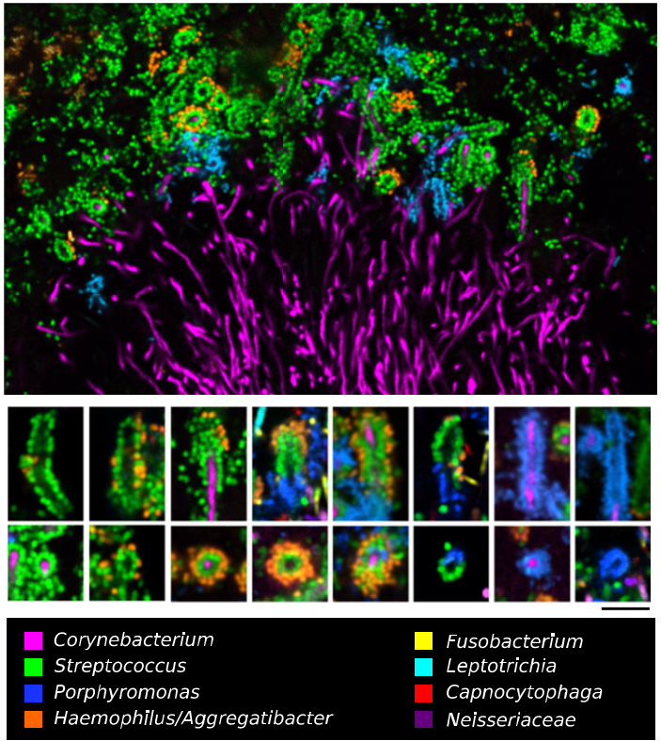

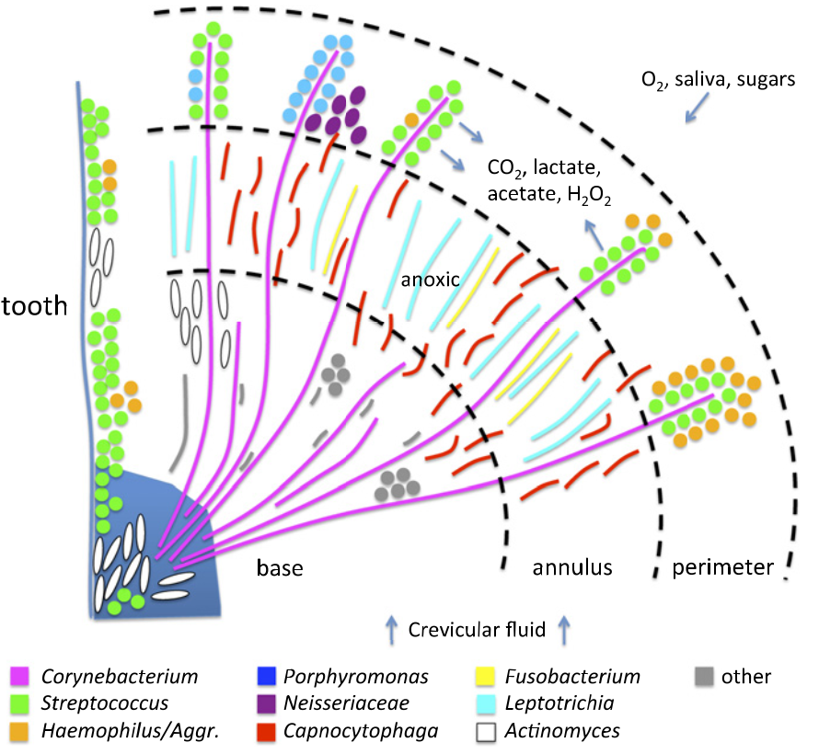
Jessica Mark Welch PhD
Associate Scientist
Marine Biology Lab / University of Chicago. Woods Hole, MA
2011. Valm, Borisy, PNAS.
2016. Mark Welch, Borisy, PNAS.

Slide 4

C. matruchotii
Gram positive
Facultative anaerobe
Plaque ‘specialist’
Commensal
Eric Almeida

Slide 5
Interactions With Oral Streptococci
?
Lactate
Streptococcus sp.
O₂
Adjacent species
?
H₂O₂
Sugars

Slide 6

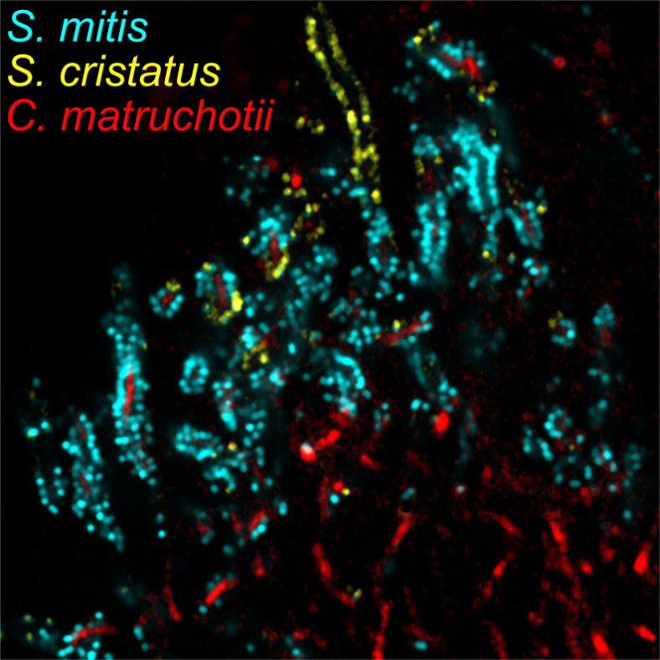
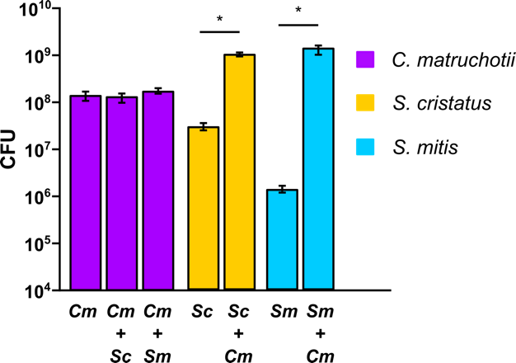
Aerobic cocultures

Slide 7
Why is streptococcal growth increased in the presence of
C. matruchotii?
Hypotheses:
C. matruchotii mitigates streptococcal-produced H₂O₂
  Removal of ROS
C. matruchotii catabolizes streptococcal metabolic end products
  Removal of acid stress

Slide 8
What about lactate?
Cm upregulates the lutABC operon in coculture with either streptococci
ΔlutA deletion strains are deficient in lactate catabolism
Cm ΔlutA and Sm yields decrease in coculture
  Additional pH buffering does not help…

Slide 9
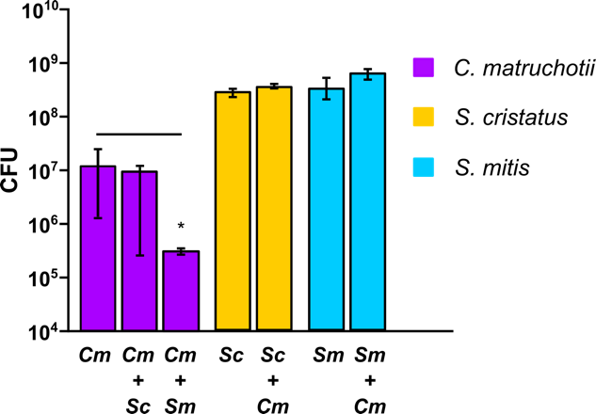
Anaerobic Coculture

Slide 10
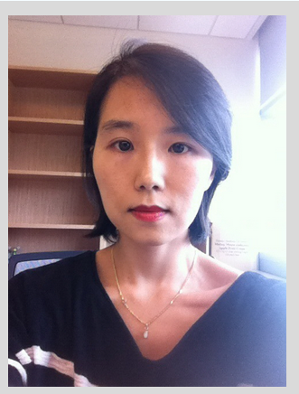
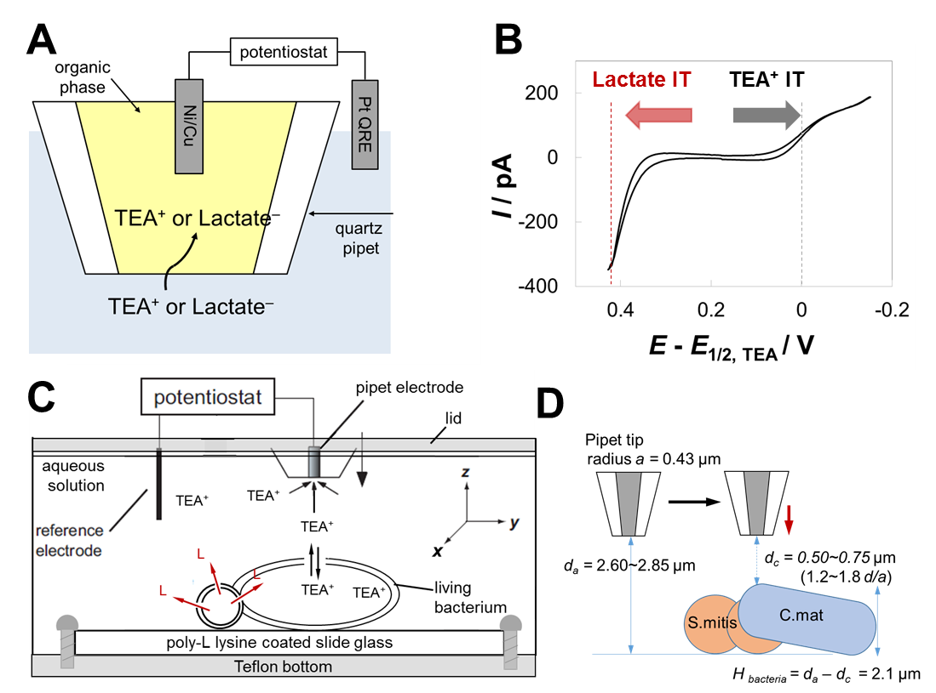
Scanning Electrochemical Microscopy
SECM
Uses current measurement at set redox potential to quantify specific molecules in real-time in 3-dimensions in sub-micron scales
Dr. Jiyeon Kim
URI Dept. of Chemistry

Slide 11
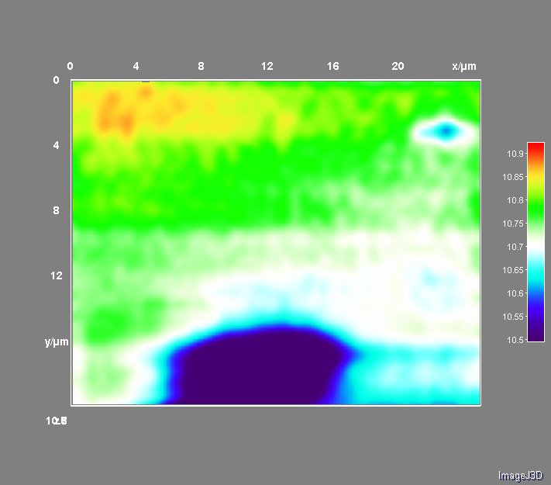
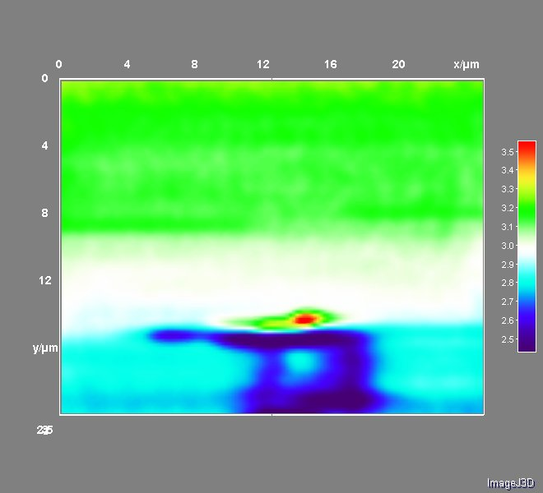
SECM Image with TEA
SECM Image for
Lactate Detection
At d_{a} = 2.85 μm, d_{c} = 0.75 μm (1.8 d/a)
At d_{a} = 2.6 μm, d_{c} = 0.5 μm (1.2 d/a)
I x10
/ pA
I x10
/ pA
S.mitis
C.mat
Demonstrates object presence by lack of permeability to TEA

Slide 12
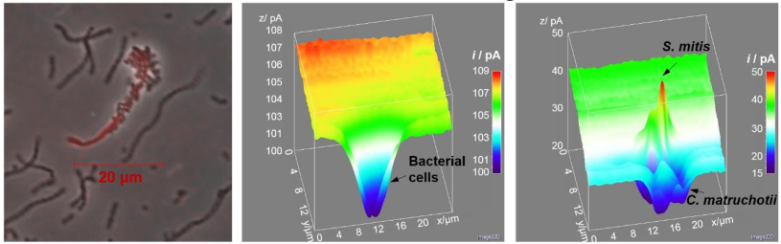
SECM Image for
Lactate Detection
SECM Image with TEA
Almeida et al https://doi.org/10.1101/2022.05.09.491233
Puri et al (in submission @ JACS)

Slide 13
Cm interaction summary
H₂O₂ removal enhances S. mitis growth and Cm survival is required for full Sm yields
Lactate utilization by Cm also enhances S. mitis yield and is NOT dependent on pH modulation (not shown)

Slide 14
Why is streptococcal growth increased in the presence of
C. matruchotii?
Hypotheses:
C. matruchotii mitigates streptococcal-produced H₂O₂
  Removal of ROS (TRUE)
C. matruchotii catabolizes streptococcal metabolic end products
  Removal of acid stress (FALSE)

Slide 15
What’s next?
Use SECM to test metabolite transfer of cofactors
Anaerobic interx of C. matruchotii with oral commensals and opportunists
What is the impact on immune activation for more complex healthy communities?

Slide 16
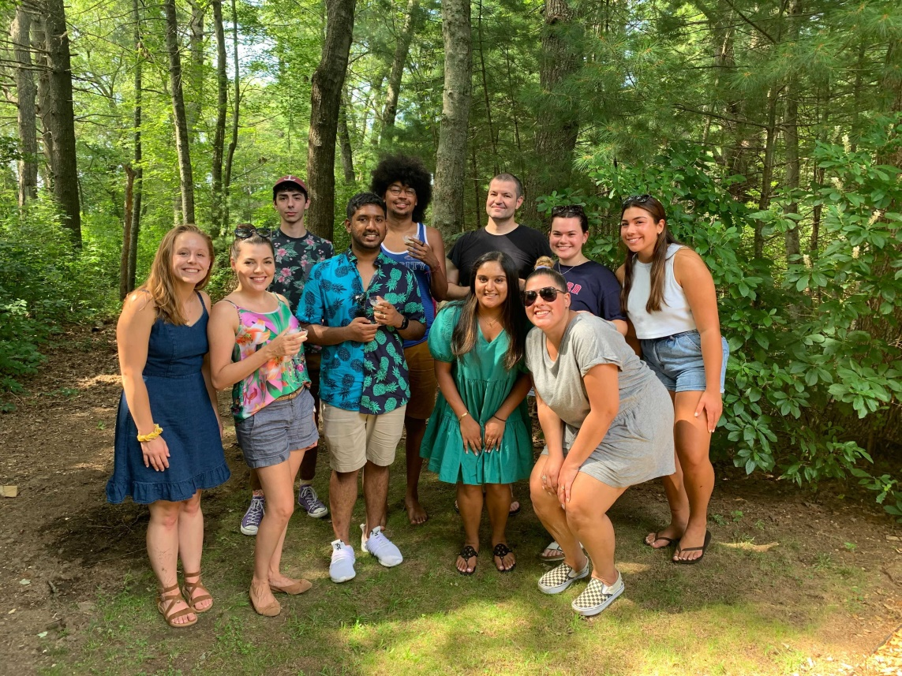



Acknowledgements
Graduate Students:
Eric Almeida
Thais Harder De Palma
Dasith Perera
Alex Labossiere
Funding:
RI Foundation Medical Research Fund
RI COBRE - #P20GM104317
RI INBRE Early Career Award – #P20GM103430
NIH – NIDCR #R01DE027958
Collaborators:
Marcelo Freire (JCVI) / Hatice Hasturk (Forsyth)
Jessica Mark Welch (U Chicago / MBL)
Jiyeon Kim (URI)

