Slide 1
Matthew Ramsey
College Professor
MS – University of Oklahoma 2003

Slide 2
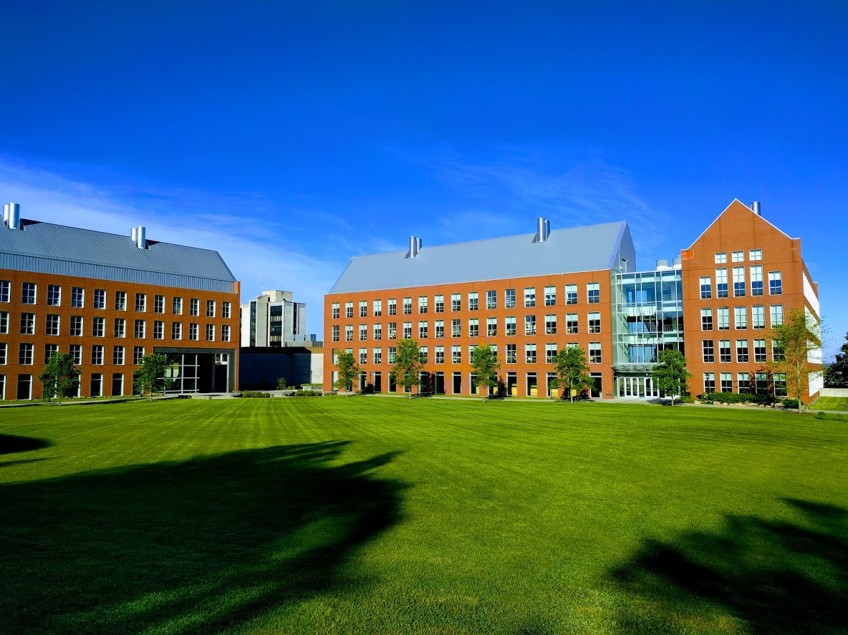

Mechanisms underlying spatial interaction in the oral microbiota
Matthew M. Ramsey, PhD
University of Rhode Island

Slide 3
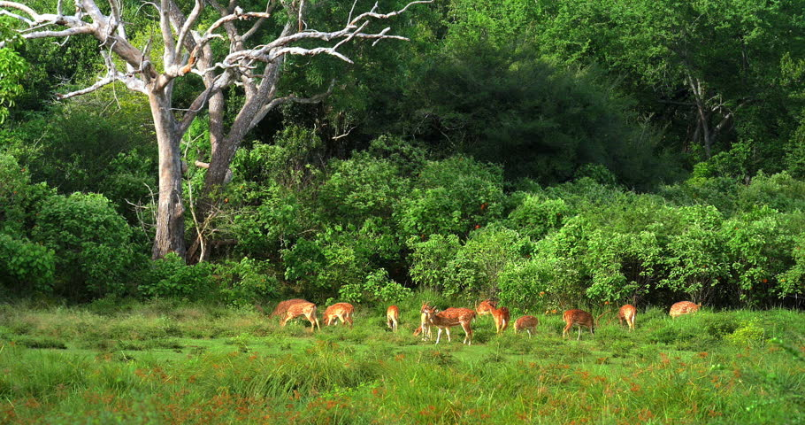
Current Microbiome Standard
13 Odocoileus (deer)
3 tree Genus X
2 tree Genus Y
17 shrub Genus X
2 shrub Genus Y
125 grass Genus X
27 grass Genus Y
4 bird Genus X
5 bird Genus Y
What hypotheses could you generate from a list?

Slide 4
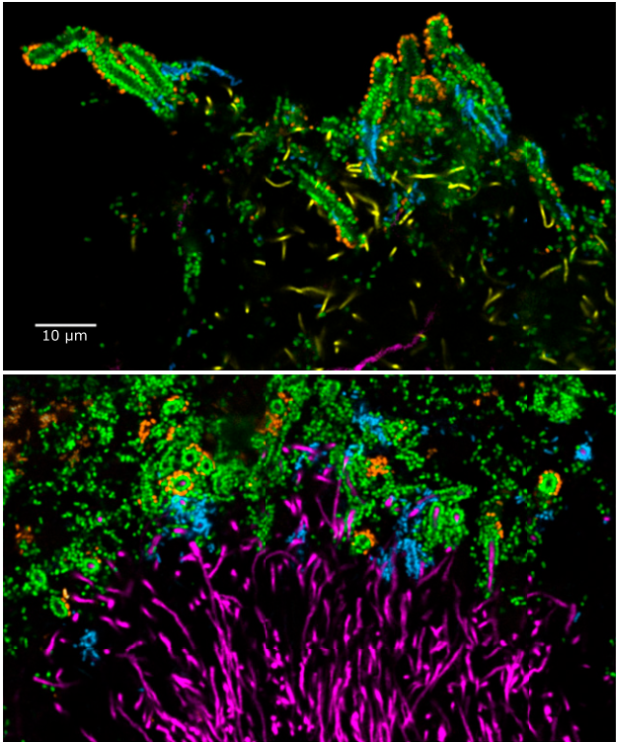
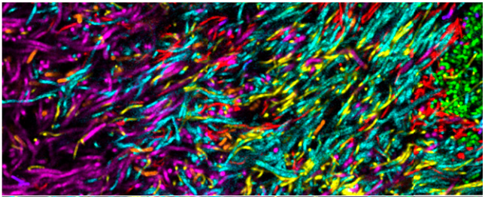
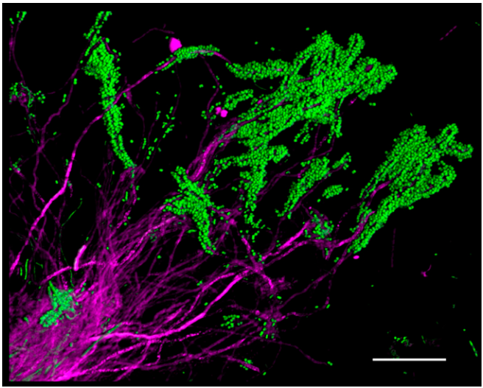
Human oral plaque
c/o Jessica Mark Welch

Slide 5
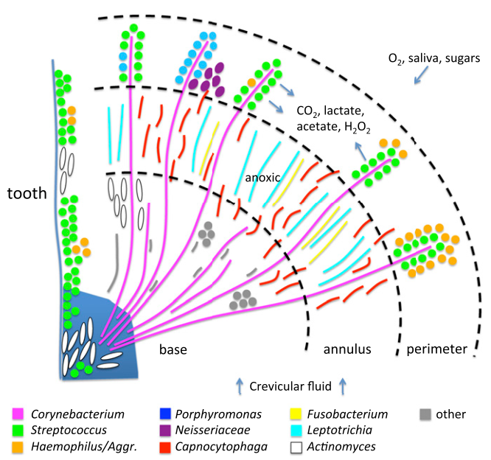
We need species-level identification to test mechanistic hypotheses

Slide 6
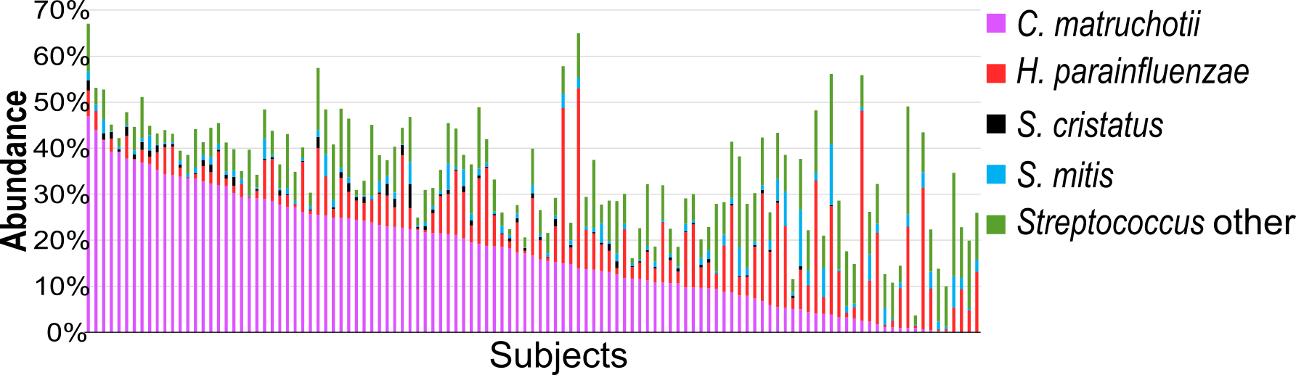
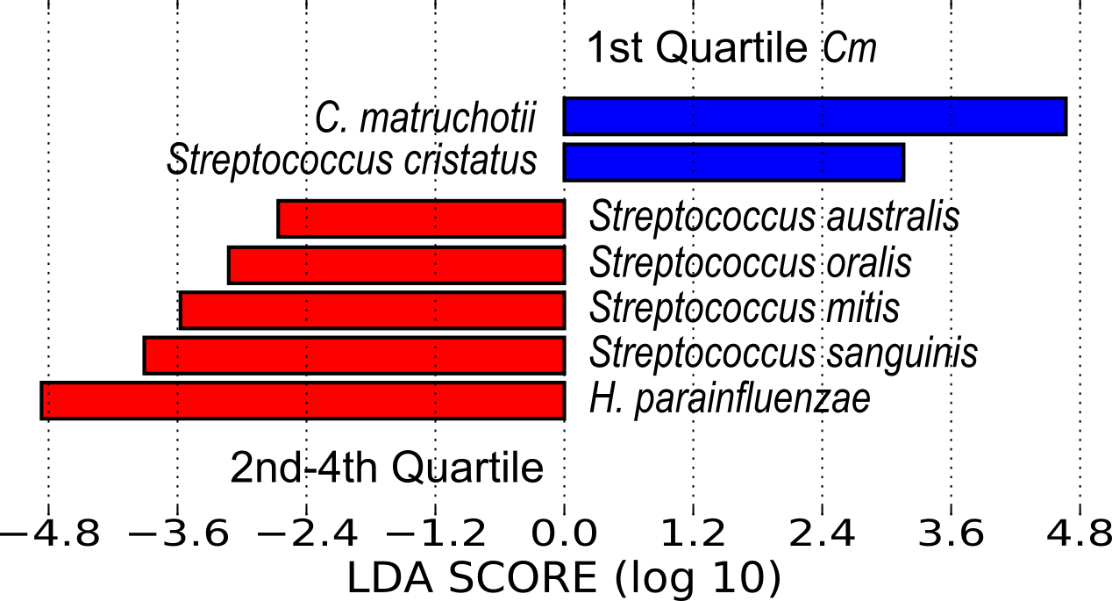
Species-assigned human oral microbiome data (n=117)
Do these also interact directly?

Slide 7
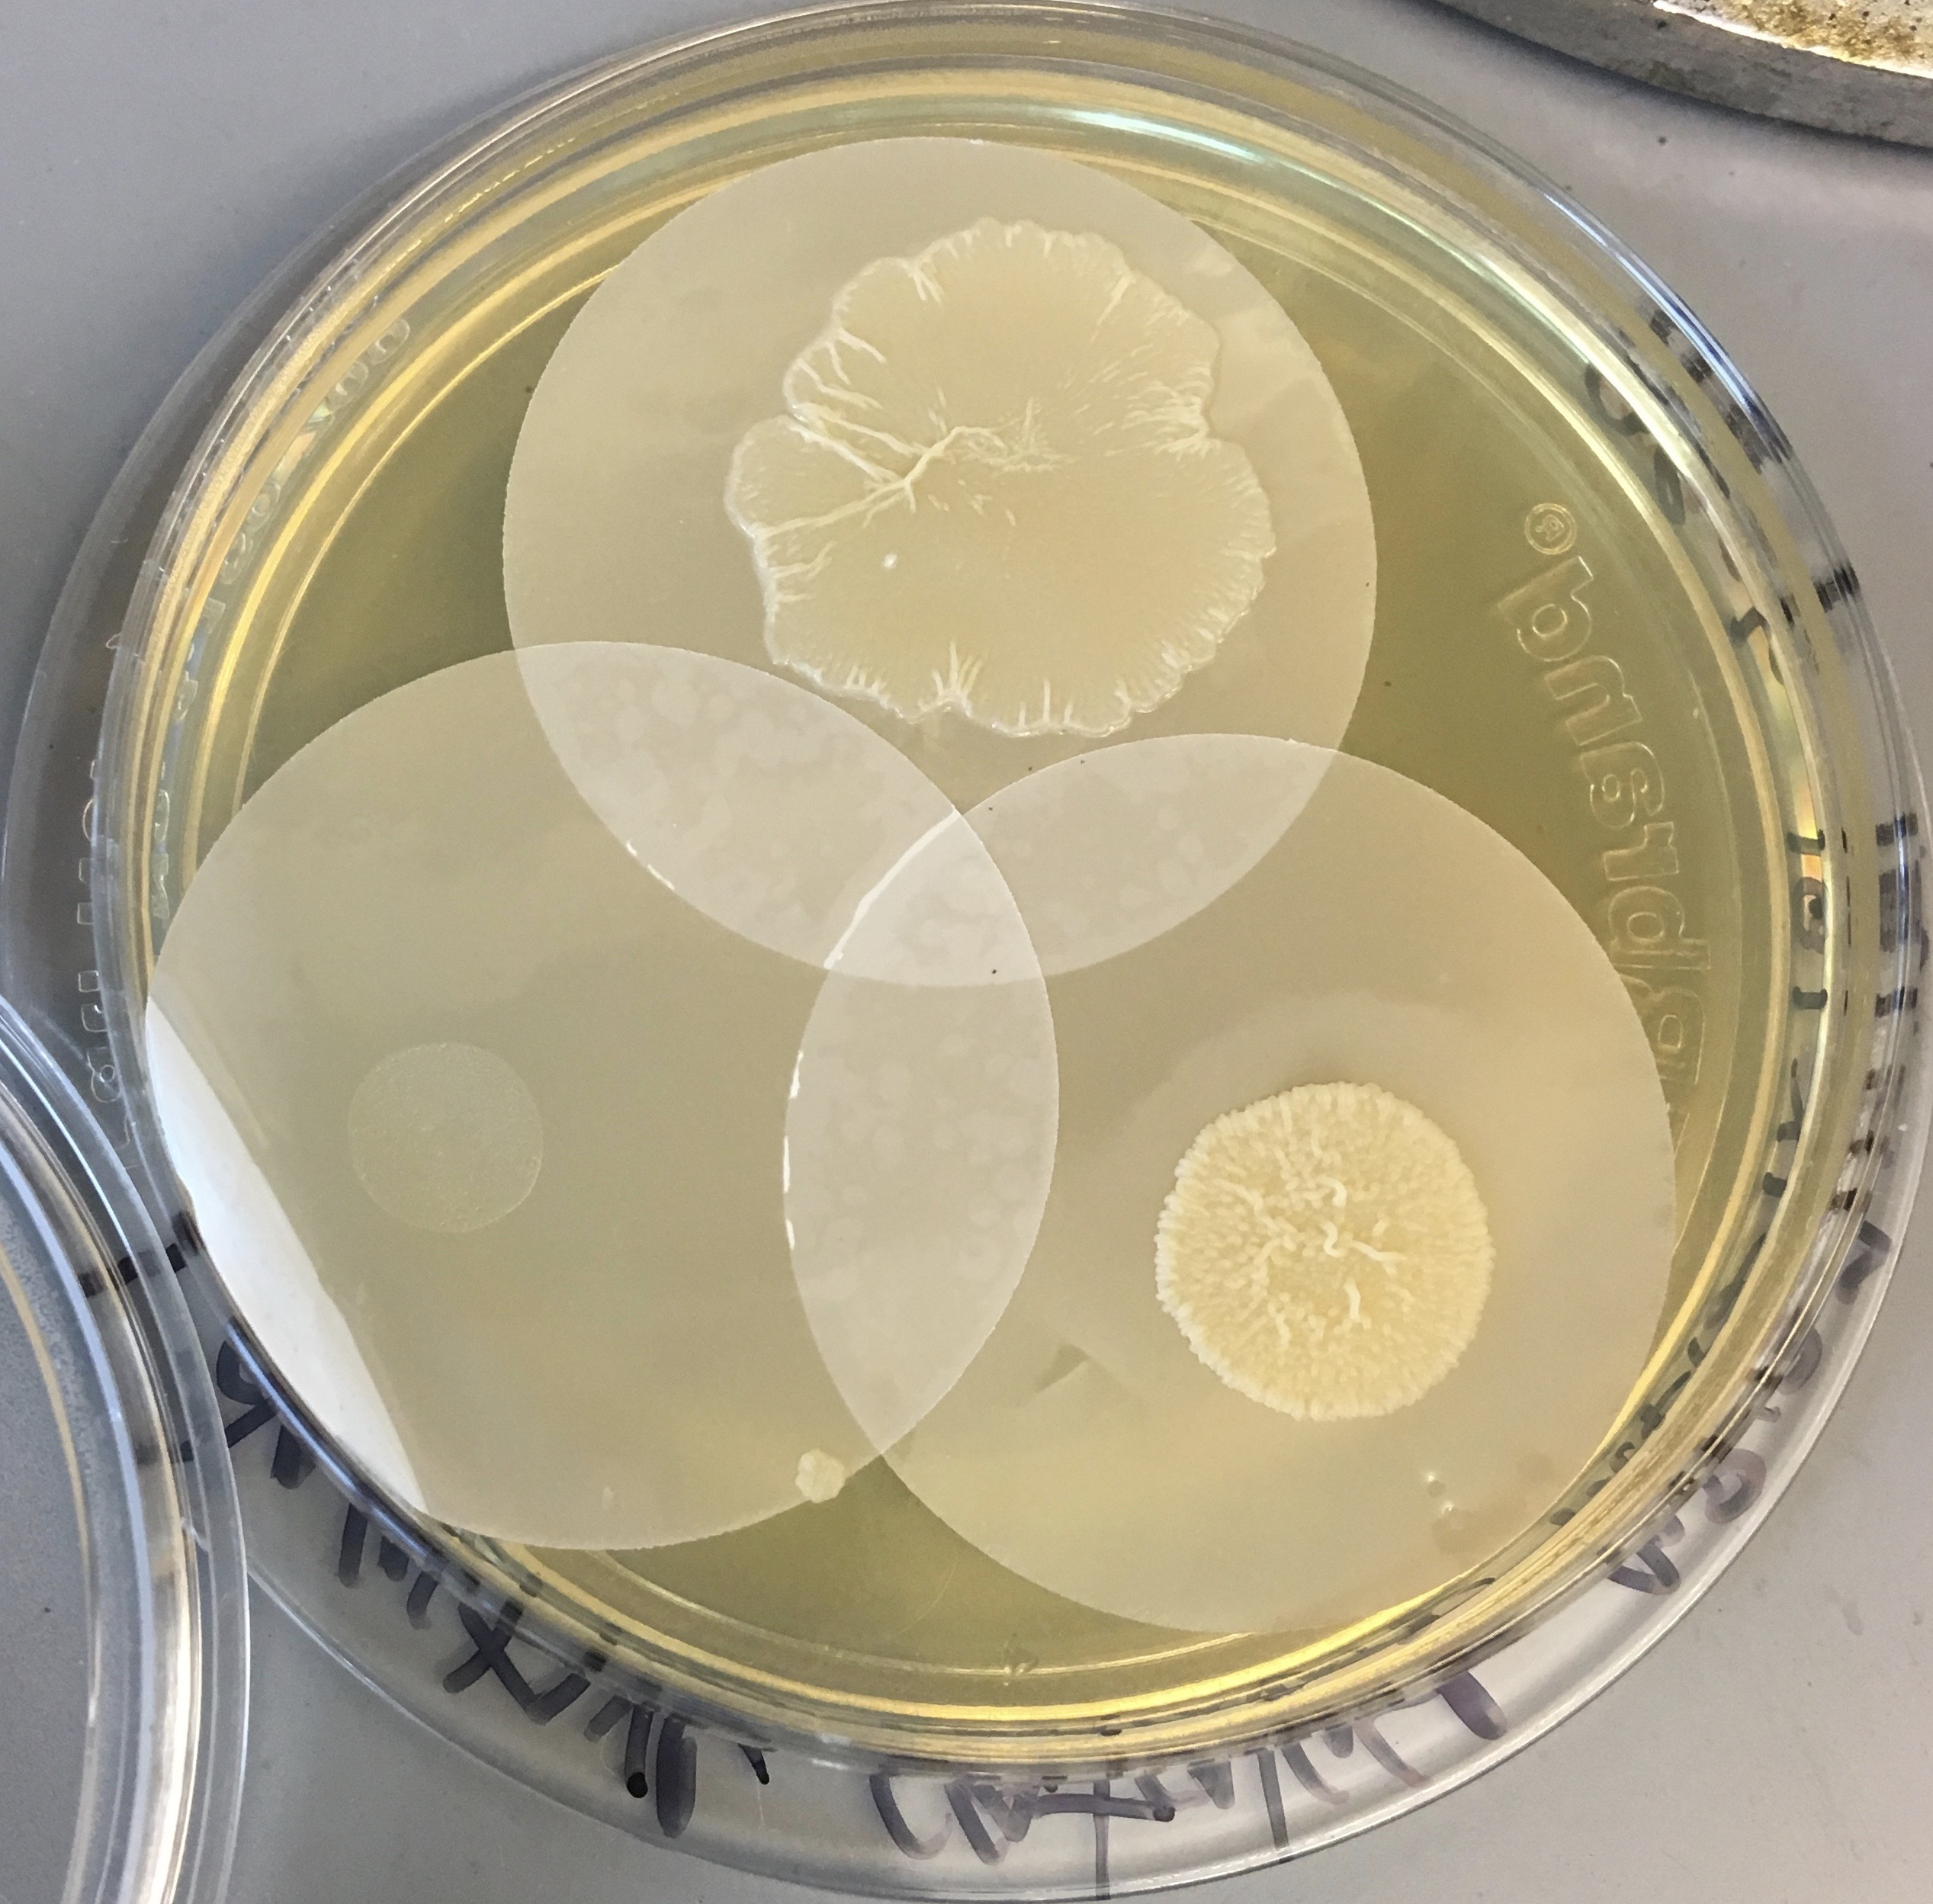
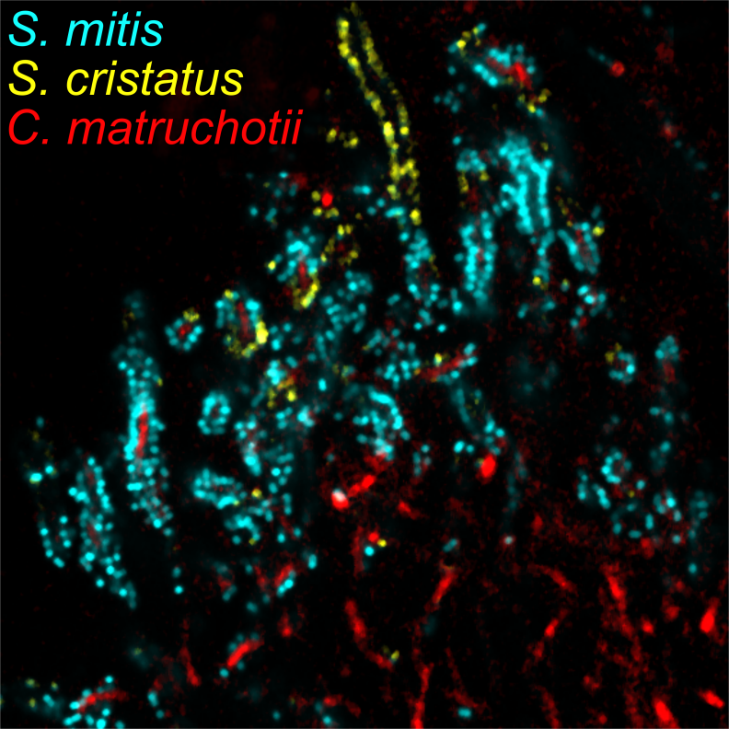
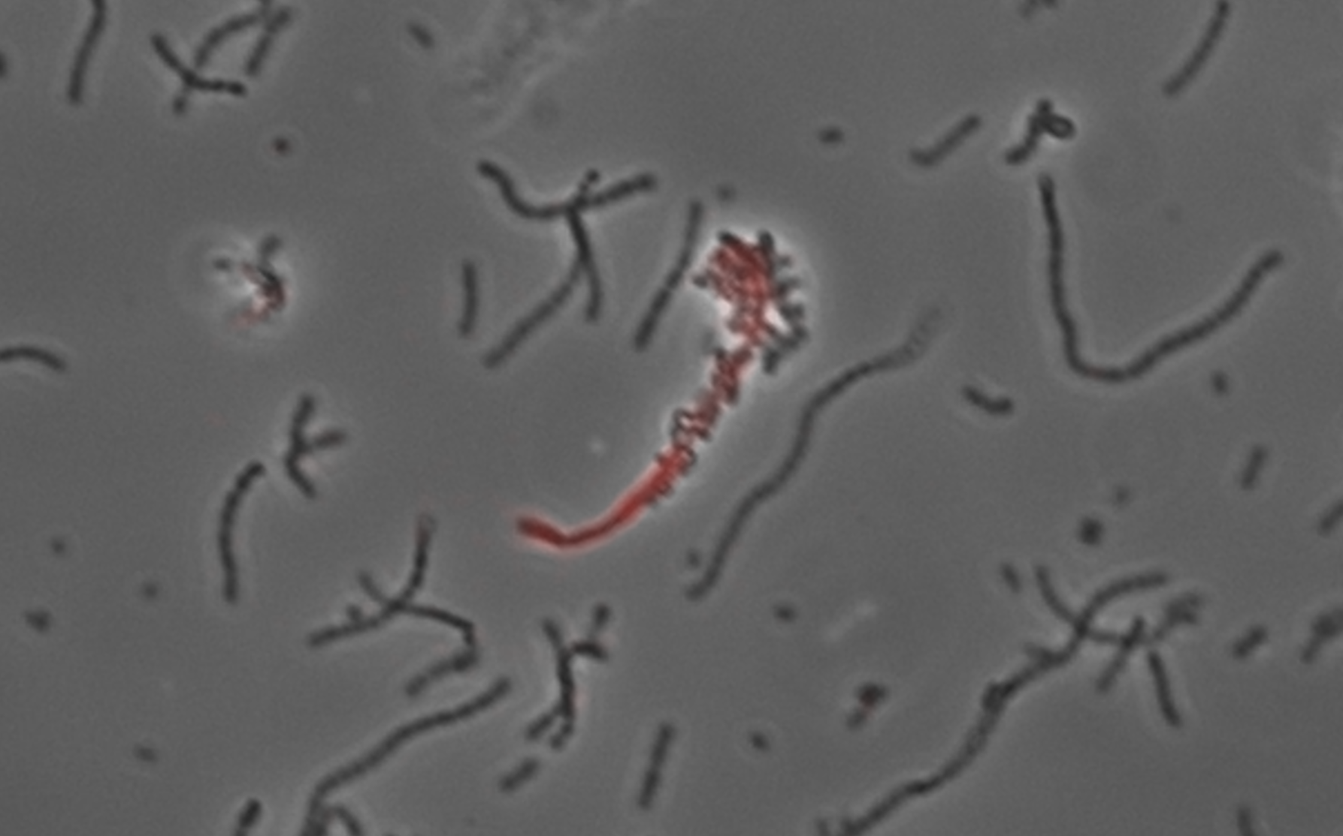
Do these predicted species interact in vivo?

Slide 8
Average week as a professor - teaching
I teach two 1h 15m lectures per week.
  ~1h per lecture prepping slides (2-3x longer if its brand new)
  ~2h per week for office hours set aside
  Grading and administrative work is another ~2h per week
I manage a 1h per week seminar course.
  Little work other than setting the schedule and making announcements / moderating the course discussion.
I have a 1h faculty meeting every 1-2 weeks.

Slide 9
Average week as a professor - research
I have a 2h lab meeting per week
I spend anywhere from 2-20h per week working directly with the students (in person or zoom)
On average I spend another 5h per week working on editing and writing. (this is 20-30h some weeks, 1-2h others)
Grant writing can be all consuming up to the deadline.
I work on a grant review panel and 6 weeks out of the year spend ~10h per week reviewing and 6 full workdays in conference.

Slide 10
Some takeaways
When I can afford to be lazy and relax, I try to make the most of that.
Setting boundaries for your time is important. Be realistic.
Multitasking is constant, setting good habits now for time organization and learning how to prioritize is of the highest importance for grad school and for professors.
Meetings will eat up as much time as you allow them to.

Slide 11
Biographical
Born in 1979, New Orleans, LA
High School in LA, 1996
College at Louisiana Tech University, 2000
MS degree at OU 2000-2002/3
Core Facility Technician, Dean McGee Eye Institute, OKC. 2003-2005
PhD University of Texas 2006-2011
Postdoc, Harvard Medical School 2013
Postdoc, The Forsyth Institute 2016
University of Rhode Island 2016 - Present

Slide 12
When did I know it was what I wanted to do?
Started in undergrad
  More just thinking it was a possible career path
I didn’t really know if I was going to be a professor back then, but I 1st considered at that time.
I knew I loved the science, microbiology in particular
I was considering other options right up until I started grad school
  I was considering other options not long after too!

Slide 13
Going to Grad school (pt 1)
Mostly due to monetary concerns I went straight into grad school
  More on that later
I started in one lab but after 6 months it wasn’t a great fit
I moved to a different lab and went for a MS degree instead of PhD
I needed to work and get more financial independence
I also just needed to “get my shit together”

Slide 14
My 1st science job
Directly due to the skills I learned in my MS degree I got a job
I ran confocal and flow cytometry instruments at the Dean McGee Eye Institute in OKC.
  I commuted from my apartment in Norman for the 1st year (do not recommend)
I enjoyed the work and the major supervisor there was a good and caring mentor
  My direct supervisor was not
After working for a few years, I realized I still was thinking about research of my own

Slide 15
Going to Grad school (pt 2)
I reached out to my MS advisor and friends from the lab
There was a brand new project starting up and it was more interesting than to me than what I had done before.
I had a very bad 1st year (more later)
After that things improved a lot
I was lucky but I was also very persistent.
  External funding
Graduate school is more like learning a new language, the more you are immersed in it, the better you will understand and perform.

Slide 16
Postdoc (pt 1)
Through connections from my PhD advisor, I joined a lab starting a new project that I was a good fit for.
I really loved the project.
The advisor was very difficult.
I began looking for another postdoc.

Slide 17
Postdoc (Pt 2)
I was fortunate to find another advisor who had funding in a similar enough area that my work could continue.
This mentor was fantastic and we are still close.
I enjoyed my time here even though the institute had some troubles.
  Important life lesson
I was just starting to go on the academic job market and had a chance meeting.
  Another life lesson

Slide 18
Getting an academic job
If it’s what you want to do, know that it’s difficult.
Not that science is particularly hard (if you love it), its just the numbers.
Where you go to school does influence the odds
Ultimately you as an individual needs to get results

Slide 19
The life of a Graduate student
It’s sometimes fun.
It’s often frustrating.
You’re going to be broke.
You are getting paid to learn! Make the most of it!
Your fit with your advisor and lab are critical. If its not good when things are good, its not going to work.
Time management is the single greatest skill you will learn.

Slide 20
Tips for Graduate School
Discussion

Slide 21
Mental health and graduate school
You are not your project
  But you and your advisor both need results
This is a job
  Take it as seriously as one
You can say no
  You will not always enjoy what needs to be done to succeed
Protect your own time / interests
  Take care of your physical AND mental health

Slide 22
Mental health and graduate school
Impostor syndrome
  It’s never going to go away
Looking for a way out?
  Thinking about quitting happens, be sure its real
Consider your career choices early
  Academic employment is rare

