Slide 1
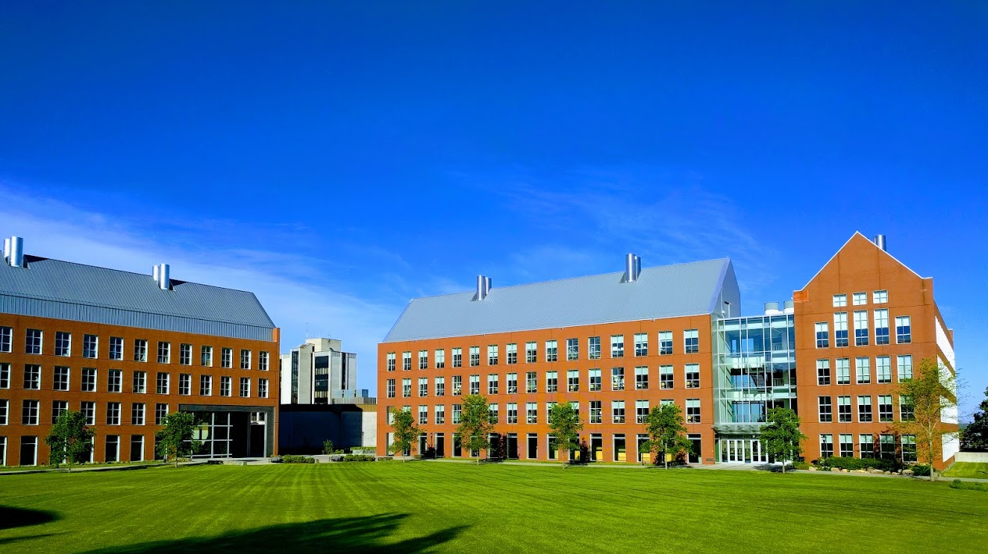

Mechanisms underlying spatial interaction in the oral microbiota
Matthew M. Ramsey, PhD
University of Rhode Island

Slide 2
If we want to understand mechanisms of interaction in a healthy community, where do we start looking?
How do we choose our species and interactions of interest?
Composition > Structure > Function

Slide 3
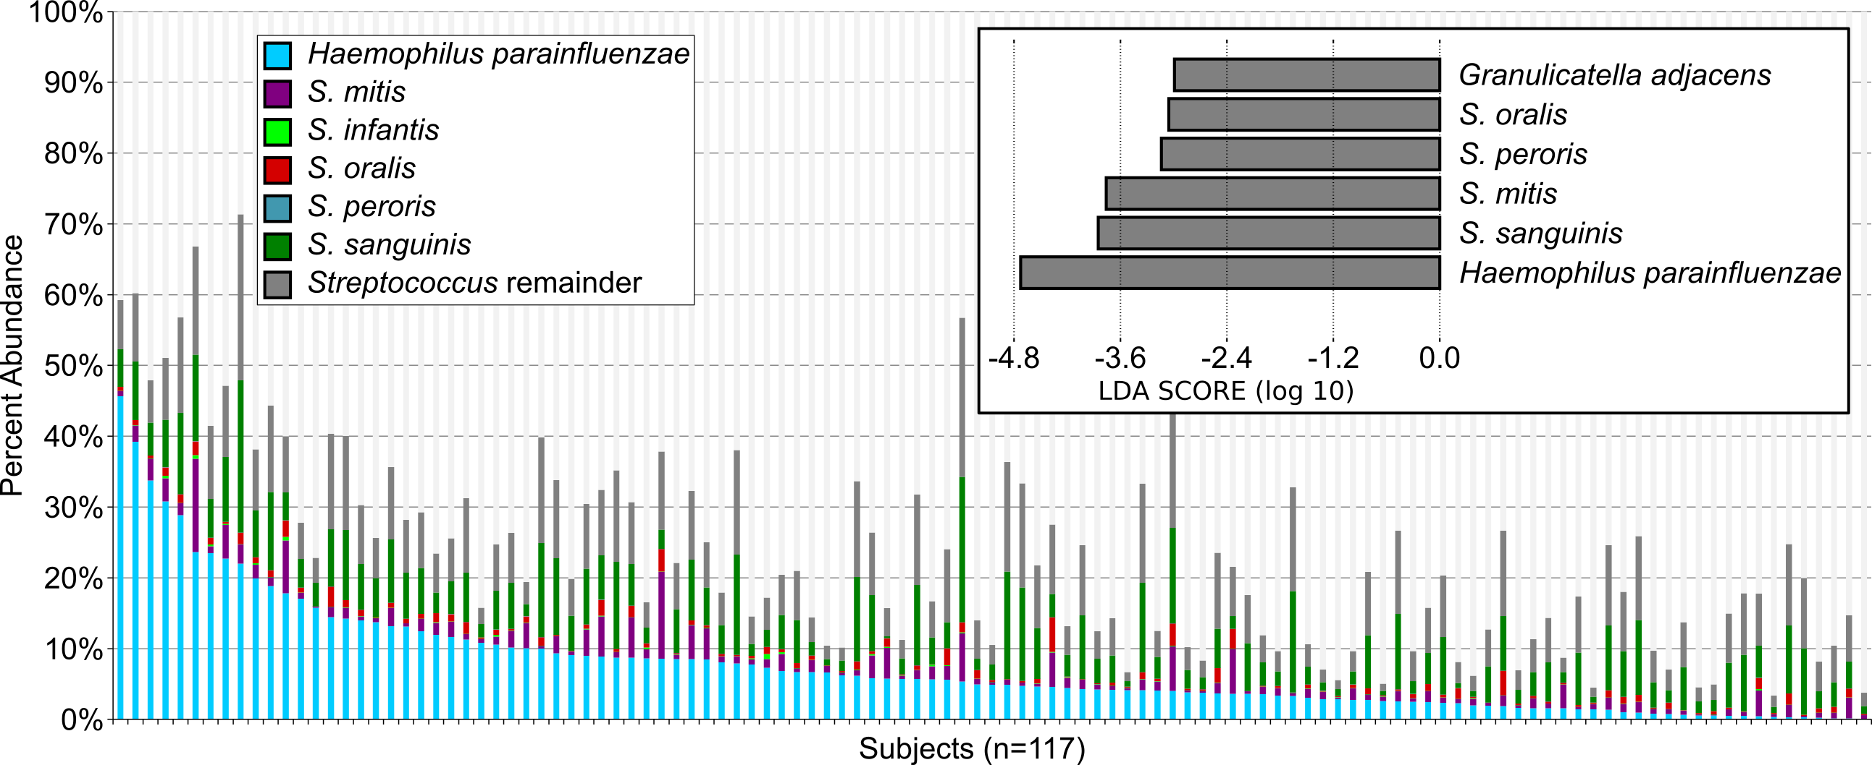
Composition
Perera D., McLean, A., Mark Welch, J, Ramsey, M. (2021), ISME

Slide 4

H. parainfluenzae
Gram negative
Facultative anaerobe
Abundant in several oral sites / extraoral
Opportunist, generalist
Dasith Perera

Slide 5
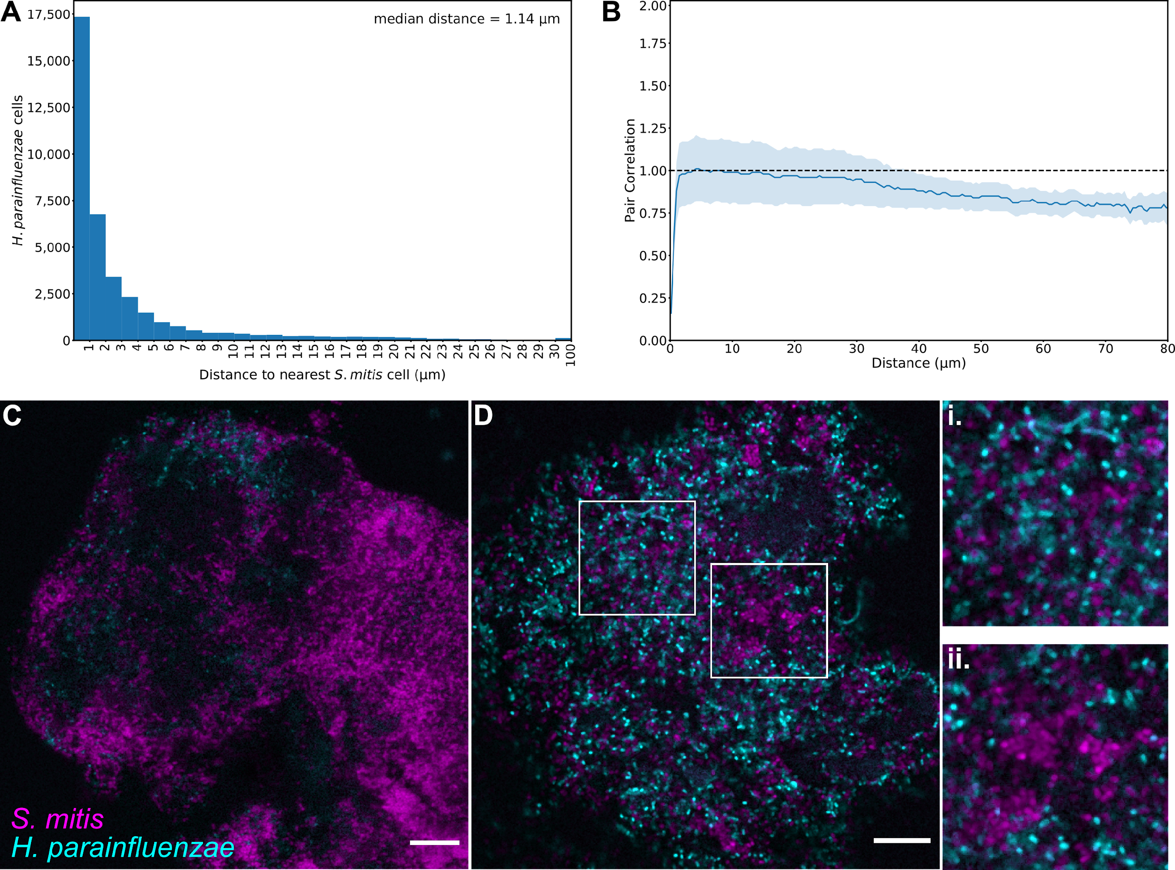
Hp – Sm in vivo
Structure
“mitis-group”

Slide 6
Hp only found near Sm
Photos taken based on Hp presence

Slide 7
Interactions With Oral Streptococci
?
Lactate
Streptococcus sp.
O₂
Your organism
?
H₂O₂
Sugars

Slide 8
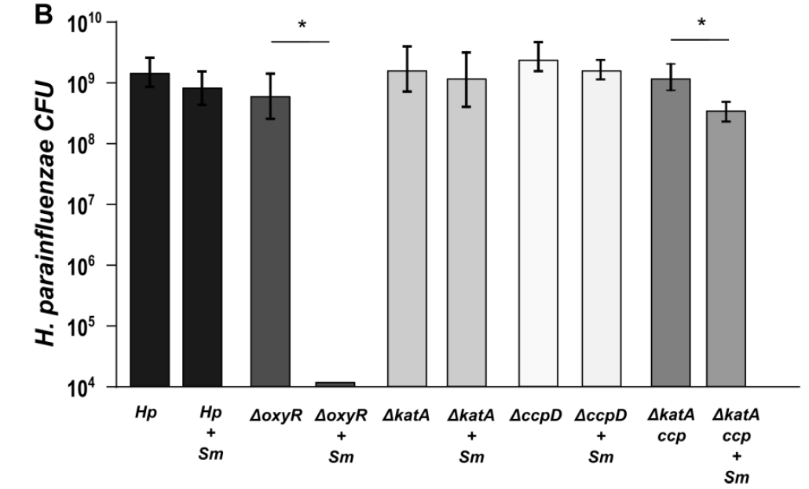
Hp in vitro coculture

Slide 9
So…
Hp has a highly redundant system for H₂O₂ resistance
They live next to H₂O₂ producers in vivo
Why does Hp put up with this “toxic relationship” ?

Slide 10
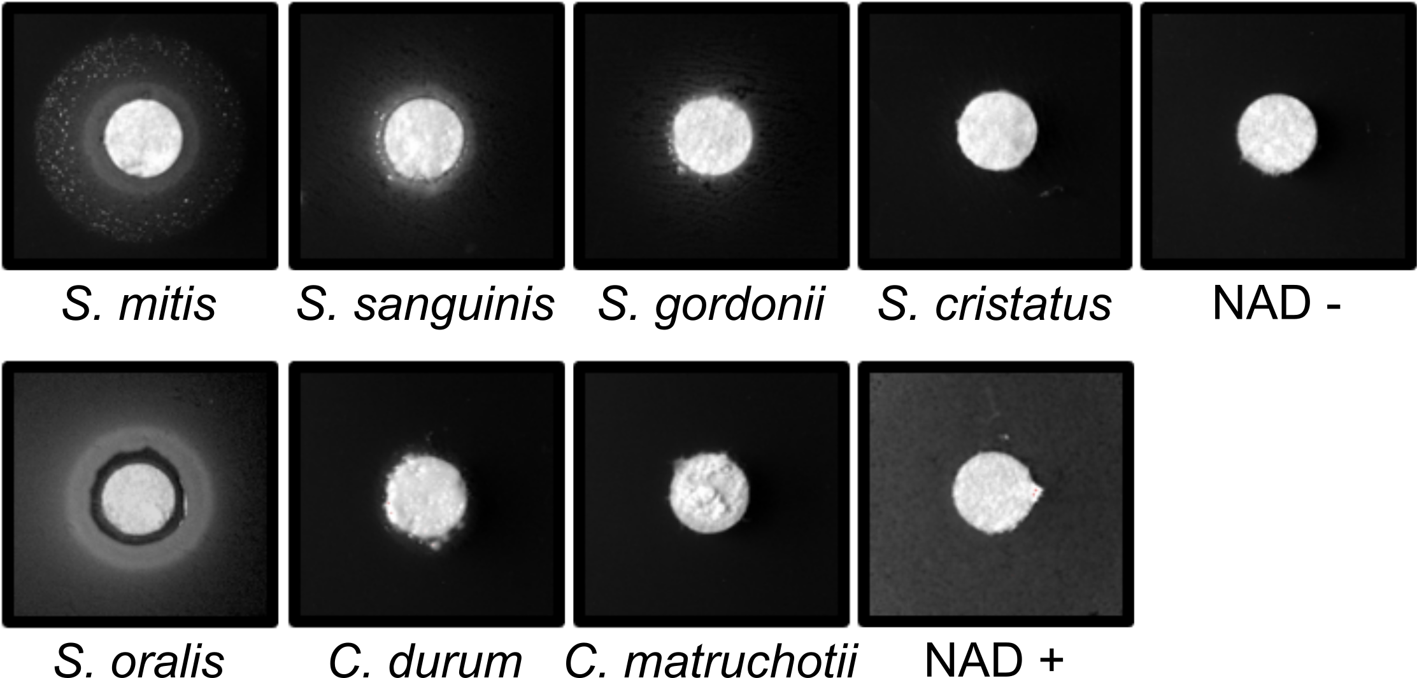
Mitis-group streptococci complement NAD auxotrophy
Hp lawns
Media:
BHI +YE +Hemin + Catalase
Notes:
Hpara is an NAD auxotroph- it cannot synthesize its own NAD, it needs to get it from its environment. We’ve tested saliva and it doesn’t appear to have sufficient free NAD to support hpara growth, so other microbes could be an important source.
I spread hpara on plates lacking NAD and spotted equal inoculums of some of the most abundant species found in plaque and incubated together for 48 hours.
We see good growth of hpara when next to mitis, some growth with other streps, and very little if any with the coryne’s.
So despite being killed by mitis due to hydrogen peroxide, hpara prefers to be around mitis because it can be an important source of NAD

Slide 11
Summary / Function
Mechanisms suggested for cooperative mucin degradation in coculture
The mechanism for NAD release by Streptococcus is not yet known (ideas?)
New data indicates Hp coculture enhances Sm resistance to phagocytosis
Perera D., McLean, A., Mark Welch, J, Ramsey, M. (2021), ISME

Slide 12
If we want to understand mechanisms of interaction in a healthy community, where do we start looking?
How do we choose our species and interactions of interest?
Composition > Structure > Function

Slide 13
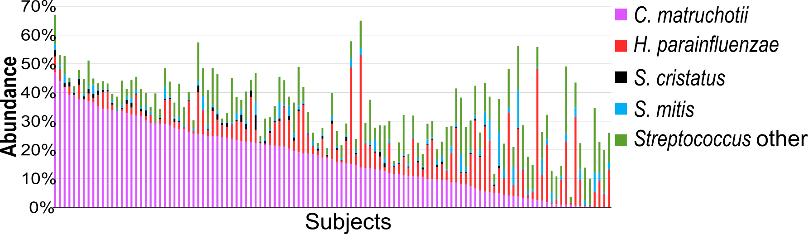

Composition
Human Supragingival Plaque n=117

Slide 14
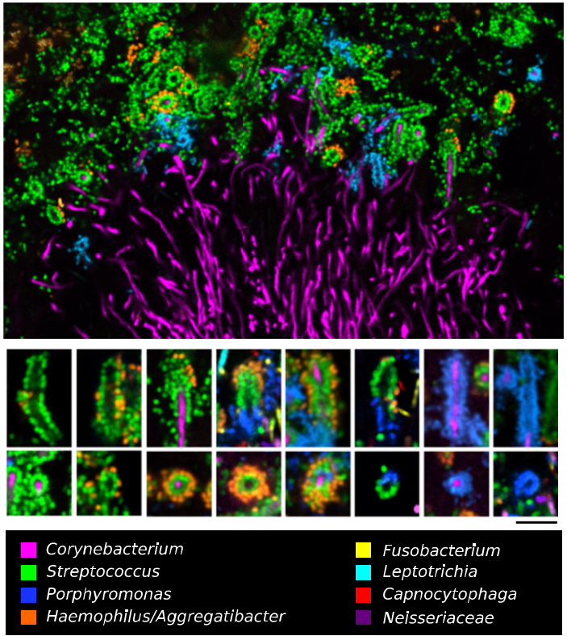
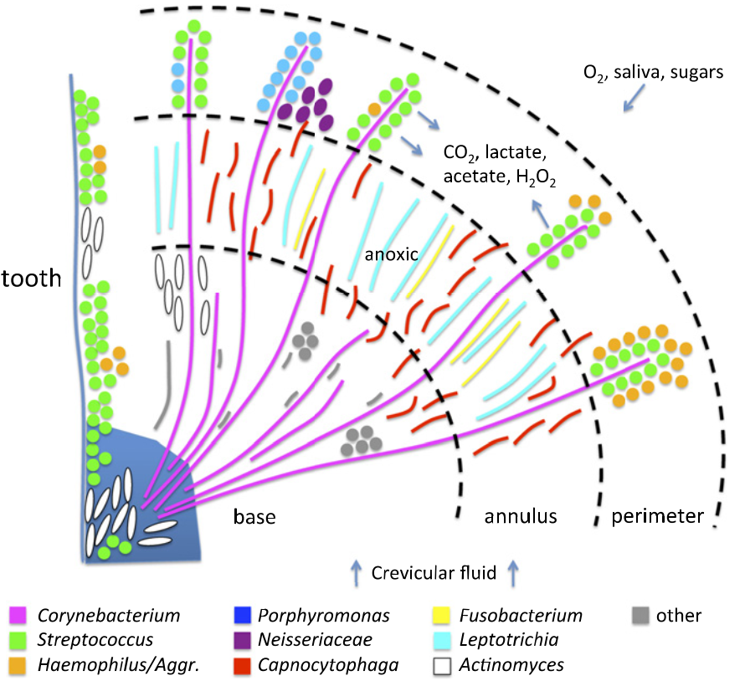

Jessica Mark Welch PhD
Associate Scientist
Marine Biology Lab / University of Chicago. Woods Hole, MA
2011. Valm, Borisy, PNAS.
2016. Mark Welch, Borisy, PNAS.

Slide 15
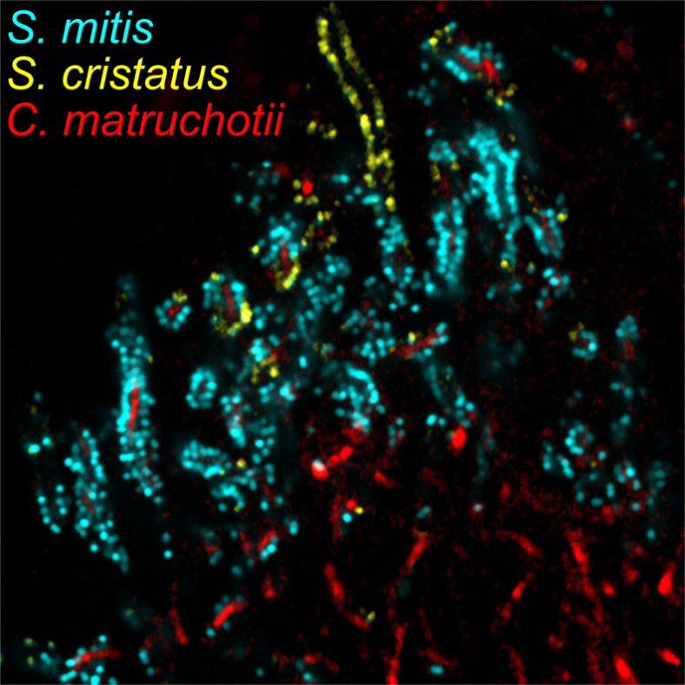
Structure
Predicted species level correlation also observed in direct proximity

Slide 16
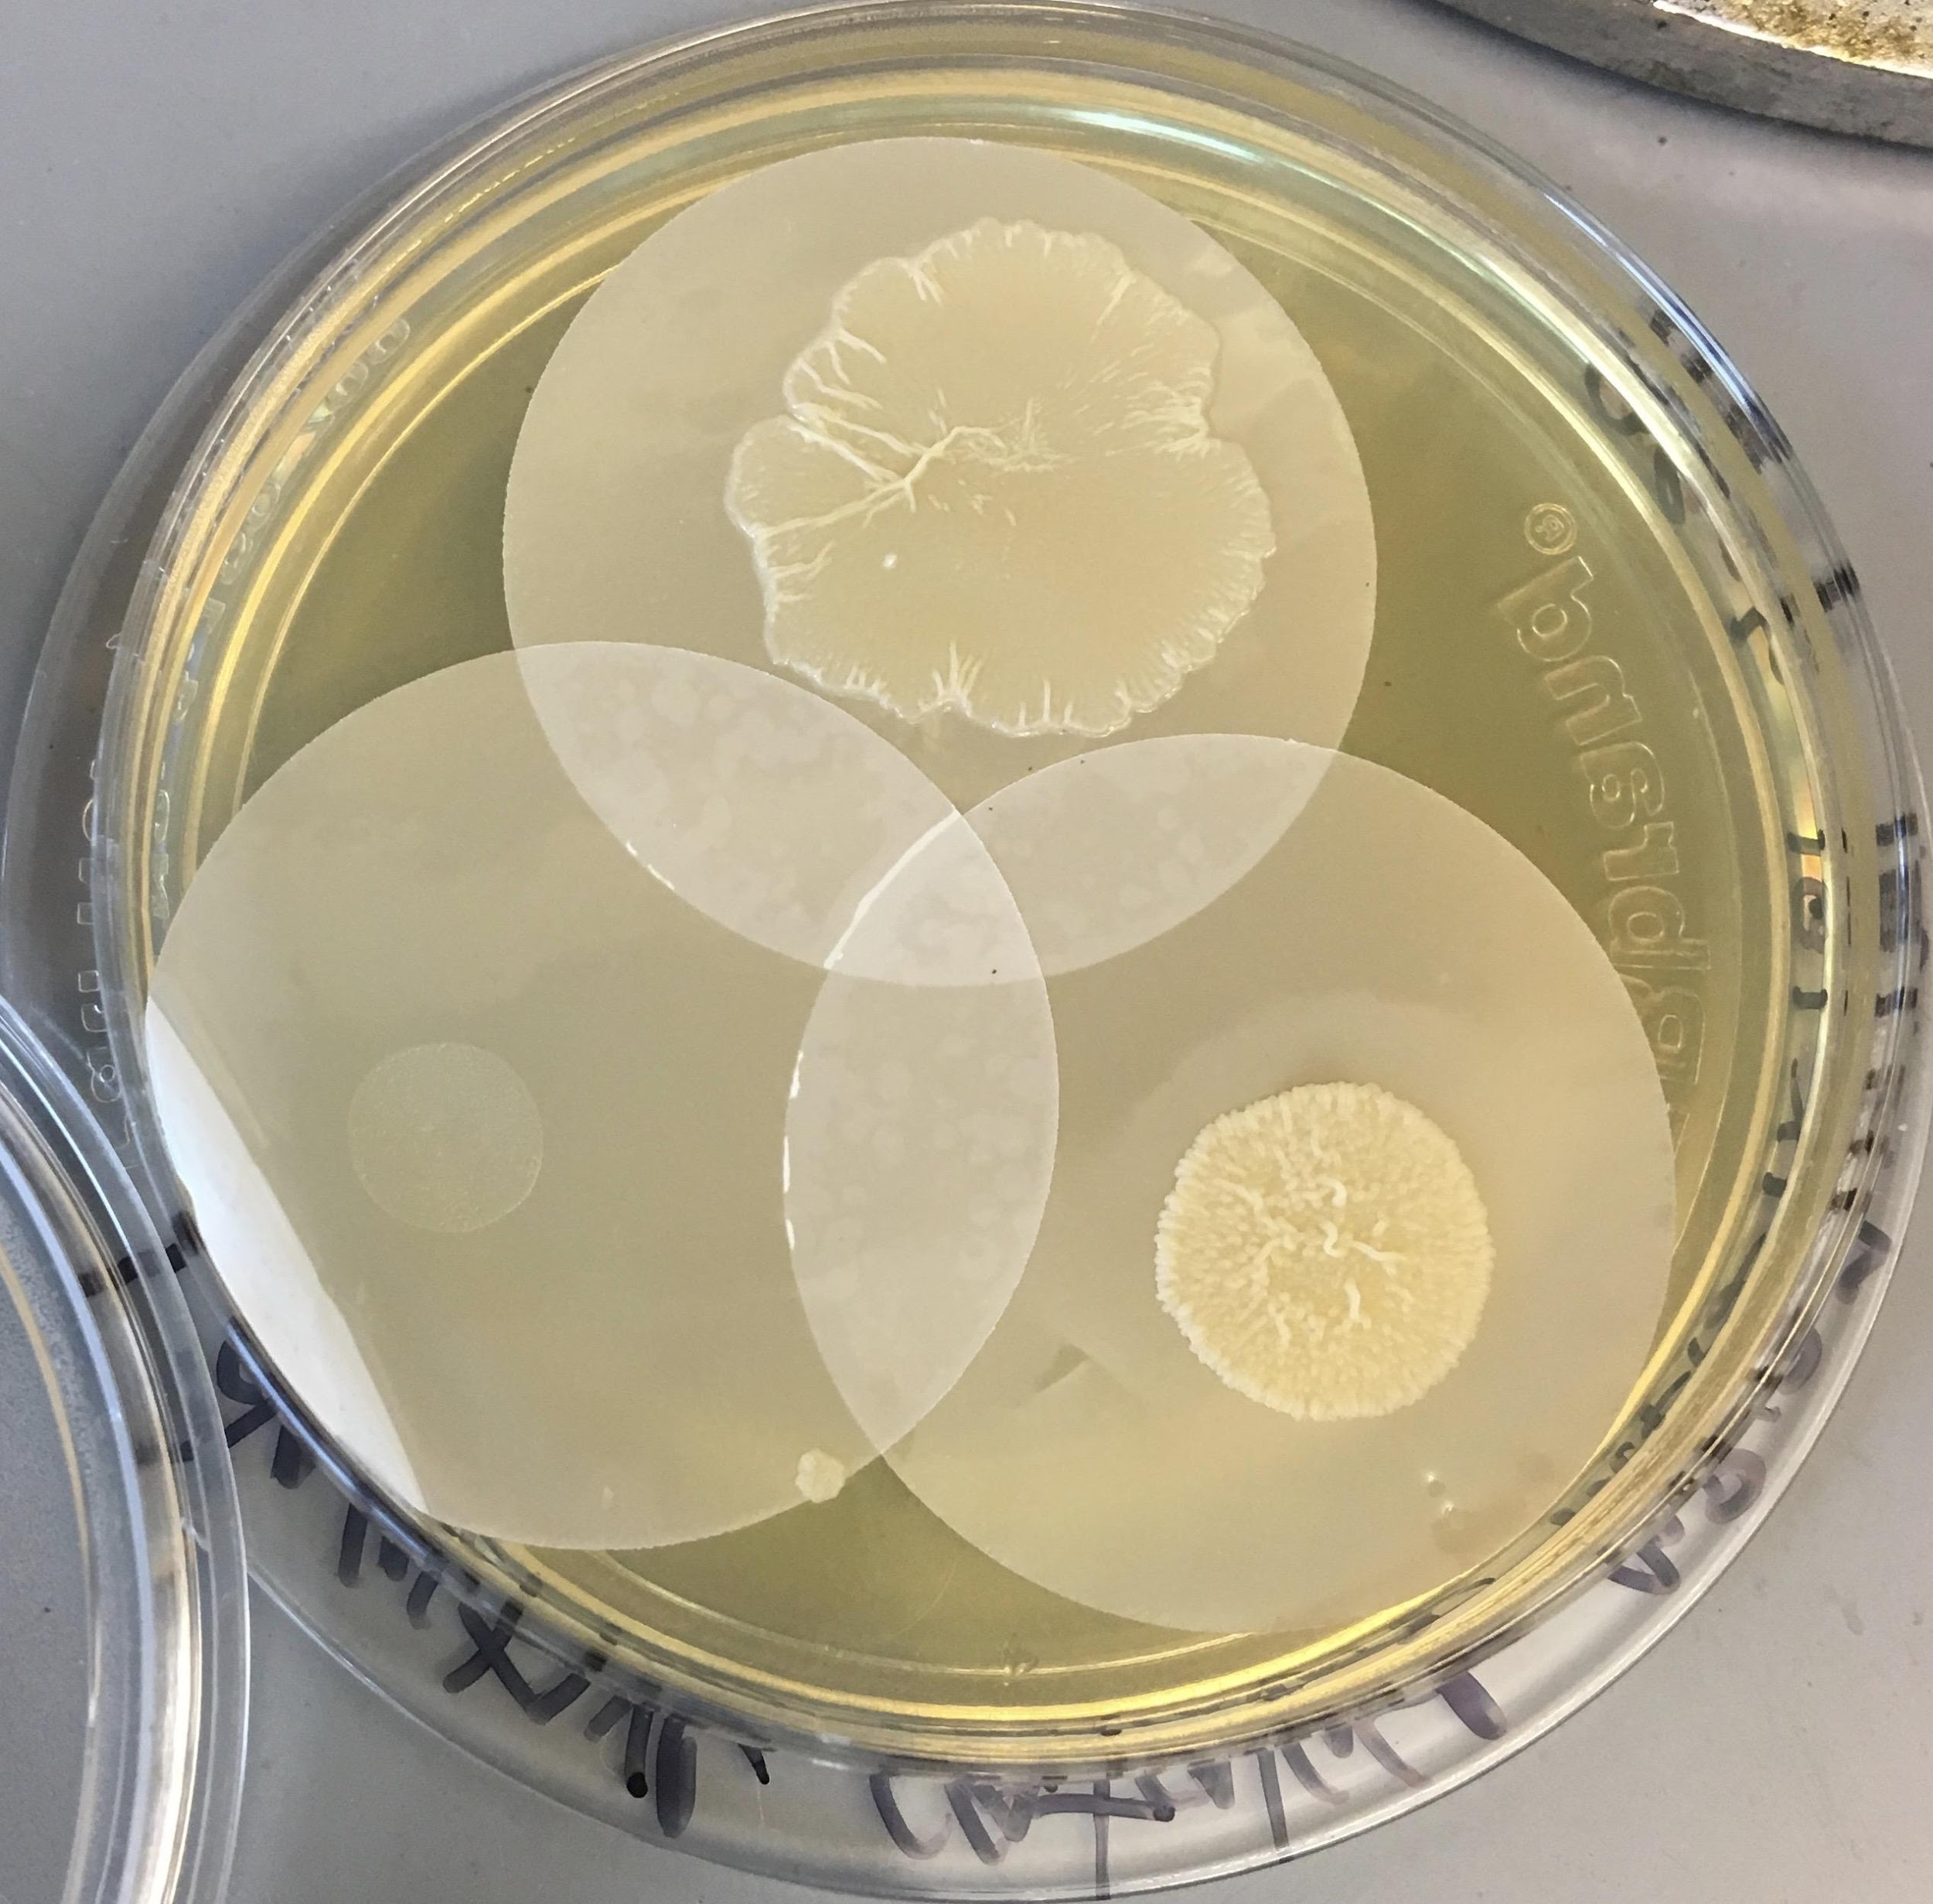

Corynebacterium matruchotii
Gram positive
Facultative anaerobe
Plaque ‘specialist’
Commensal
Eric Almeida

Slide 17
Interactions With Oral Streptococci
?
Lactate
Streptococcus sp.
O₂
Your organism
?
H₂O₂
Sugars

Slide 18
Hypothesized interactions
H₂O₂
O₂
Function
S. mitis
Lactate
CO₂
C. matruchotii

Slide 19

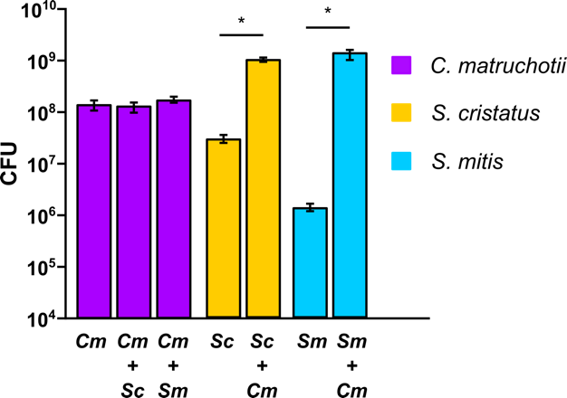
Aerobic cocultures

Slide 20
Why is streptococcal growth increased in the presence of
C. matruchotii?
Hypotheses:
C. matruchotii mitigates streptococcal-produced H₂O₂
C. matruchotii catabolizes streptococcal metabolic end products

Slide 21
Cm oxidative stress responses
Single catalase (katA) maximally expressed aerobically
Catalase mutants don’t grow aerobically!
We stopped S. mitis from making H₂O₂ instead

Slide 22
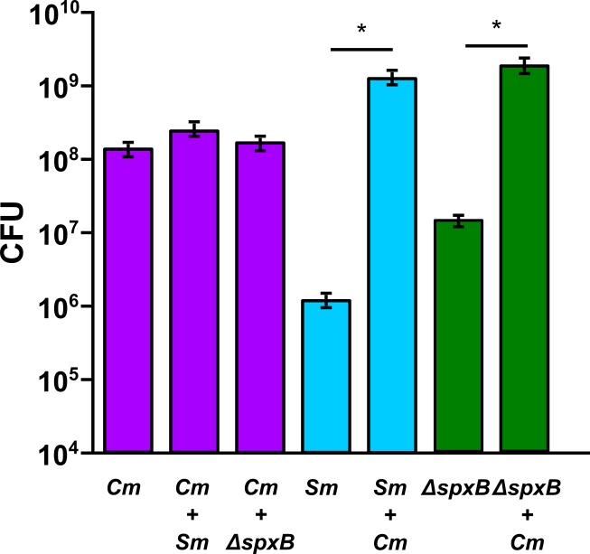
Sm ΔspxB Coculture
ΔspxB strains cannot produce H₂O₂
Notes:
And when we look at a mutant of S. mitis that cannot produce peroxide, the spxB mutant, we see there is still a growth benefit but it is smaller compared to S. mitis wildtype and cmat.

Slide 23
What about lactate?
Cm upregulates the lutABC operon in coculture with either streptococci
ΔlutA deletion strains are deficient in lactate catabolism
  < 50% yield and growth rate

Slide 24
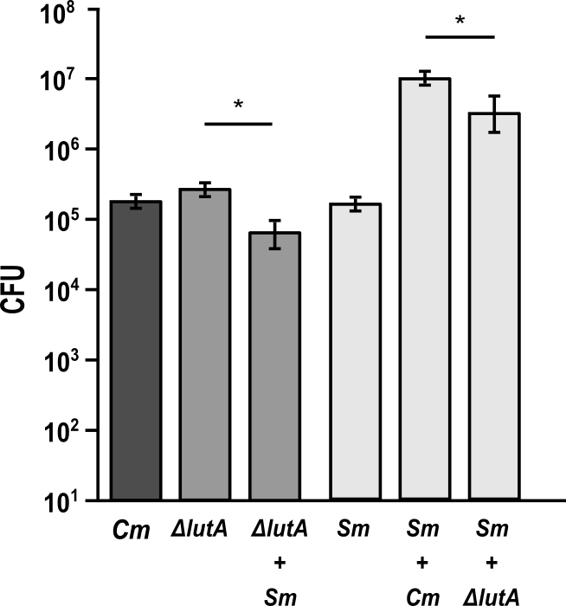
Partial loss of lactate oxidation
Cells grown under limited glucose conditions

Slide 25
pH mitigation was not a factor
Cm ΔlutA and Sm yields decrease in coculture
Additional pH buffering does not help
Lactate consumption is likely alleviating feedback inhibition in S. mitis allowing further glucose oxidation

Slide 26
Presumed interactions
O₂
Lactate
CO₂
X
O₂

Slide 27
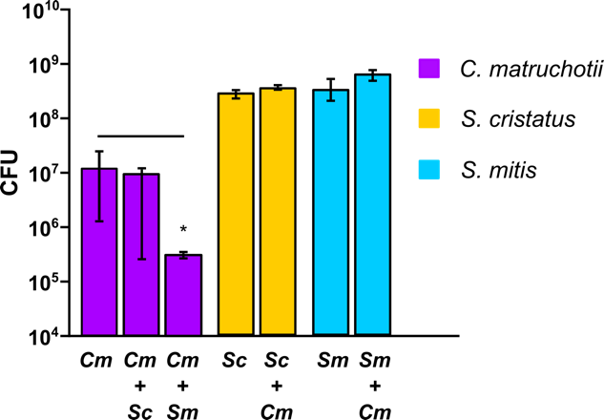
Anaerobic Coculture

Slide 28
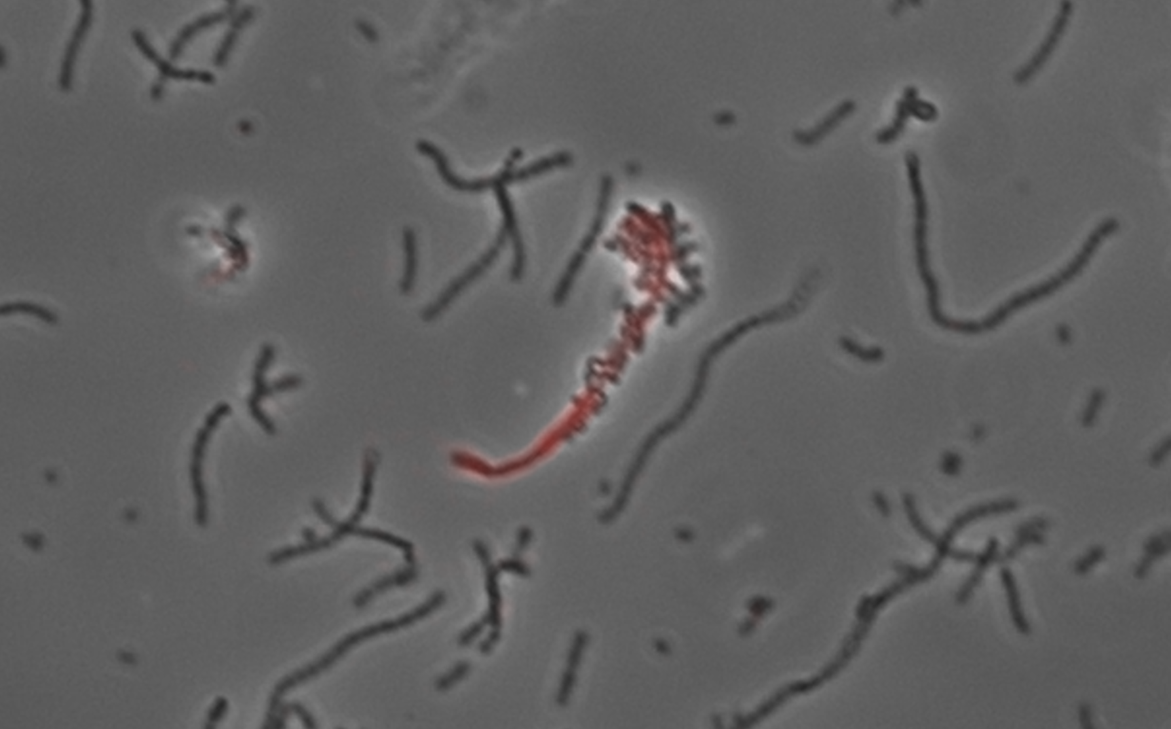
Cm interaction summary
H₂O₂ removal enhances S. mitis growth and Cm survival is required for full Sm yields
Cm lactate consumption enhances S. mitis yield and is NOT dependent on pH modulation
  Direct proximity?

Slide 29
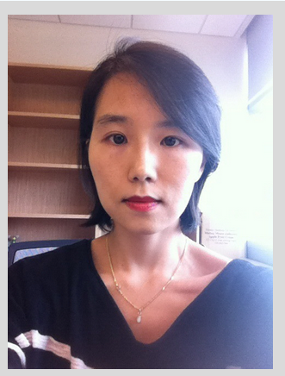
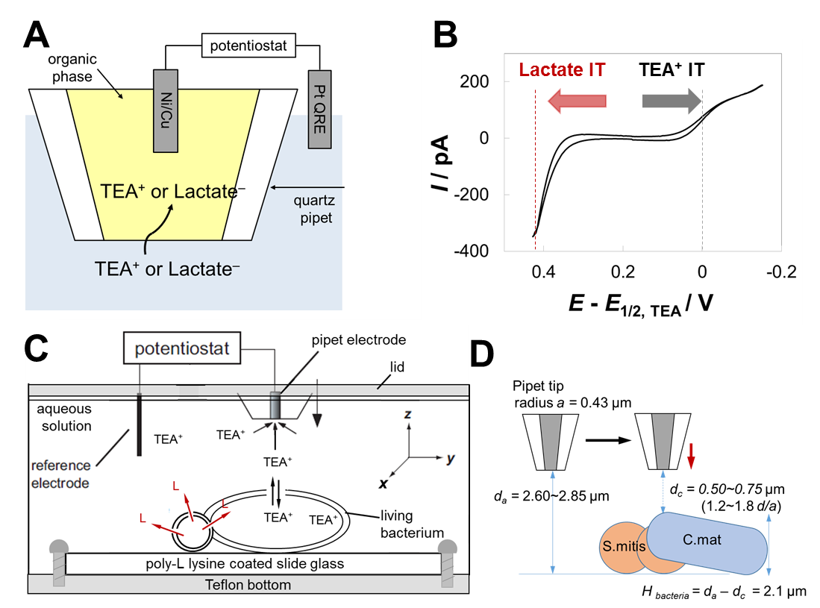
Scanning Electrochemical Microscopy
SECM
Uses current measurement at set redox potential to quantify specific molecules in real-time in 3-dimensions in sub-micron scales
Dr. Jiyeon Kim
URI Dept. of Chemistry

Slide 30
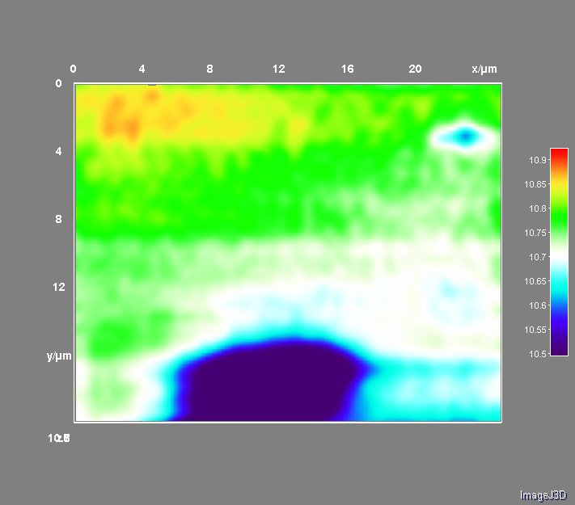
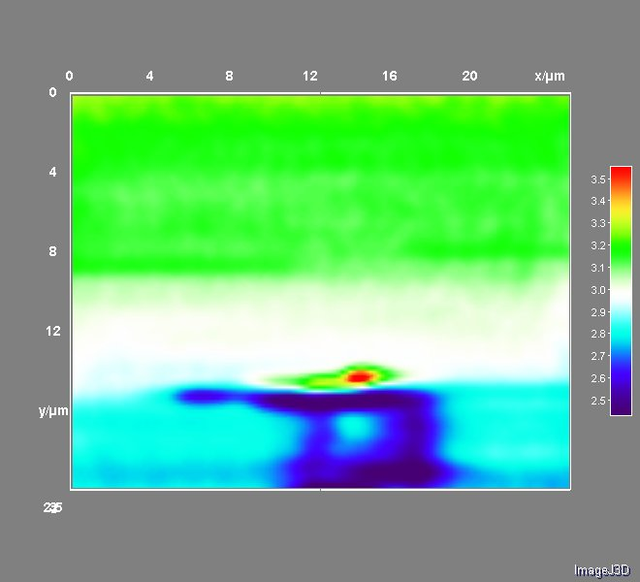
SECM Image with TEA
SECM Image for
Lactate Detection
At d_{a} = 2.85 μm, d_{c} = 0.75 μm (1.8 d/a)
At d_{a} = 2.6 μm, d_{c} = 0.5 μm (1.2 d/a)
I x10
/ pA
I x10
/ pA
S.mitis
C.mat
Demonstrates object presence by lack of permeability to TEA

Slide 31
Mechanisms underlying spatial interaction in the oral microbiota
NAD(H) transfer from S. mitis to H. parainfluenzae
Aerobic lactate oxidation and H₂O₂ decomposition drive C. matruchotii / S. mitis arrangements

Slide 32
What’s next?
Test mechanisms of interaction from Streptococcus side
Development of a more complex in vitro plaque model (in progress)
What is the impact on immune activation for more complex healthy communities?
Physical parameters of attachment

Slide 33
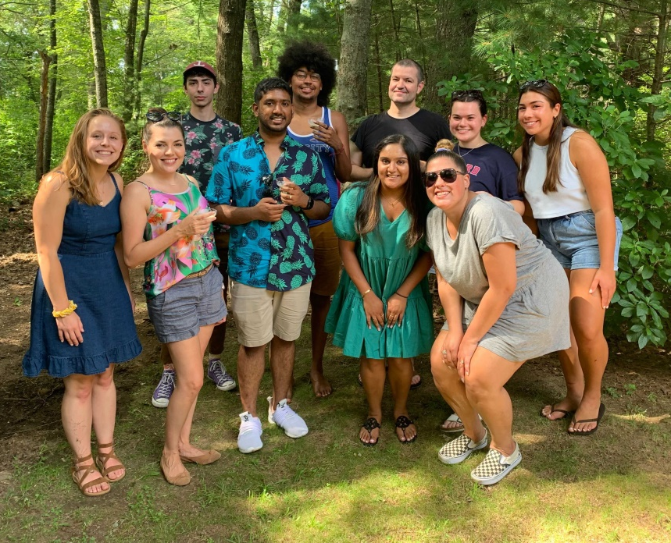



Acknowledgements
Graduate Students:
Dr. Eric Almeida
Dr. Dasith Perera
Thais Harder De Palma
Alex Labossiere
Funding:
RI Foundation Medical Research Fund
RI COBRE - #P20GM104317
RI INBRE Early Career Award – #P20GM103430
NIH – NIDCR #R01DE027958
Collaborators:
Marcelo Freire (JCVI) / Hatice Hasturk (Forsyth)
Jessica Mark Welch (U Chicago / MBL)
Jiyeon Kim (URI)

