Slide 1
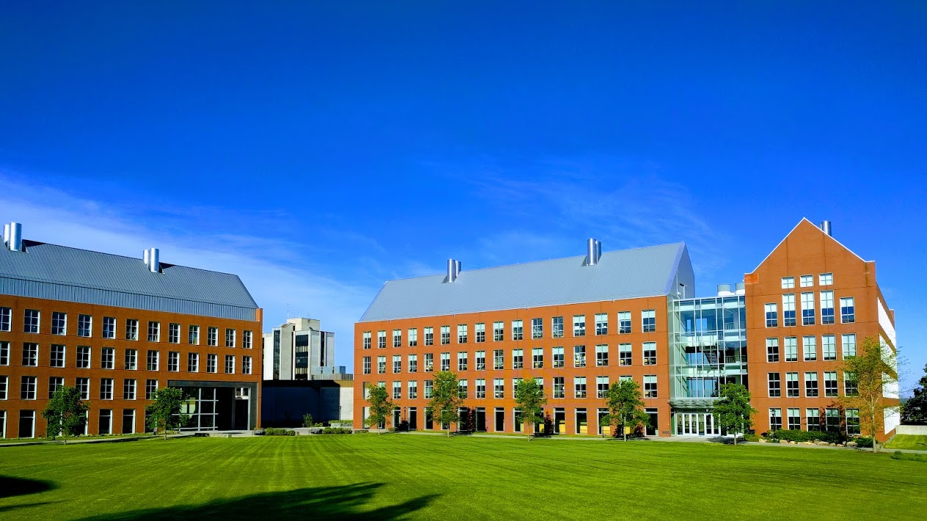

Mechanisms underlying spatial interaction in the oral microbiota
Matthew M. Ramsey, PhD
University of Rhode Island

Slide 2
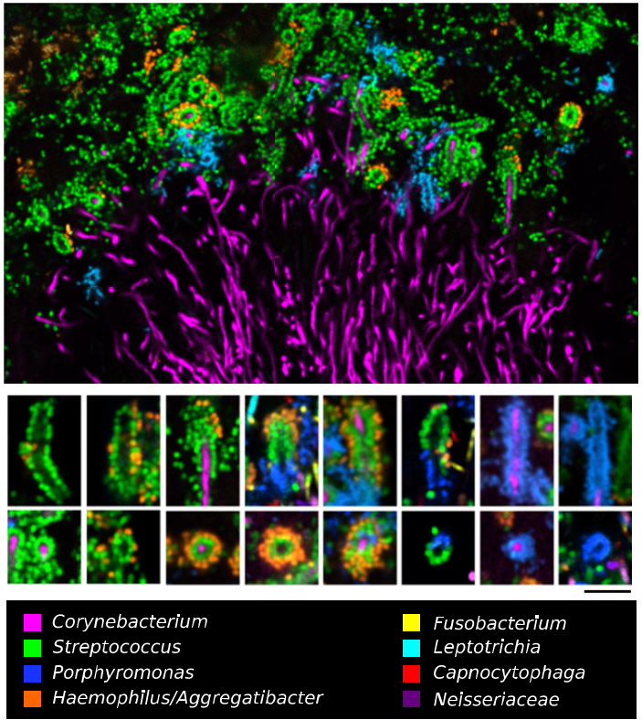

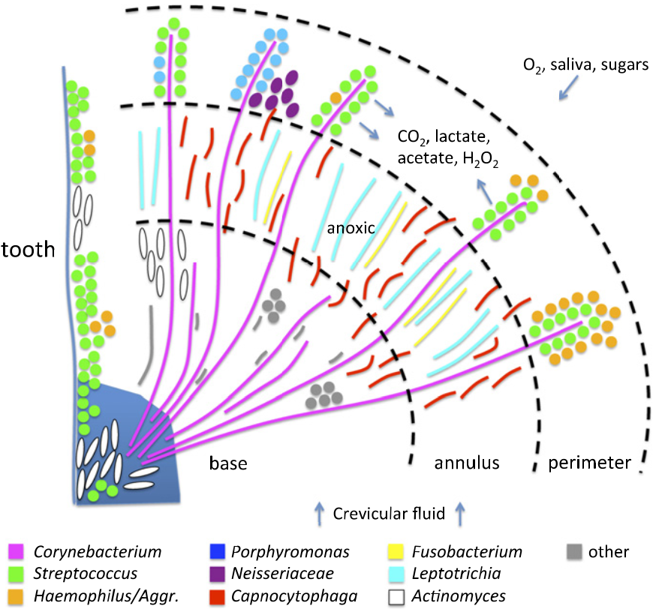
Jessica Mark Welch PhD
Associate Scientist
Marine Biology Lab / University of Chicago. Woods Hole, MA
2011. Valm, Borisy, PNAS.
2016. Mark Welch, Borisy, PNAS.

Slide 3
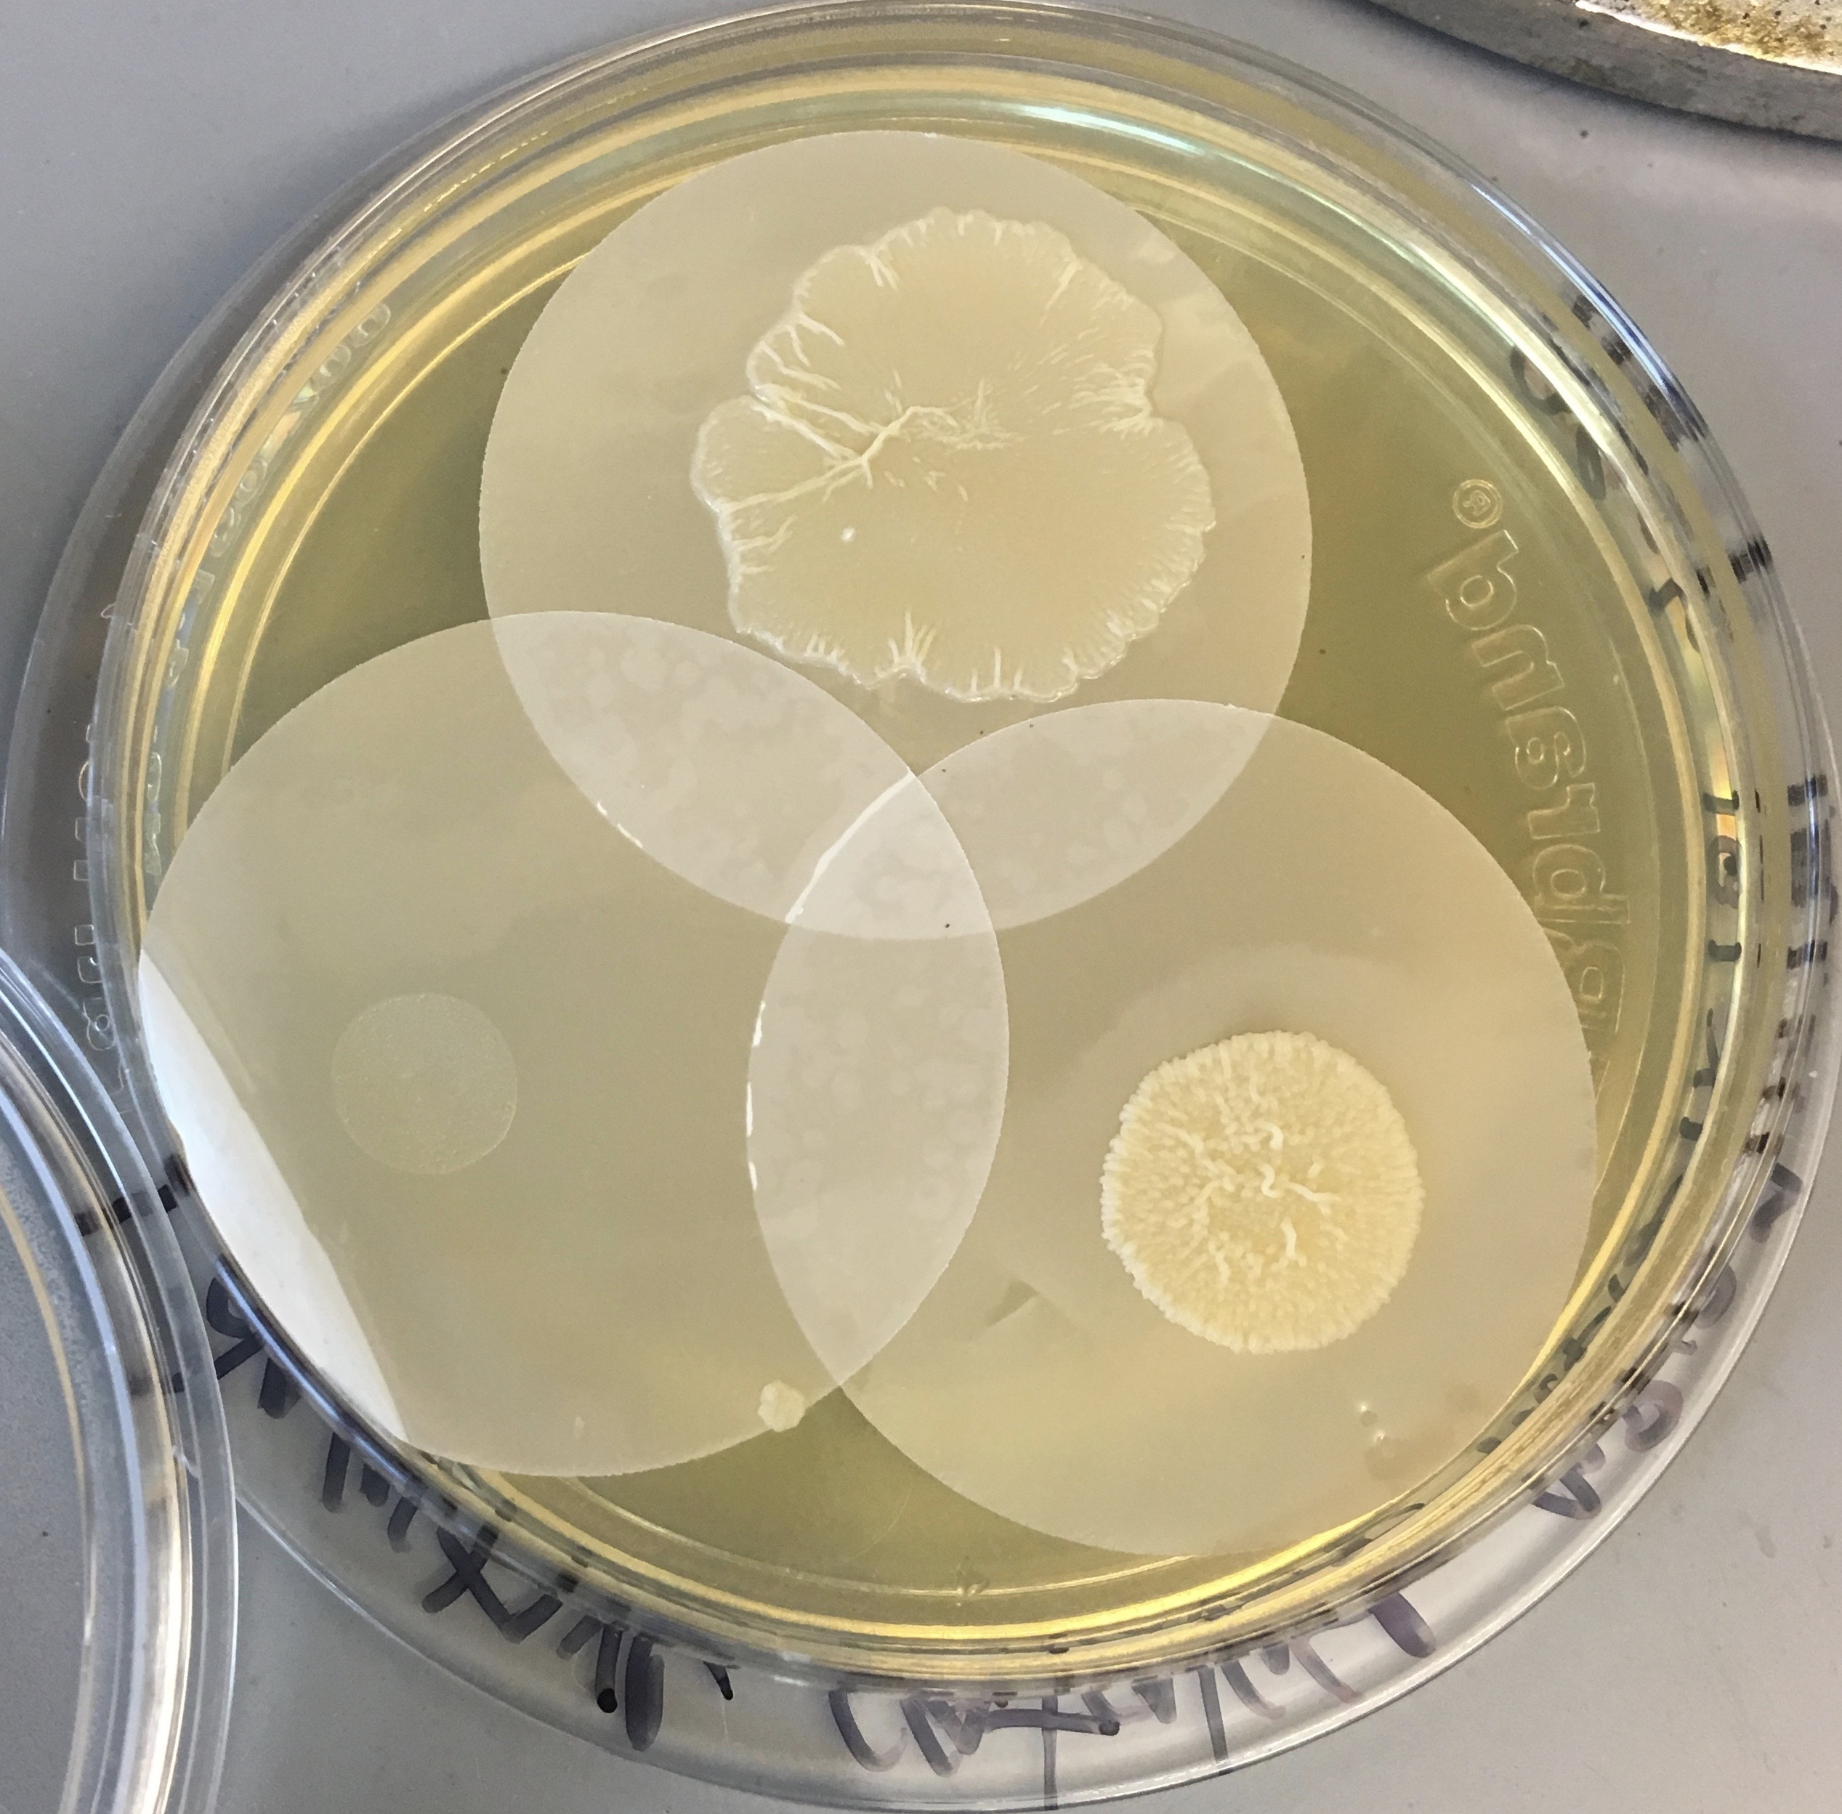
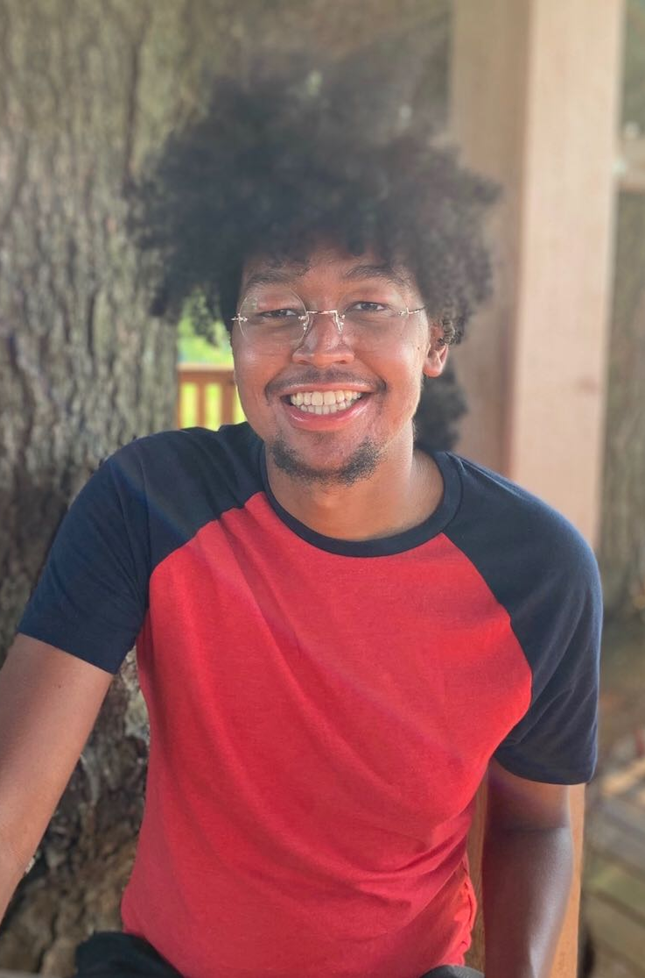
C. matruchotii
Gram positive
Facultative anaerobe
Plaque ‘specialist’
Commensal
Eric Almeida

Slide 4

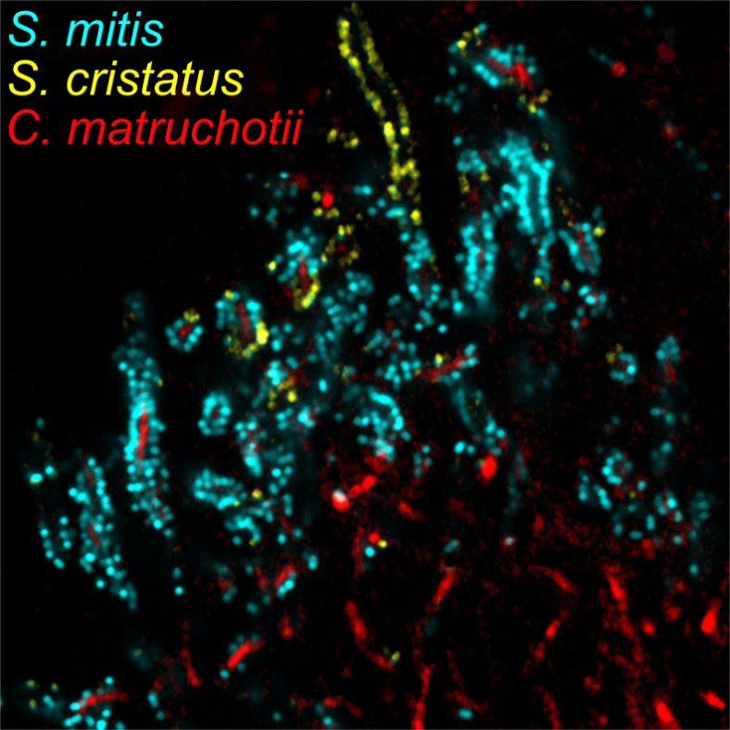
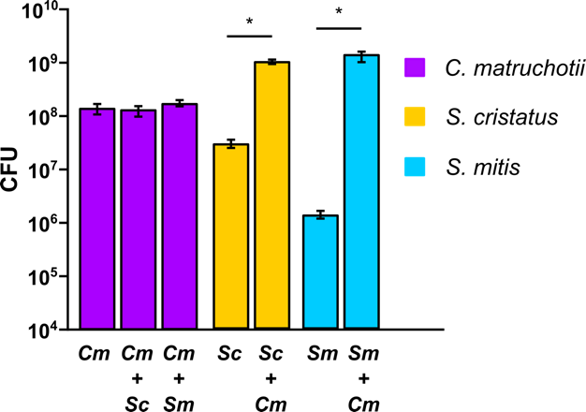
Aerobic cocultures

Slide 5
Why is streptococcal growth increased in the presence of
C. matruchotii?
Hypotheses:
C. matruchotii mitigates streptococcal-produced H₂O₂
C. matruchotii catabolizes streptococcal metabolic end products

Slide 6
Presumed interactions
H₂O₂
O₂
Lactate
CO₂

Slide 7
Cm oxidative stress responses
Single catalase (katA) maximally expressed aerobically
Catalase mutants don’t grow aerobically!
Ferritin (ftn) upregulated when with Sm
  Sequesters Fe, protects from ROS damage

Slide 8
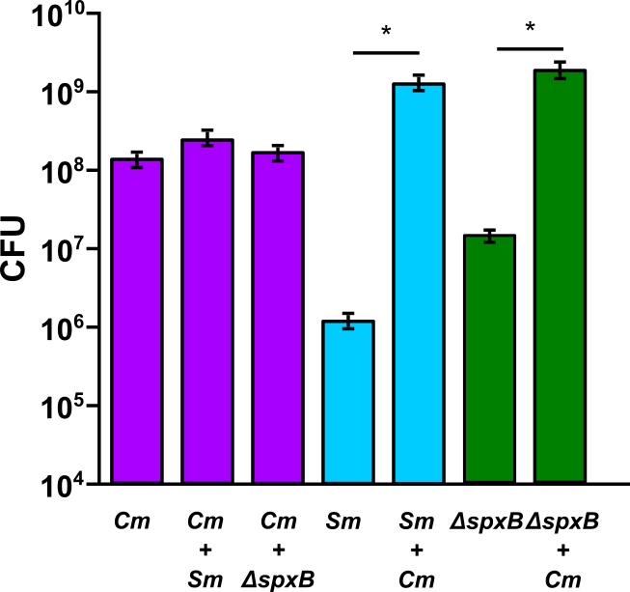
Sm ΔspxB Coculture
Notes:
And when we look at a mutant of S. mitis that cannot produce peroxide, the spxB mutant, we see there is still a growth benefit but it is smaller compared to S. mitis wildtype and cmat.

Slide 9
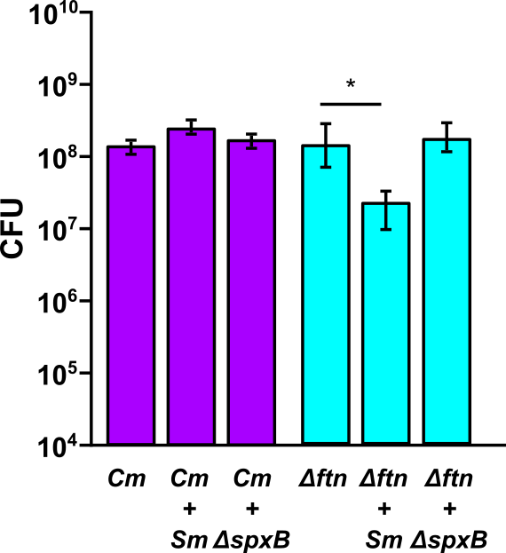
C. matruchotii Δftn with S. mitis
S. mitis CFUs follow similar trend

Slide 10
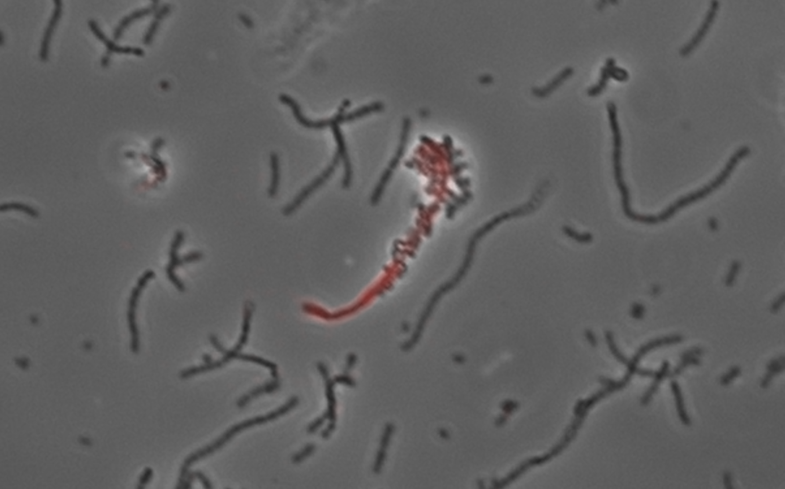
What about lactate?
Cm upregulates the lutABC operon in coculture with either streptococci
ΔlutA deletion strains are deficient in lactate catabolism
Cm ΔlutA and Sm yields decrease in coculture
  Additional pH buffering does not help

Slide 11
Presumed interactions
O₂
ΔlutA
Lactate
CO₂
X
O₂

Slide 12
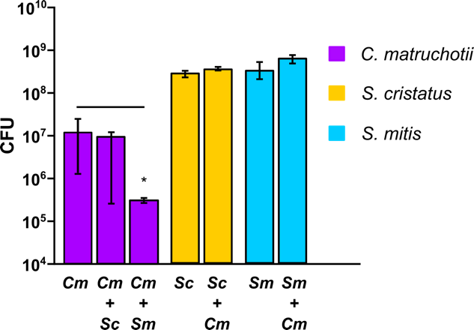
Anaerobic Coculture

Slide 13
Cm interaction summary
H₂O₂ removal enhances S. mitis growth and Cm survival is required for full Sm yields
Cm lactate consumption enhances S. mitis yield and is NOT dependent on pH modulation
  Direct proximity?

Slide 14
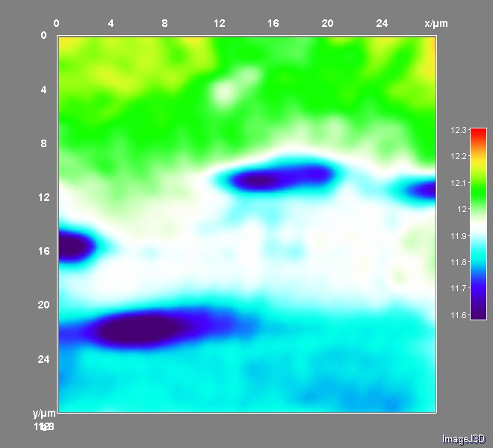
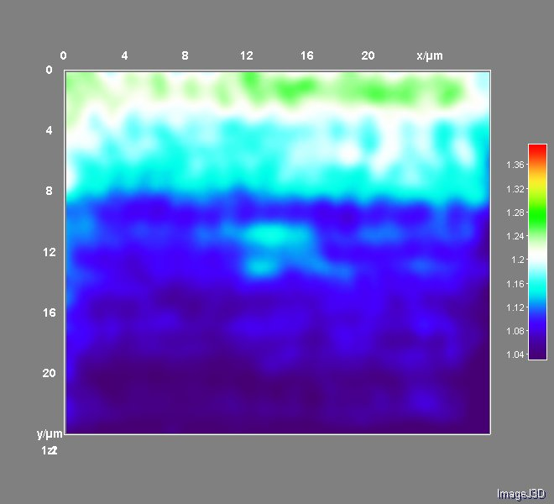
Relevance of in vivo proximity
SECM – H₂O₂ production in S. mitis cells

Slide 15
What’s next?
Test mechanisms of interaction from Streptococcus side
  alpha hemolysin down in coculture, Factor H binding protein up
What is the impact on immune response for more complex healthy communities?
Development of a more complex in vitro plaque model (in progress)

Slide 16
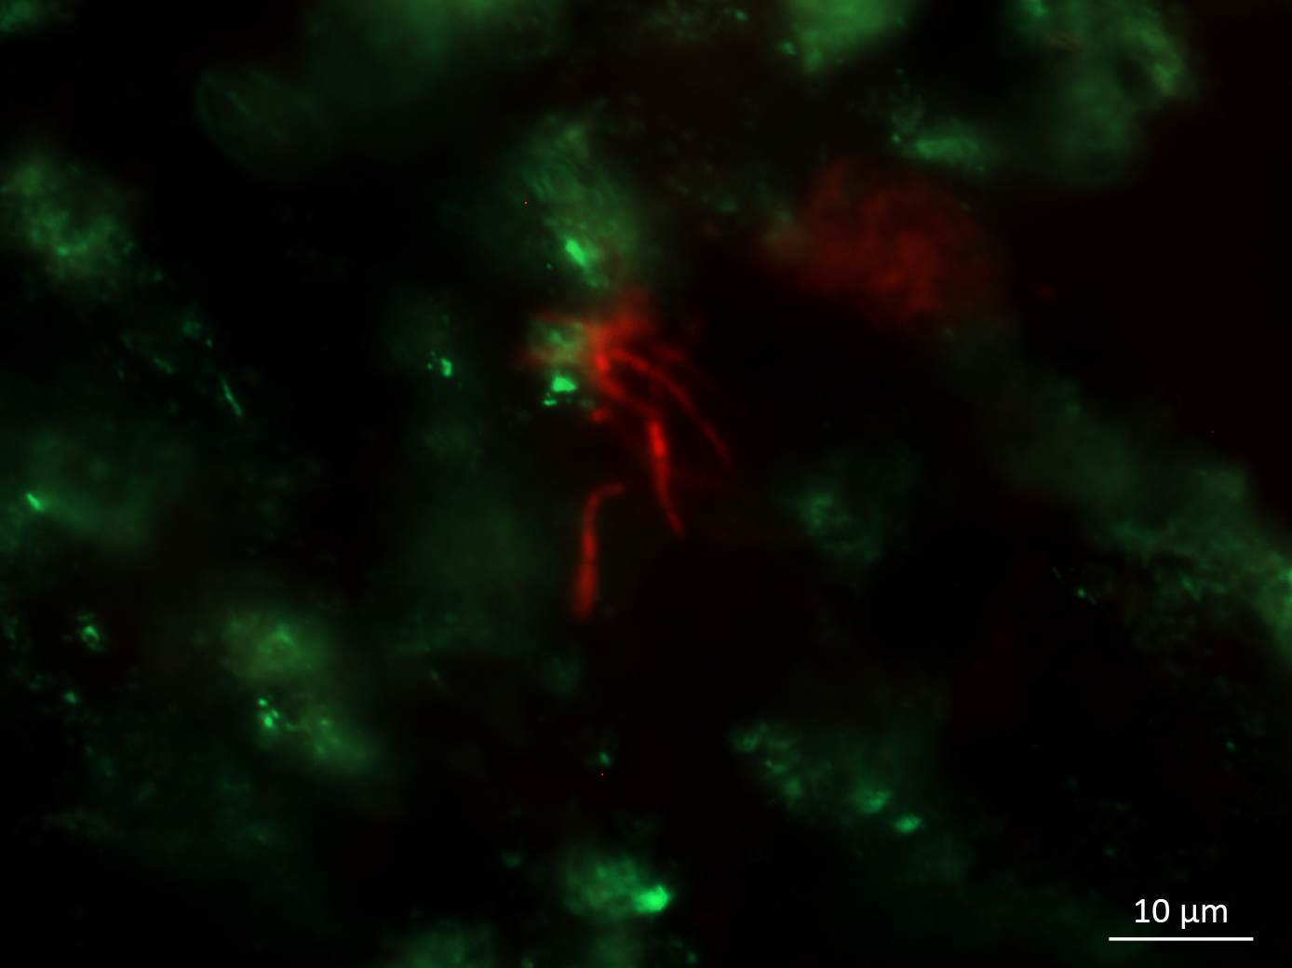
C. matruchotii
H. parainfluenzae
>48h
Hydroxyapatite biofilm growth with native plaque biofilm

Slide 17
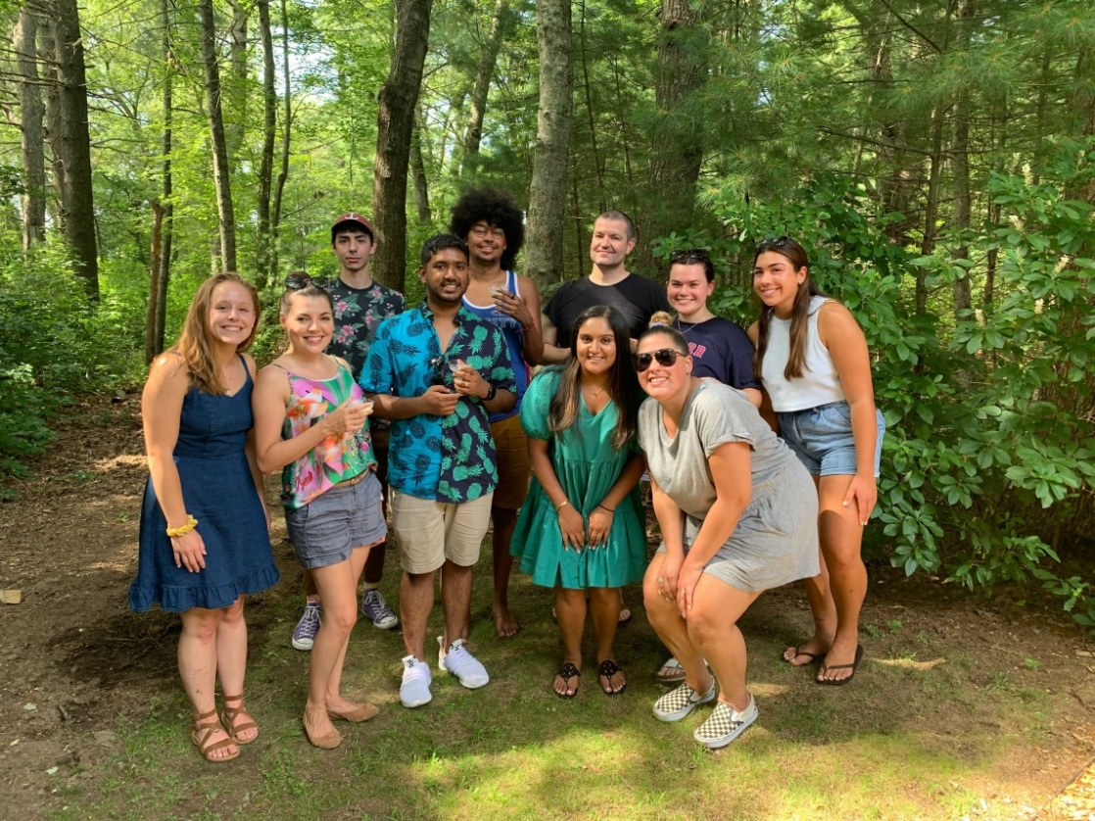



Acknowledgements
Graduate Students:
Eric Almeida
Thais Harder De Palma
Dasith Perera
Alex Labossiere
Funding:
RI Foundation Medical Research Fund
RI COBRE - #P20GM104317
RI INBRE Early Career Award – #P20GM103430
NIH – NIDCR #R01DE027958
Collaborators:
Marcelo Freire (JCVI) / Hatice Hasturk (Forsyth)
Jessica Mark Welch (U Chicago / MBL)
Jiyeon Kim (URI)

