Slide 1
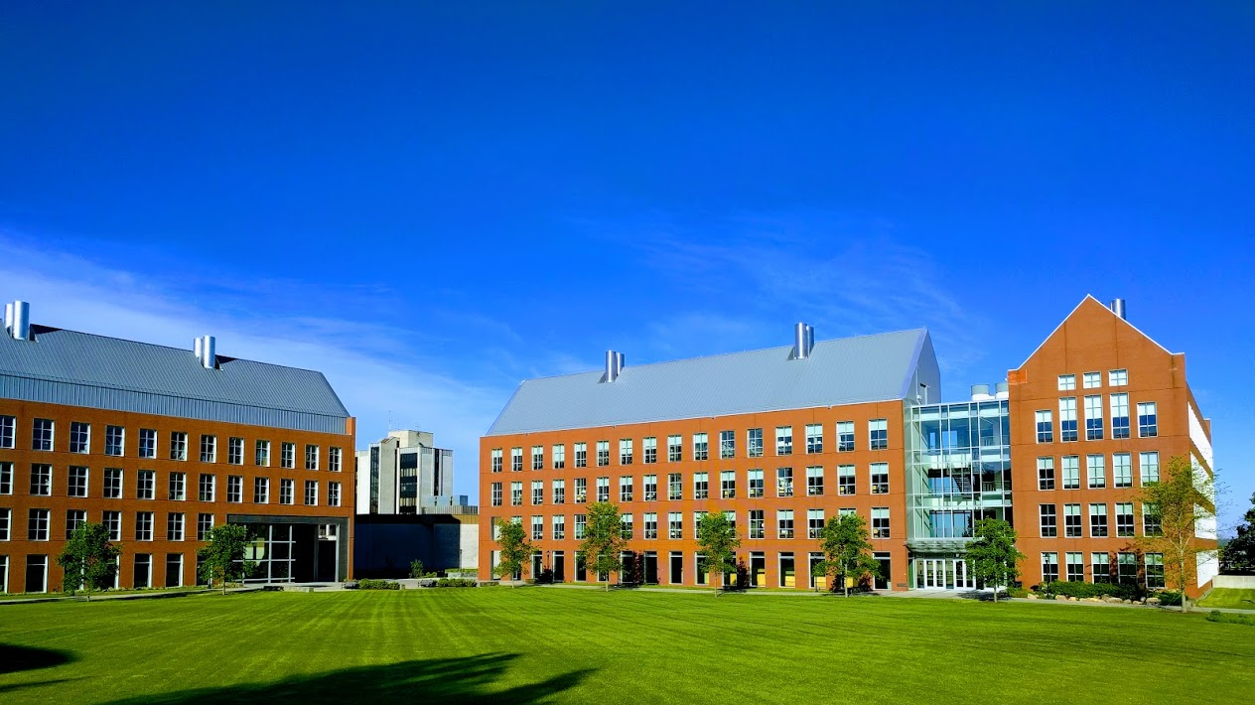

Mechanisms underlying spatial interaction in the oral microbiota
Matthew M. Ramsey, PhD
University of Rhode Island

Slide 2
We must understand mechanisms of interaction between commensals to exploit them for our benefit.
My laboratory studies interactions within supragingival plaque (for now)
How do we choose the right ones?

Slide 3
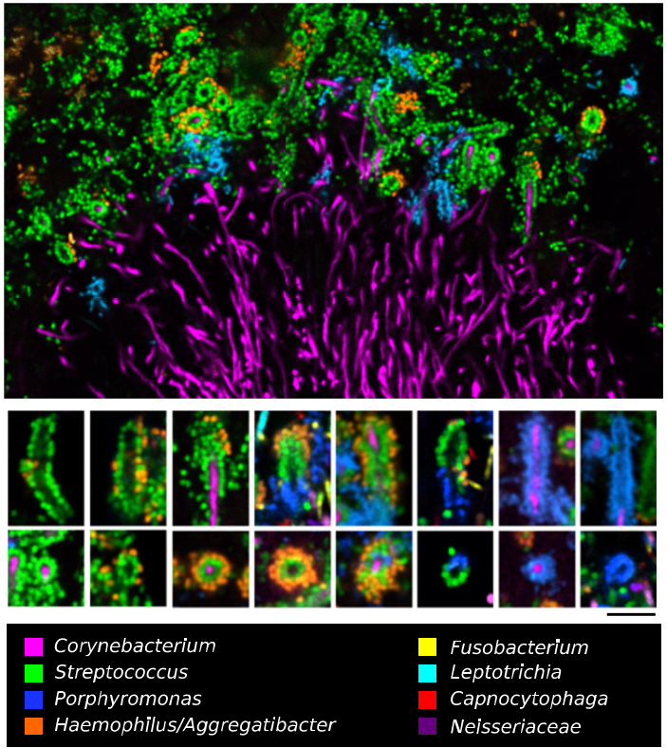

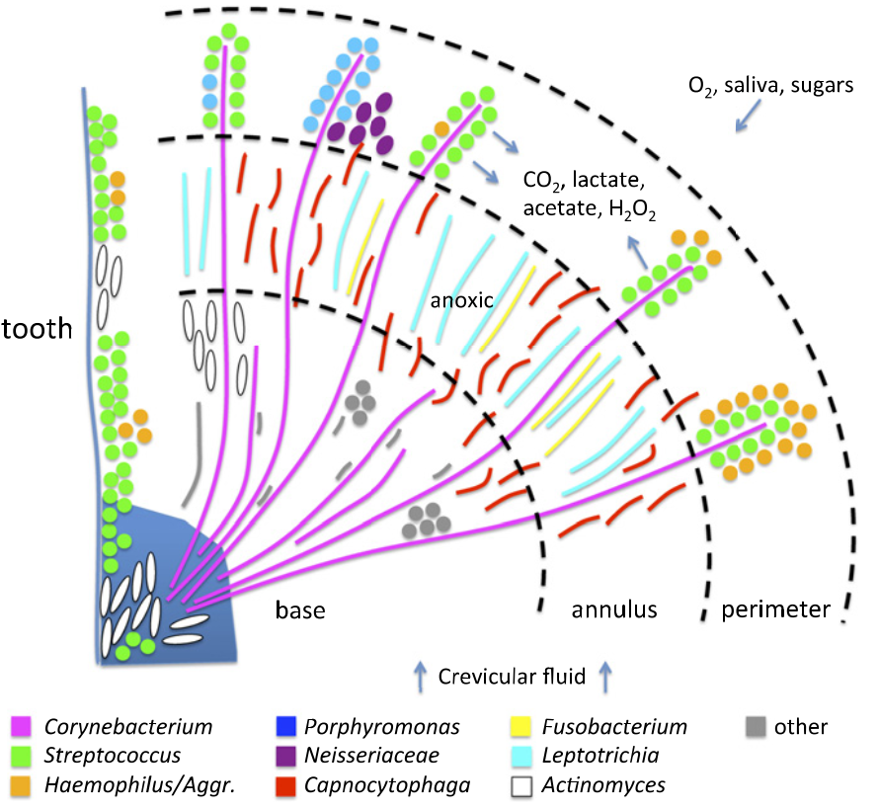
Jessica Mark Welch PhD
Associate Scientist
Marine Biology Lab / University of Chicago. Woods Hole, MA
2011. Valm, Borisy, PNAS.
2016. Mark Welch, Borisy, PNAS.

Slide 4
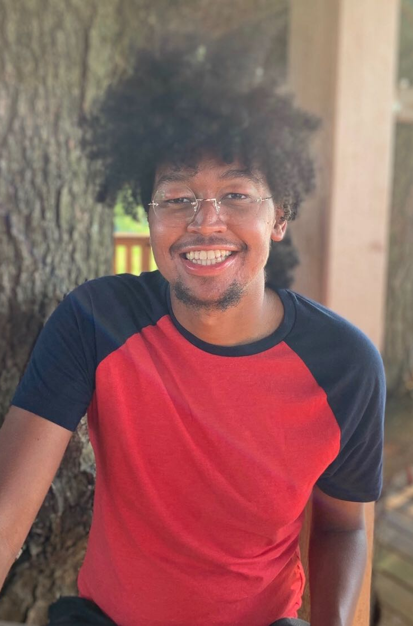
C. matruchotii
Gram positive
Facultative anaerobe
Plaque ‘specialist’
Commensal
Eric Almeida

Slide 5
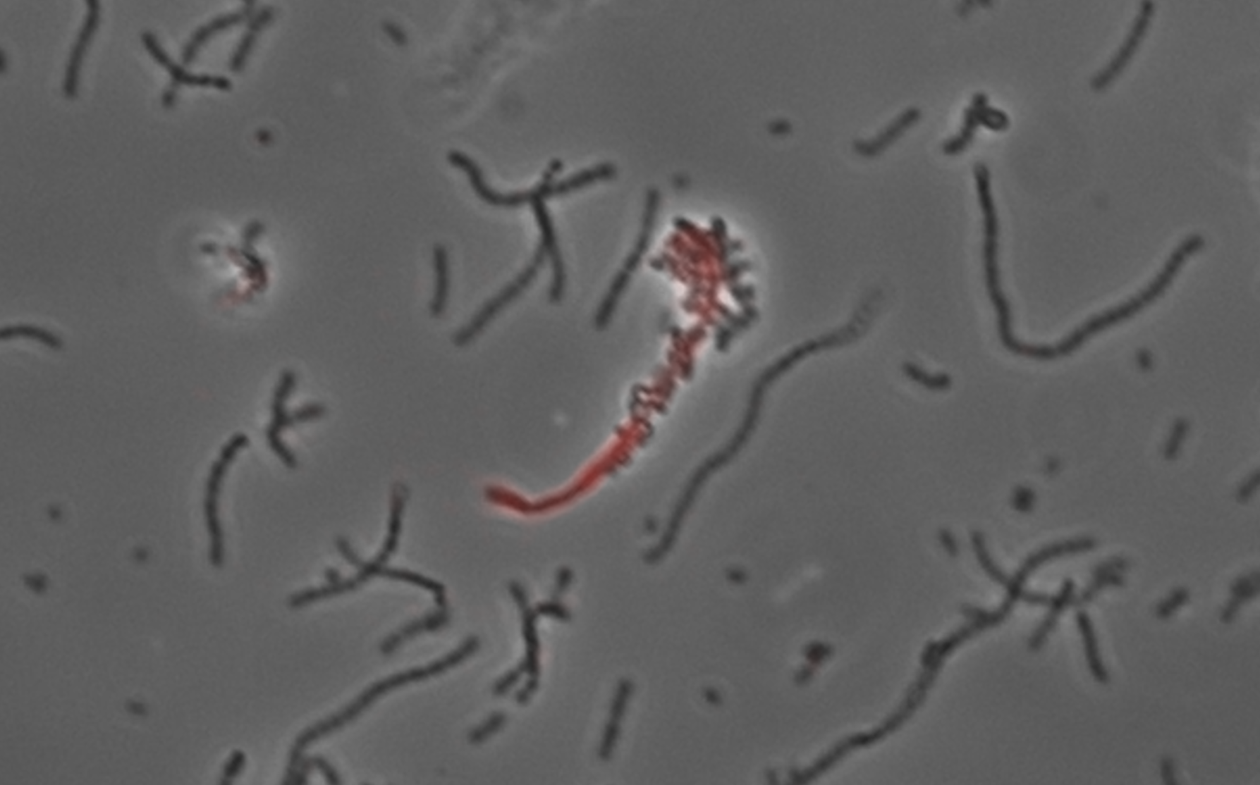
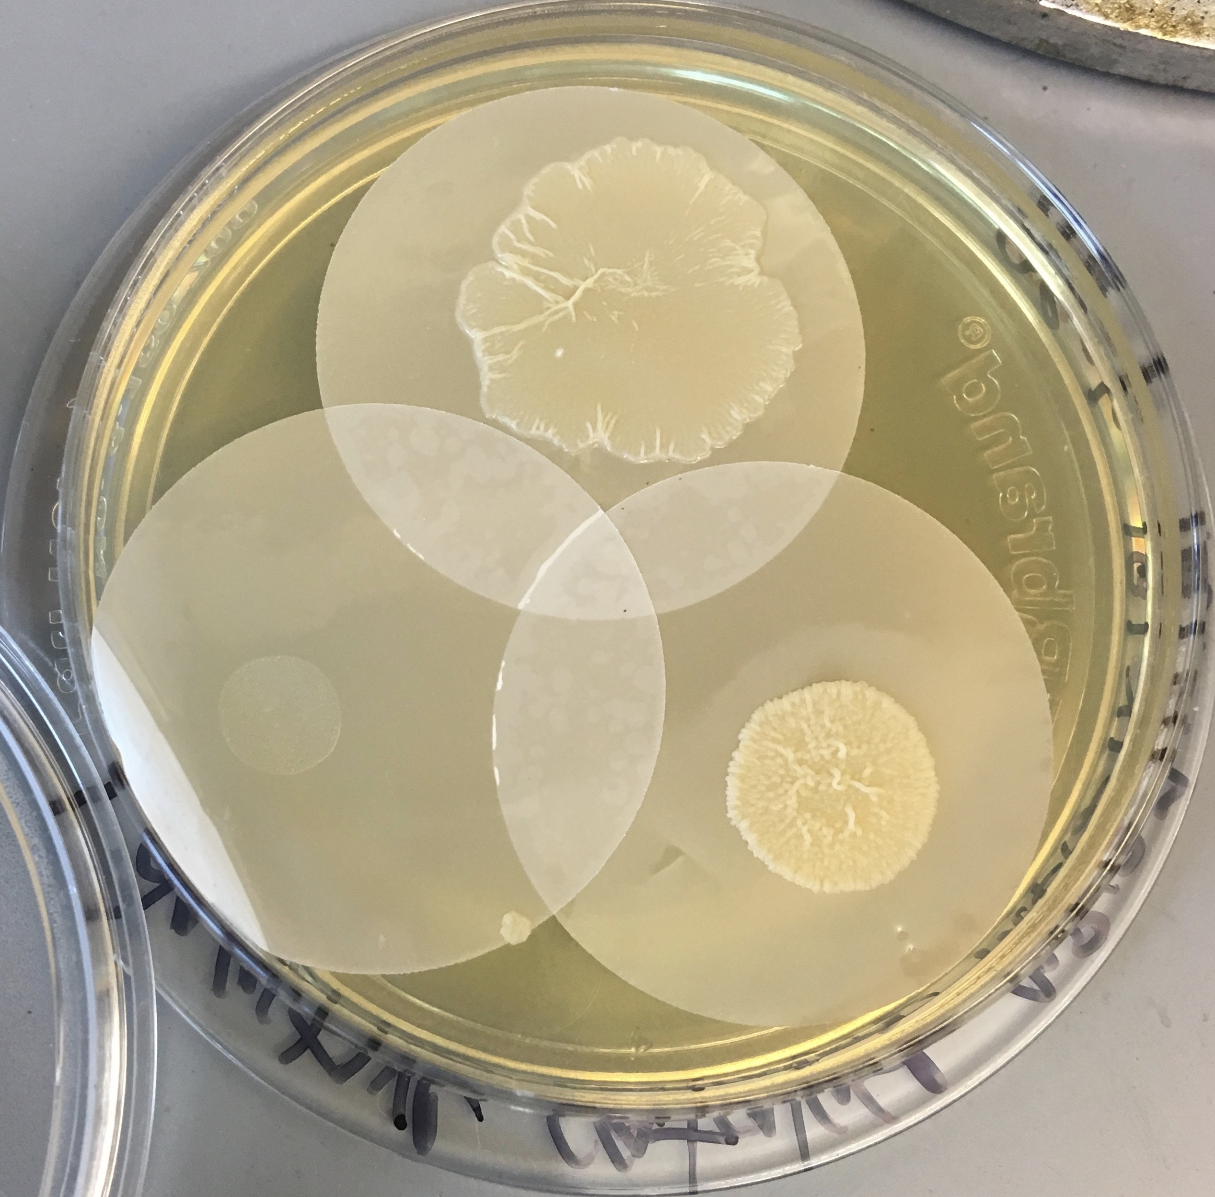
In vitro testing for Cm interactions

Slide 6

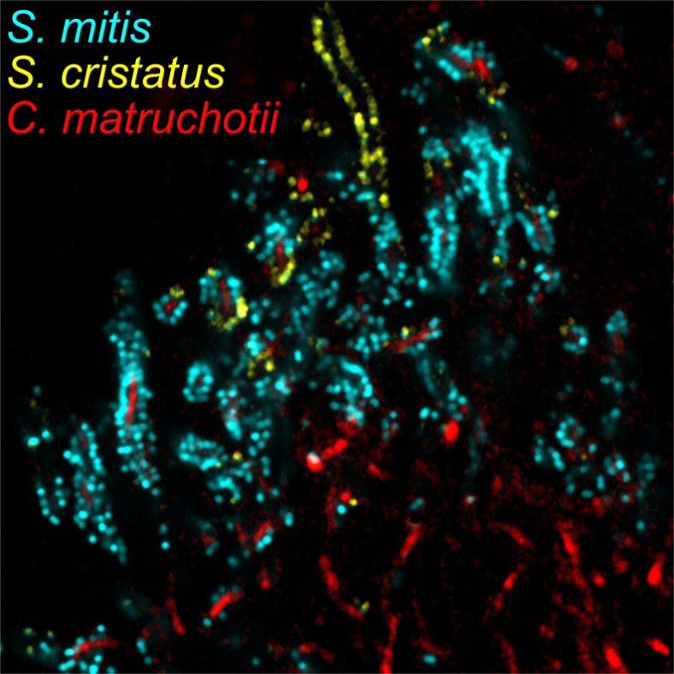
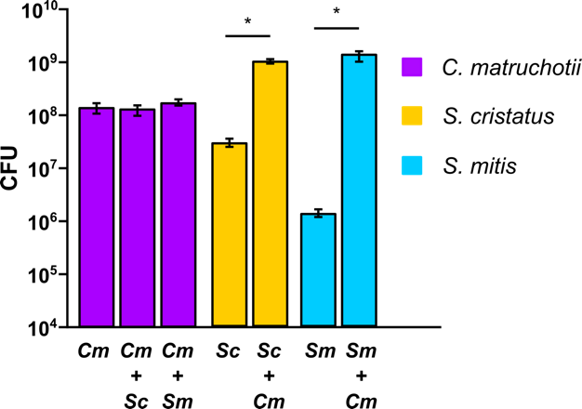
Aerobic cocultures

Slide 7
Why is streptococcal growth increased in the presence of
C. matruchotii?
Hypotheses:
C. matruchotii mitigates streptococcal-produced H₂O₂
C. matruchotii catabolizes streptococcal metabolic end products (true)

Slide 8
Cm oxidative stress responses
Ferritin (ftn) upregulated when with Sm
  Sequesters Fe, protects from ROS damage
Single catalase (katA) maximally expressed aerobically
Catalase mutants were unable to grow aerobically!

Slide 9
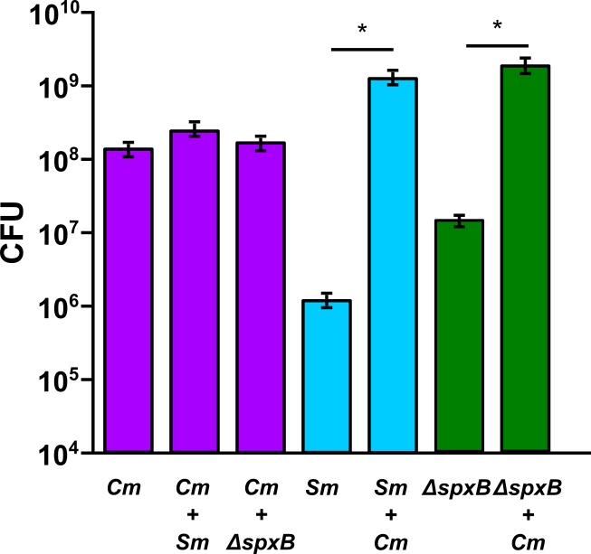
Sm ΔspxB Coculture
Notes:
And when we look at a mutant of S. mitis that cannot produce peroxide, the spxB mutant, we see there is still a growth benefit but it is smaller compared to S. mitis wildtype and cmat.

Slide 10
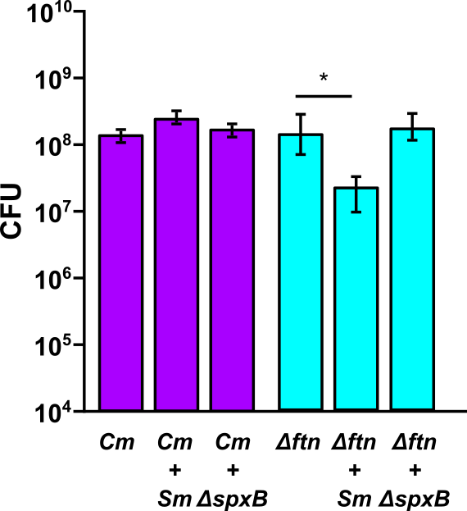
C. matruchotii Δftn with S. mitis

Slide 11
What about lactate?
Cm upregulates the lutABC operon in coculture with either streptococci
ΔlutA deletion strains are deficient in lactate catabolism
Cm ΔlutA and Sm yields decrease in coculture
  Additional pH buffering does not help

Slide 12
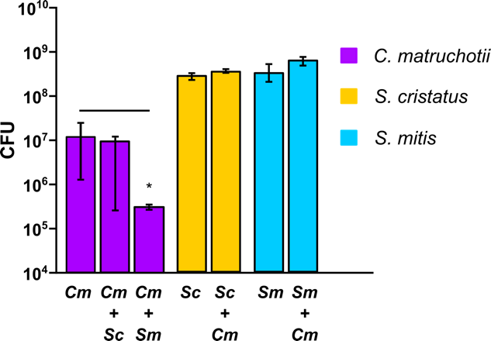
Anaerobic Coculture

Slide 13
Cm interaction summary
H2O2 removal enhances S. mitis growth and Cm survival is required for full Sm yields
Lactate utilization by Cm also enhances S. mitis yield and is NOT dependent on pH modulation (not shown)

Slide 14
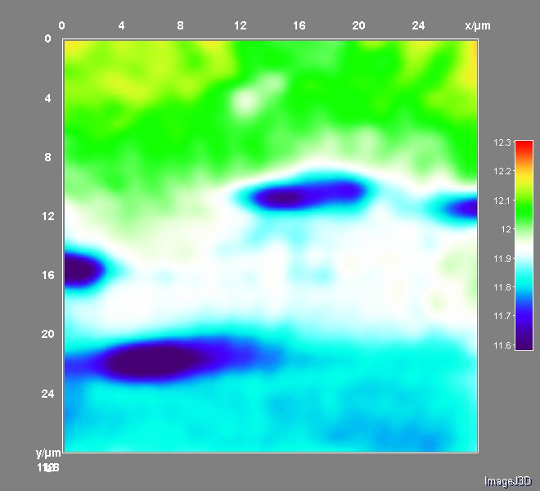
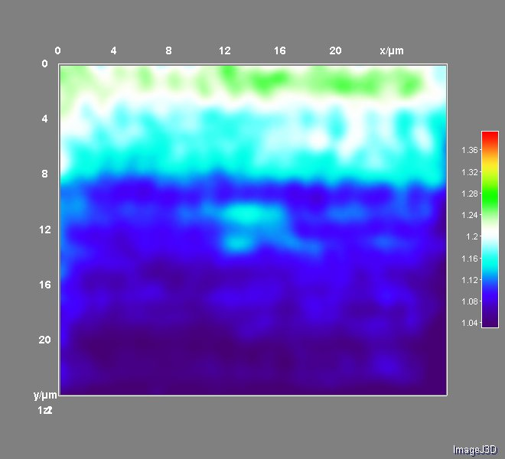
Relevance of in vivo proximity

Slide 15
What’s next?
Development of a more complex in vitro plaque model (in progress)
Test mechanisms of interaction from Streptococcus side
  X hemolysin down in coculture, Factor H binding protein up
What is the impact on immune activation for more complex healthy communities?

Slide 16
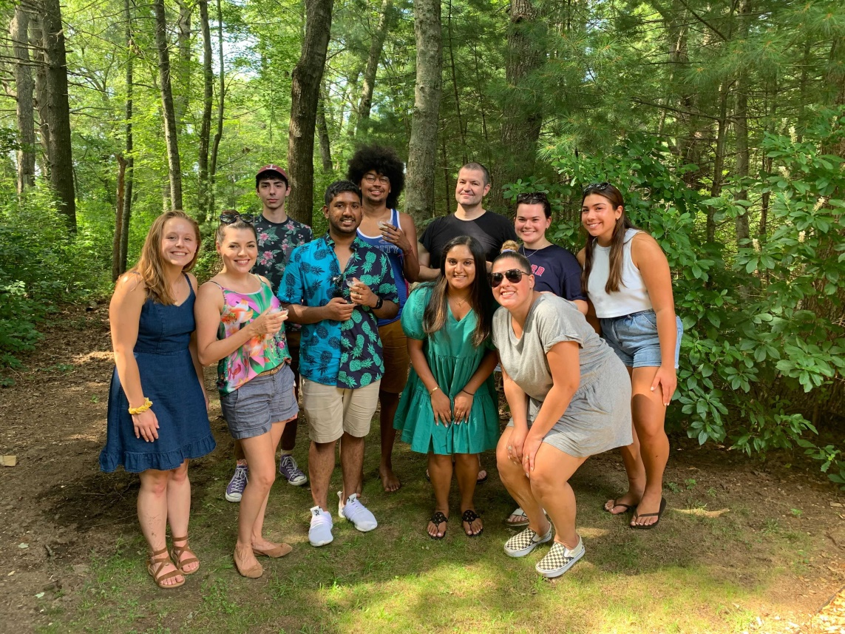



Acknowledgements
Graduate Students:
Eric Almeida
Thais Harder De Palma
Dasith Perera
Alex Labossiere
Funding:
RI Foundation Medical Research Fund
RI COBRE - #P20GM104317
RI INBRE Early Career Award – #P20GM103430
NIH – NIDCR #R01DE027958
Collaborators:
Marcelo Freire (JCVI) / Hatice Hasturk (Forsyth)
Jessica Mark Welch (U Chicago / MBL)
Jiyeon Kim (URI)

