Slide 1
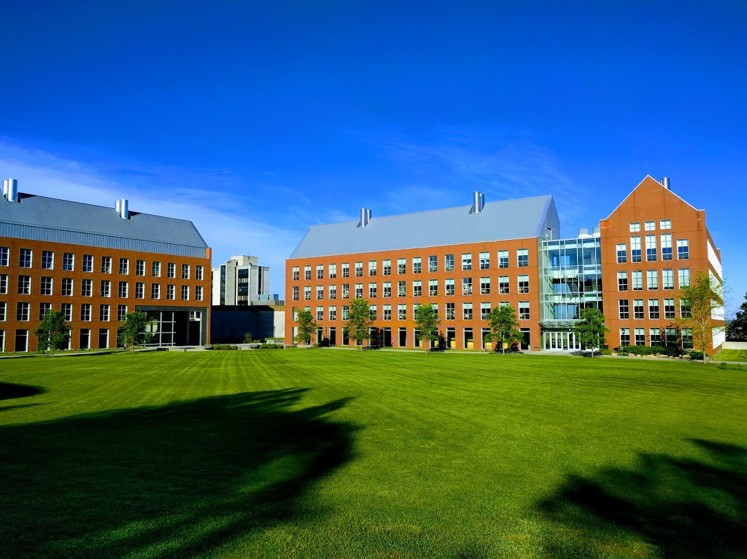

Mechanisms underlying spatial interaction in the oral microbiota
Matthew M. Ramsey, PhD
University of Rhode Island

Slide 2
We must understand mechanisms of interaction between commensals to exploit them for our benefit.
My laboratory studies interactions within supragingival plaque (for now)
How do we choose the right ones?

Slide 3
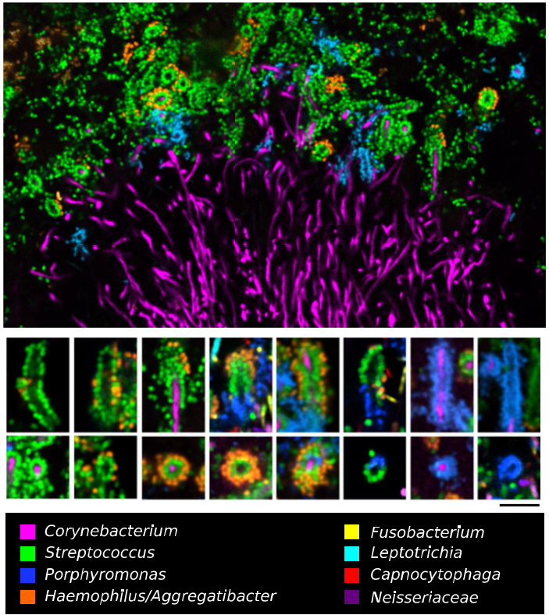

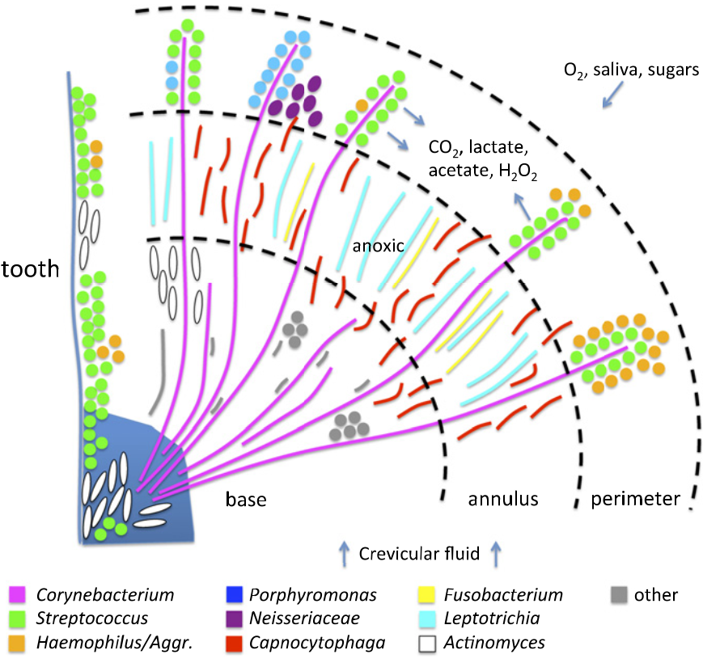
Jessica Mark Welch PhD
Associate Scientist
Marine Biology Lab / University of Chicago. Woods Hole, MA
2011. Valm, Borisy, PNAS.
2016. Mark Welch, Borisy, PNAS.

Slide 4

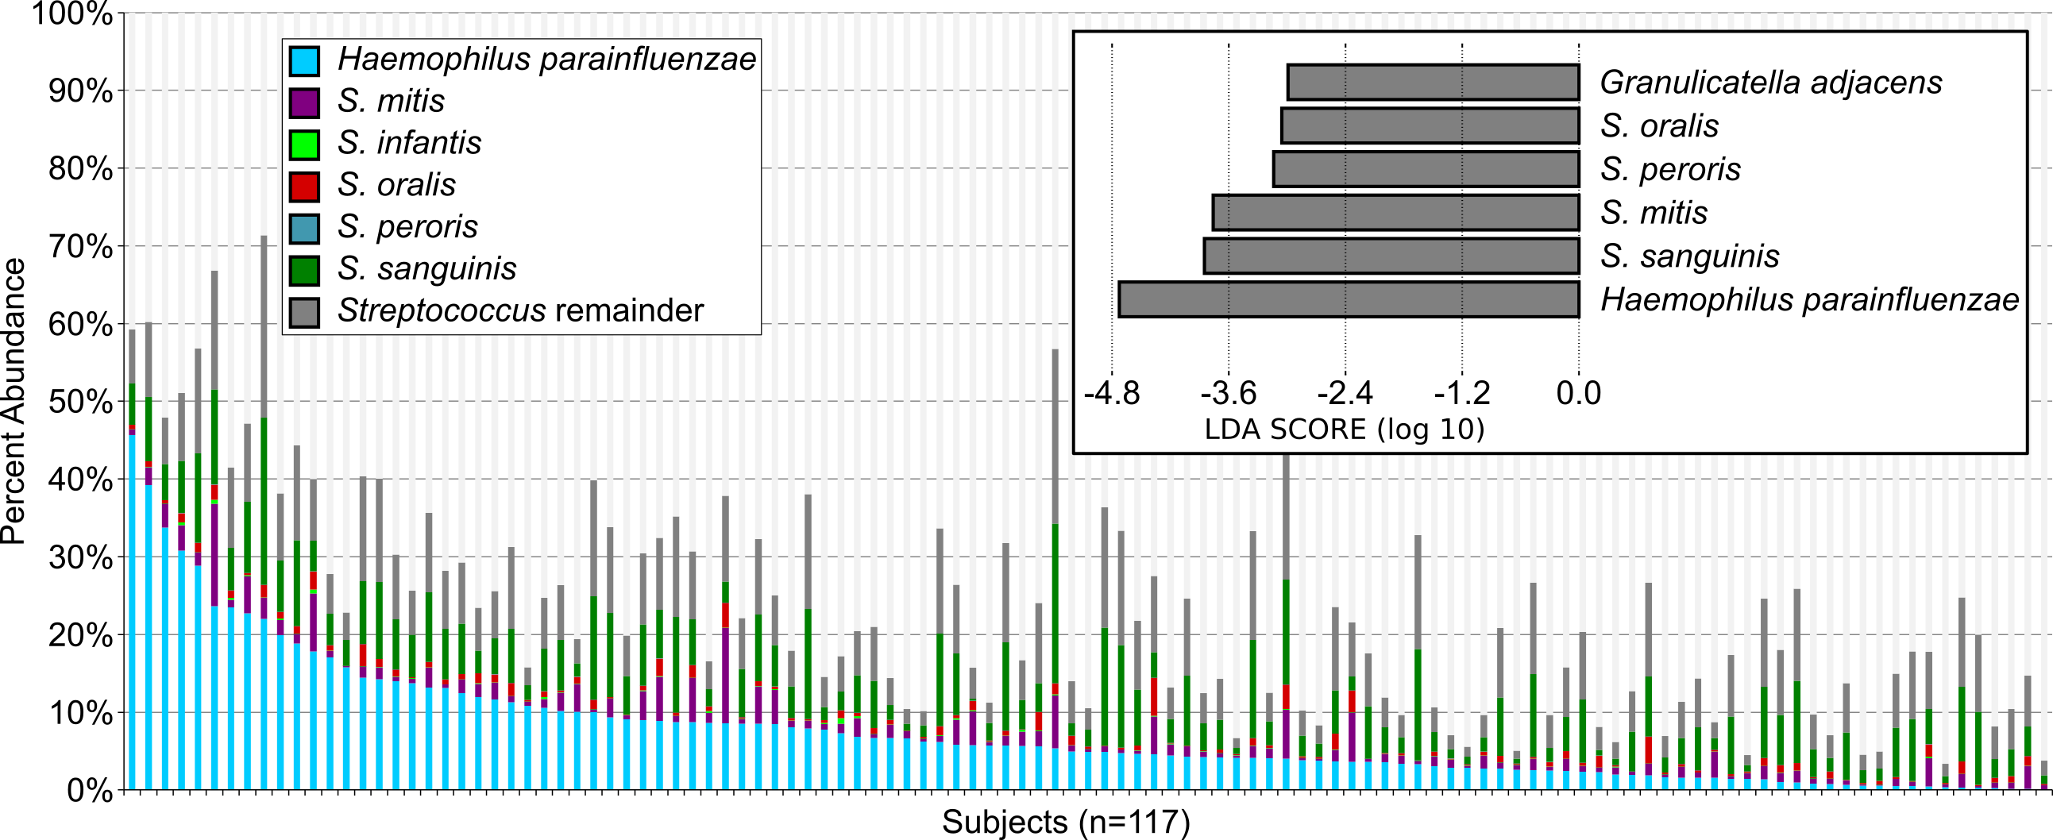
Dasith Perera
Perera D., et al. (2020). Mechanisms underlying proximity between oral commensal bacteria. bioRxiv

Slide 5
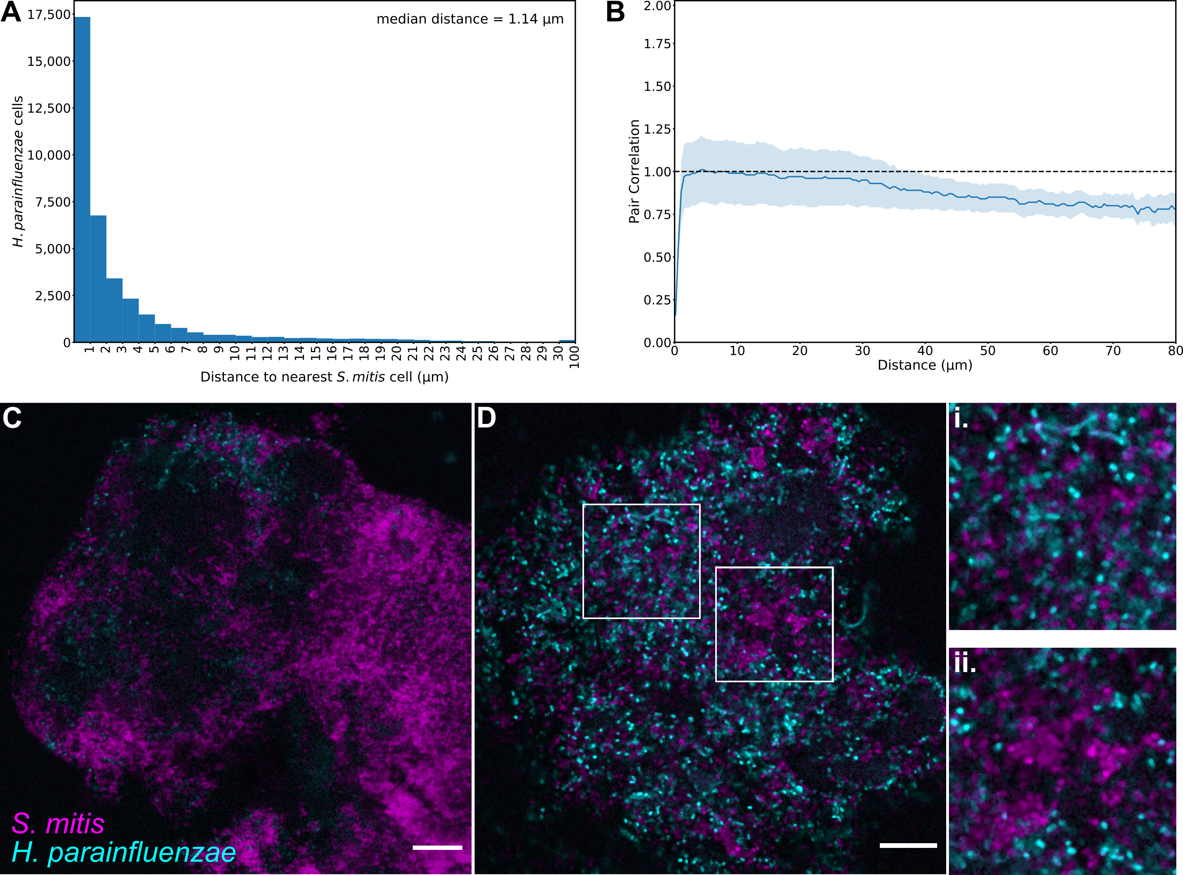
Hp – Sm in vivo
“mitis-group”
Perera D., et al. (2020). bioRxiv

Slide 6
Hp only really found near Sm
Photos taken based on Hp presence
Perera D., et al. (2020). bioRxiv

Slide 7
Major takeaways
Hp has a multifaceted H₂O₂ detoxification system
Sm H₂O₂ excludes Hp in a density dependent fashion
Sm-produced NAD stimulates Hp growth
Both organisms express alternate catabolism pathways when together

Slide 8
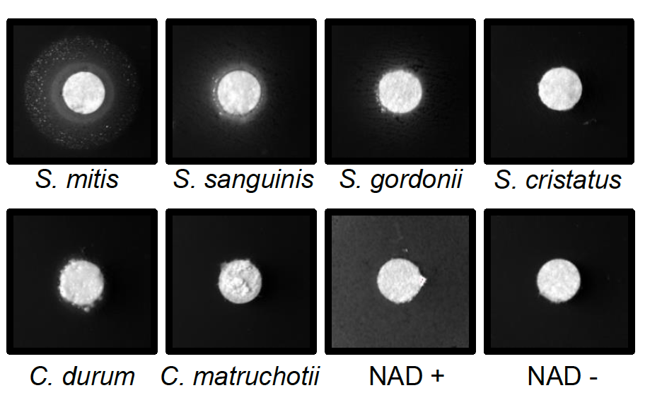
Mitis-group streptococci complement NAD auxotrophy
Hp lawns
Media:
BHI +YE +Hemin + Catalase
Notes:
Hpara is an NAD auxotroph- it cannot synthesize its own NAD, it needs to get it from its environment. We’ve tested saliva and it doesn’t appear to have sufficient free NAD to support hpara growth, so other microbes could be an important source.
I spread hpara on plates lacking NAD and spotted equal inoculums of some of the most abundant species found in plaque and incubated together for 48 hours.
We see good growth of hpara when next to mitis, some growth with other streps, and very little if any with the coryne’s.
So despite being killed by mitis due to hydrogen peroxide, hpara prefers to be around mitis because it can be an important source of NAD

Slide 9
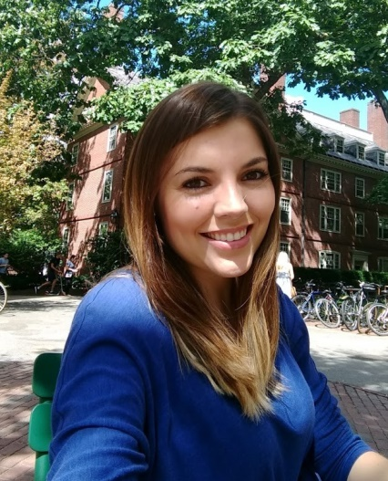
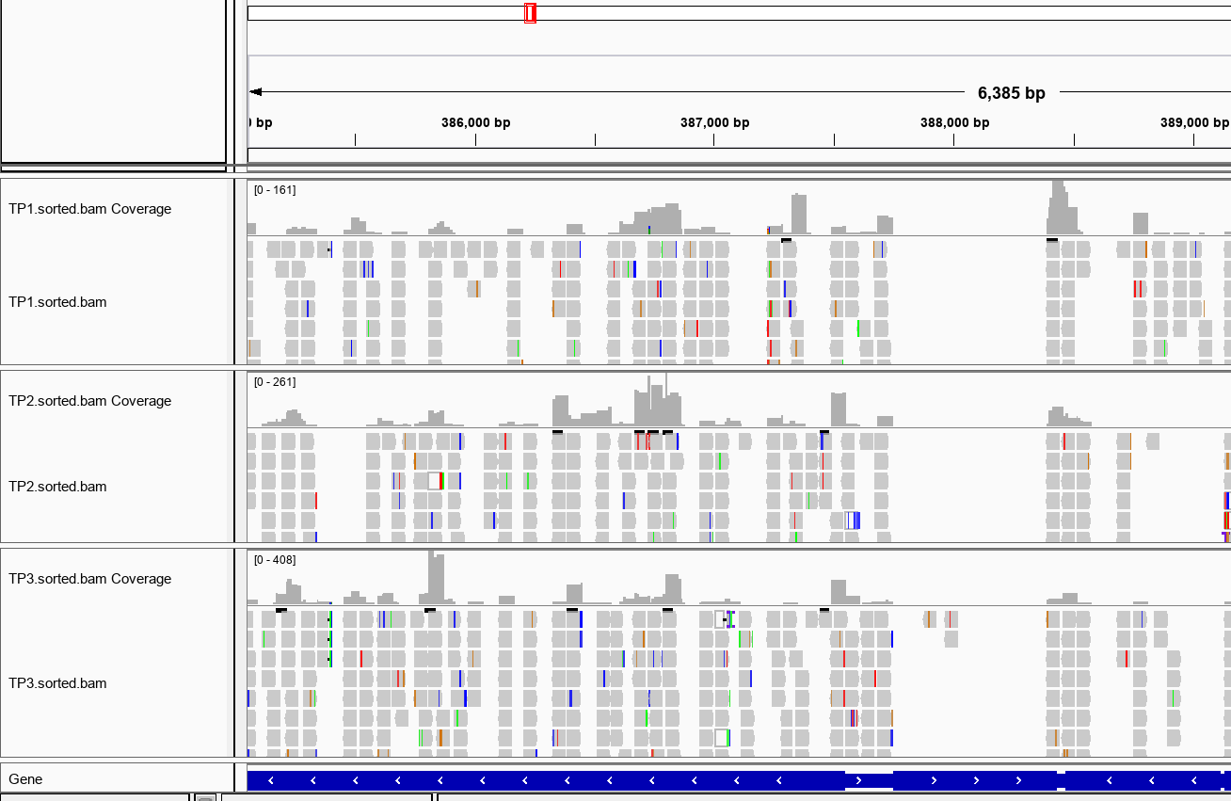
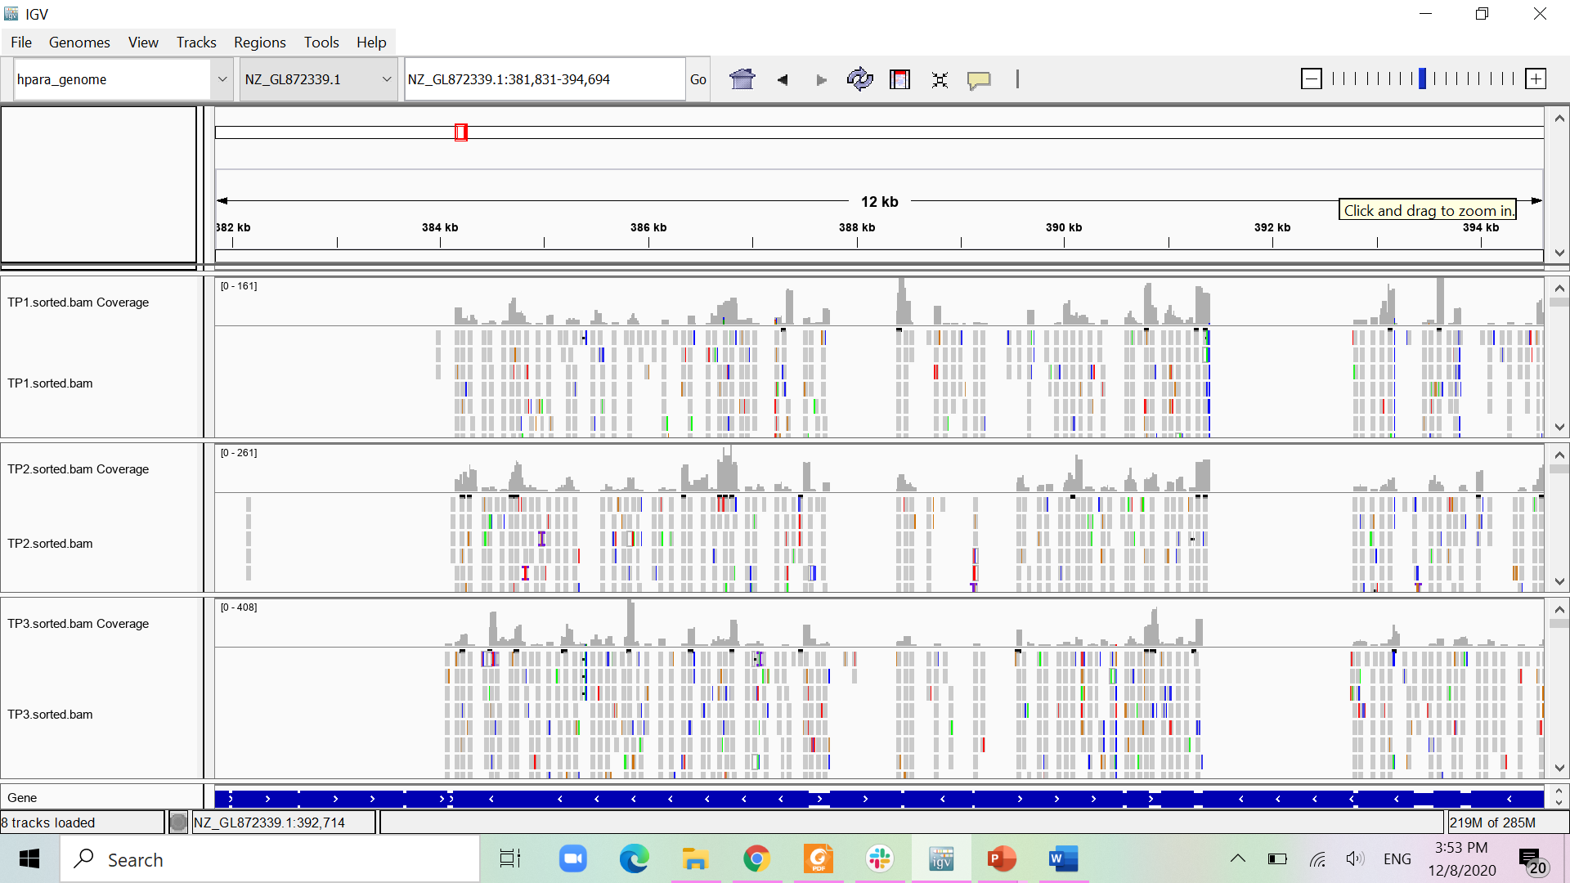
NAD transport is essential
RapA
Nicotinamide riboside transporter
tRNA
Thais Harder De Palma
>120k mariner TA insertions

Slide 10
How about in vivo ?
We chose 2 supragingival plaque metatranscriptome studies with healthy controls
  Benítez-Páez, BMC Genomics 2014
  Jorth et al, mBio 2014
We aligned our Hp and Sm genomes to these reads to generate new “libraries”
These were then compared to our in vitro monoculture RNASeq libraries to give us fold-changes in differential expressed genes (DEG)

Slide 11
Comparisons
Significant upregulated DEGs
Jorth-14’
Benítez-Páez-14’
424
30
79
6
29
16
This was done for downregulated DEGs and compared with anaerobic DEGs
137
Sm – Hp in vitro

Slide 12
We did the same for Hp
18 upregulated DEGs
Glycerol catabolism
Gluconeogenesis
Pili biogenesis
22 downregulated DEGs
Stringent response
Methonine metabolism
fur
Chaperones and proteases

Slide 13

What Sm does
6 upregulated DEGs
nanE - N-acetylmannosamine-6-phosphate 2-epimerase (EC 5.1.3.9)
ABC transporter 2C predicted N-acetylneuraminate transport system permease protein 2
PTS system 2C mannose-specific IIA component (EC 2.7.1.191)
PTS system 2C mannose-specific IIC component
yrrO - Uncharacterized protease
beta-galactosidase (EC 3.2.1.23)
24 downregulated DEGs
Envelope and cell-wall stress
Iron-sulfur center repair functions / general stress responses
Group B strep surface immunogenic protein
Alex Labossiere

Slide 14
Hypotheses
Hp
opportunist
Sm
Sialic Acid
Fucose
Galactose
GlcNAc
Does Sm sialic acid catabolism influence adjacent microbes immune status?
GalNAc
N
C
Salivary mucin

Slide 15
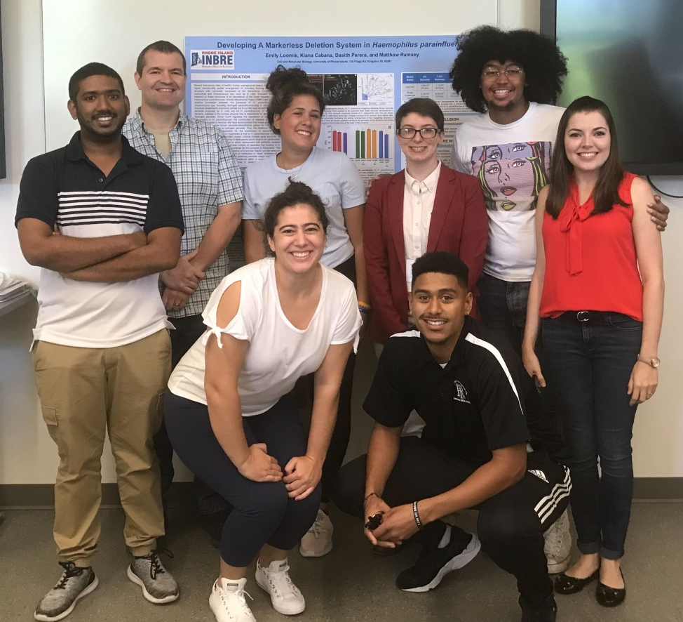



Acknowledgements
Graduate Students:
Eric Almeida
Thais Harder De Palma
Dasith Perera
Alex Labossiere
Funding:
RI Foundation Medical Research Fund
RI COBRE - #P20GM104317
RI INBRE Early Career Award – #P20GM103430
NIH – NIDCR #R01DE027958
Collaborators:
Marcelo Freire (JCVI) / Hatice Hasturk (Forsyth)
Jessica Mark Welch (U Chicago / MBL)

