Slide 1


Mechanisms underlying spatial interaction in the oral microbiota
Matthew M. Ramsey, PhD
University of Rhode Island

Slide 2
We must understand mechanisms of interaction between commensals to exploit them for our benefit.

Slide 3
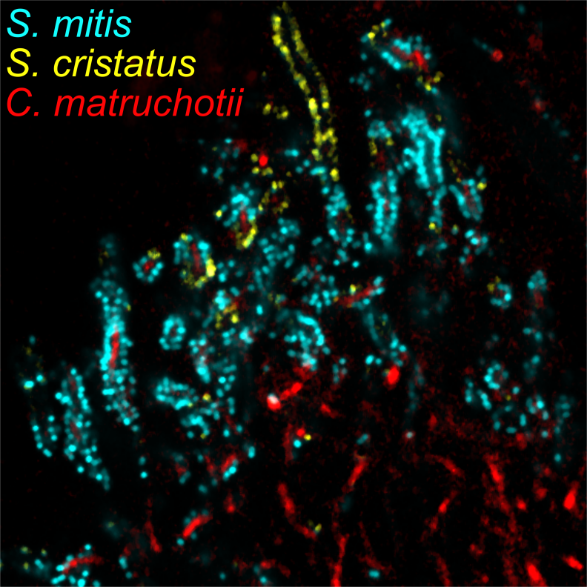
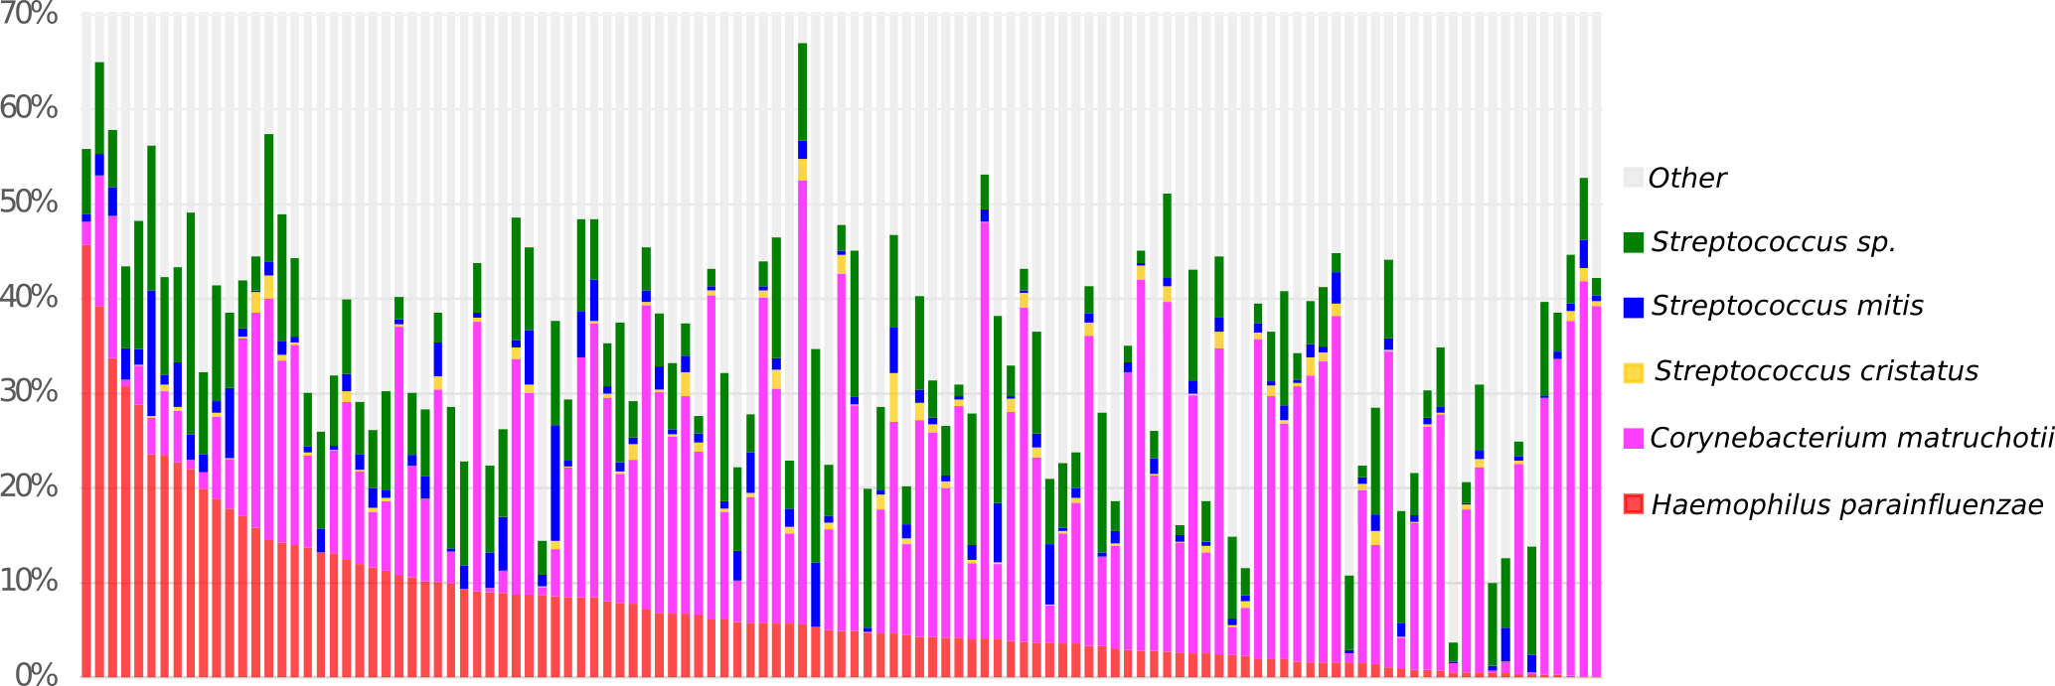
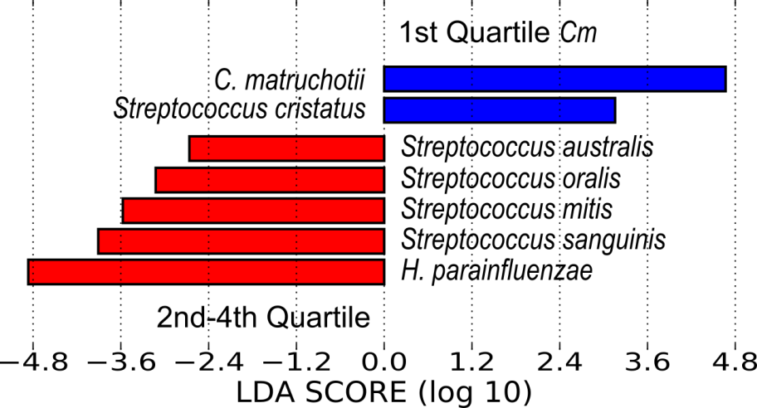
Microbiome data correlations can predict colocalization
Segata et al., (2010)
Notes:
One way is by read abundance- this is read abundance data of SUP from the human microbiome project.
Each vertical bar
A lot of pink/purple- Corynebacterium matruchotii
Also a lot of red- this is the species that I work on- haemophilus parainfluenzae- or hpara for short.
Hpara is found in high abundance and is also high prevalence- probably found in all of us
We wanted to see which species correlate with hpara
To do this he sorted the data based on abundance of hpara and carried out a group correlation analysis using the program lefse
To compare individuals with the most hpara to that of the rest of the dataset.
This was the result- if you have a lot of hpara- you also tend to have a lot of these species.
What interests us are the streptococcus sp. Particularly strep mitis
So I work on interactions between hpara and streps

Slide 4
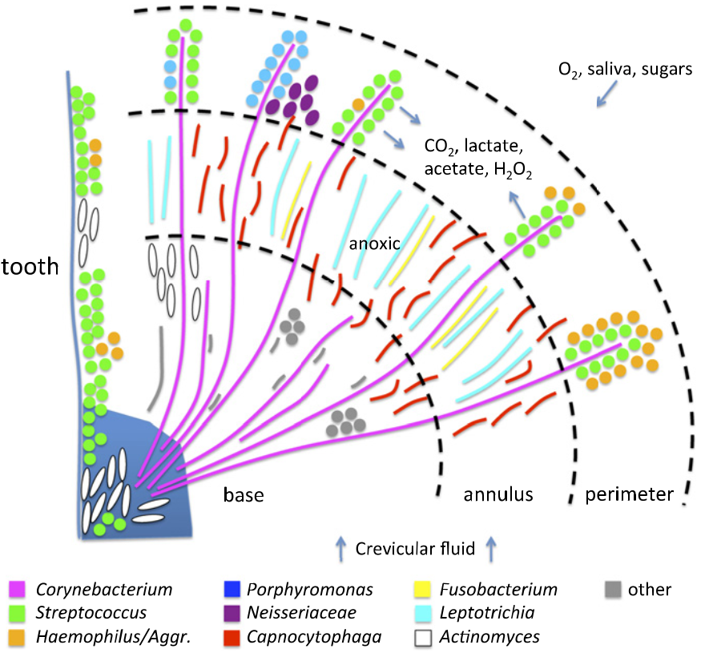
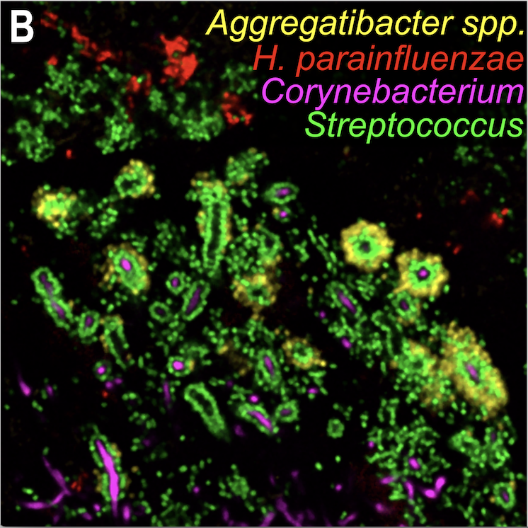
H. parainfluenzae in supragingival plaque
Image courtesy of Dr. Jessica Mark-Welch
Welch et al., (2016)
Notes:
Where is hpara found
Image from out collaborators, using an hpara specific probe-
Down -hedgehog structure of plaque
No hpara
excluded from this structure
Strep association

Slide 5
Interactions With Oral Streptococci
?
Lactate
Streptococcus sp.
O₂
H. parainfluenzae
?
Sugars
H₂O₂

Slide 6
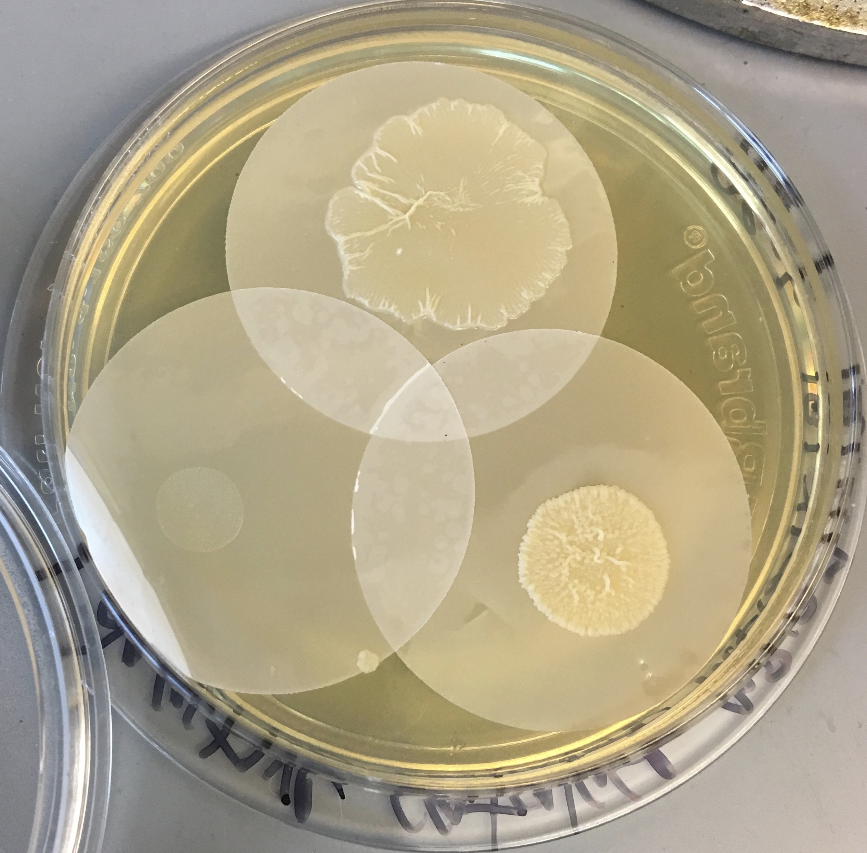
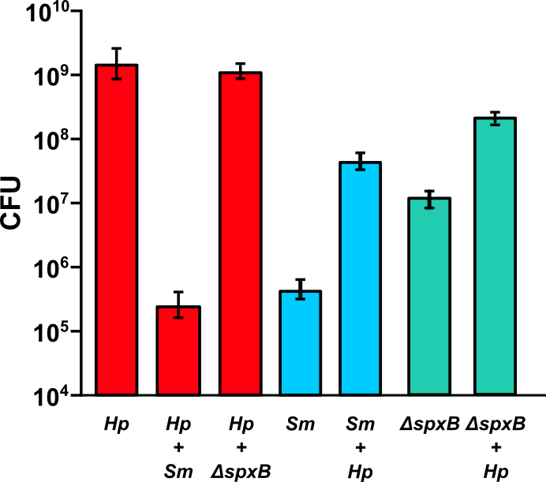
H. parainfluenzae coculture with S. mitis
*
*
*
𝛥spxB does not produce H₂O₂
S. mitis produced H₂O₂ kills H. parainfluenzae
Notes:
Took one step further
Using a pyruvate oxidase mutant of mitis that was sent to us by colleagues

Slide 7
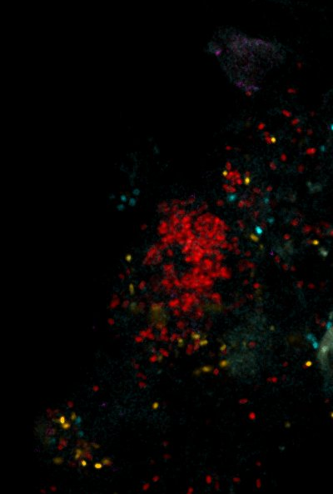
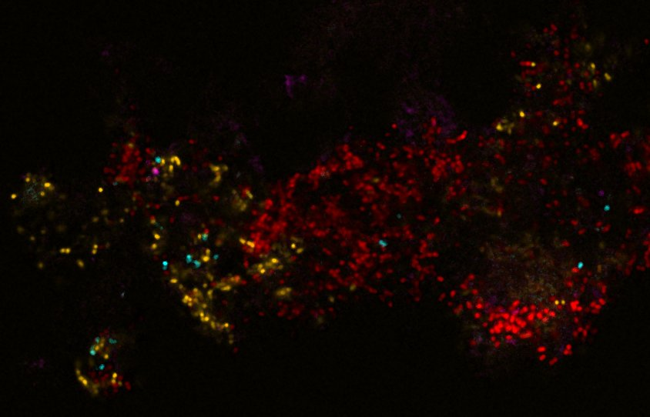
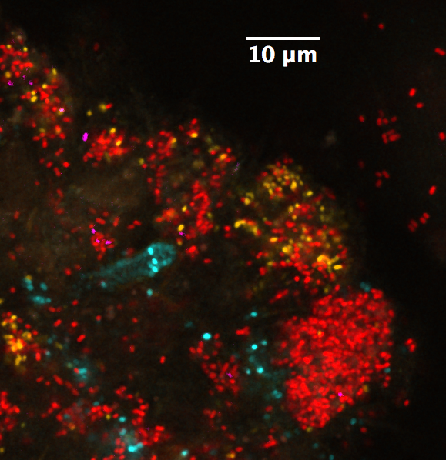
Hp – Sm in vivo
H. parainfluenzae
S. mitis
S. cristatus

Slide 8
Hypothesis:
There is a “Goldilocks” zone for Hp – Sm cohabitation dependent on Sm density
This likely applies to other H₂O₂-producing streptococci

Slide 9
Aerobic RNASeq Data
No Hp H₂O₂-related genes were induced in coculture!
  Maximally induced aerobically
Hp genes for acid stress and DNA damage were upregulated
Sm largely downregulated stress response genes
Hp ΔoxyR transcriptome quantified
  42 genes differentially expressed
  Most involved in known oxidative stress responses
    Fe sequestration
    Repair functions
    Redox enzymes

Slide 10
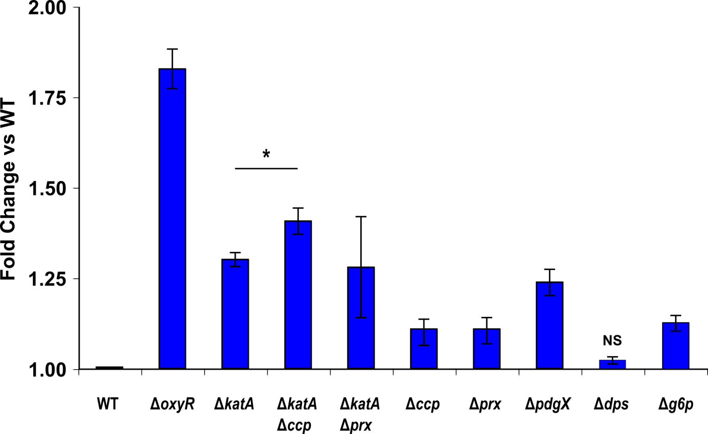
Zone of Inhibition of H₂O₂ exposed Hp

Slide 11
Cui bono?
S. cristatus
No H₂O₂
S. gordonii
H₂O₂ producer
Hp lawn
No NAD+ added

Slide 12
Conclusions
Hp has a robust, multifaceted peroxide resistance mechanism
Sm growth is enhanced by adjacent Hp primarily due to peroxide removal
Hp obtains NAD (or a precursor) from adjacent Streptococci
Evidence of cooperative complex carbohydrate degradation anerobically (not shown)

Slide 13




Acknowledgements
Graduate Students:
Eric Almeida
Thais Harder De Palma
Dasith Perera
Funding:
RI Foundation Medical Research Fund
RI COBRE - #P20GM104317
RI INBRE Early Career Award – #P20GM103430
NIH – NIDCR #R01DE027958
Collaborators:
Marcelo Freire (JCVI)
Jessica Mark Welch (U Chicago / MBL)

