Slide 1
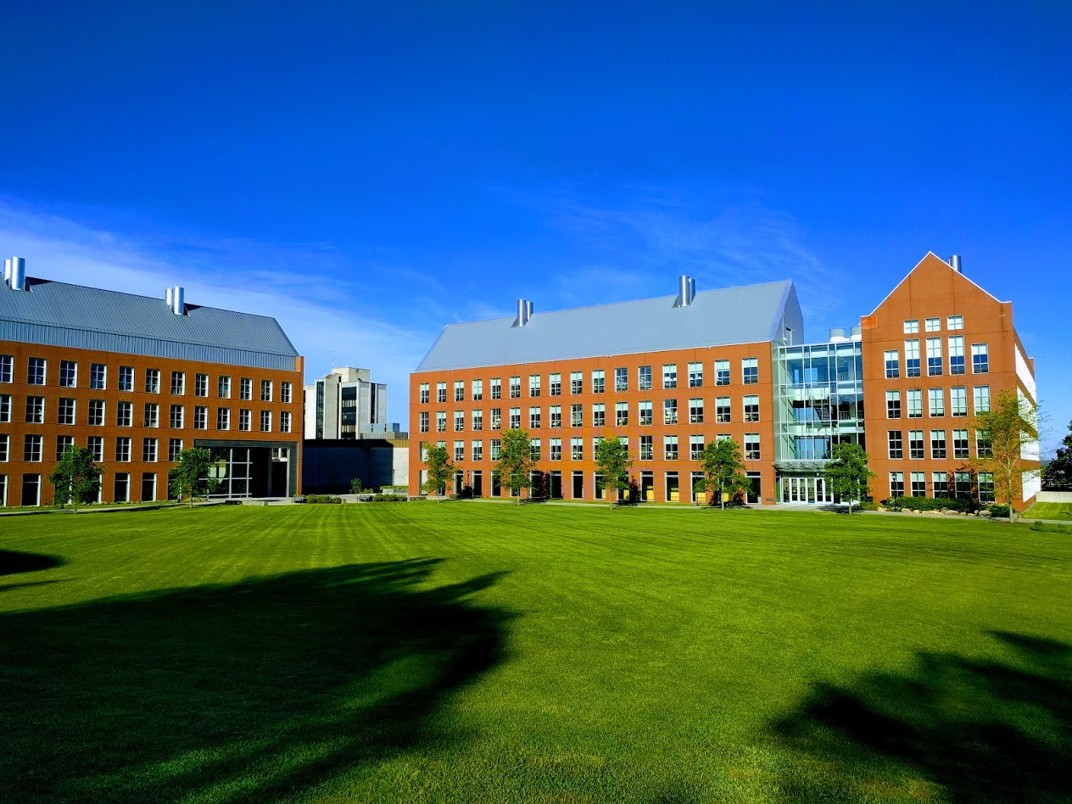

Mechanisms underlying spatial interaction in the oral microbiota
Matthew M. Ramsey, PhD
University of Rhode Island

Slide 2
We must understand mechanisms of interaction between commensals to exploit them for our benefit.
How do we choose the right ones?

Slide 3
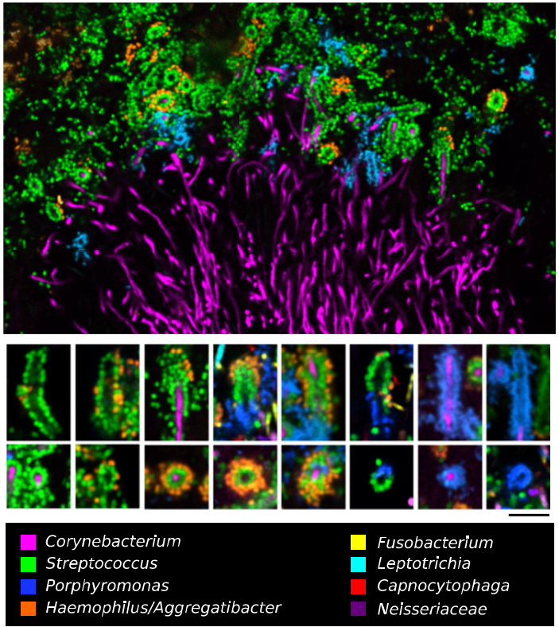

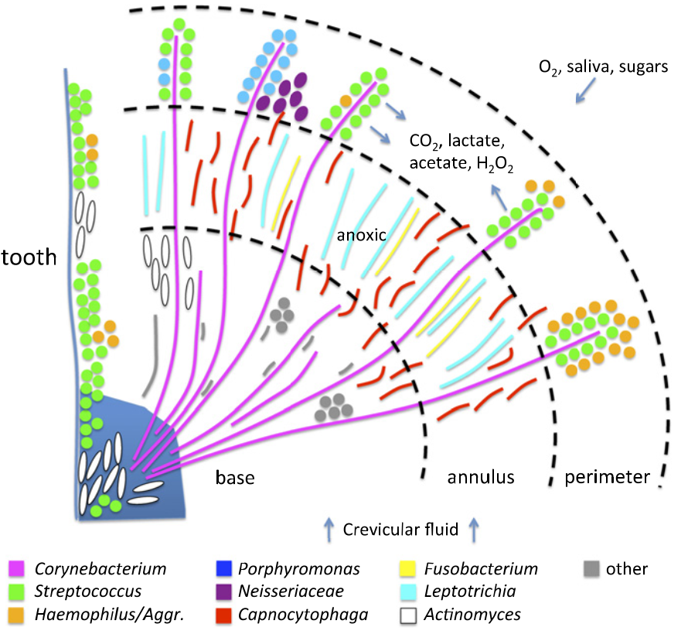
Jessica Mark Welch PhD
Associate Scientist
Marine Biology Lab / University of Chicago. Woods Hole, MA
2011. Valm, Borisy, PNAS.
2016. Mark Welch, Borisy, PNAS.

Slide 4
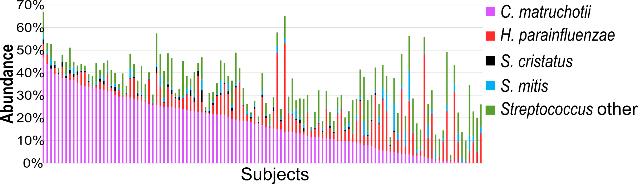
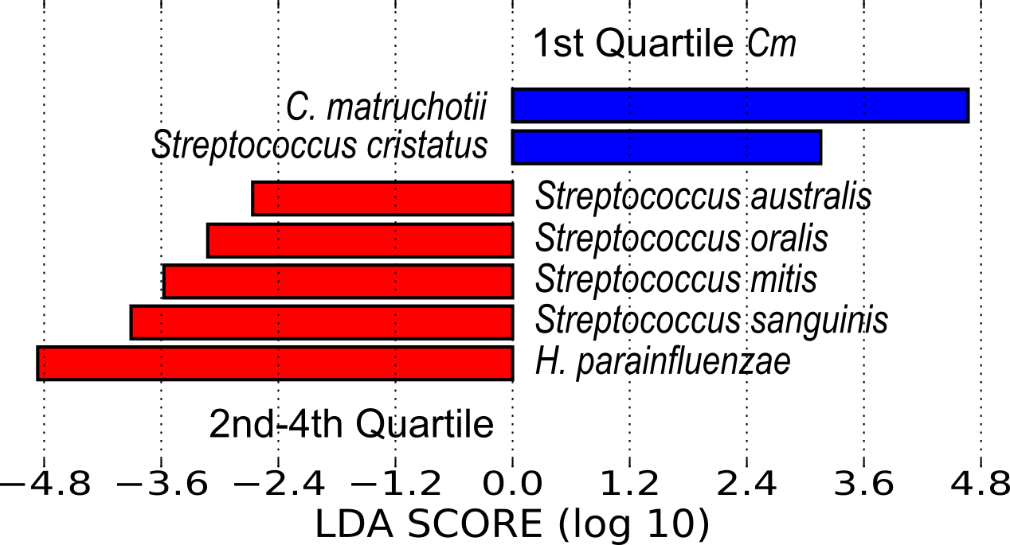

Slide 5
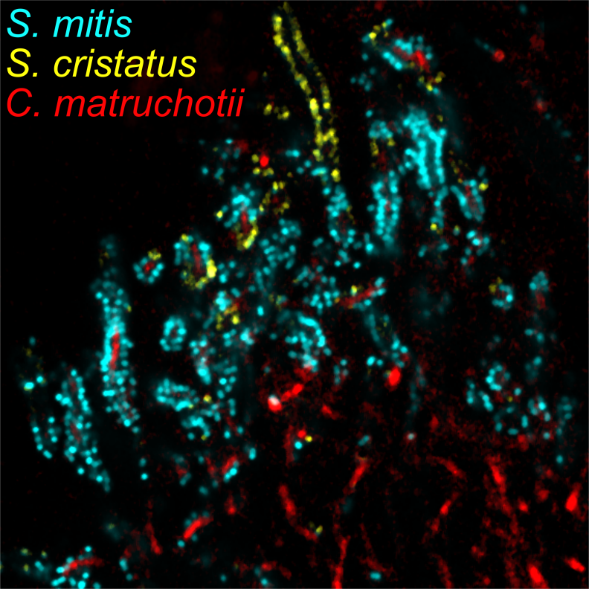
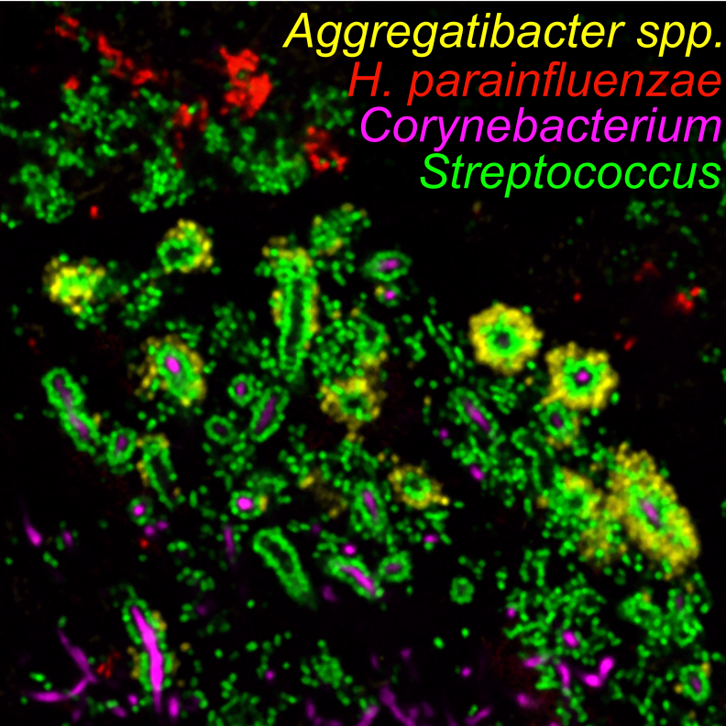
c/o J. Mark Welch

Slide 6
Microbiome prediction for imaging
Currently we are focused on the following:
  Corynebacterium matruchotii - Cm
  Haemophilus parainfluenzae - Hp
  Streptococcus mitis - Sm
  Streptococcus cristatus - Sc

Slide 7

H. parainfluenzae
Gram negative
Facultative anaerobe
Abundant in several oral sites / extraoral
Opportunist
Perera D., et al. (2020). Mechanisms underlying proximity between oral commensal bacteria. bioRxiv
Dasith Perera

Slide 8
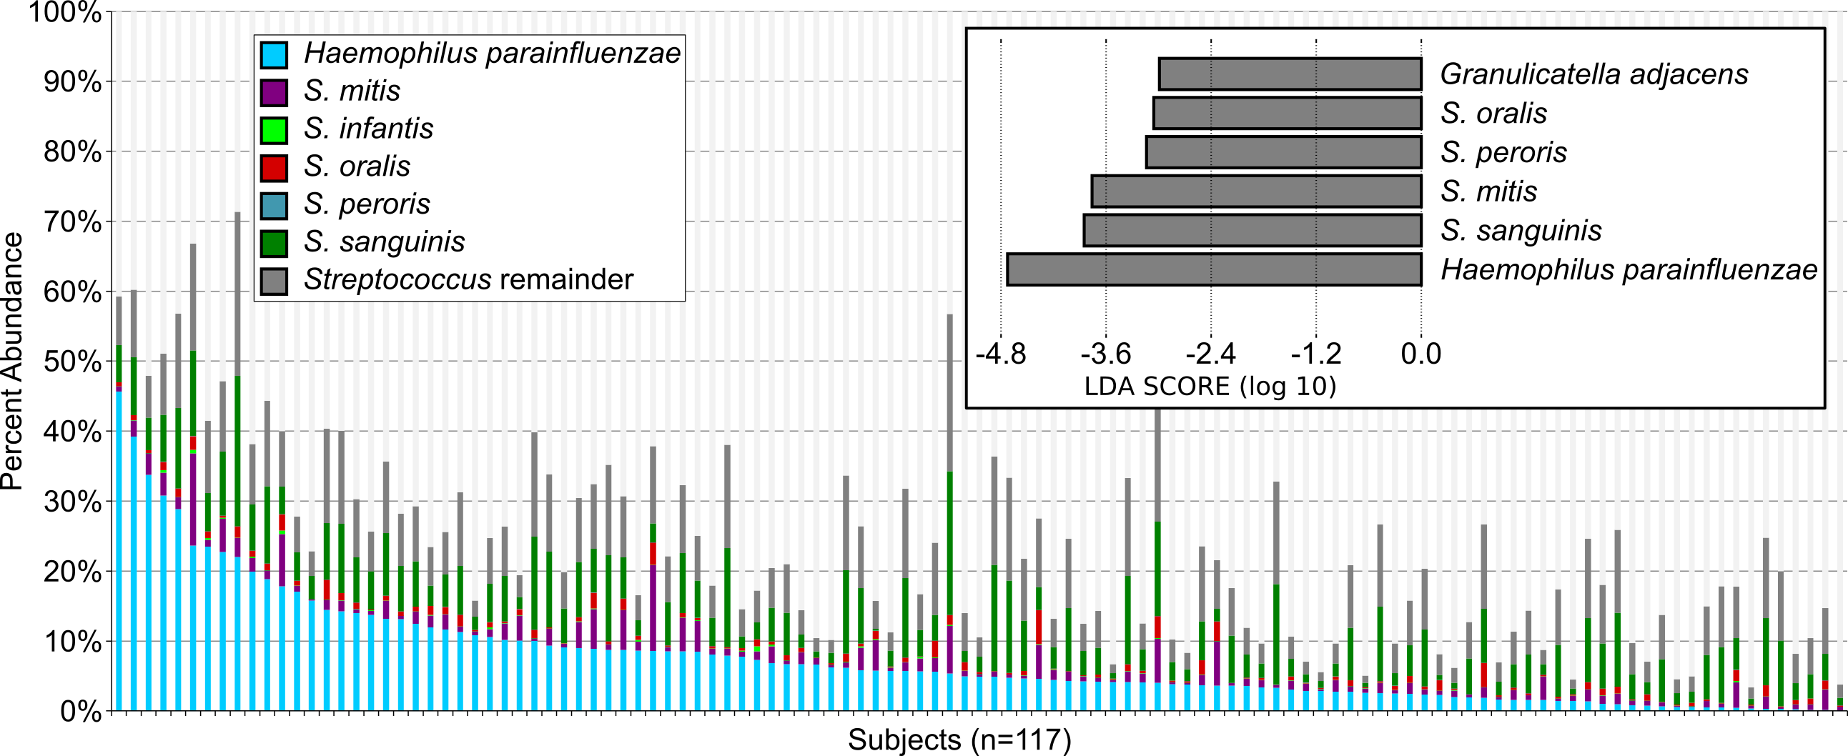

Slide 9
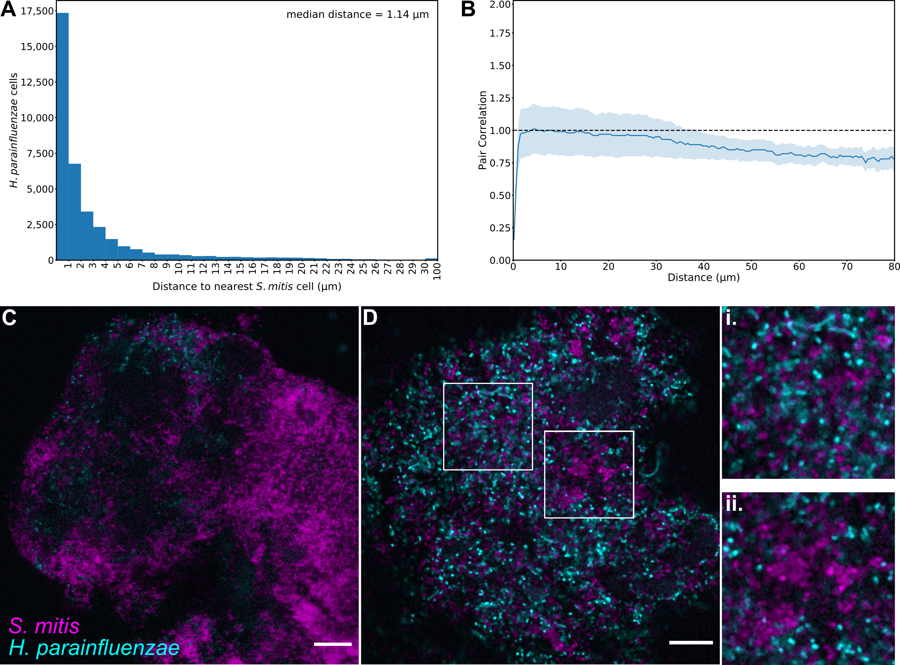
Hp – Sm in vivo
“mitis-group”

Slide 10
Hp only really found near Sm
Photos taken based on Hp presence
Adapted from: Perera D., et al. (2020). Mechanisms underlying proximity between oral commensal bacteria. bioRxiv

Slide 11
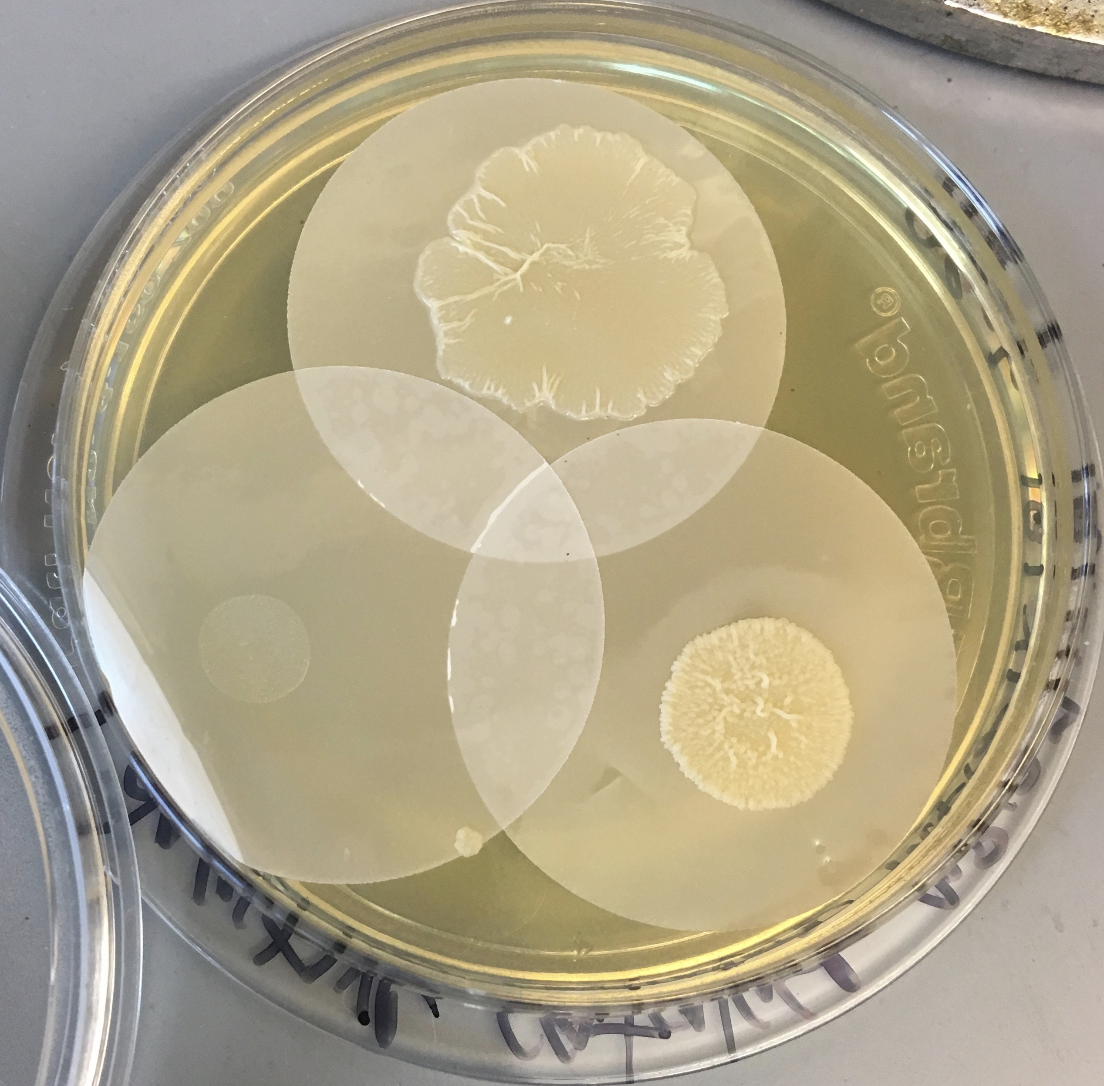
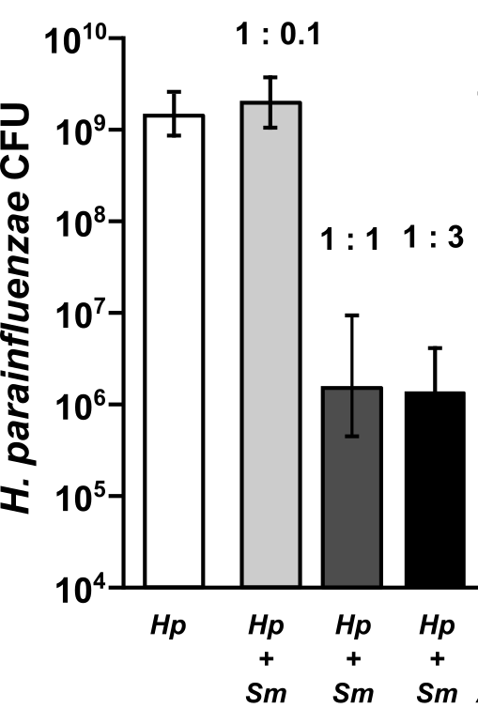
Hp in vitro growth
Hp : S. mitis ratio

Slide 12
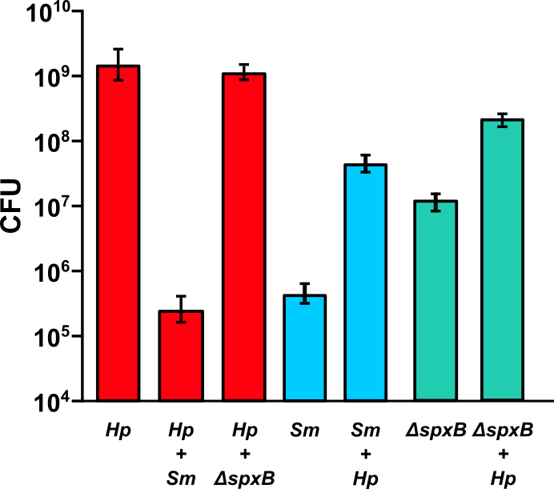
H. parainfluenzae coculture with S. mitis
*
*
*
𝛥spxB does not produce H₂O₂
S. mitis produced H₂O₂ kills H. parainfluenzae
Notes:
Took one step further
Using a pyruvate oxidase mutant of mitis that was sent to us by colleagues

Slide 13
Interactions With Oral Streptococci
?
Lactate
Streptococcus sp.
O₂
H. parainfluenzae
?
H₂O₂
Sugars

Slide 14
OxyR
RNA Polymerase
?
WT vs ΔoxyR
47 Genes differentially expressed
Fold Change | p-adj | CDS | Gene name | Description
15.9 | 1.46E-49 | 1440 | katA | Catalase
3.2 | 1.69E-07 | 1675 | ccp | Cytochrome-C peroxidase
6.5 | 1.18E-27 | 1526 | prx | Peroxiredoxin
4.5 | 9.26E-18 | 1074 | sox | Superoxide dismutase
35.7 | 2.47E-64 | 1219 | dps | DNA starvation protection protein
7.7 | 1.34E-33 | 397 | g6pd | Glucose-6 phosphate dehydrogenase
2.5 | 1.93E-05 | 396 | pgls | 6-phosphogluconolactonase
3.2 | 7.74E-07 | 644 | tkt | Transketolase
2.4 | 1.78E-05 | 13 | tal | Transaldolase
4.3 | 1.06E-15 | 1865 | gsr | Glutathione-disulfide reductase
2.6 | 1.34E-05 | 1624 | trx | Thioredoxin
3 | 1.15E-07 | 858 | grxA | Glutaredoxin
Notes:
I then did some RNASeq experiments where I took wildtype and the oxyr mutant, subjected them to a sublethal dose of peroxide and looked at gene expression.
We found 47 genes were affected by the loss of oxyr.. These are some of them
So we see genes that directly breakdown peroxide, like catalase, a peroxidase, peroxiredoxin, we see superoxide dismutase, dps, and other genes involved in iron sequesteration, genes involved in the pentose phosphate pathway, and genes involved in reduction of oxyR, suggesting that oxyR is autoregulated

Slide 15
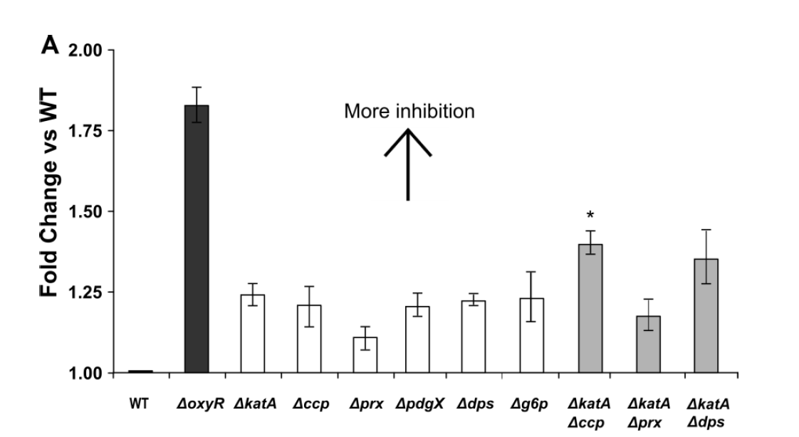
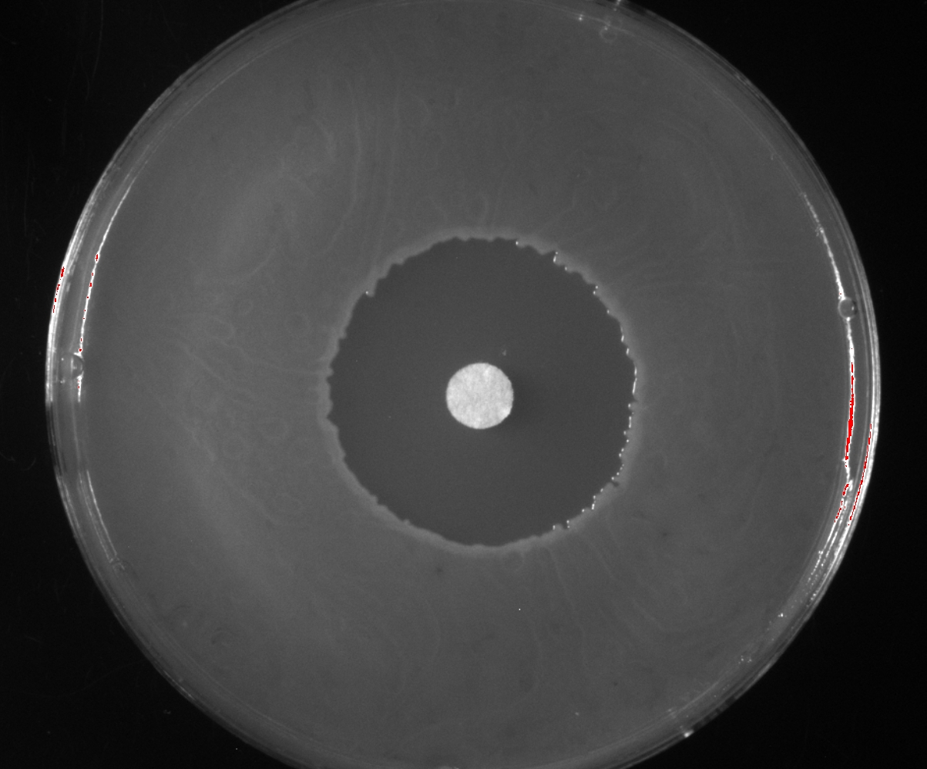
H₂O₂ sensitivity in Hp
Perera D., et al. (2020)
Notes:
So I made deletions in some of these genes. And we carried out a zone of inhibition assay. Basically we spread plated equal inoculums of the different strains, spotted an equal concentration of hydrogen peroxide. And measured the zones generated. We then compared the zones created by the mutants to that of wildtype hpara.
We see that deletion of oxyR results in a zone 1.8 times greater than wildtype. Every other individual mutant showed modest increases in sensitivities compared to wildtype.
Only when you lose the function of more than 1 gene is when you start to see greater differences.
So the take home message here is, hpara’s response to peroxide doesn’t rely on a single gene, like catalase in other species, where the loss of catalase results in much greater inhibition, instead it involves a redundant multi-factorial response.

Slide 16
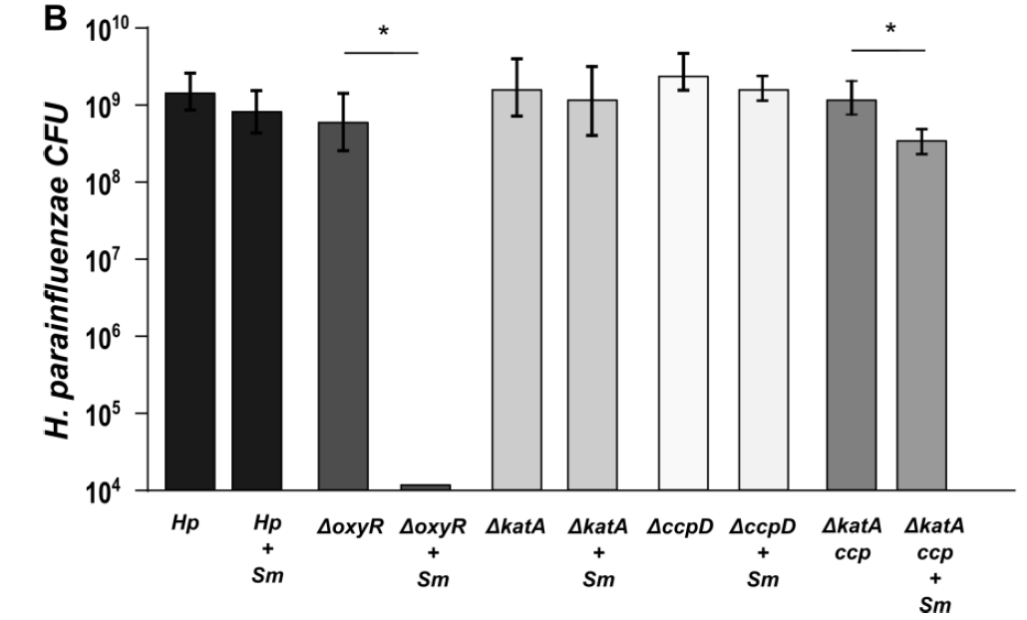
Hp in vitro coculture

Slide 17
Catching up
Hp has a redundant system for H₂O₂ resistance
Makes sense as they seem to co-exist in vivo
Why does Hp put up with this?
  Hint: auxotrophy

Slide 18
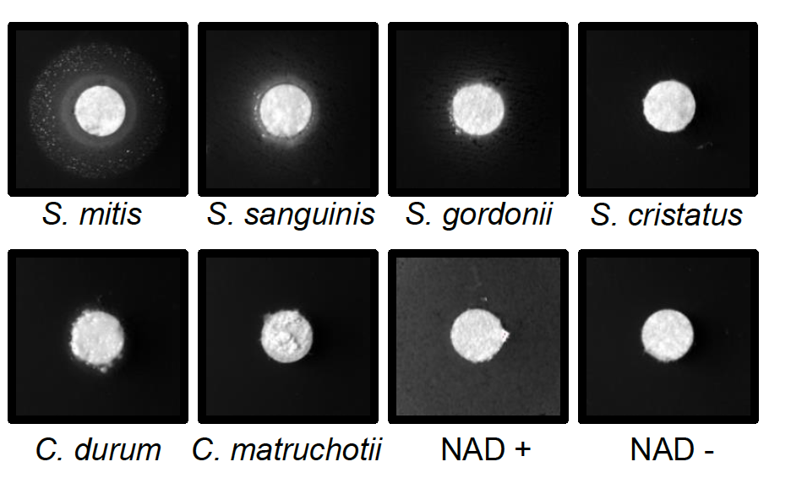
Mitis-group streptococci complement NAD auxotrophy
Hp lawns
Media:
BHI +YE +Hemin + Catalase
Notes:
Hpara is an NAD auxotroph- it cannot synthesize its own NAD, it needs to get it from its environment. We’ve tested saliva and it doesn’t appear to have sufficient free NAD to support hpara growth, so other microbes could be an important source.
I spread hpara on plates lacking NAD and spotted equal inoculums of some of the most abundant species found in plaque and incubated together for 48 hours.
We see good growth of hpara when next to mitis, some growth with other streps, and very little if any with the coryne’s.
So despite being killed by mitis due to hydrogen peroxide, hpara prefers to be around mitis because it can be an important source of NAD

Slide 19

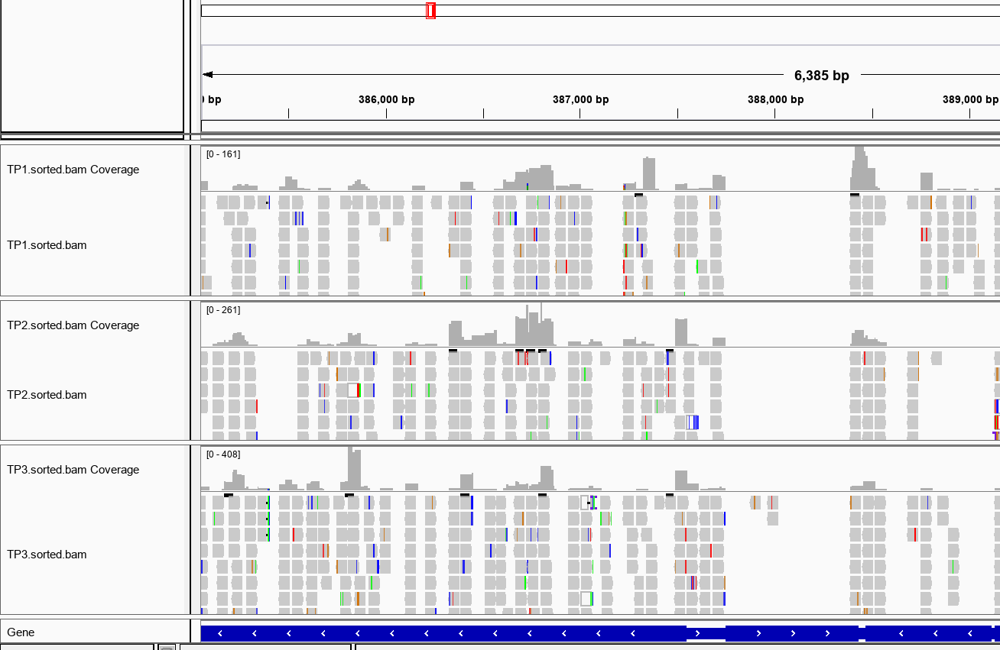
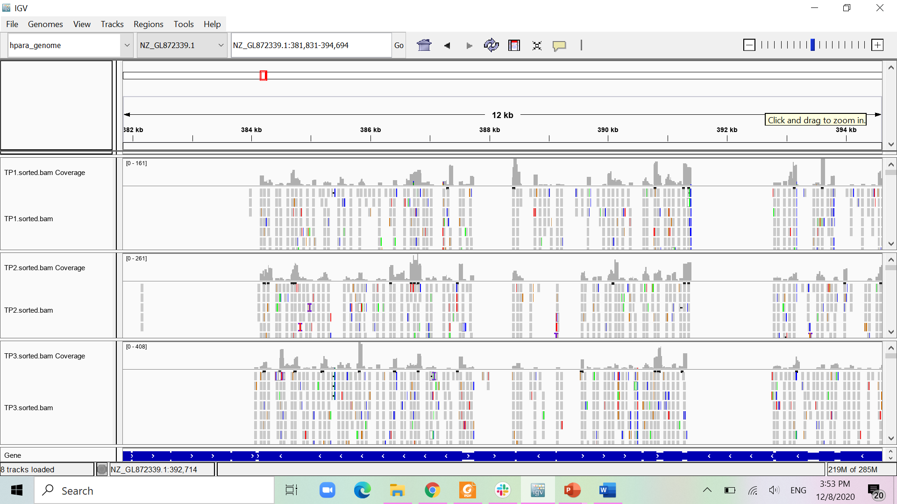
NAD transport is essential
RapA
Nicotinamide riboside transporter
tRNA
Thais Harder De Palma
>120k mariner TA insertions

Slide 20
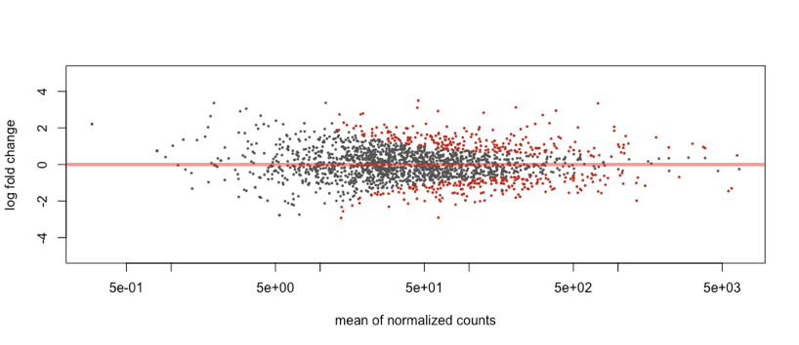
H. parainfluenzae RNASeq
H. parainfluenzae differentially expressed genes
 | S. mitis | S. cristatus
Up | 90 | 64
Down | 115 | 8

Slide 21
Aerobic RNASeq Data
No Hp H₂O₂-related genes were induced in coculture!
  Maximally induced aerobically
Hp genes for acid stress and DNA damage were upregulated
No evidence of lactate utilization, other carbohydrates were catabolized
B12 transport up
Pilin production increased
It seemed that Hp might be trying to increase its mutation rate

Slide 22
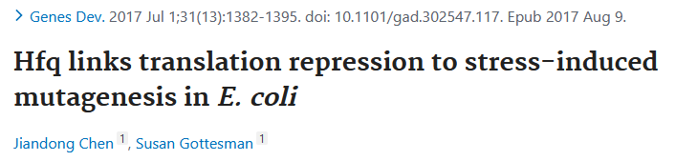
Hp mutagenesis involved genes
Fold change | padj
10.87 | 0.0003 | Type IV pilin PilA
5.13 | 0.0360 | Type IV pilus biogenesis protein PilM
3.99 | 0.0000 | DNA transformation protein TfoX
2.89 | 0.0000 | DNA uptake protein and related DNA-binding proteins (ComE)
4.60 | 0.0000 | Site-specific tyrosine recombinase XerC
4.72 | 0.0000 | Type III restriction-modification system methylation subunit (EC 2.1.1.72)
2.85 | 0.0019 | Type III restriction-modification system restriction subunit (EC 3.1.21.5)
2.31 | 0.0080 | Putative DNA-binding protein in cluster with Type I restriction-modification system
3.27 | 0.0000 | CRISPR-associated endonuclease Cas9
4.47 | 0.0003 | AAA+ ATPase superfamily protein YifB/ComM associated with DNA recombination
2.57 | 0.0000 | RNA-binding protein Hfq
2.74 | 0.0000 | Universal stress protein E
2.98 | 0.0386 | DNA polymerase IV
2.13 | 0.0313 | DNA mismatch repair protein MutS
-2.25 | 0.0053 | DNA polymerase III chi subunit (EC 2.7.7.7)
-2.71 | 0.0036 | DNA polymerase III psi subunit (EC 2.7.7.7)
-1.86 | 0.0227 | DNA polymerase I (EC 2.7.7.7);Ontology_term
-2.00 | 0.0000 | SOS-response repressor and protease LexA (EC 3.4.21.88);Ontology_term
“By interacting with the mutS leader, Hfq serves as a critical switch that modulates bacteria from high-fidelity DNA replication to stress-induced mutagenesis.”

Slide 23
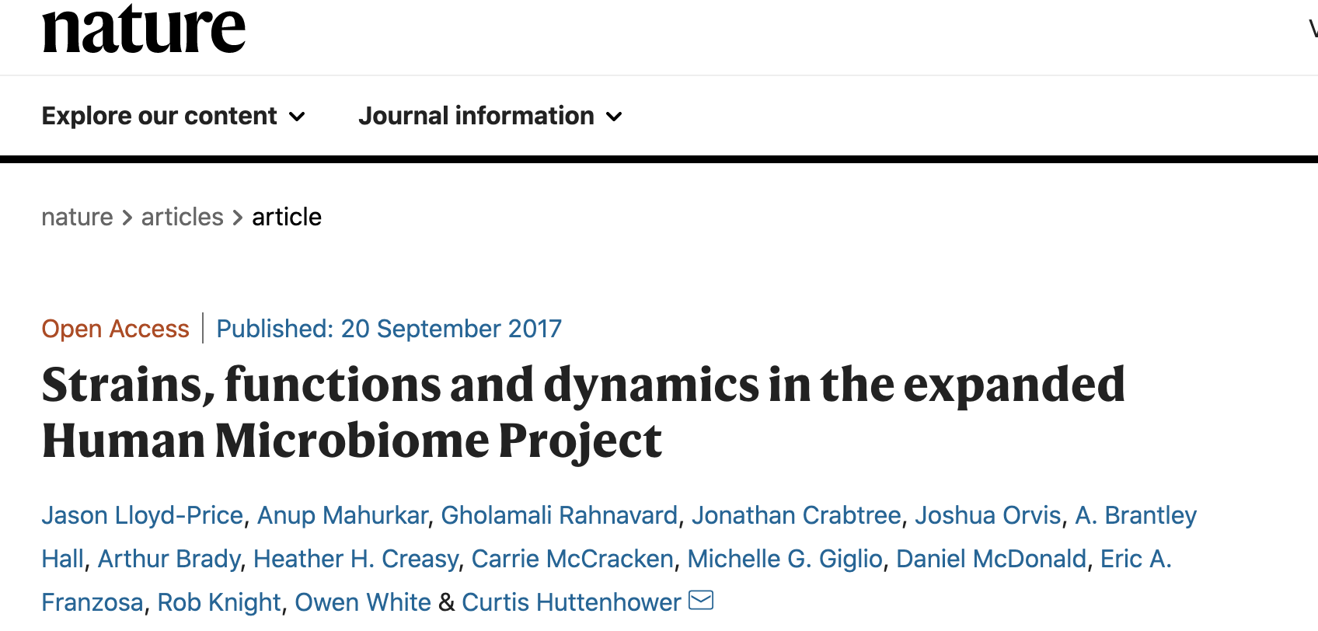
Some species showed high degree of genome variation
Extreme case: H. parainfluenzae “where distinct subspecies are apparent in supragingival plaque, buccal mucosa and tongue dorsum”
Notes:
Well, maybe there’s some clues in the literature. This paper from the huttenhower lab looked at metagenomes from the oral cavity and what they found was that:
Some species showed a high degree of genome variation.
They highlighted hpara as as an extreme example of this, where it also appeared that hpara existed almost like distinct subspecies in the different sites.

Slide 24
Hypothesis: Strain variation in H. parainfluenzae is due to stress induced mutagenesis by S. mitis
We are currently performing 30-day coculture transfers of Hp with Sm WT and Sm ΔspxB
As we passage each day we are quantifying changes in spontaneous spectinomycin resistance and saving strains for genomic sequencing
If our hypothesis is correct, SNP accumulation will be greater in Hp cocultured with the Sm WT

Slide 25
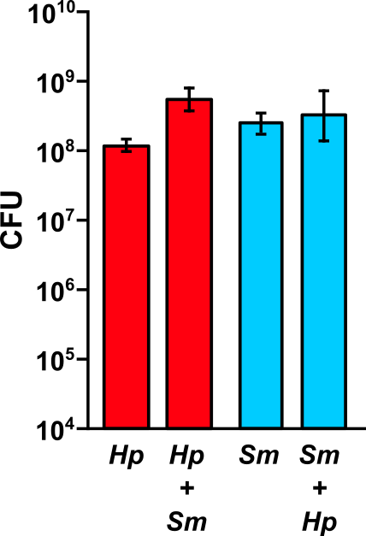
Anaerobic cocultures
*

Slide 26
Anaerobic transcript changes
Fold Change | CDS | Description
10.65 | 1543 | β-galactosidase
8.96 | 1411 | β-galactosidase subunit
6.77 | 985 | β-galactosidase
5.65 | 1052 | β-galactosidase
Fold Change | CDS | Description
3.47 | 1696 | mglB
2.51 | 1697 | mglA
2.3 | 1698 | mglC
3.05 | 1692 | galM
2.74 | 1693 | galK
2.66 | 1694 | galT
2.44 | 1695 | Transcriptional control of Galactose metabolism
* These are also upregulated in aerobic coculture
S. mitis
H. parainfluenzae
Notes:
From rnaseq

Slide 27
Hypothetical anaerobic interaction of H. parainfluenzae and S. mitis
Lactose
β-galactosidases
Glucose
Galactose
H. parainfluenzae
Leloir pathway
S. mitis
Investigating this occurrence in saliva
Notes:
In saliva
Could be other galactose containing disaccharides
Glycoproteins
Defined media
Leloir pathway
Explains growth benefit in bhi-ye

Slide 28
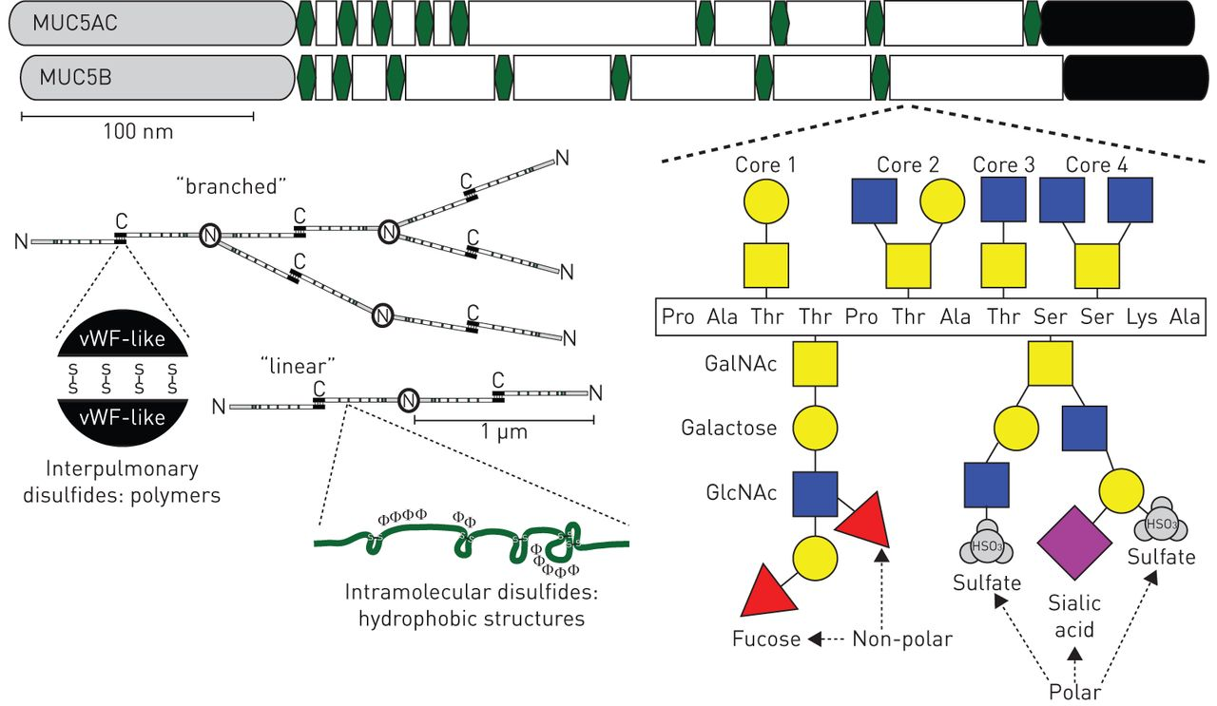
Hypothesis: Cooperative degradation of Muc carbohydrates feeds Sm and Hp
Sialic acid catabolism genes are upgregulated in Hp in coculture with Sm
Janssen, W., et al. 2016, Euro Respiratory Journal

Slide 29

So what about S. mitis ?
With Hp in vitro:
Stress response genes downregulated
Sialic acid catabolism genes upregulated
Numerous PTS transporters upregulated
  Mannose, galactose, others
Beta-galactosidases upregulated
Alex Labossiere

Slide 30
How about in vivo ?
We chose 2 supragingival plaque metatranscriptome studies with healthy controls
  Espinosa et al, mBio 2018
  Jorth et al, mBio 2014
We aligned our Hp and Sm genomes to these reads to generate new “libraries”
These were then compared to our in vitro monoculture RNASeq libraries to give us fold-changes in differential expressed genes (DEG)

Slide 31
Comparisons
Significant upregulated DEGs
Jorth-14’
Espinosa-18’
424
30
79
6
29
16
This was done for downregulated DEGs and compared with anaerobic DEGs
137
Sm – Hp in vitro

Slide 32
What Sm does
6 upregulated DEGs
N-acetylmannosamine-6-phosphate 2-epimerase (EC 5.1.3.9)
ABC transporter 2C predicted N-acetylneuraminate transport system permease protein 2
PTS system 2C mannose-specific IIA component (EC 2.7.1.191)
PTS system 2C mannose-specific IIC component
Uncharacterized protease YrrO
beta-galactosidase (EC 3.2.1.23)
24 downregulated DEGs
Envelope and cell-wall stress
Iron-sulfur center repair functions / general stress responses
Group B strep surface immunogenic protein

Slide 33
We did the same for Hp
18 upregulated DEGs
Glycerol catabolism
Gluconeogenesis
Pili biogenesis
22 downregulated DEGs
Stringent response
Methonine metabolism
fur
Chaperones and proteases

Slide 34
Summary
Hp responses to peroxide were unexpected
Changes to Hp mutagenesis by Sm could explain its genomic variation
Both species seem to express parts of what is needed to catabolize mucins when together

Slide 36

C. matruchotii
Gram positive
Facultative anaerobe
Plaque ‘specialist’
Commensal
Eric Almeida

Slide 37
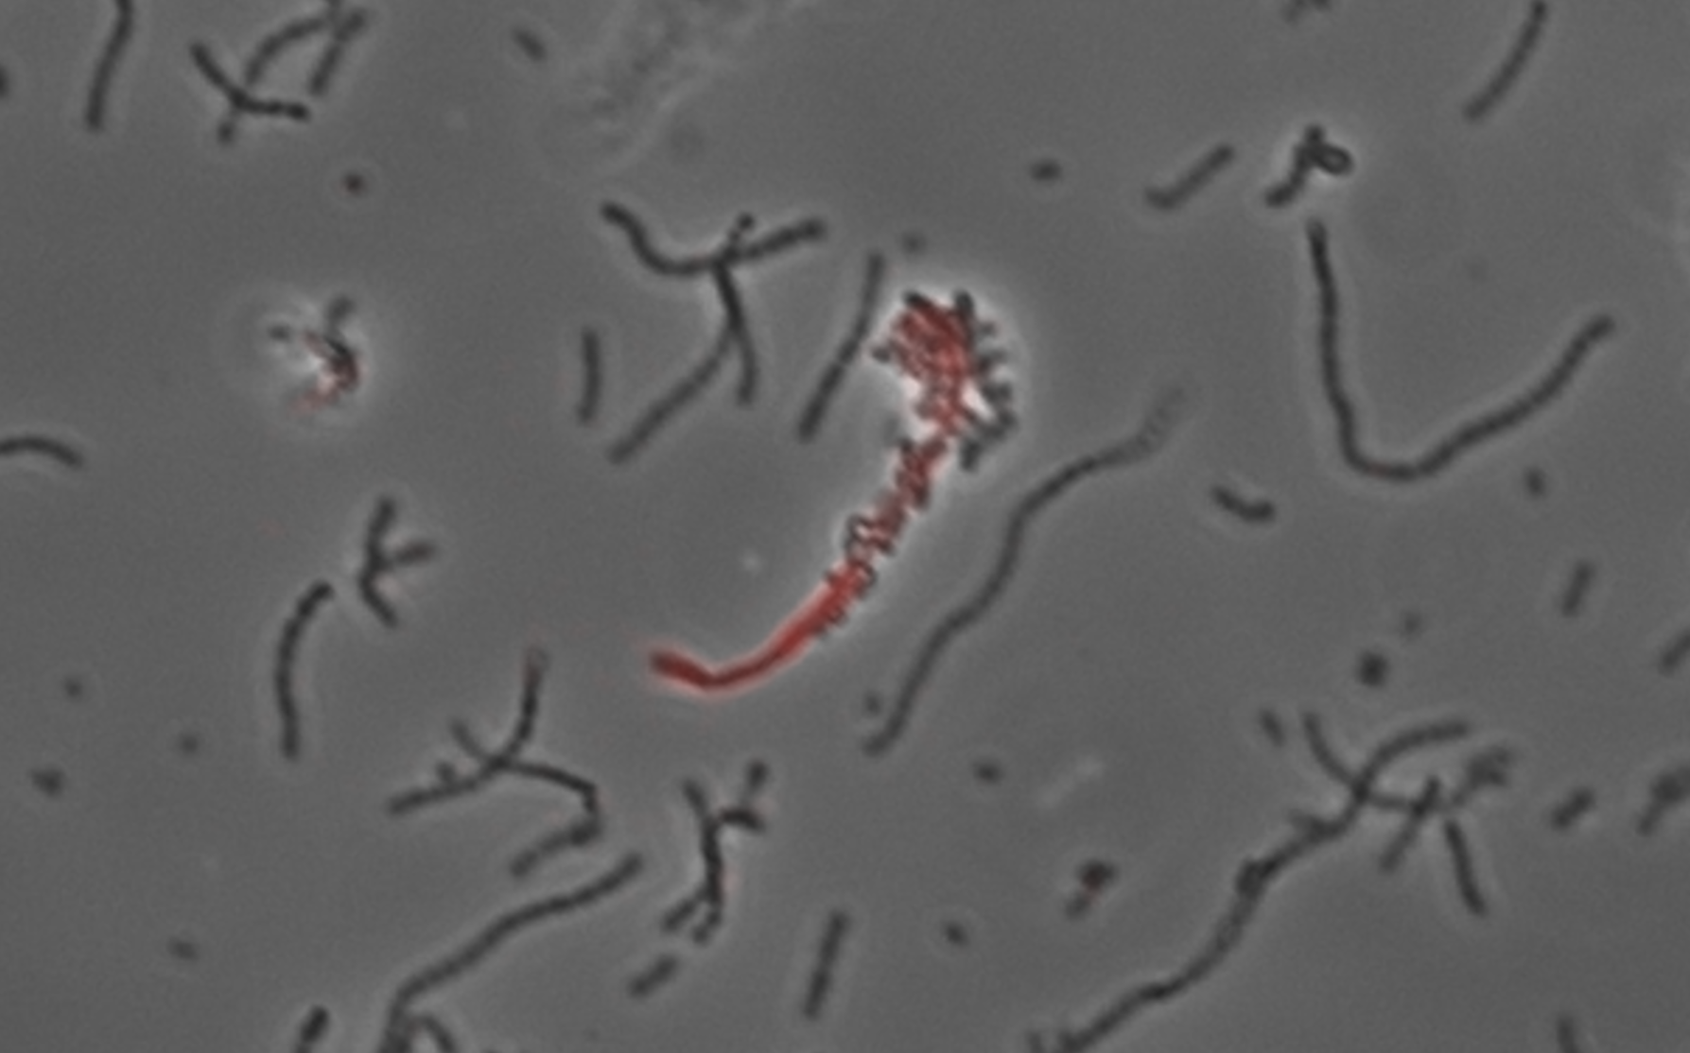
In vitro testing for Cm interactions

Slide 38

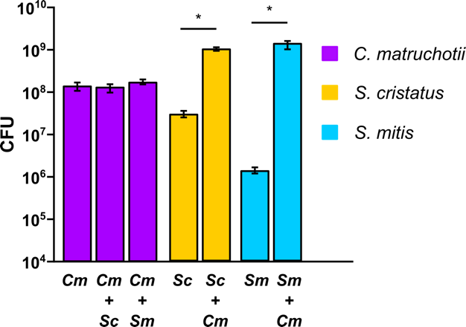
Aerobic cocultures

Slide 39
Why is streptococcal growth increased in the presence of
C. matruchotii?
Hypotheses:
C. matruchotii mitigates streptococcal-produced H₂O₂
C. matruchotii catabolizes streptococcal metabolic end products

Slide 40
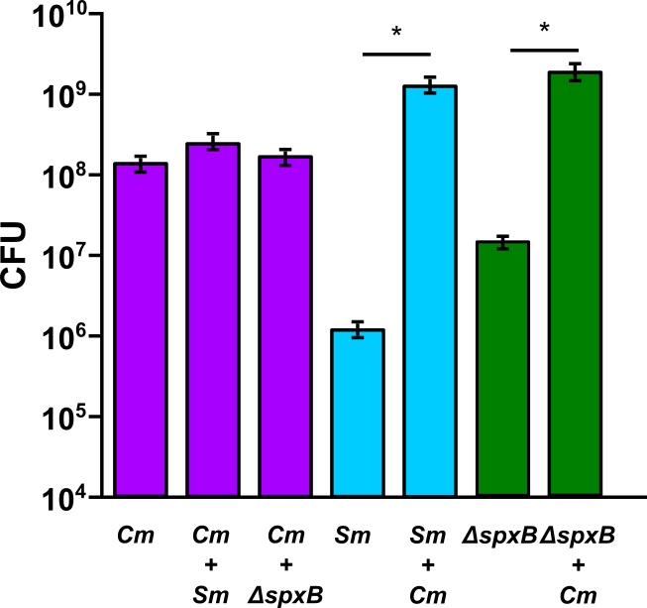
Sm ΔspxB Coculture
Notes:
And when we look at a mutant of S. mitis that cannot produce peroxide, the spxB mutant, we see there is still a growth benefit but it is smaller compared to S. mitis wildtype and cmat.

Slide 41
Cm oxidative stress responses
Ferritin (ftn) upregulated when with Sm
  Sequesters Fe, protects from ROS damage
Single catalase (katA) maximally expressed aerobically
Catalase mutants were unable to grow aerobically!

Slide 42
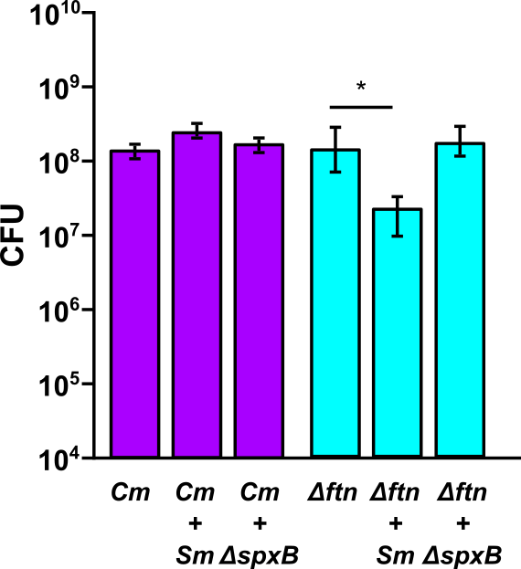
C. matruchotii Δftn with S. mitis

Slide 43
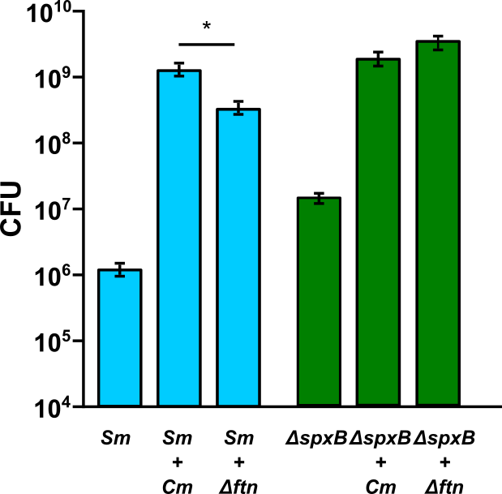
S. mitis with C. matruchotii Δftn

Slide 44
Summary
The functional oxidative stress response of C. matruchotii enhances streptococcal fitness
Catalase
Ferritin
C. matruchotii expresses catalase aerobically
Exogenous catalase enhances H₂O₂-producing streptococci growth
Catalase is essential for C. matruchotii aerobic growth
C. matruchotii Δftn is inhibited by S. mitis WT and not by S. mitis ΔspxB
S. mitis growth benefit is decreased when cocultured with C. matruchotii Δftn compared to wildtype

Slide 45
Hypothesis:
C. matruchotii catabolizes streptococcal metabolic end products (lactate)

Slide 46
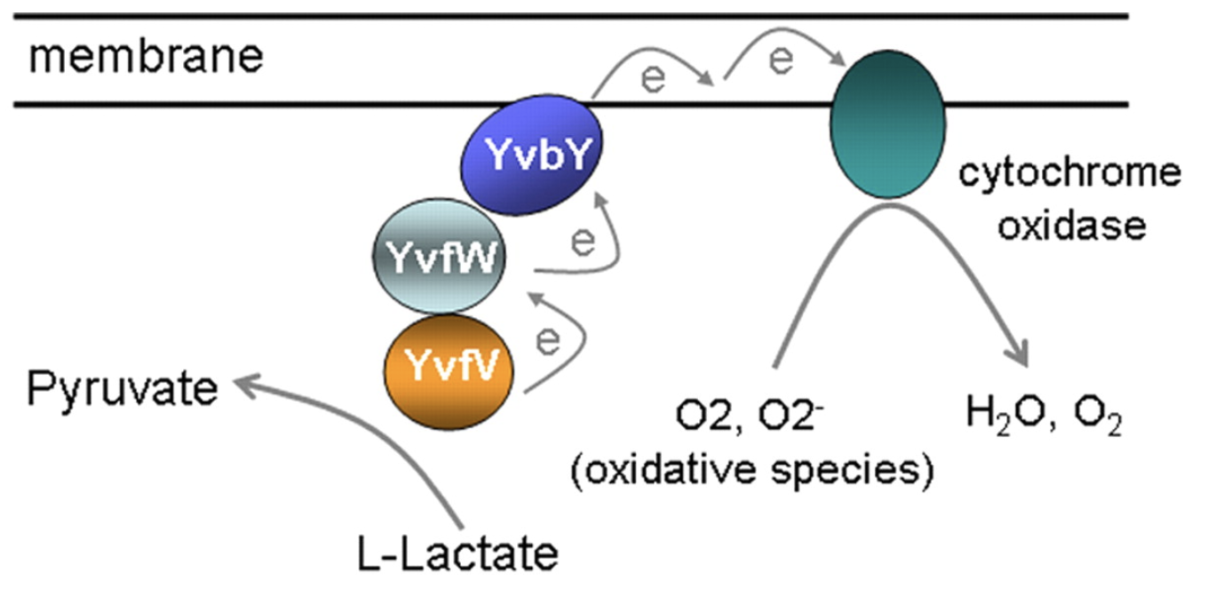
C. matruchotii Lactate Metabolism
Upregulated in coculture with all streptococci
lutABC operon
LutC
LutB
LutA
Chai et. al, 2009

Slide 47
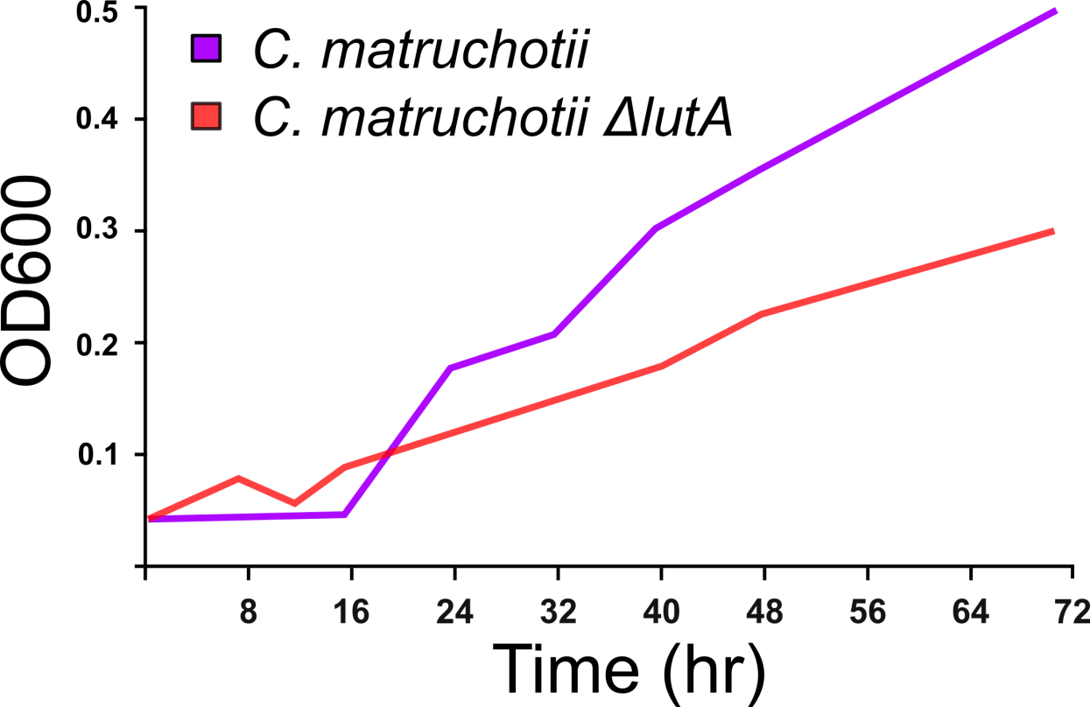
Cm lactate utilization
Aerobically Cm upregulated the lutABC operon (≥3-fold) in response to either streptococci
Cm ΔlutA grows poorly on L-lactate alone

Slide 48
Limited Glucose Assay
Coculture with glucose as growth limiting factor (8mM)
  Competition for carbon source
  Forced crossfeeding
Would C. matruchotii fitness decrease if they had to compete for glucose?
Notes:
So, streps grow much faster and metabolize sugars at a greater rate than cmat so possibly to avoid competing with these streps it can rely on their end products such as lactate. But now that I have this poor lactate catabolizer it has to compete for other sugars to get to its full growth yield. So, would cmat’s fitness decrease if they had to compete for glucose?

Slide 49
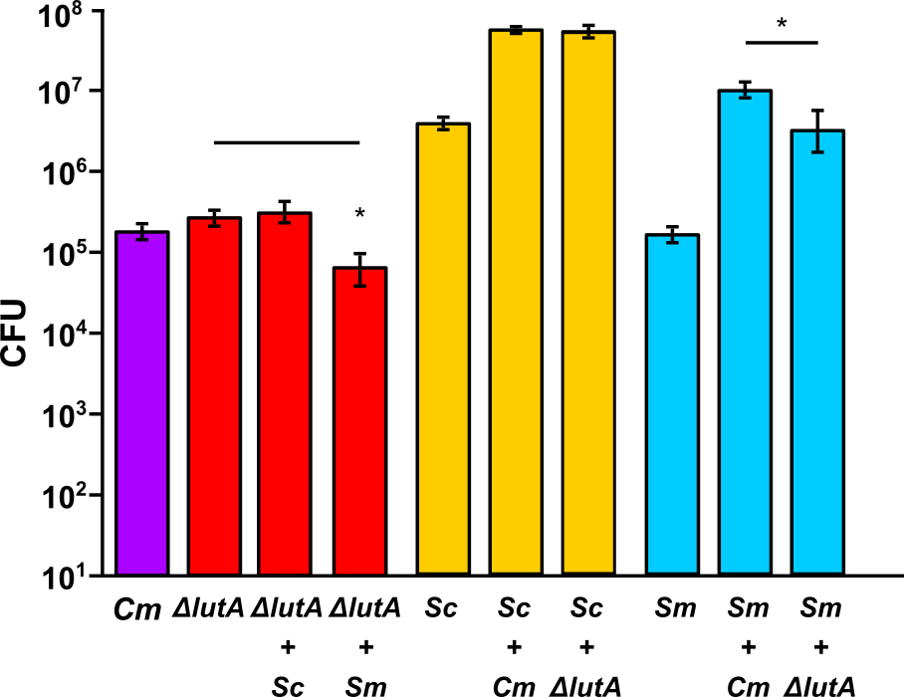
Limited Glucose Coculture

Slide 50
Cm Encodes Multiple Lactate Metabolism Genes
Cm encodes two L-lactate dehydrogenase
Cm encodes one D-lactate dehydrogenase
  Significantly upregulated with S. cristatus and not with S. mitis
  The lutABC system cannot catabolize D-lactate
L-Lactate
L-Lactate
S. mitis
S. cristatus
D-Lactate
?

Slide 51
Sm and Sc have similar responses to Cm
Aerobic in vitro RNASeq
Multiple sugar transporters up
  Mannose PTS
  Sialic acid catabolism
Beta-galactosidases up
Multiple chaperones and repair enzymes down
Competence genes down

Slide 52
In vivo RNASeq comparisons
There were few DEGs for Cm cocultures
  < 20 for both Sm or Sc
lutABC, ftn
  D-lac dehydrogenase with Sc

Slide 53
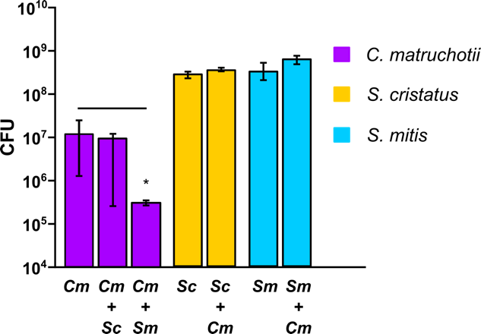
Anaerobic Coculture

Slide 54
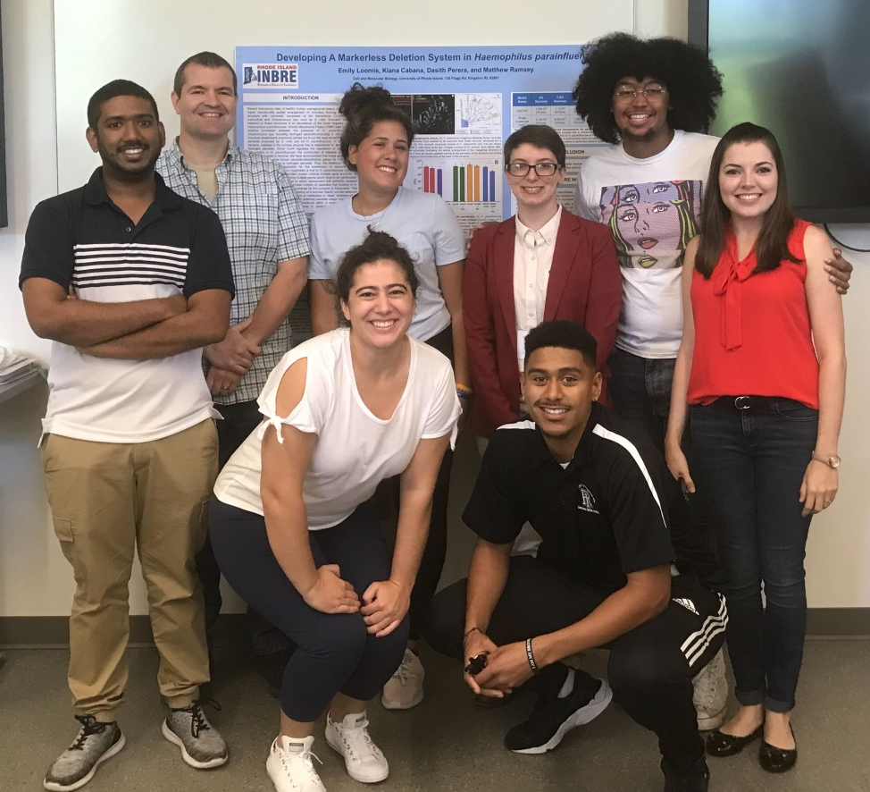



Acknowledgements
Graduate Students:
Eric Almeida
Thais Harder De Palma
Dasith Perera
Alex Labossiere
Funding:
RI Foundation Medical Research Fund
RI COBRE - #P20GM104317
RI INBRE Early Career Award – #P20GM103430
NIH – NIDCR #R01DE027958
Collaborators:
Marcelo Freire (JCVI) / Hatice Hasturk (Forsyth)
Jessica Mark Welch (U Chicago / MBL)

Slide 55
Cm in vitro saliva vs in vivo
In vitro
Glucose vs saliva
Jorth-14’
379
161
770
436
186
617
Upregulated DEG
Downregulated DEG

Slide 56
Notable Cm DEGs
Upregulated
Downregulated
lut genes
Gluconeogenesis
Oligopeptide transport
Biotin transport
Riboflavin transport
Tryptophan synthesis
Heme synthesis

