Slide 1
Microbiomes and oral infection
Matthew M. Ramsey PhD
URI 2019

Slide 2
DNA Sequencing History
1869 – Fredrick Miescher isolated DNA
1953 – Watson, Crick, Franklin and Wilkins determined the structure of DNA
1955 – Fredrick Sanger determined the protein sequence of Insulin. This led to Francis Crick hypothesizing that the DNA sequence correlated to protein sequence
1977 – Sanger developed dideoxy sequencing (Sanger sequencing) for DNA. DNA sequencing took off rapidly
1995 – Craig Venter, Hamilton Smith (TIGR) sequenced the 1st free-living organism Haemophilus influenzae
1998 – Solexa / Illumina sequencing developed, gained widespread use in the mid-2000s

Slide 3
What’s a microbiome?
All sites on a human that contain microorganisms are part of a microbiome.
A microbiome is a functional collection of different microbes and their genomes in a particular environmental system (e.g., the human microbiome).
Scientists use the term microbiota to describe just the microbes in a microhabitat (e.g., skin microbiota).
Different microhabitats support different microbes, so the skin will have very different microbes than the mouth.

Slide 4
The Human Microbiome
Early estimates stated 100 trillion bacterial cells to 10 trillion human cells as part of a normal human
Current estimates state ~3:1 bacteria per human cell in the body
Humans start being colonized from birth and the microbiome changes as they develop
How does the microbiome impact us?

Slide 5
The Human Microbiome Project
Started in 2008 as a 5 year $115m project
Fulfilled its primary goals in 2012
Major goals:
  To develop a reference set of microbial genome sequences and to perform preliminary characterization of the human microbiome
  To explore the relationship between disease and changes in the human microbiome
  To develop new technologies and tools for computational analysis
  To establish a resource repository
  To study the ethical, legal, and social implications of human microbiome research

Slide 6
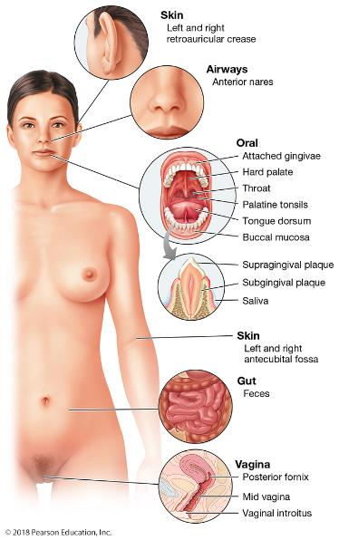

Slide 7
Microbiome impact
Currently, the microbiome has been linked to many disorders
However, quite a few of these are not conclusively proven

Slide 8
Major microbiome findings
Oral bacteria linked to artherosclerotic plaque (heart disease)
Intestinal microbiota linked to obesity (maybe)
Same linked to inflammatory bowel disease / Crohn’s disease
Not fully proven but microbiome during development seems to have a link to autism
  Raises the question of a link to early age antibiotic use vs autism (again, not yet fully proven)

Slide 9
Now where does the field go?
Mechanism
  Is a shifting microbiome a cause or an effect?
Appropriate manipulation of the microbiome
  Diet changes show promise. Replacement therapy is dubious at present
Further characterization is required
  What is ‘healthy’ vs disease and are the correlations meaningful?

Slide 10
Further reading
http://www.nature.com/news/microbiology-microbiome-science-needs-a-healthy-dose-of-scepticism-1.15730
https://www.forbes.com/sites/kavinsenapathy/2016/03/07/keep-calm-and-avoid-microbiome-mayhem/#bed695126b3a
https://www.theatlantic.com/health/archive/2015/06/gut-bacteria-on-the-brain/395918/?utm_source=atlfb

Slide 11
Disease and dysbiosis
Dysbiosis = disruption of homeostasis, specifically the microbiota composition
Pseudomembraneous colitis – caused by C. difficile. Long term depletion of GI tract microbiota by antibiotic use
  Large Clostridial Toxins (LCT), primarily Toxin B LctB are a major factor, destroy host cells

Slide 12
Dysbiosis GI diseases
VRE – vancomycin-resistant Enterococcus faecalis / faecium
Part of the GI microbiota, not very pathogenic
Vancomycin used in serious treatment cases
Leads to depletion of GI microbiota
Spreads to cause UTIs, endocarditis, meningitis, others
1986 – identified in Europe, 1989 in USA
2004 1/3 of US intensive care unit infections were VRE
Nearly 10% of Enterococcus clin lab cultures are VRE

Slide 13
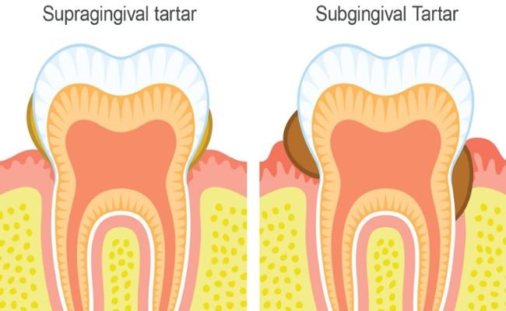
Oral biofilm sites

Slide 14
Oral Diseases
Caries / cavities – caused by Streptococcus mutans and others
  Fulfills Koch’s postulates
No major virulence factors involved
Low species diversity on the tooth surface can enable more incidence

Slide 15
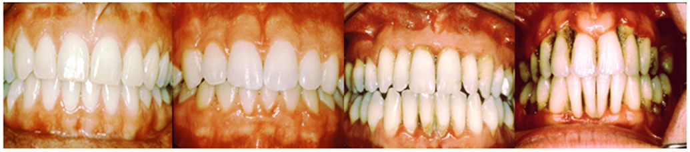
Periodontitis
Complex polymicrobial infection
Healthy plaque transitions to a Gram-negative anaerobe-rich variety
A risk factor for heart disease
www.oramd.com
Notes:
Add images of gingivitis then Perio

Slide 16
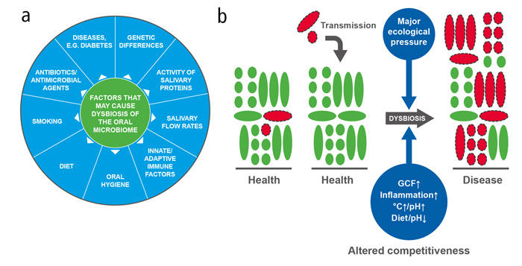
https://www.nature.com/articles/sj.bdj.2016.865

Slide 17
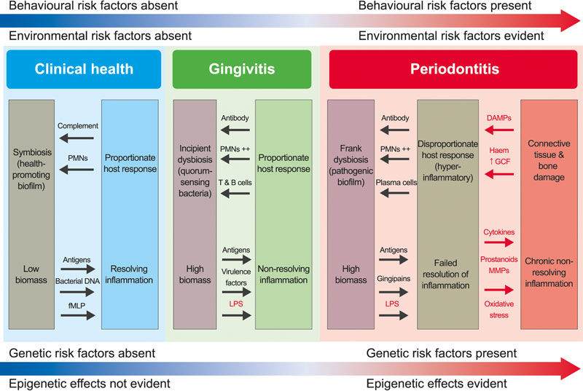
https://www.nature.com/articles/sj.bdj.2016.865

Slide 18
So who is there causing trouble?
Predates the microbiome era
  Socransky et al 1998
  Used DNA array hybridization (not culture dependent)
Introduced color coded ‘complexes’ that contain organisms that do or don’t correlate with periodontal pocket depth
  Red = worst, orange = bad, yellow = more ambiguous
Most Red/Orange group species are carried in health to a low extent
https://www.ncbi.nlm.nih.gov/pubmed/9495612

Slide 19
Oral biofilm sites

Slide 20
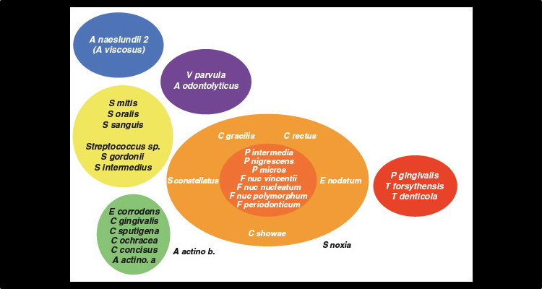

Slide 21
Porphyromonas gingivalis
Gram negative strict anaerobe
Gingipain proteases
  Cleave IgG, several cytokines, collagen (periodontal ligament). One stimulates host inflammatory responses.
Capsule polysaccharide
  Prevents phagocytosis while stimulating inflammation
Fimbrae
  Mediate attachment to host and to other bacteria

Slide 22
Pg pt 2
Pg outer membrane vesicles contribute to T. forsythia binding to and invasion of host epithelial cells
Fimbrae required for robust polymicrobial biofilm formation
Germ free mice infected with Pg do not develop bone loss but normal microbiota mice demonstrate disease

Slide 23
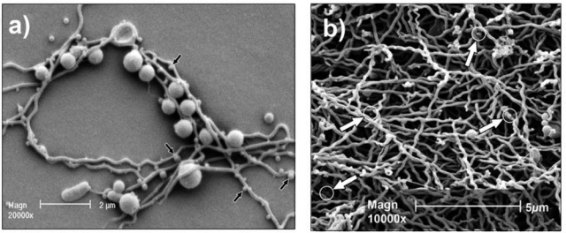
P. gingivalis and T. denticola

Slide 24
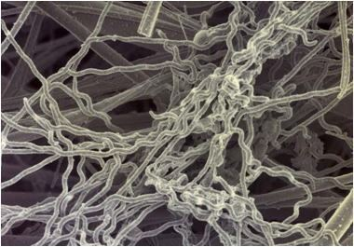
Treponema denticola

Slide 25
Treponema denticola
Gram negative strict anaerobic spirochete
Highly motile (unusual)
Dentilisin
  Protease, facilitates host cells separation, degrades several cytokines
OppA lipoprotein
  Binds soluble host fibrinogen to outside of Td. Camouflage?
Can induce gingival cells to produce less defensin antimicrobial peptides

Slide 26
Td cooperation
Td and Pg will bind to each other and form stable ratios in coculture
Proteases of both are cooperative (don’t degrade each other) and target different cleavage sites of same host proteins
Td and T. forsythia also have specific cell-cell adhesin factors to each other
Td, Pg and Tf show enhanced infection in animal models together in coculture vs monocultures

Slide 27
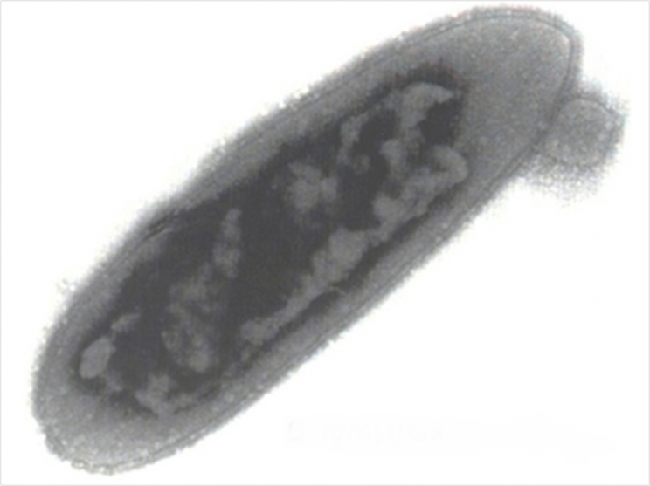
Tanerella forsythia

Slide 28
Tannerella forsythia
Gram negative strict anaerobe
  Does not grow on sugars, typically uses peptides
Proteases
  One nonspecific, other facilitates host cell detachment
Glycosidases
  Expose host cells to attachment by Tf, other bacteria
BspA protein
  Induces host cytokines, helps attach to fibronectin

Slide 29
Other oral pathogens
Members of the orange and yellow groups can contribute to disease(s)
Typically this is indirect, as they may allow red group members to grow better, etc
Fusobacterium nucleatum is good for this

Slide 30
How has the microbiome era helped?
Microbiome studies have confirmed the importance of the red / orange / yellow complexes and added new species to these categories
Culture-independent studies indicate presence of oral bacteria in endocardial infections
Also present in atherosclerotic plaque
Potentially in diabetic foot ulcers
  I’m trying to prove this

Slide 31
Healthy oral plaque interactions
So, these opportunists are lurking in healthy dental plaque in low abundance
What keeps them in check?
  Immune system
  ‘Healthy’ microbiota
Is there niche competition between healthy plaque constituents vs opportunistic pathogens?

Slide 32
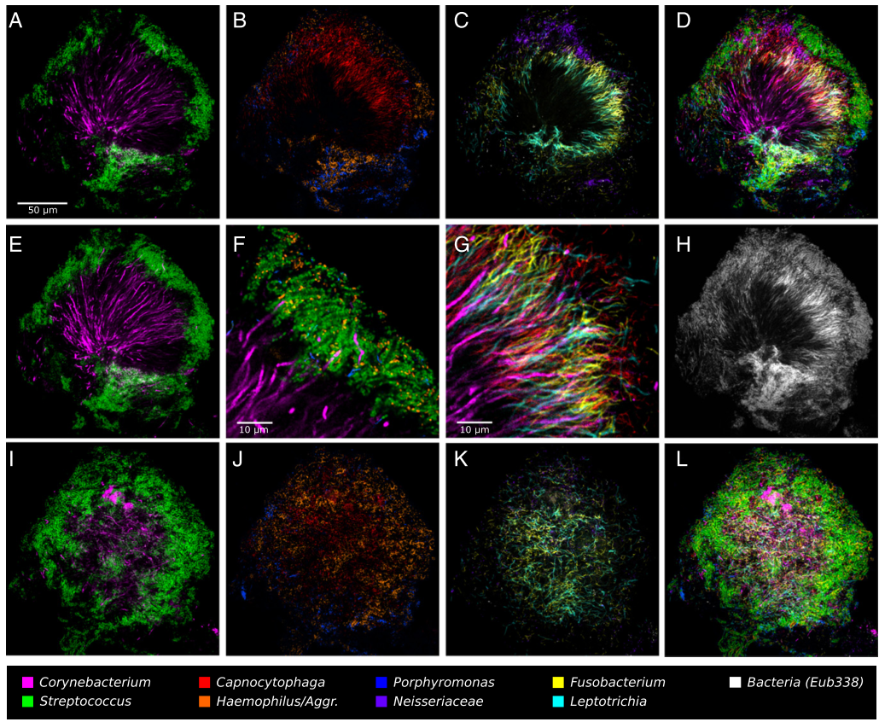

Slide 33
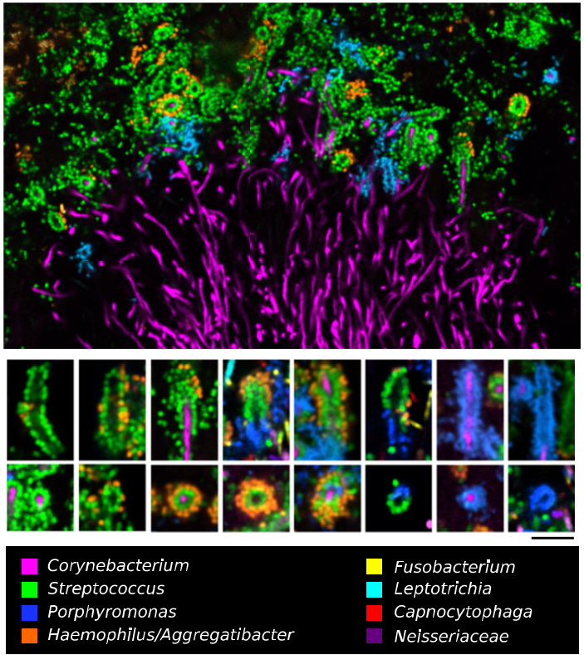

Slide 34
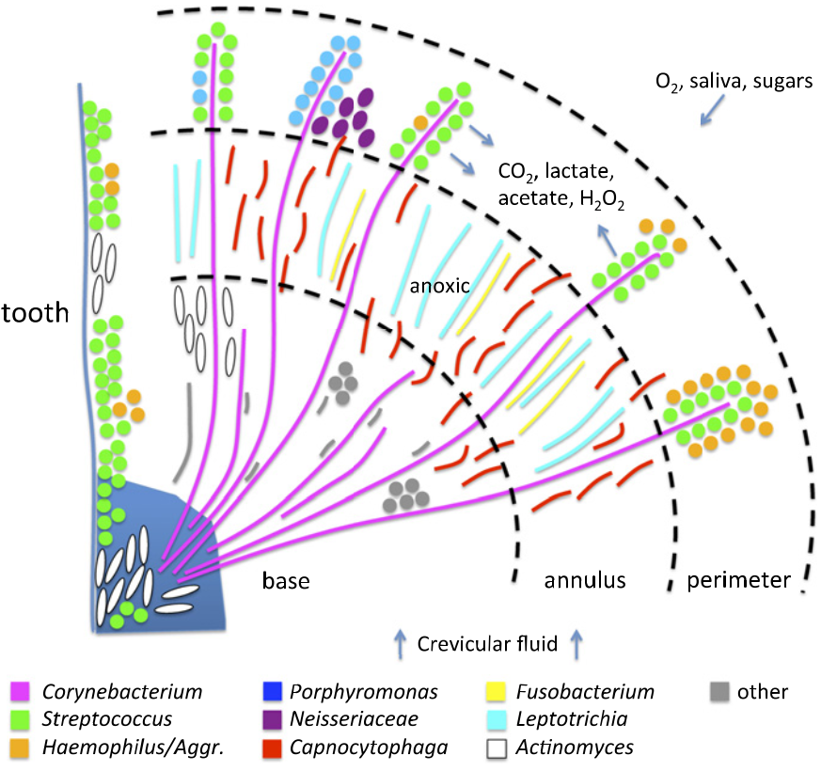
‘Hedgehog’ metabolism

Slide 35
What’s happening?
My lab is currently investigating these healthy interactions
Specific focus is on the ‘scaffold’-like Corynebacterium matruchotii
We will find out what metabolic and signal mechanisms exist between healthy microbes
This will indicate who is providing resistance to opportunistic pathogen dysbiosis

Slide 36
Aggregatibacter
actinomycetemcomitans
Streptococcus gordonii
Aa
Sg
Gram negative
Facultative anaerobe
Pathogen
Gram positive
Facultative anaerobe
Commensal

Slide 37
Necessary for in vivo coinfection
Lactate
X
Aa
Sg
OxyR
H₂O₂
KatA
ApiA
Contributes to immune resistance
Detoxifies mM concentrations in <10 um distances
Ramsey et al., PLoS Pathog 2011
Ramsey et al., PNAS 2009
Liu, Ramsey et al., PNAS 2010

Slide 38
Other polymicrobial infections
Soft tissue abscesses
  “companion organisms”
Cystic Fibrosis pulmonary infections
Otitis media
Bacterial / viral pneumonia
Endocardial infections
  “HACEK” group organisms
http://www.thelancet.com/journals/lancet/article/PIIS0140-6736(05)17745-9/fulltext

