Slide 1
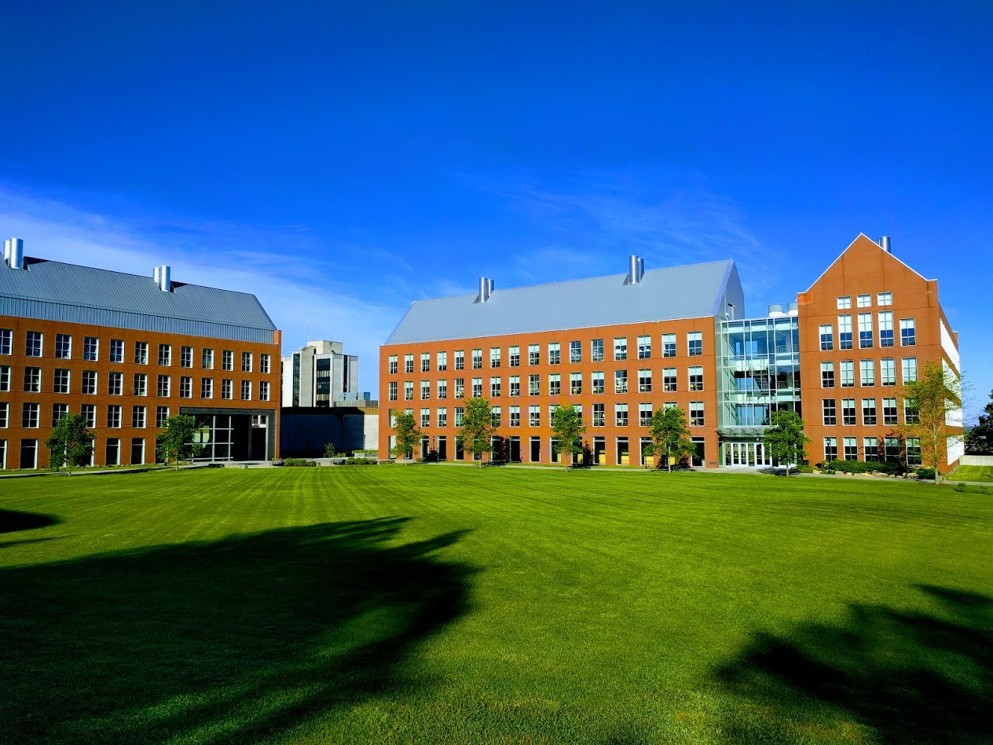

Mechanisms underlying spatial interaction in the oral microbiota
Matthew M. Ramsey, PhD
University of Rhode Island

Slide 2
We must understand mechanisms of interaction between commensals to exploit them for our benefit.
(probiotics)

Slide 3
How do we prioritize interactions?
Abundance
Prevalance
Co-localization

Slide 4
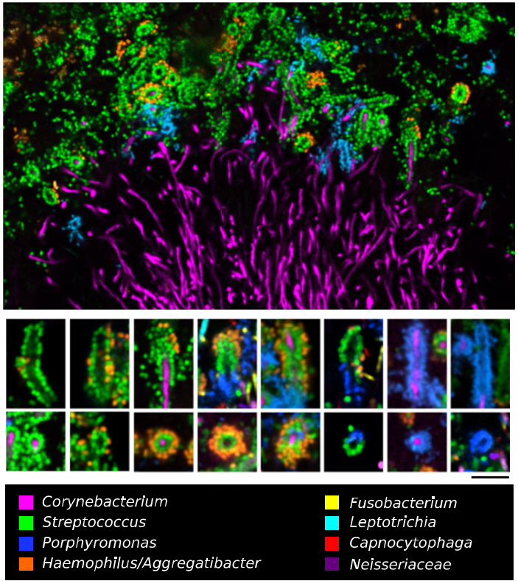

Jessica Mark Welch PhD
Associate Scientist
Marine Biology Lab / University of Chicago. Woods Hole, MA
2011. Valm, Borisy, PNAS.
2016. Welch, Borisy, PNAS.

Slide 5
Supragingival Plaque Data
Human Microbiome Project (HMP) Supragingival site data
Full assembly metagenomic data (n=117)
Species level identification is important
Notes:
Combine with next slide
2. Healthy participants are subjects and not patients.

Slide 6
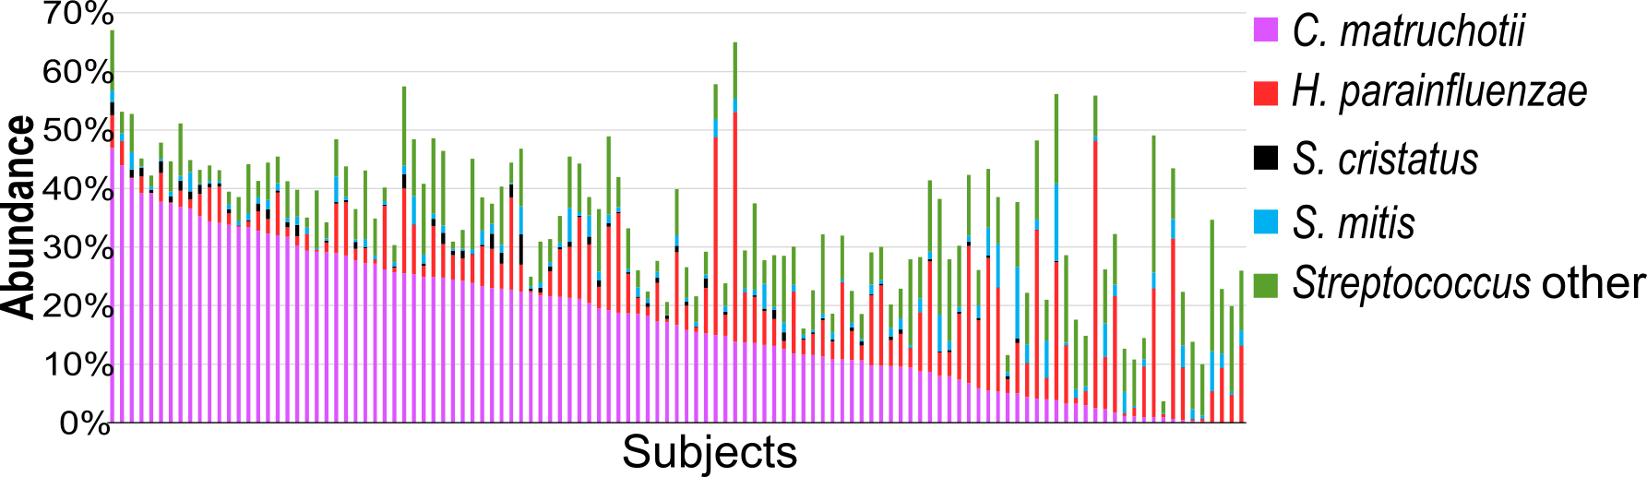
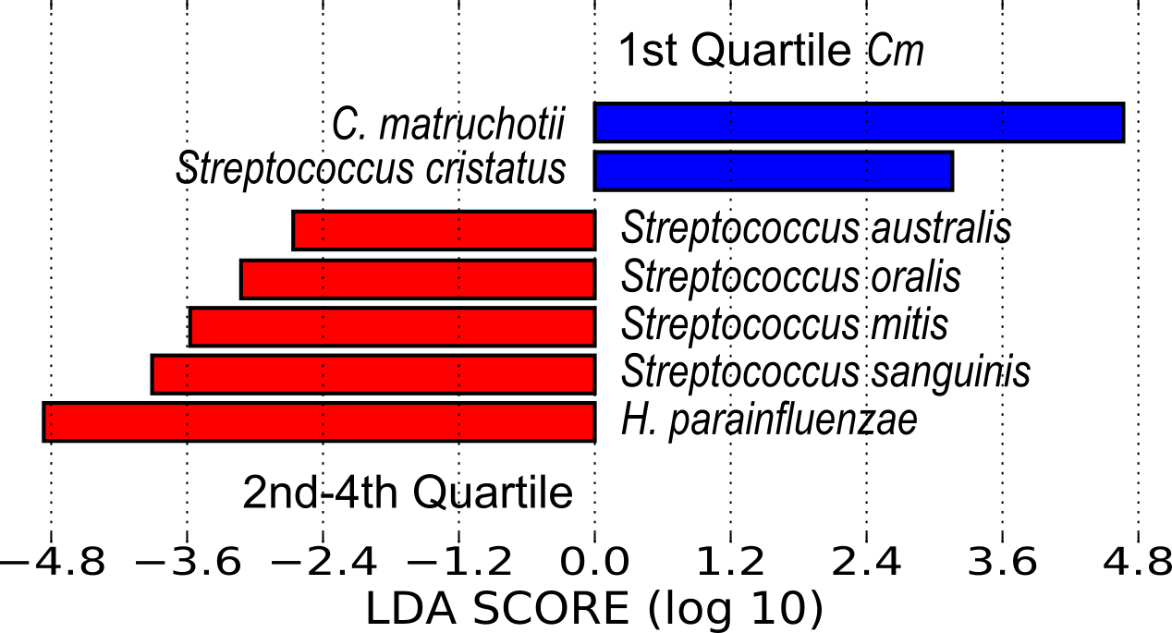

Slide 7
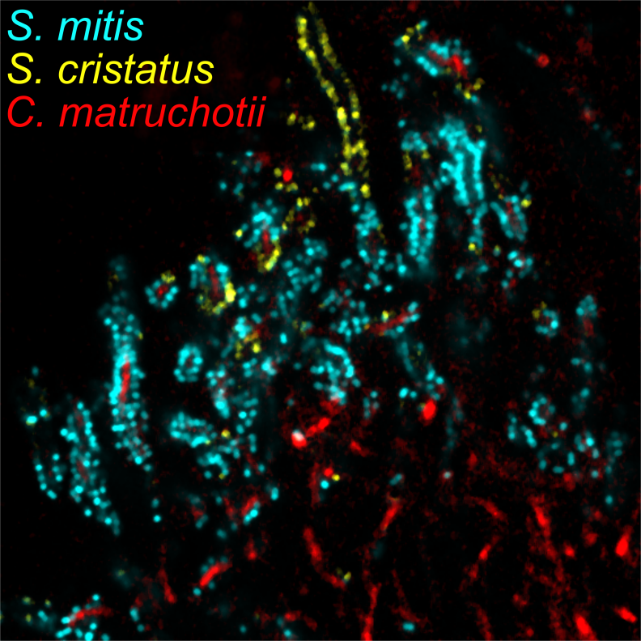
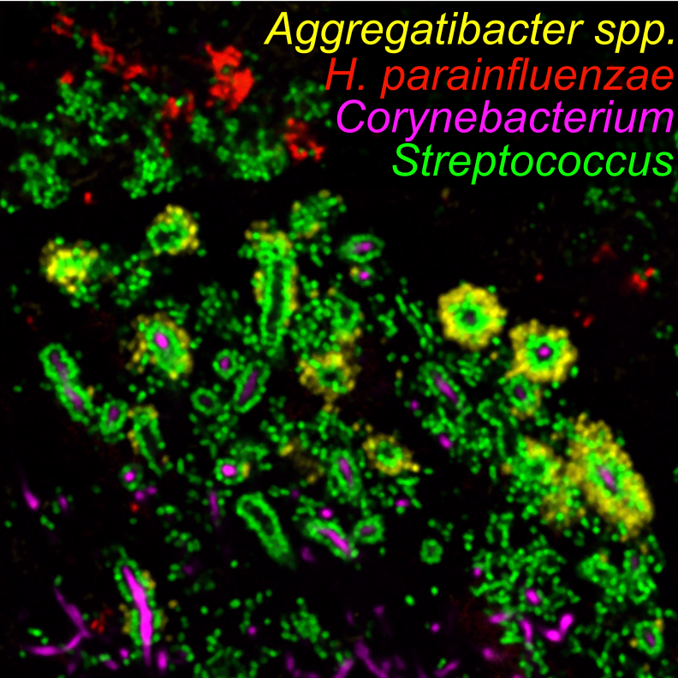

Slide 8
Aerobic mono vs coculture
S. mitis
H. parainfluenzae
C. matruchotii
S. cristatus

Slide 9
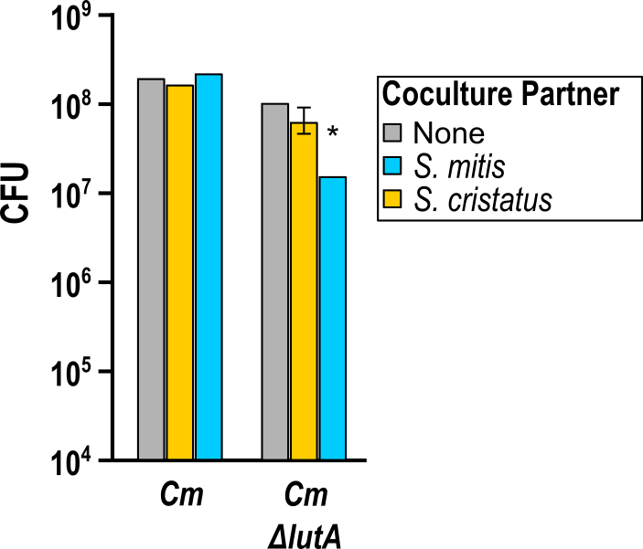
Cm coculture transcriptomes
Aerobically Cm upregulated the lutABC operon (≥3-fold) in response to either streptococci
Cm ΔlutA grows poorly on lactate alone

Slide 10
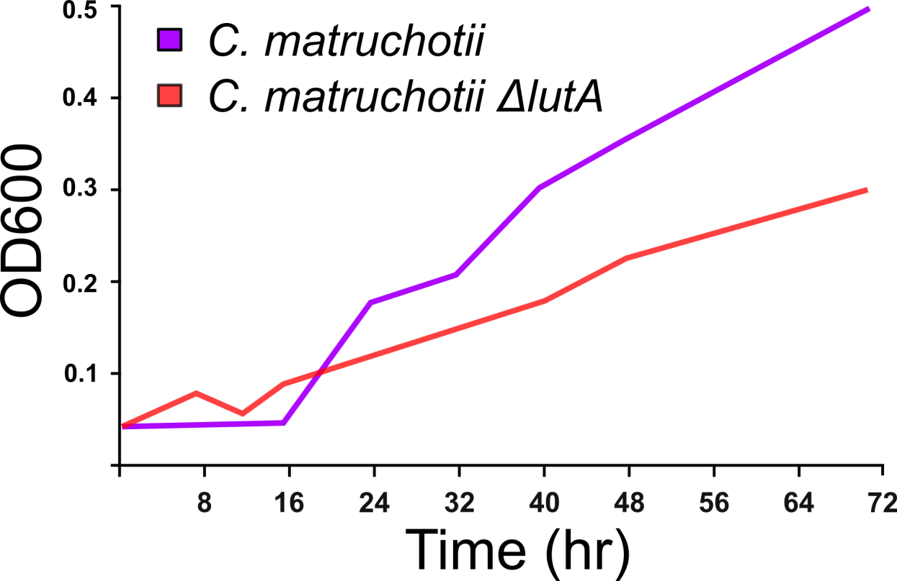
Cm ΔlutA grows poorly on lactate alone

Slide 11
RNASeq for Hp cocultures
Aerobically with S. mitis, Hp exhibited signs of DNA damage and acid stress
  No differential expression of ROS / H₂O₂-related genes
  H₂O₂ in Sm supernatant kills Hp

Slide 12
Hydrogen Peroxide MIC (µM)

Slide 13
Two hypotheses for peroxide resistance
OxyR – regulated single gene product
Cooperative OxyR-regulated genes
Inducibly overexpress shotgun libraries of Hp DNA in a ΔoxyR strain, assay for enhanced peroxide resistance
  Peroxiredoxin only hit so far
Test MIC for double, triple+ mutants
  SURF fellow Emily Loomis developed a markerless deletion system for Hp this summer to assist this

Slide 14
RNASeq of Hp wildtype vs ΔoxyR
Fold Change | p-adj | CDS | Gene name | Description
15.9 | 1.46E-49 | 1440 | katA | Catalase
3.2 | 1.69E-07 | 1675 | ccp | Cytochrome-C peroxidase
35.7 | 2.47E-64 | 1219 | dps | DNA starvation protection protein
2.7 | 8.98E-05 | 807 |  | Metal ABC transporter substrate binding protein
3.6 | 1.94E-08 | 806 |  | Iron ABC transporter permease
2.8 | 2.79E-07 | 805 |  | Metal ABC transporter permease
7.7 | 1.34E-33 | 397 | g6pd | Glucose-6 phosphate dehydrogenase
2.5 | 1.93E-05 | 396 | pgls | 6-phosphogluconolactonase
3.2 | 7.74E-07 | 644 | tkt | Transketolase
2.4 | 1.78E-05 | 13 | tal | Transaldolase
6.5 | 1.18E-27 | 1526 | prx | Peroxiredoxin
2.6 | 1.34E-05 | 1624 | trx | Thioredoxin
3 | 1.15E-07 | 858 | grxA | Glutaredoxin

Slide 15
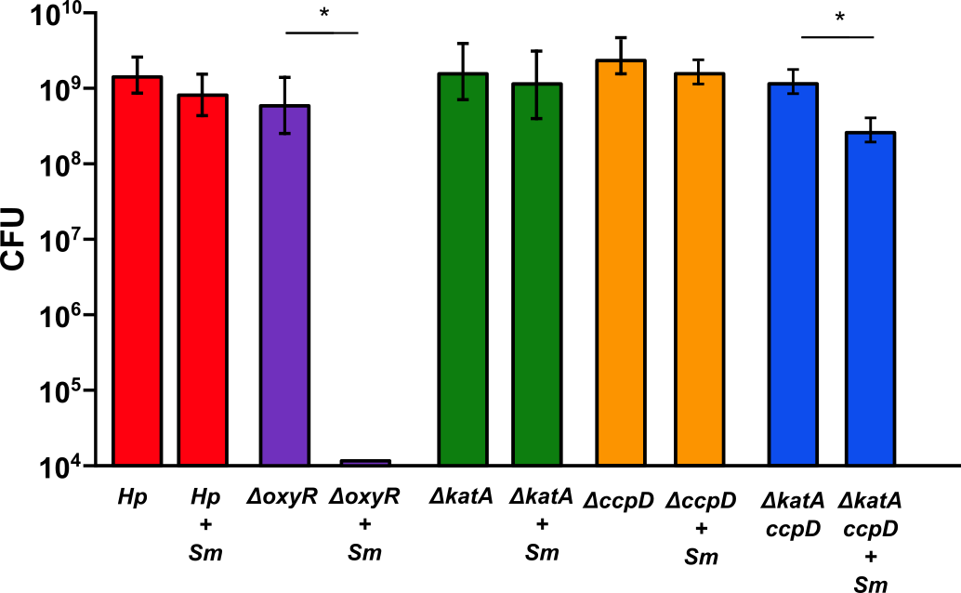
H. parainfluenzae mutants in coculture

Slide 16
Anaerobic mono vs coculture
S. mitis
H. parainfluenzae
C. matruchotii
S. cristatus

Slide 17
Anaerobic transcript changes
Fold Change | CDS | Description
10.65 | 1543 | β-galactosidase
8.96 | 1411 | β-galactosidase subunit
6.77 | 985 | β-galactosidase
5.65 | 1052 | β-galactosidase
Fold Change | CDS | Description
3.47 | 1696 | mglB
2.51 | 1697 | mglA
2.3 | 1698 | mglC
3.05 | 1692 | galM
2.74 | 1693 | galK
2.66 | 1694 | galT
2.44 | 1695 | Transcriptional control of Galactose metabolism
S. mitis
H. parainfluenzae
Notes:
From rnaseq

Slide 18
Hypothetical anaerobic interaction of H. parainfluenzae and S. mitis
Lactose
β-galactosidases
Glucose
Galactose
H. parainfluenzae
Leloir pathway
S. mitis
Investigating this occurrence in saliva
Notes:
In saliva
Could be other galactose containing disaccharides
Glycoproteins
Defined media
Leloir pathway
Explains growth benefit in bhi-ye

Slide 19
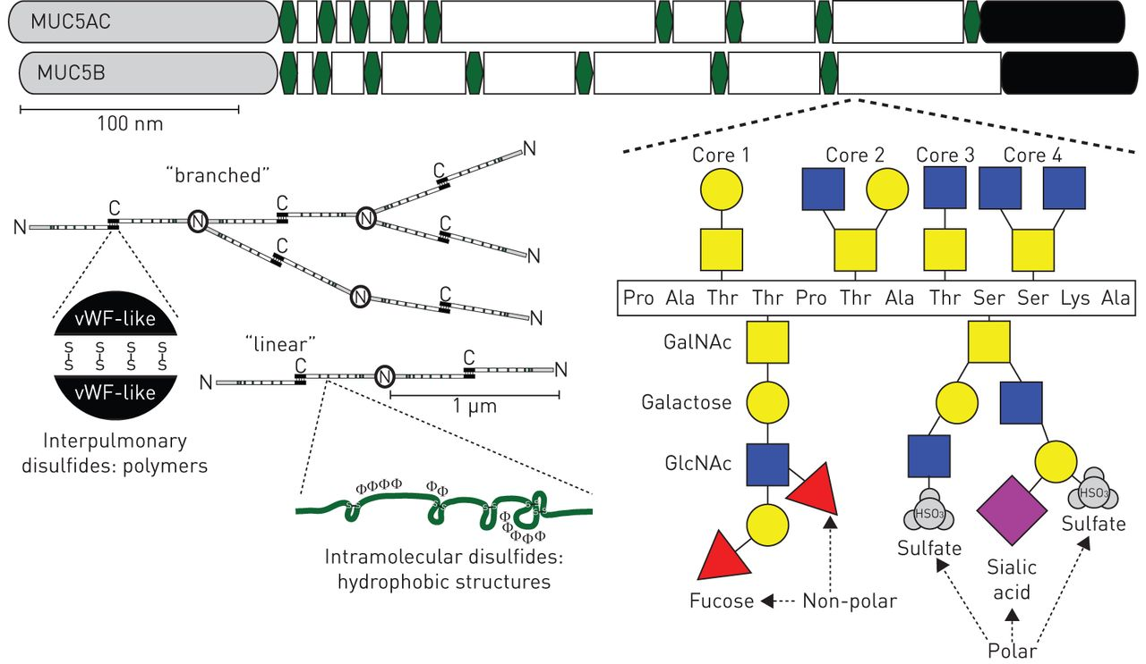
Hypothesis: Cooperative degradation of Muc carbohydrates feeds Sm and Hp anaerobically
Janssen, W., et al. 2016, Euro Respiratory Journal

Slide 21
Conclusions
Coculture data supports observed species colocalization and sequence data in vivo
Interaction mechanisms examined:
  Cm crossfeeding on streptococci-produced lactate
  S. mitis H2O2-dependent exclusion of Hp from hedgehog structure
  Hp – Sm anaerobic co-utilization of polysaccharides

Slide 22
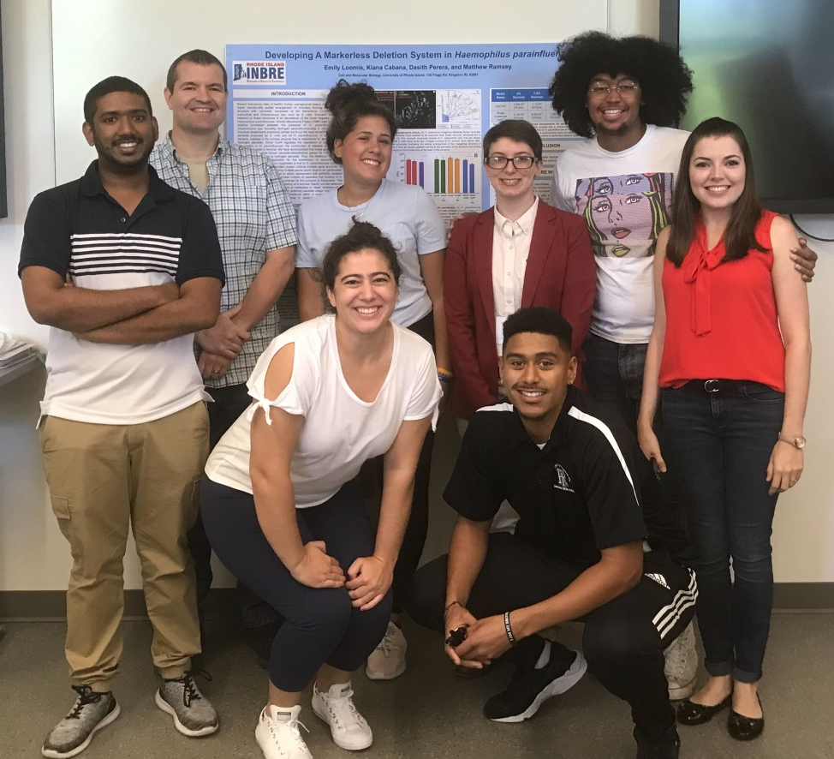



Acknowledgements
Graduate Students:
Eric Almeida
Thais Harder De Palma
Dasith Perera
Funding:
RI Foundation Medical Research Fund
RI COBRE - #P20GM104317
RI INBRE Early Career Award – #P20GM103430
NIH – NIDCR #R01DE027958
Collaborators:
Marcelo Freire (JCVI)
Jessica Mark Welch (U Chicago / MBL)

