Slide 1

Mechanisms underlying spatial interaction in the oral microbiota
Matthew M. Ramsey PhD
University of Rhode Island

Slide 2
To exclude opportunists we must understand the mechanism(s) they use to survive in a complex community.
If we want to use probiotics we should know what niches they occupy.
We must understand mechanisms of interaction between commensals to understand colonization resistance

Slide 3
How do we prioritize interactions?
Abundance
Co-localization

Slide 4
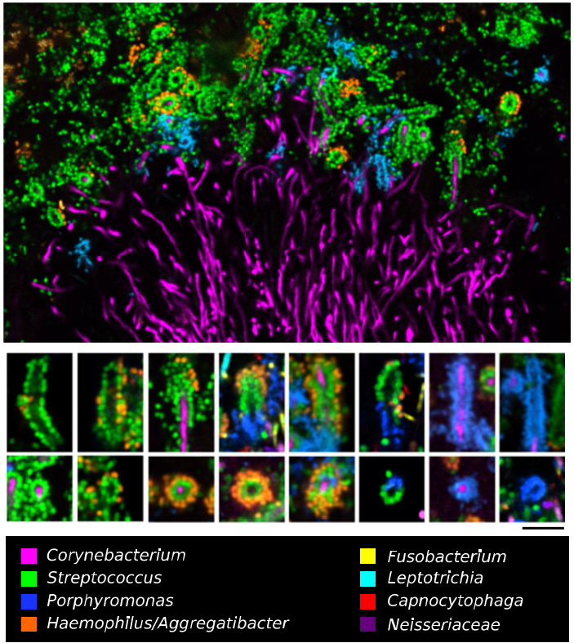

Jessica Mark Welch PhD
Associate Scientist
Marine Biology Lab / University of Chicago. Woods Hole, MA
2011. Valm, Borisy, PNAS.
2016. Welch, Borisy, PNAS.

Slide 5
Supragingival Plaque Data
Human Microbiome Project (HMP) Supragingival site data
Full assembly metagenomic data (n=117)
Species level identification is important
Notes:
Combine with next slide
2. Healthy participants are subjects and not patients.

Slide 6
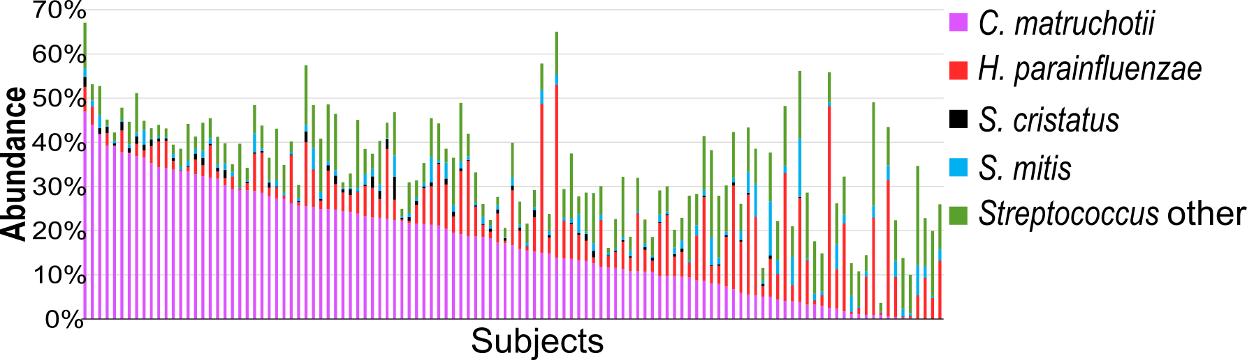
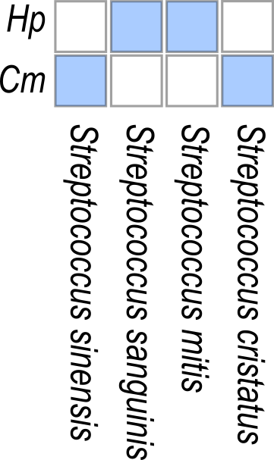
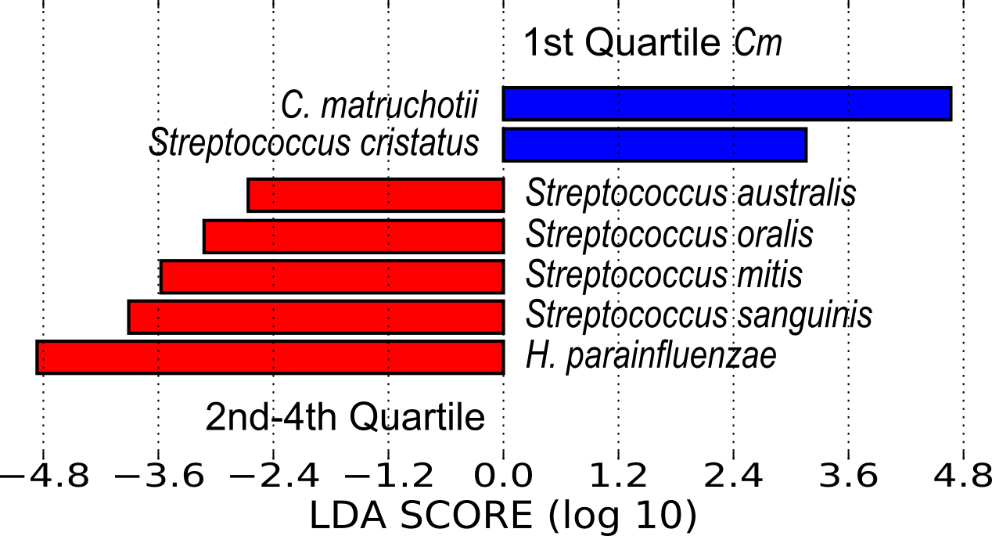

Slide 7
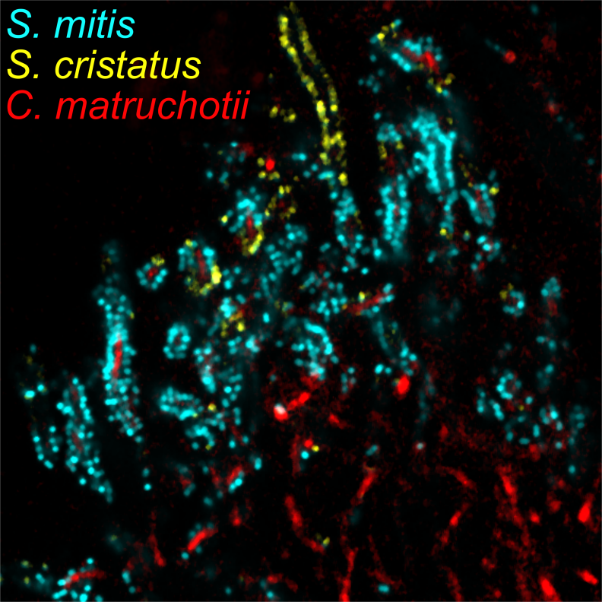
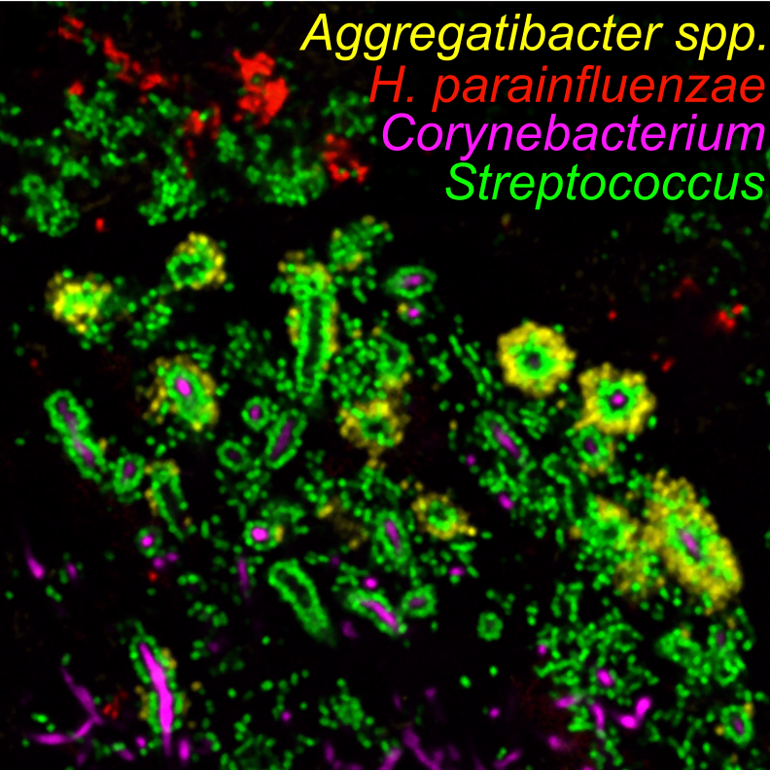

Slide 8
Aerobic mono vs coculture
S. mitis
H. parainfluenzae
C. matruchotii
S. cristatus

Slide 9
Anaerobic mono vs coculture
S. mitis
H. parainfluenzae
C. matruchotii
S. cristatus

Slide 10
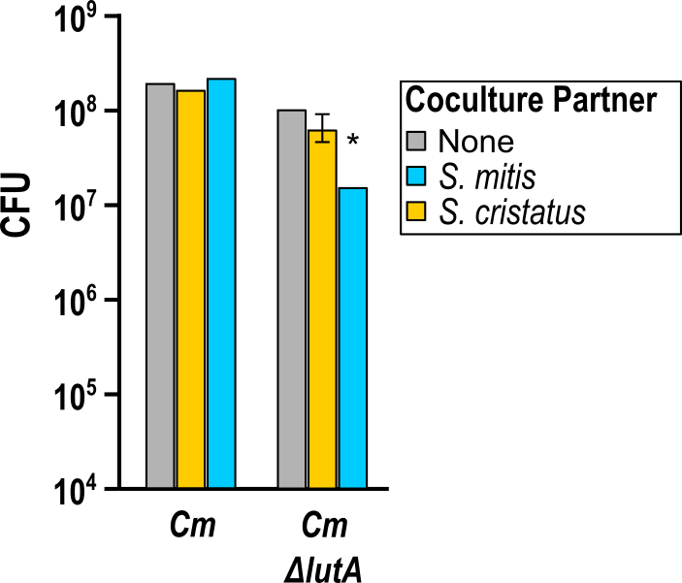
RNASeq for Cm cocultures
Aerobically Cm upregulated the lutABC operon (≥3-fold) in response to either streptococci
Cm ΔlutA cannot grow on lactate alone

Slide 11
RNASeq for Hp cocultures
Aerobically with S. mitis Hp exhibited signs of DNA damage and acid stress
  mutation repair / competence pathways, deamination mechanisms.
  No differential expression of ROS / H₂O₂-related genes

Slide 12
Hp and oxidative stress
pH 7 S. mitis supernatant kills Hp unless exogenous catalase was added
  H₂O₂ responsible for killing
Factors between OxyR and protection are still unclear
 | H₂O₂ MIC (uM)
Wild-type | 417
ΔoxyR | 52
ΔkatA | 209
ΔccpD | 209
ΔkatA, ΔccpD | 209

Slide 13
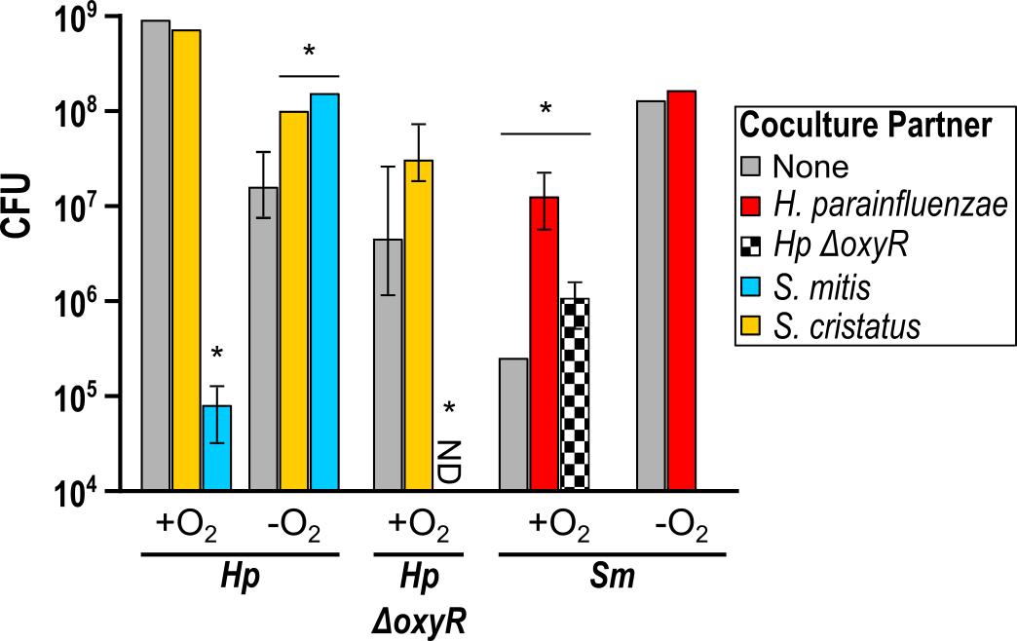
Hp and oxidative stress
OxyR-dependent responses enhance S. mitis growth
What is enhancing Hp growth with S. mitis anaerobically?

Slide 14
Anaerobic transcript changes
Fold Change | CDS | Description
10.65 | 1543 | β-galactosidase
8.96 | 1411 | β-galactosidase subunit
6.77 | 985 | β-galactosidase
5.65 | 1052 | β-galactosidase
Fold Change | CDS | Description
3.47 | 1696 | mglB
2.51 | 1697 | mglA
2.3 | 1698 | mglC
3.05 | 1692 | galM
2.74 | 1693 | galK
2.66 | 1694 | galT
2.44 | 1695 | Transcriptional control of Galactose metabolism
S. mitis
H. parainfluenzae
Notes:
From rnaseq

Slide 15
Hypothetical anaerobic interaction of H. parainfluenzae and S. mitis
Lactose
β-galactosidases
Glucose
Galactose
H. parainfluenzae
Leloir pathway
S. mitis
Investigating this occurrence in saliva
Notes:
In saliva
Could be other galactose containing disaccharides
Glycoproteins
Defined media
Leloir pathway
Explains growth benefit in bhi-ye

Slide 17
Conclusions
Coculture data supports observed species colocalization and sequence data in vivo
Interaction mechanisms are hypothesized and being validated

Slide 18
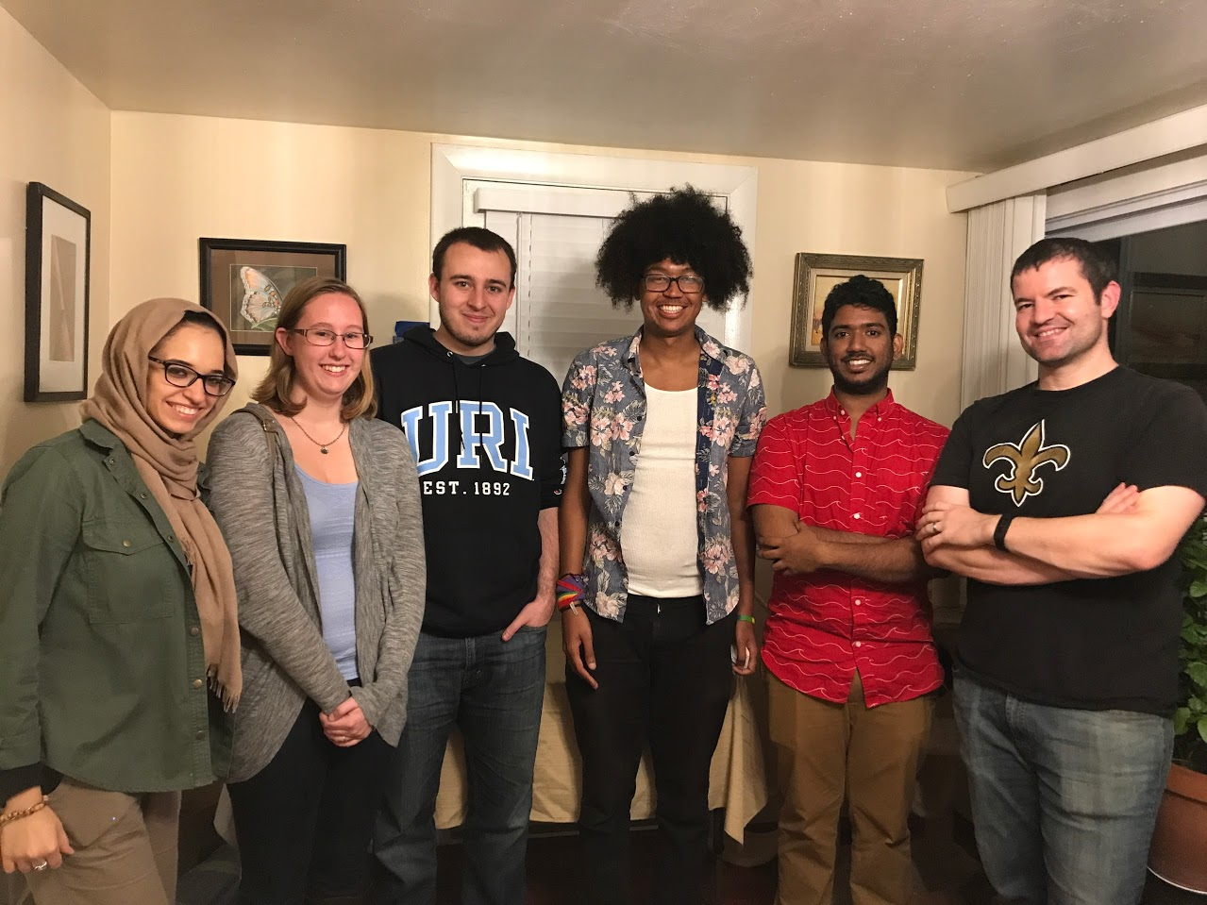



Acknowledgements
Graduate Students:
Eric Almeida
Dasith Perera
Thais Harder DePalma
Undergraduate Students:
Ben Hanson
Adam Capwell
Shannon Oliver
Quintin Rocha
Kayleigh Cloutier-LeBlanc
Funding:
RI Foundation Medical Research Fund
RI INBRE Early Career Award
Collaborators:
Marcelo Freire (JCVI)
Katherine Lemon (Forsyth / Harvard)
Jessica Mark Welch (U Chicago / MBL)

