Slide 1


Mechanisms underlying spatial interaction in the oral microbiota
Matthew M. Ramsey, PhD
University of Rhode Island

Slide 2
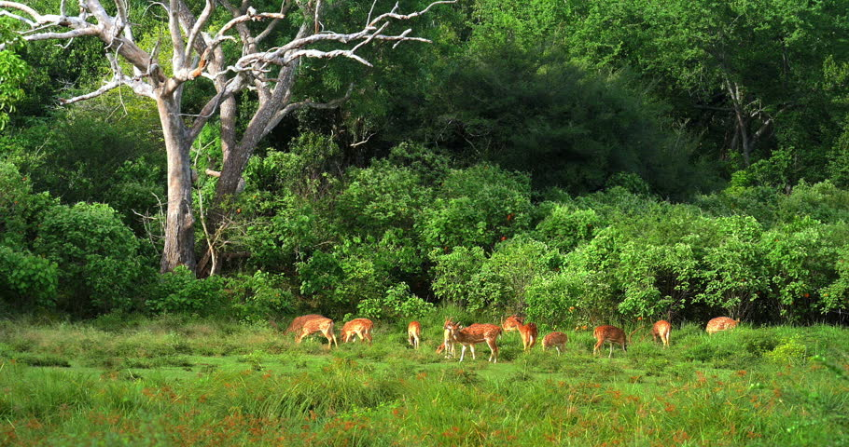
Current Microbiome Standard
13 Odocoileus (deer)
3 tree Genus X
2 tree Genus Y
17 shrub Genus X
2 shrub Genus Y
125 grass Genus X
27 grass Genus Y
4 bird Genus X
5 bird Genus Y
What hypotheses could you generate from a list?

Slide 3
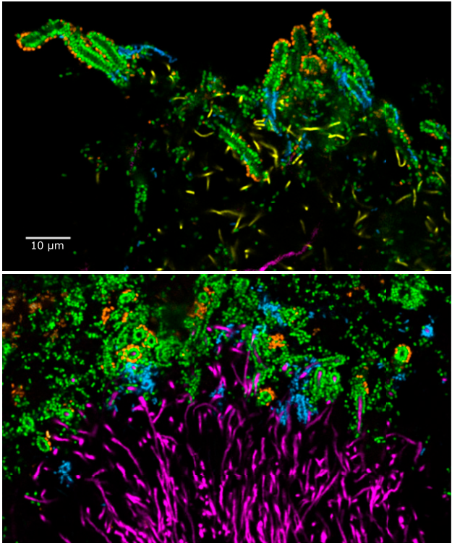
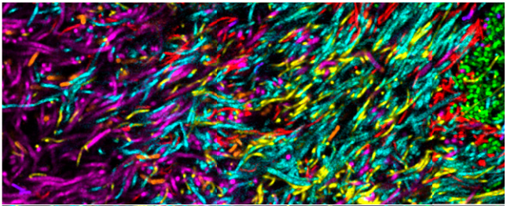
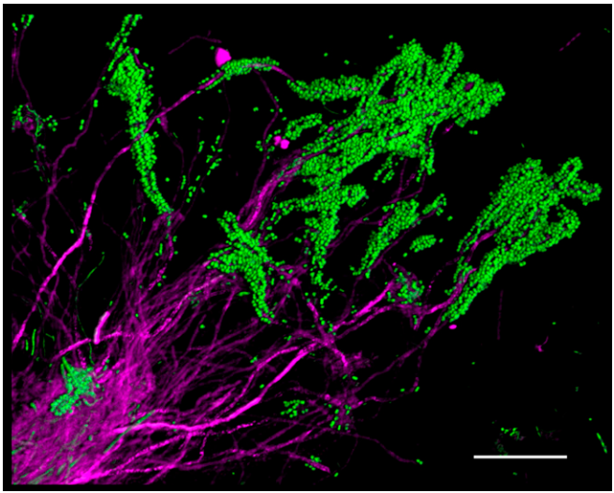
Human oral plaque
c/o Jessica Mark Welch

Slide 4
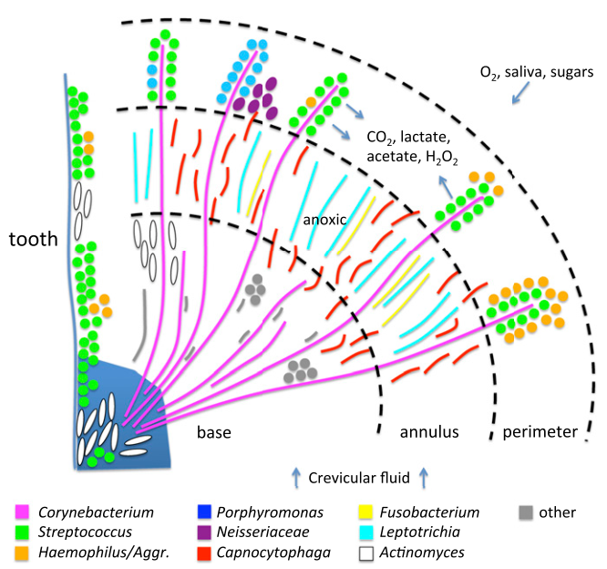
We need species-level identification to test mechanistic hypotheses

Slide 5
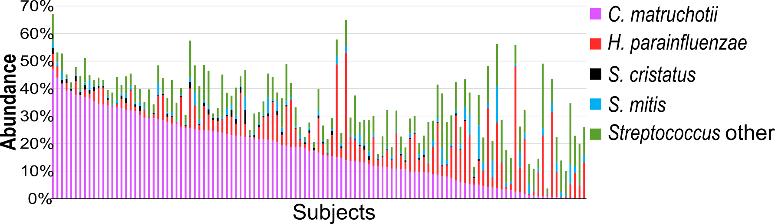
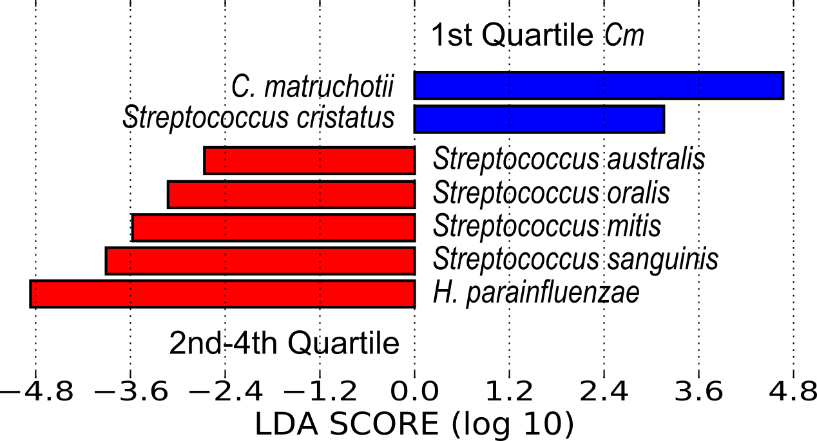
Species-assigned human oral microbiome data (n=117)
Do these also interact directly?

Slide 6
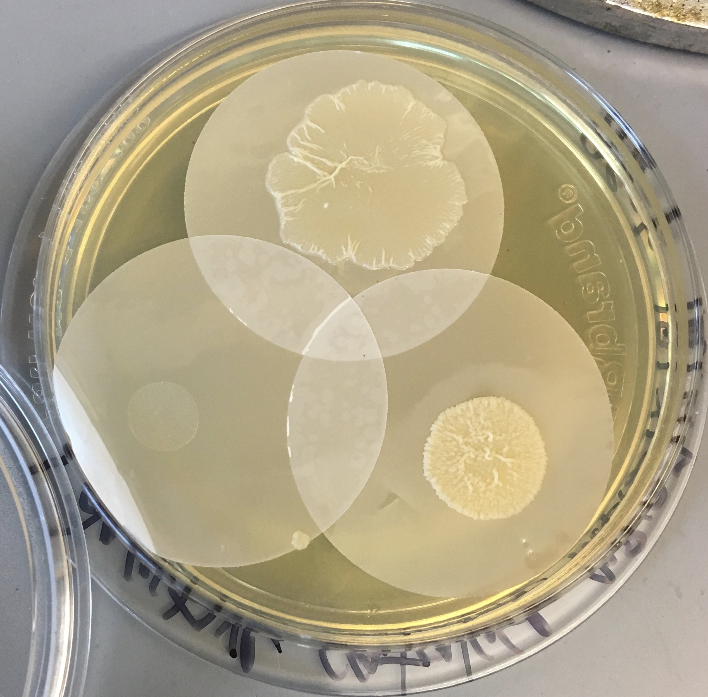
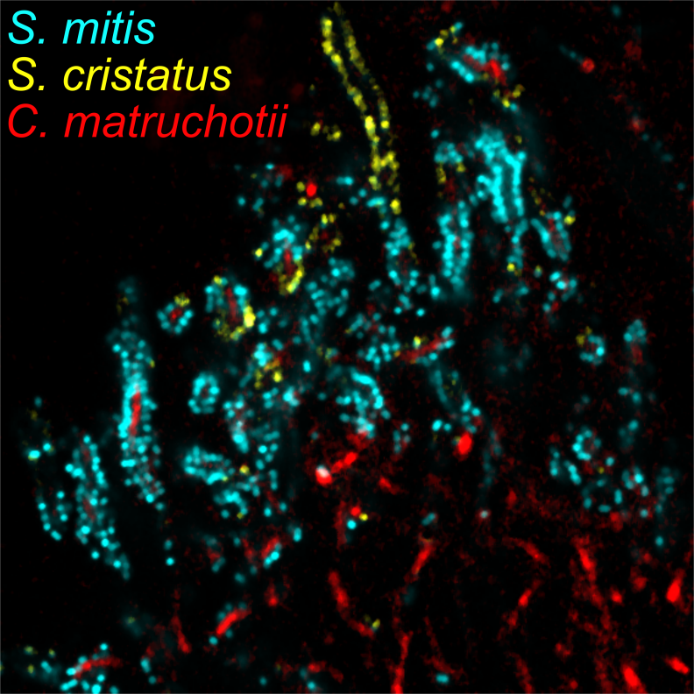
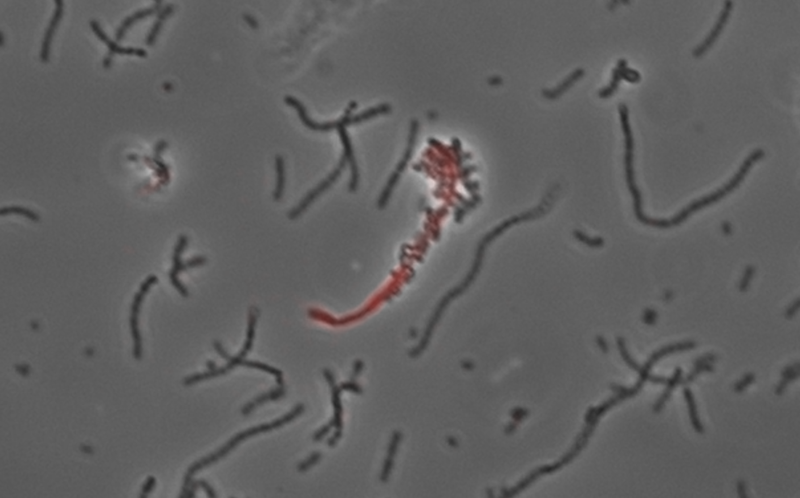
Do these predicted species interact in vivo?

Slide 7
C. matruchtoii – Streptococcus interactions
When Oxygen is present
  Cm growth is unchanged in coculture
  Streptococci growth is enhanced 50-100x
When Oxygen is absent
  Cm growth is impaired in coculture (>10x)
  Streptococci growth is no longer enhanced

Slide 8
Cm differential gene expression
Fold Change | ORF | Product | P-adj
4.33 | cds199 | LutA | 0.006239731
3.54 | cds200 | LutB | 0.000527981
3.58 | cds201 | LutC | 0.003783467
These data imply cross-feeding of Streptococcus-produced lactate
A Cm-lutA mutant suffers when grown with streptococci in coculture under glucose limiting conditions

Slide 9
Putting things together

