Slide 1
Mechanisms underlying spatial interaction in the oral microbiota
Matthew M. Ramsey PhD
University of Rhode Island

Slide 2
If we want to exclude or temper opportunistic pathogens we should understand by what mechanism(s) they use to survive in a complex community.
If we want to add or enrich for probiotics we should know what niches they occupy.

Slide 3
Preaching to the choir
Polymicrobial interactions are important
My lab uses reductionist approaches to identify specific mechanisms of interaction
How do we pick interaction pairs for study?
  Microscopy
  Microbiomes

Slide 4
Supragingival Plaque Data
Human Microbiome Project (HMP) Supragingival site data
16S rRNA gene V1-V3 (n=77), V3-V5 (n=148)
  Oligotyping / Minimal Entropy Decomposition or QIIME / DADA2
Full assembly metagenomic data (n=117)
Notes:
Combine with next slide
2. Healthy participants are subjects and not patients.

Slide 5
Microbiome data correlations
Positive and negative correlations can be calculated between different species
Account for multiple comparisons
  False discovery rate
http://huttenhower.sph.harvard.edu/ccrepe
Notes:
You will need to explain what each of these things are simply and clearly.

Slide 6
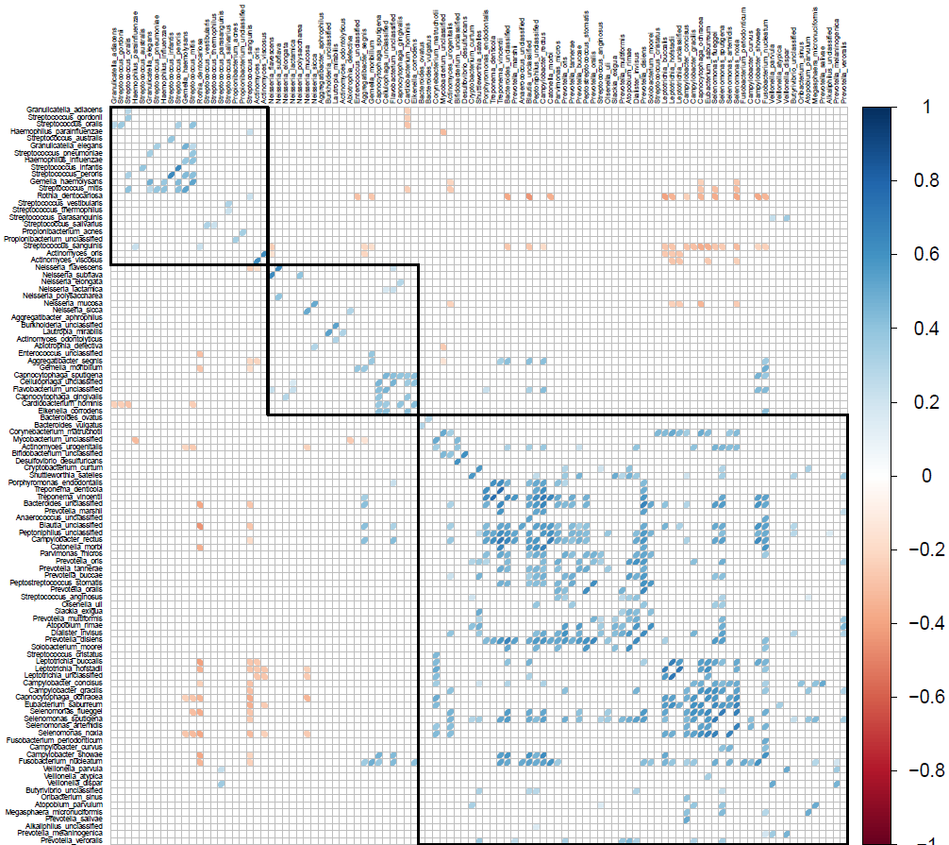

Slide 7
We end up with many correlations but which are meaningful?
Are they at high abundance?
We prioritized for species within genera that were adjacent in microscopy data

Slide 8
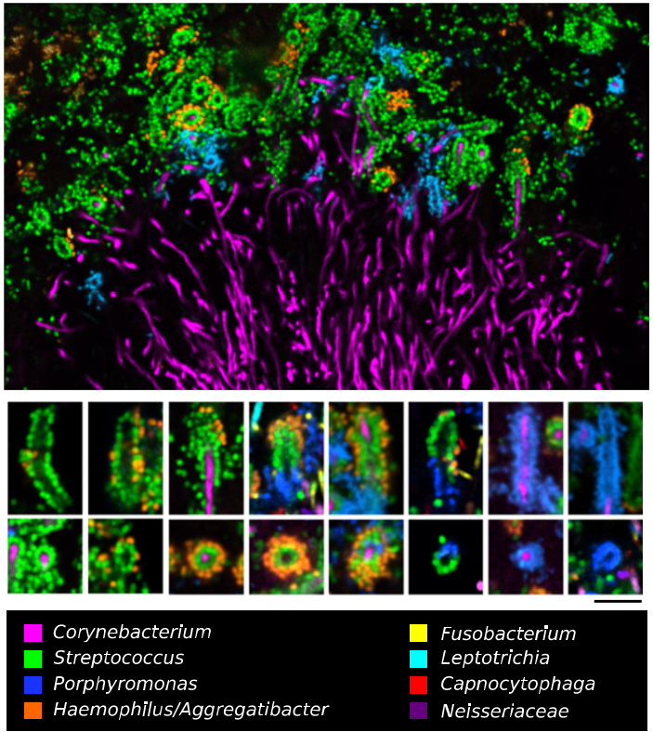
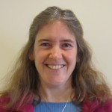
Jessica Mark Welch PhD
Associate Scientist
Marine Biology Lab / University of Chicago. Woods Hole, MA
2011. Valm, Borisy, PNAS.
2016. Welch, Borisy, PNAS.

Slide 9
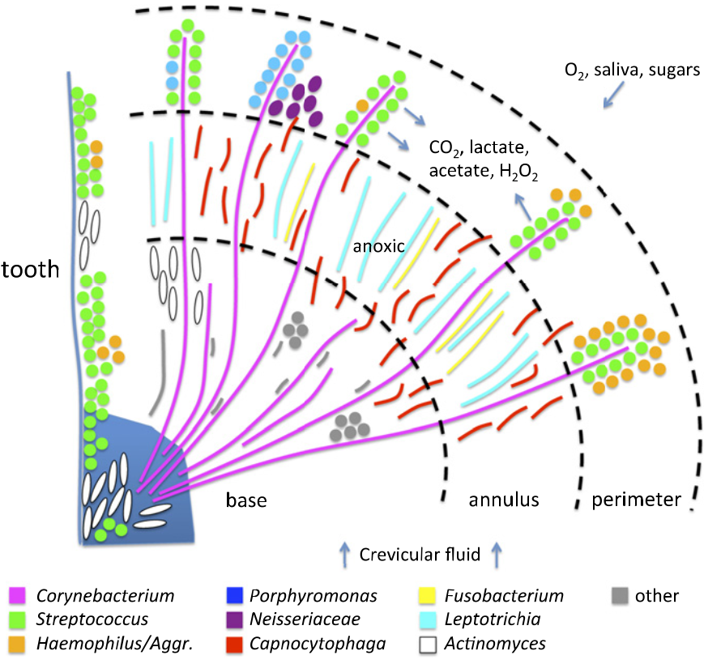
‘Hedgehog’ metabolism

Slide 10
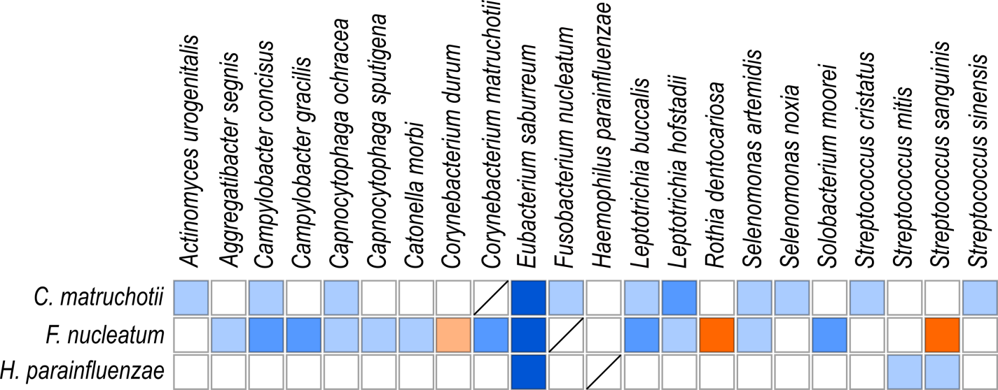
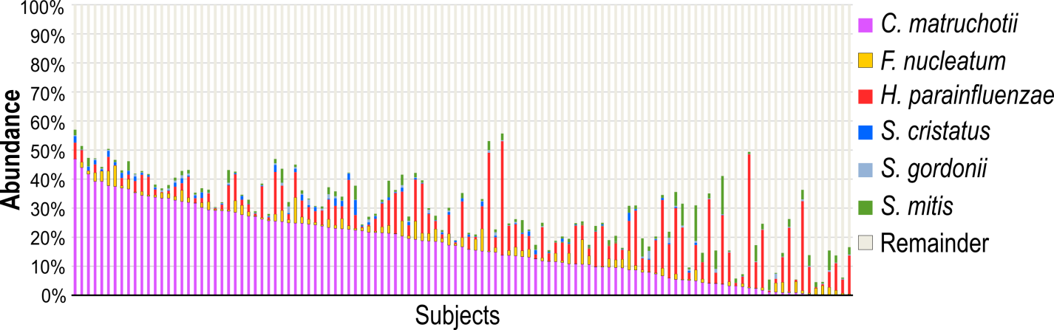

Slide 11
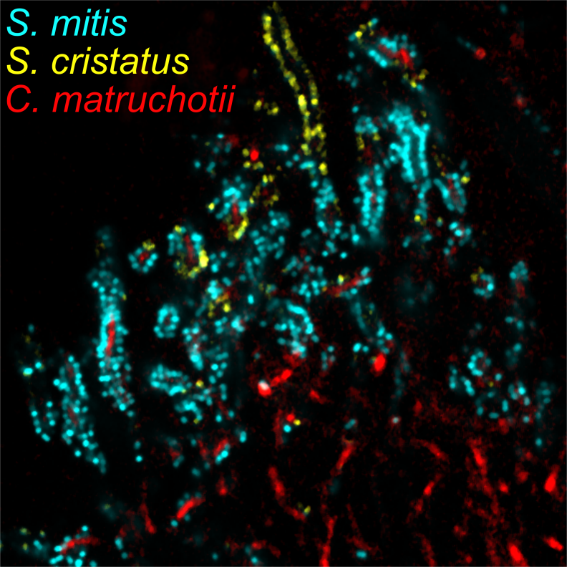
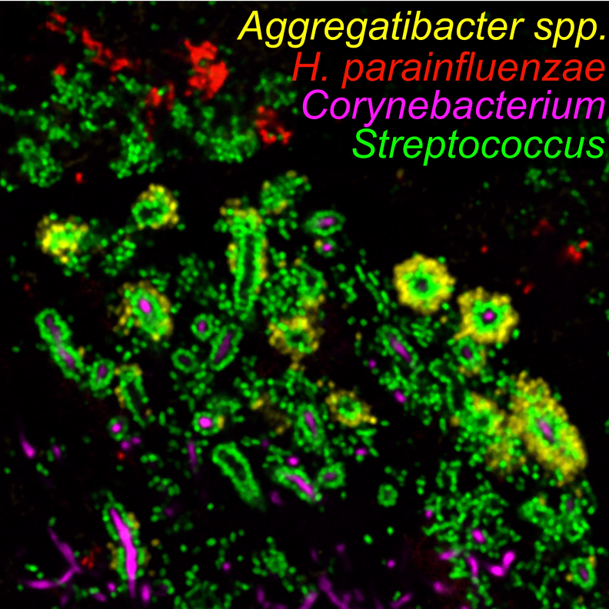
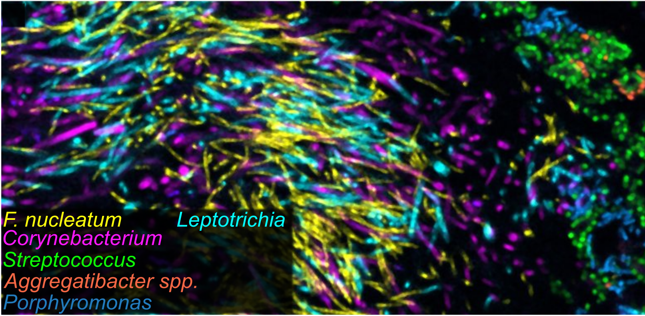

Slide 12
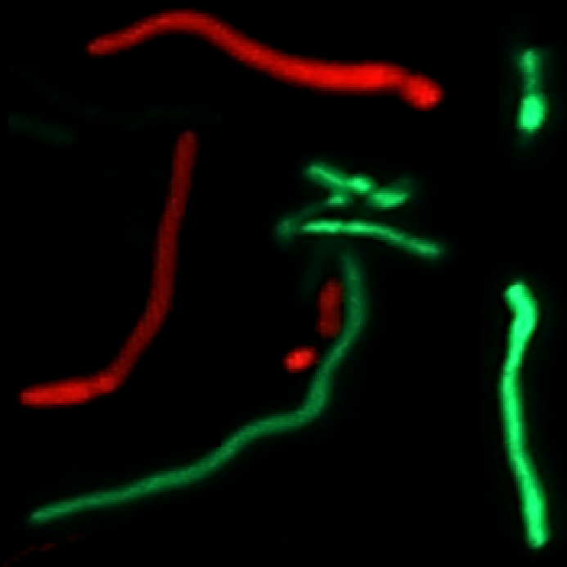
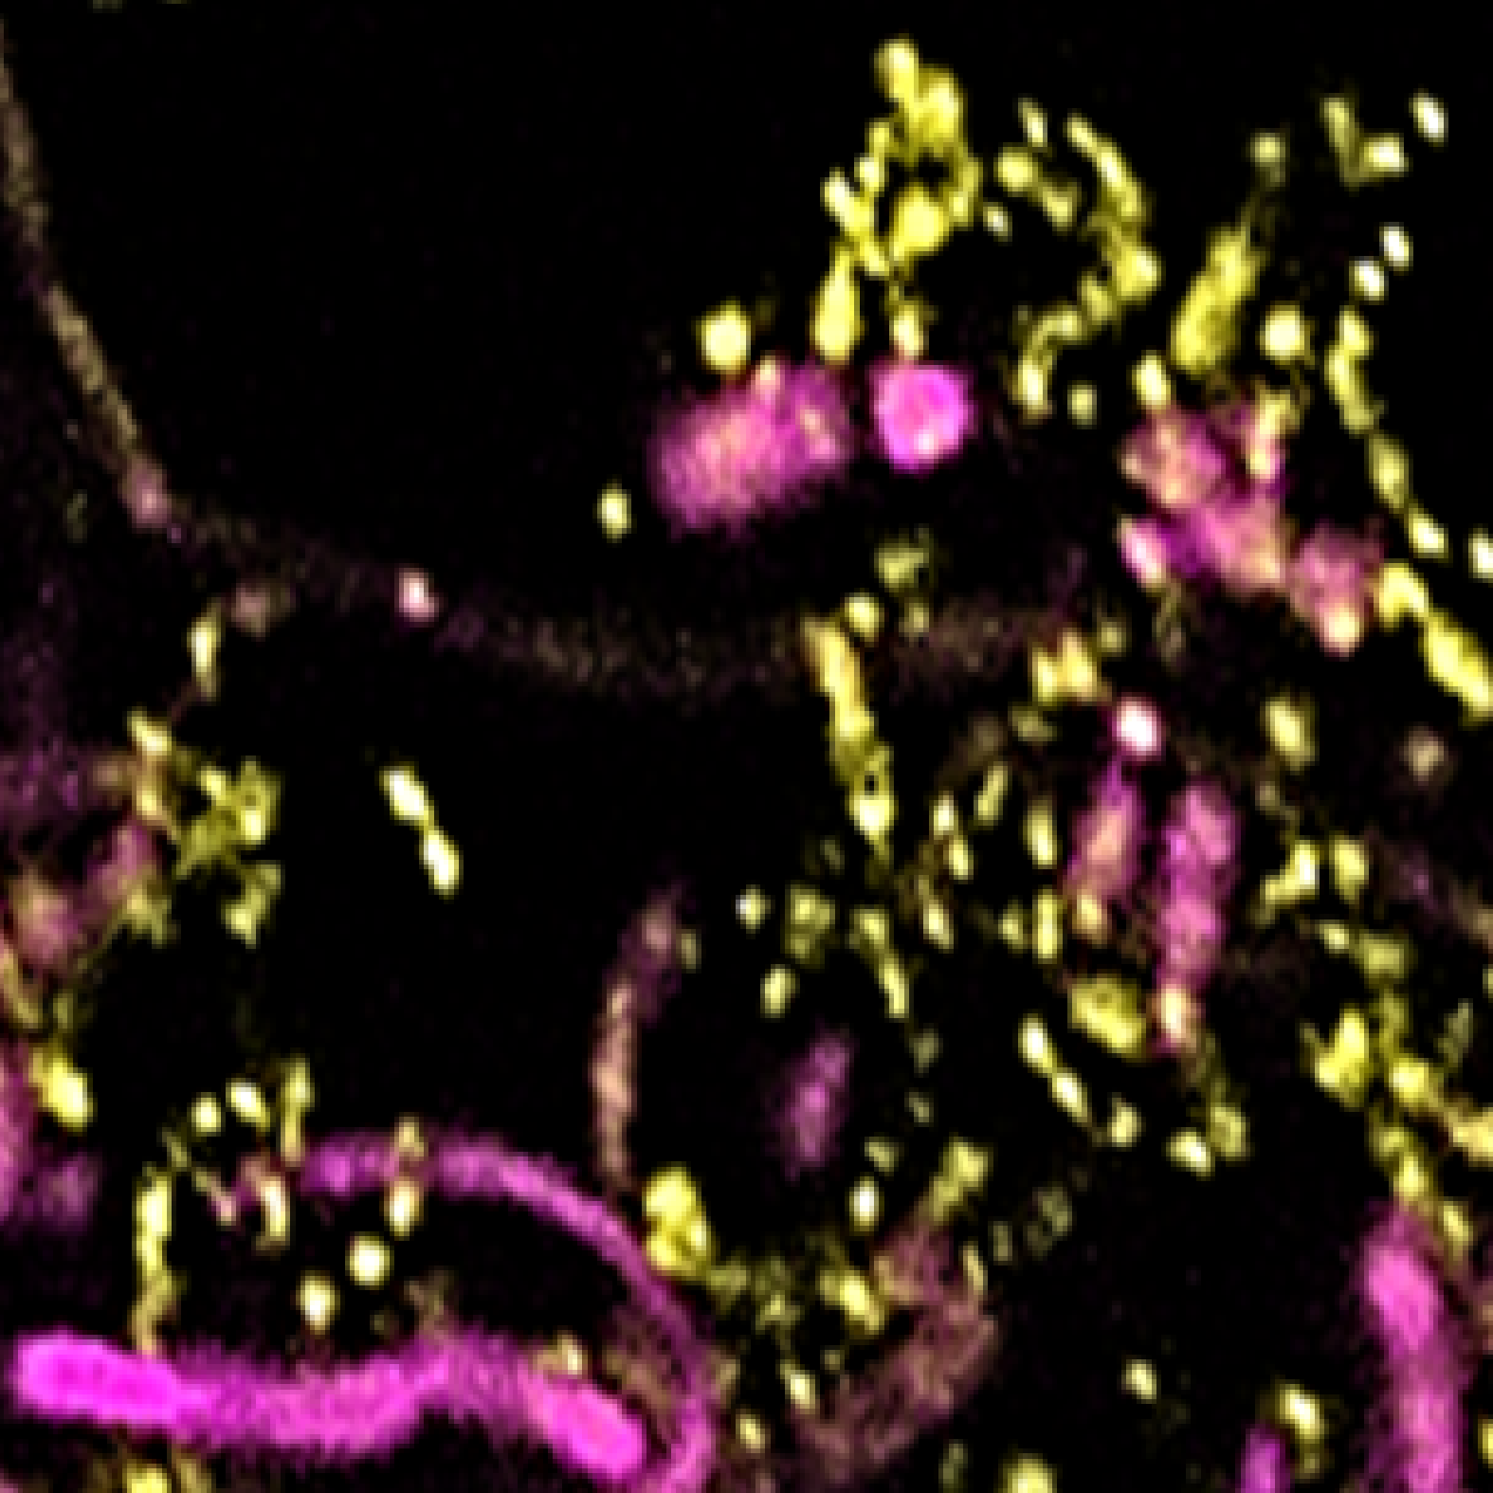
C. matruchotii
Appears to function as a ‘scaffold’
Interacts with wide variety of organisms
Multiple mechanisms?

Slide 13
Aerobic mono vs coculture
S. mitis
H. parainfluenzae
C. matruchotii
S. cristatus

Slide 14
Anaerobic mono vs coculture
S. mitis
H. parainfluenzae
C. matruchotii
S. cristatus

Slide 15
Could S. mitis be influencing hedgehog structure and H. parainfluenzae exclusion?
This could drive ‘hedgehog’ structures into observed less-organized ‘cauliflower’ structures

Slide 16
So…
We have RNASeq data forthcoming for all combinations
We have a TnSeq library finished for H. parainfluenzae
We have catalase mutants for C. matruchotii and H. parainfluenzae
Notes:
List questions then give tool.

Slide 17
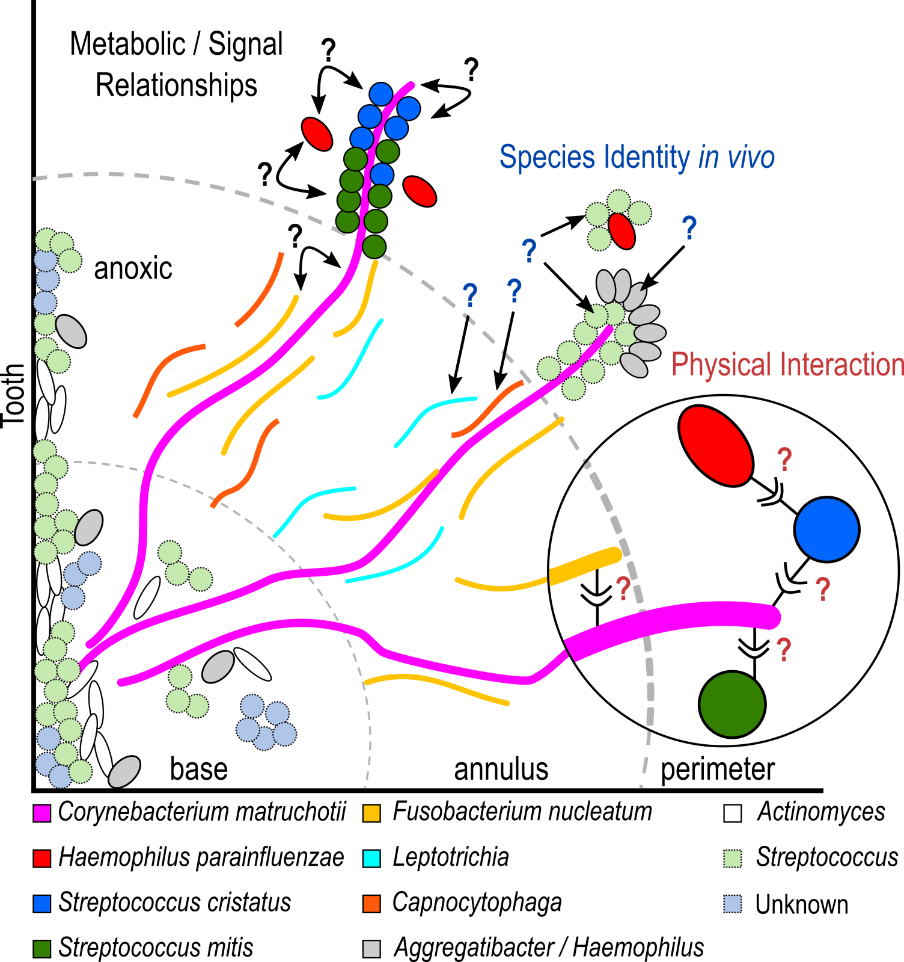

Slide 18
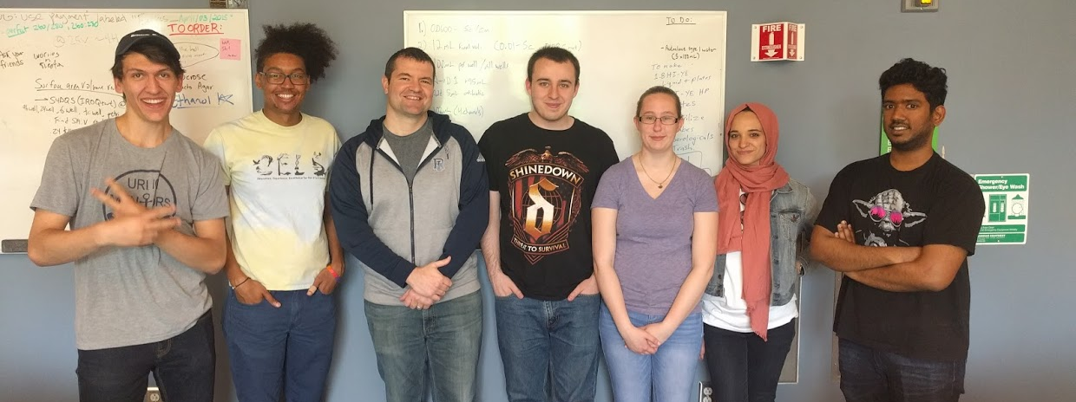




Acknowledgements
Graduate Students:
Eric Almeida
Dasith Perera
Funding:
RI Foundation Medical Research Fund
RI INBRE Early Career Award
Undergraduate Students:
Leen Alsalhi
Adam Capwell
Joe Honig
Shannon Oliver
Collaborators:
Marcelo Freire (JCVI)
Katherine Lemon (Forsyth / Harvard)
Jessica Mark Welch (U Chicago / MBL)

