Slide 1
Mechanisms underlying spatial interaction in the oral microbiota
Matthew M. Ramsey PhD
University of Rhode Island

Slide 2
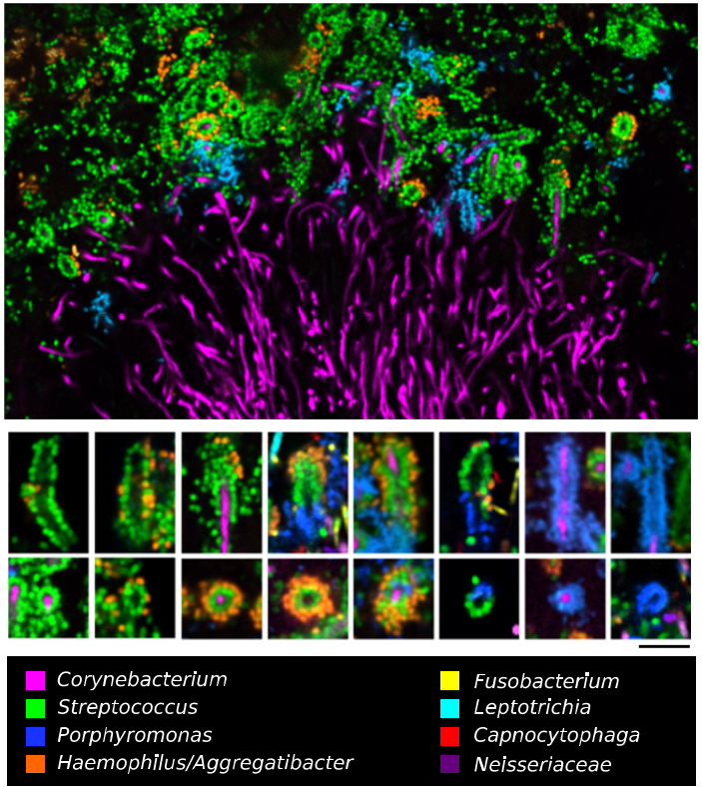
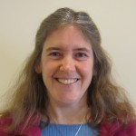
Jessica Mark Welch PhD
Associate Scientist
Marine Biology Lab / University of Chicago. Woods Hole, MA
2011. Valm, Borisy, PNAS.
2016. Welch, Borisy, PNAS.

Slide 3
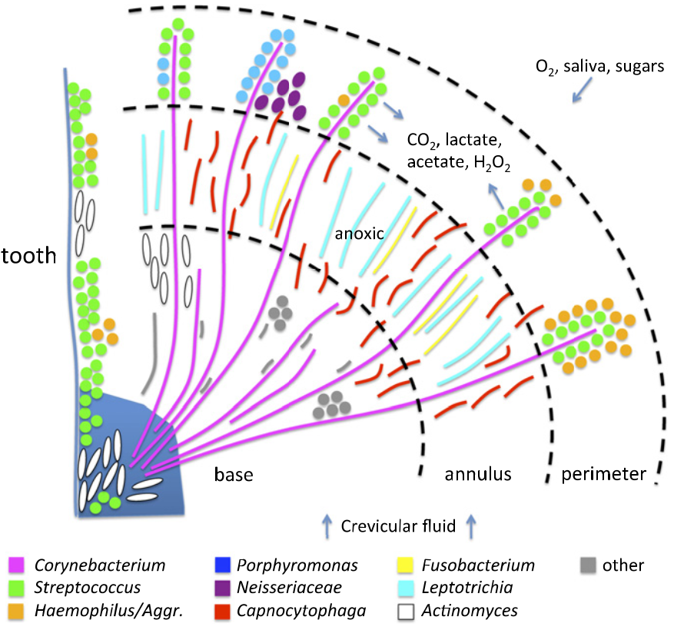
‘Hedgehog’ metabolism

Slide 4
If we want to exclude or temper opportunistic pathogens we should understand by what mechanism(s) they use to survive in a complex community.
If we want to add or enrich for probiotics we should know what niches they occupy.

Slide 5
Preaching to the choir
Polymicrobial interactions are important
My lab uses reductionist approaches to identify specific mechanisms of interaction
How do we pick interaction pairs for study?
  Microscopy
  Microbiomes

Slide 6
CLASI-FISH limitations
Not (yet) species-specific
Not high-throughput
Requires specialized instrumentation
Can we take advantage of high-throughput sequencing based data?

Slide 7
Supragingival Plaque Data
Human Microbiome Project (HMP) Supragingival plaque data
16S rRNA gene V1-V3 region (n=77)
16S rRNA gene V3-V5 region (n=148)
Full assembly metagenomic data (n=117)
Used for species level identification
  Oligotyping / Minimal Entropy Decomposition or QIIME / DADA2
Notes:
Combine with next slide
2. Healthy participants are subjects and not patients.

Slide 8
Microbiome data correlations
Positive and negative correlations can be calculated between different species
Account for multiple comparisons
  False discovery rate
http://huttenhower.sph.harvard.edu/ccrepe
Notes:
You will need to explain what each of these things are simply and clearly.

Slide 9
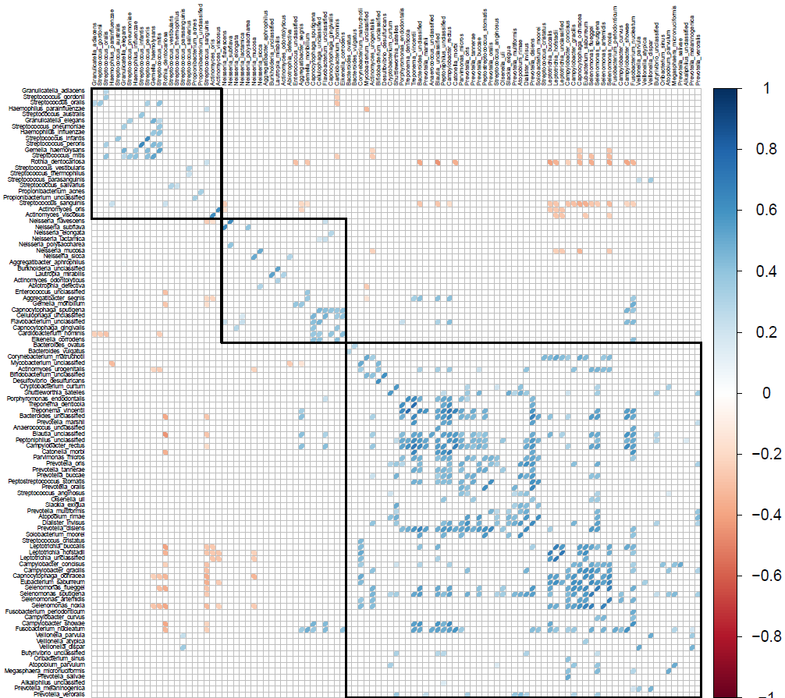

Slide 10
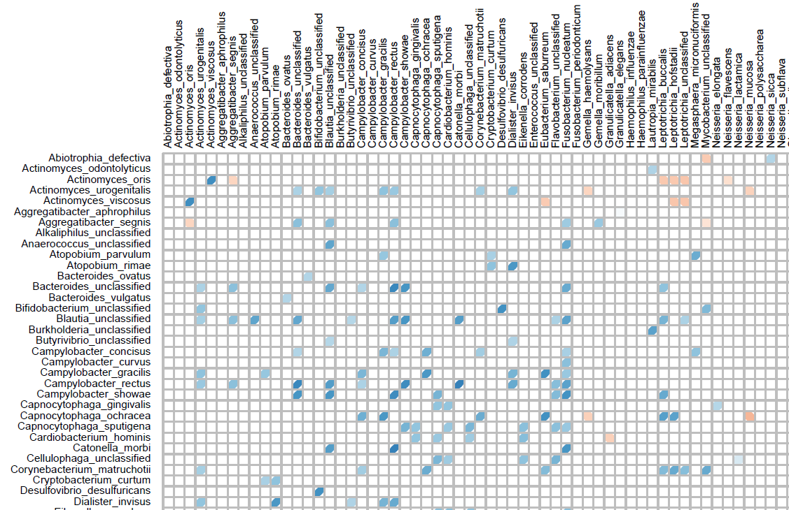

Slide 11
We end up with many correlations but which are meaningful?
Are they at high abundance?
We prioritized for species within genera that were adjacent in microscopy data

Slide 12
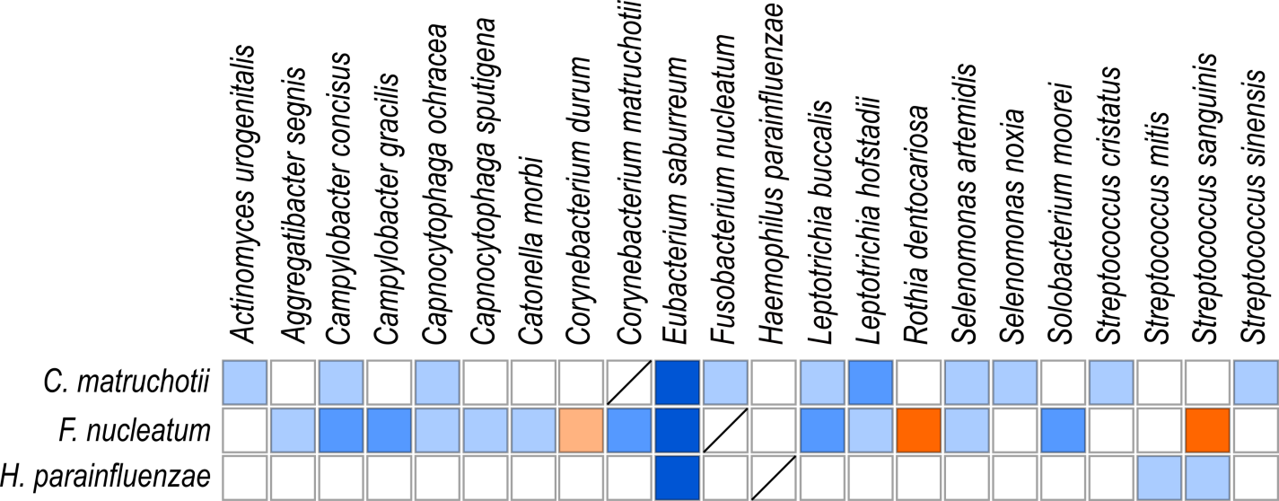
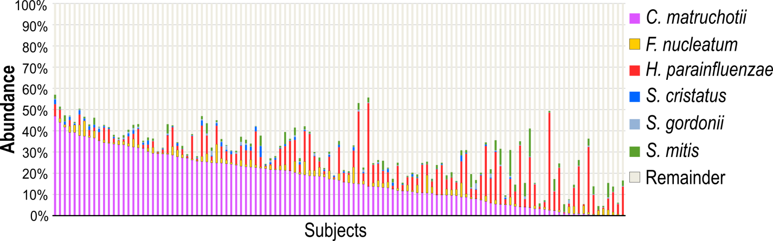

Slide 13
Does this translate to in vivo observations?

Slide 14
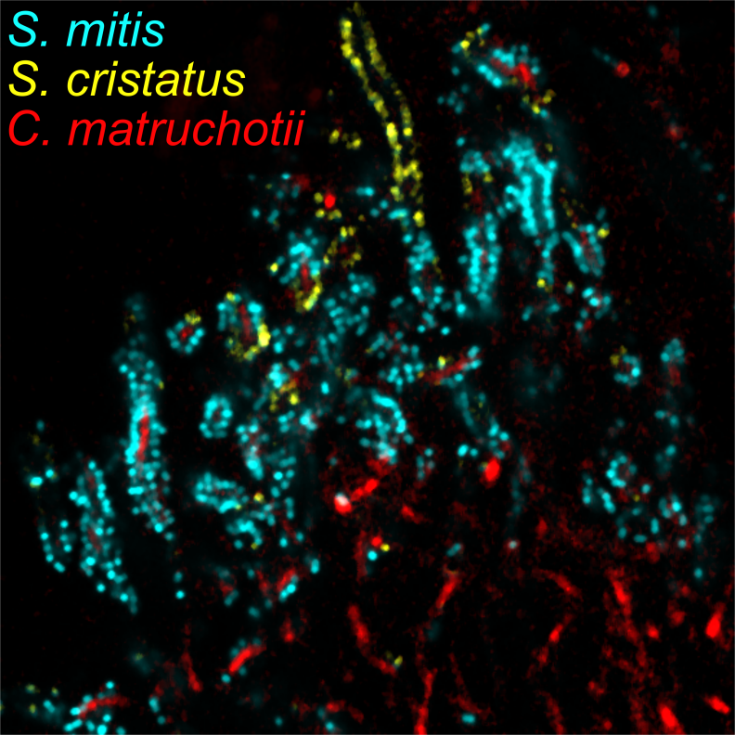
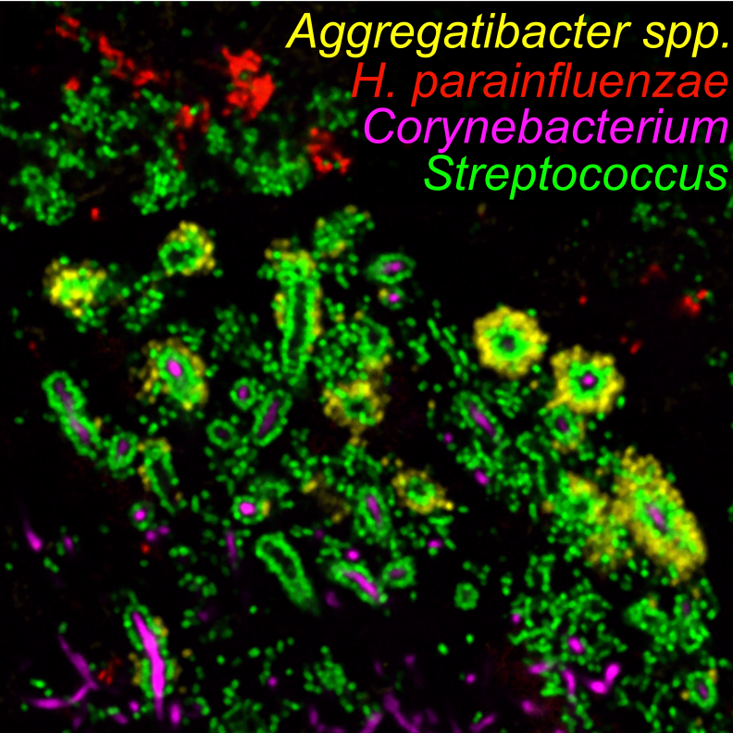
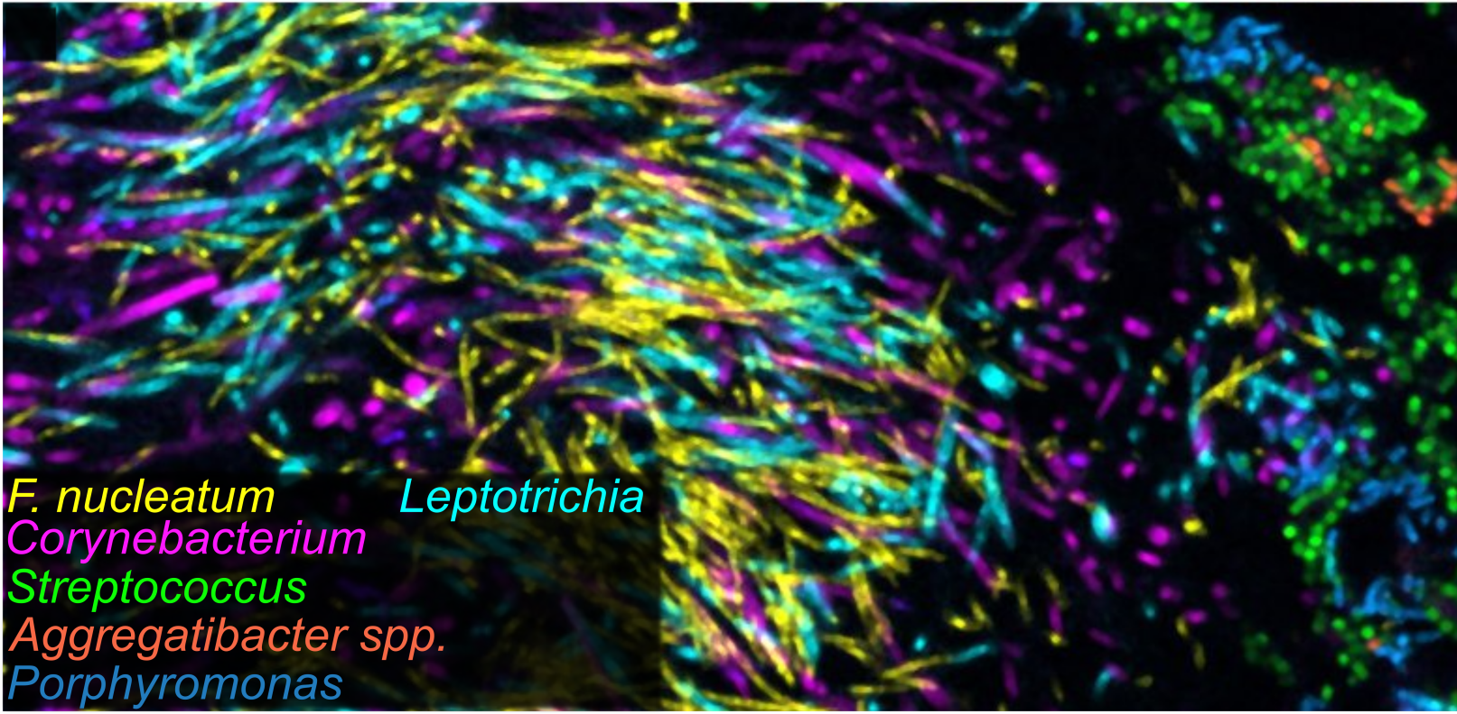

Slide 15
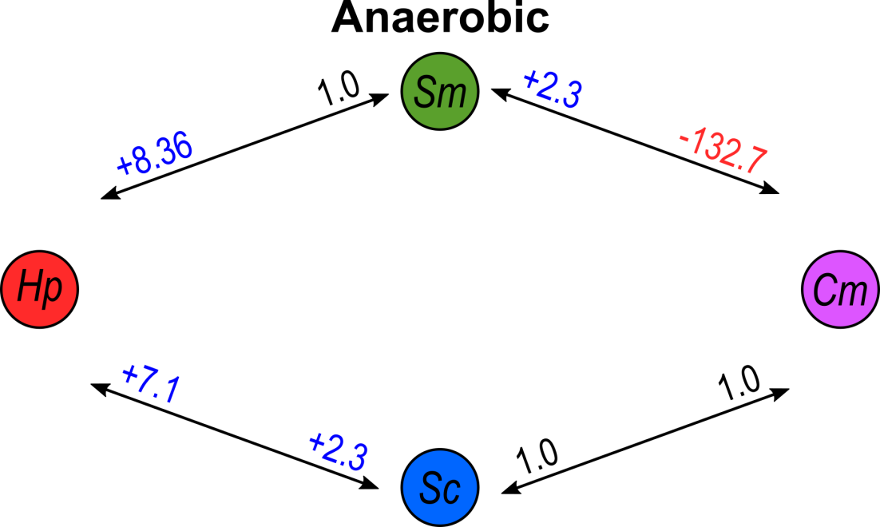

Slide 16
S. mitis
H. parainfluenzae
C. matruchotii
S. cristatus

Slide 17
Hp catalase mutant data

Slide 18
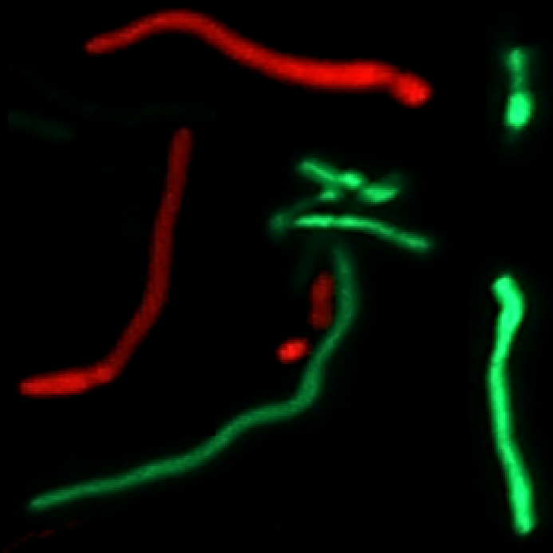
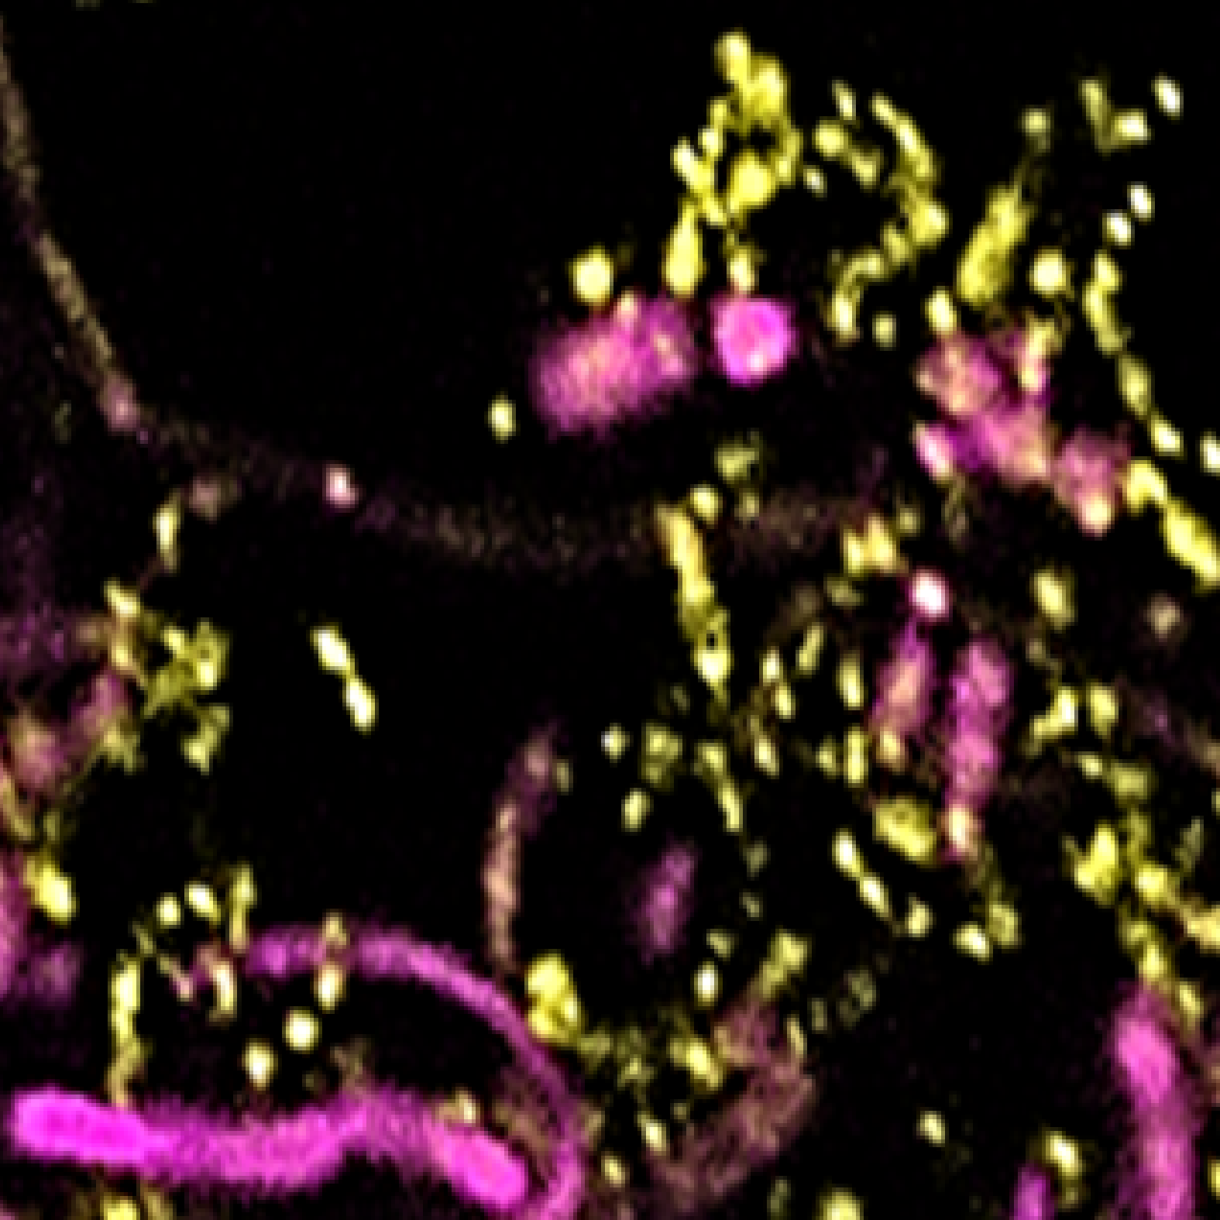
C. matruchotii
Appears to function as a ‘scaffold’
Interacts with wide variety of organisms
Multiple mechanisms?

Slide 19
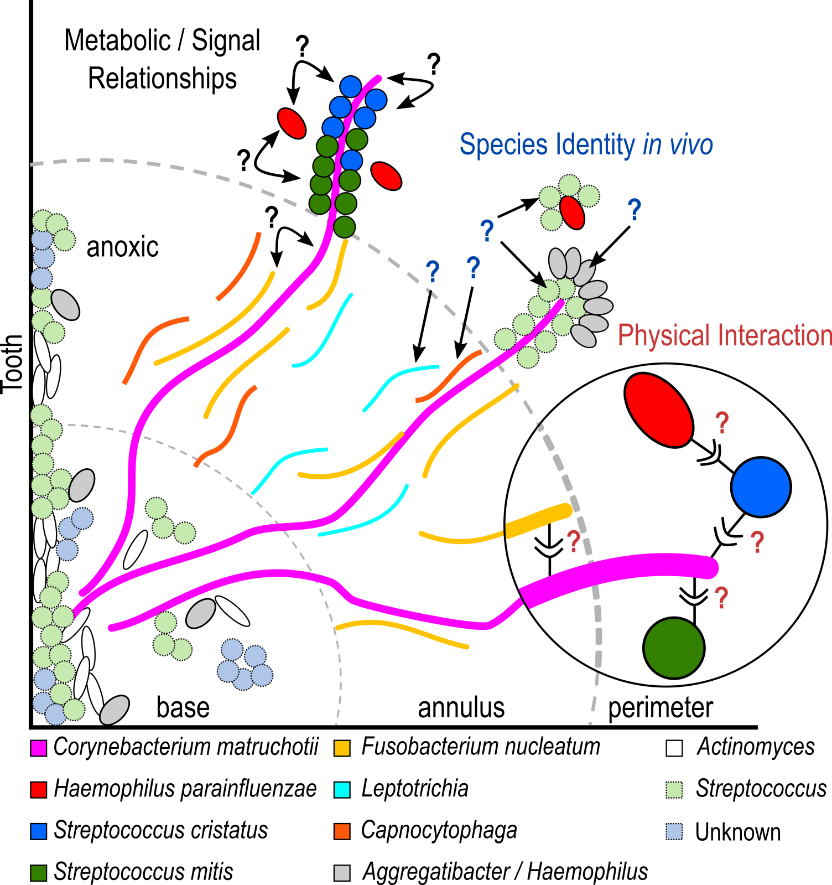

Slide 20
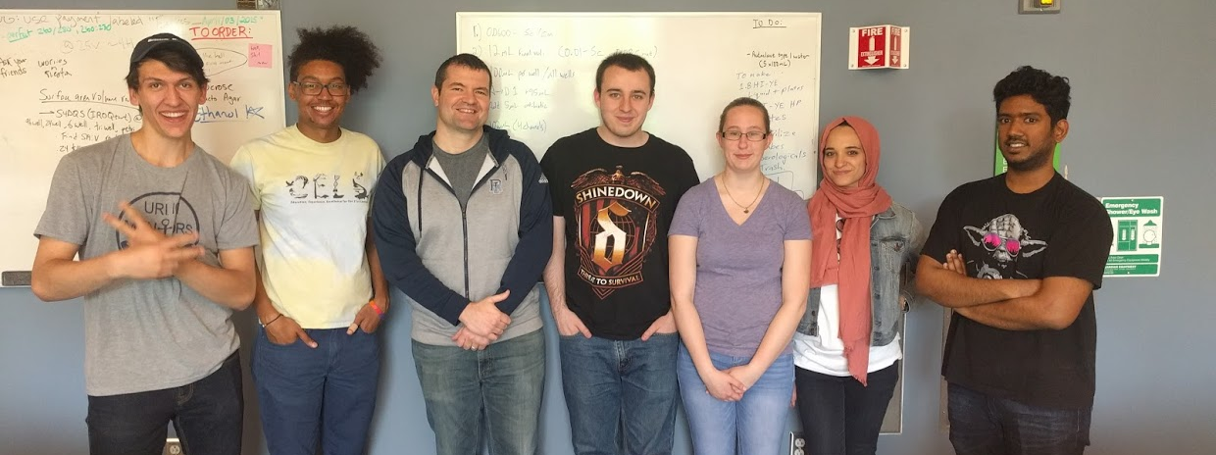




Acknowledgements
Graduate Students:
Eric Almeida
Dasith Perera
Funding:
RI Foundation Medical Research Fund
RI INBRE Early Career Award
Undergraduate Students:
Leen Alsalhi
Adam Capwell
Joe Honig
Shannon Oliver
Collaborators:
Marcelo Freire (Forsyth / Harvard)
Katherine Lemon (Forsyth / Harvard)
Jessica Mark Welch (U Chicago / MBL)

