Slide 1
Deciphering Kingella kingae RTX Toxin Regulation
Matthew M. Ramsey PhD
University of Rhode Island
Kingston, RI

Slide 2
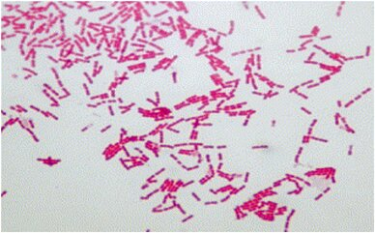
Kingella kingae
Gram-negative β- proteobacteria
β-hemolytic, oropharynx colonizing organism
Causes distal osteoarticular, septic arthritis, osteomyelitic and endocardial infections
Oropharynx colonization precedes infection, isolates from distal infection sites are clonal to the oropharynx
  This is a polymicrobial colonization site

Slide 3
Question
Do the adjacent microbiota influence K. kingae colonization and virulence?

Slide 4
Specific Aims
Aim 1. Identification of regulators of type-IV pili and rtx toxin expression in K. kingae
Aim 2. Identification of genes required for K. kingae in vivo survival and attachment

Slide 5
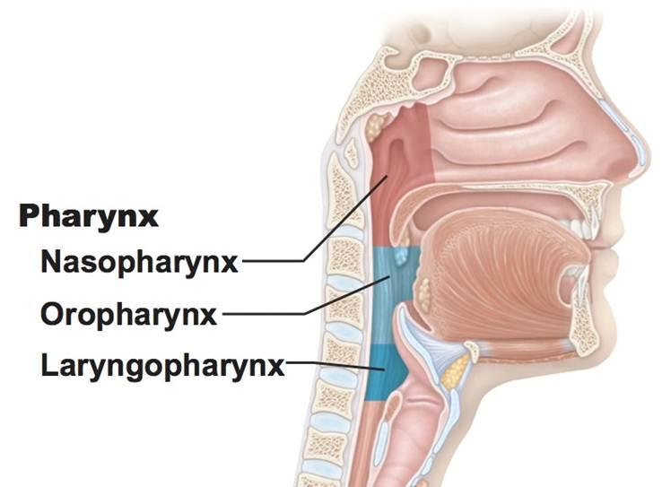
Who are Kk’s neighbors?
Genera include:
  Streptococcus
  Neisseia
  Veillonella
  Haemophilus
  Moraxella
  Rothia
We will use Haemophilus parainfluenzae and Streptococcus mitis as model interacting species

Slide 6
Complications
K. kingae type strain had severe genetic differences vs all other strains in literature
Experiments with 2 other isolates proved far more difficult to genetically manipulate
We have been testing interactions with Haemophilus parainfluenzae and Streptococcus mitis together and with K. kingae

Slide 7
Resolution
We have shifted our work to the study of H. parainfluenzae and S. mitis interactions

Slide 8
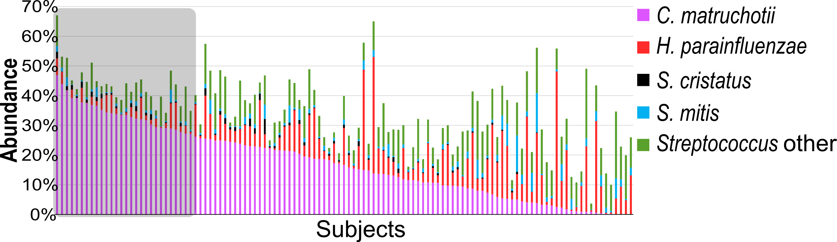
Predicted oral co-occurence
H. parainfluenzae and S. mitis are in the top 10 total abundance across 117 subjects
These data are from species level Human Microbiome Project (HMP) for supragingival plaque

Slide 9
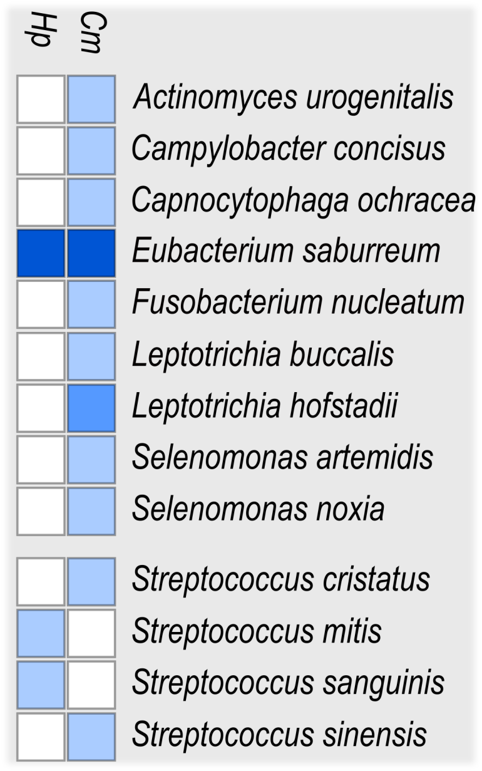
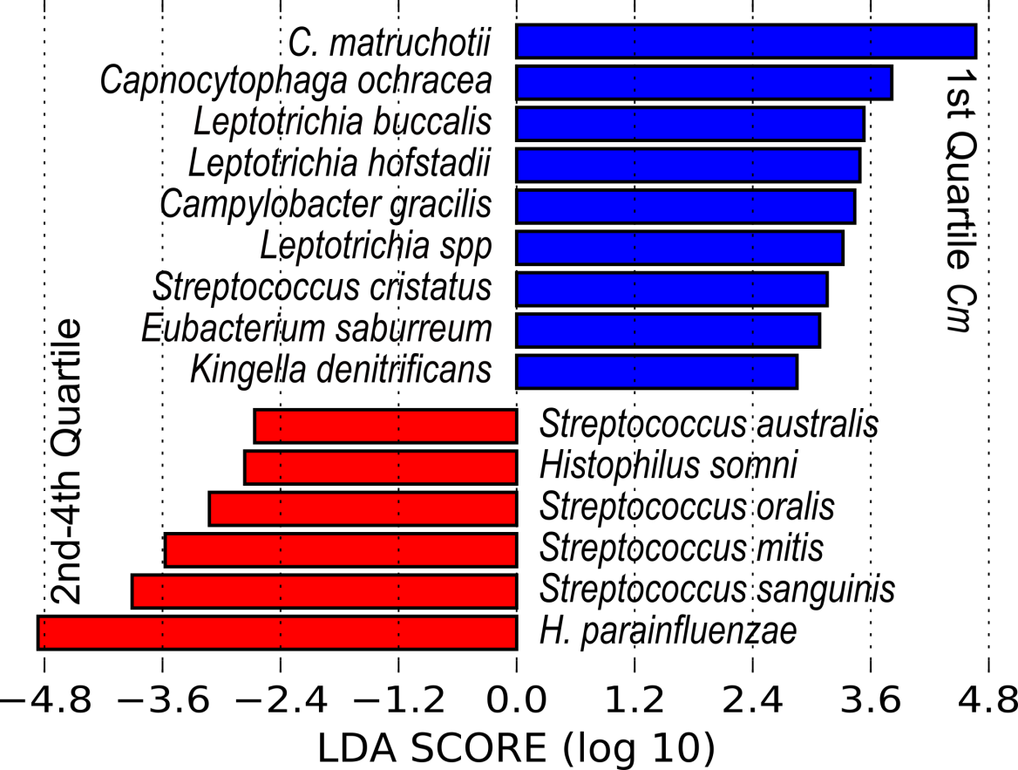
Predicted oral co-occurence

Slide 10
Hypothesized interaction mechanisms
H. parainfluenzae
Lactate
S. mitis
OxyR
H₂O₂
KatA

Slide 11
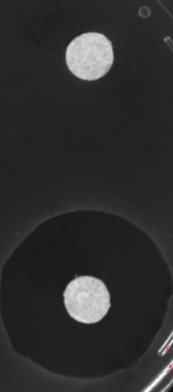
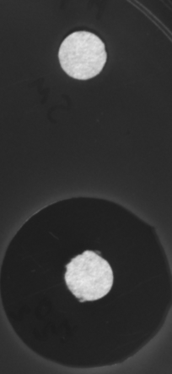
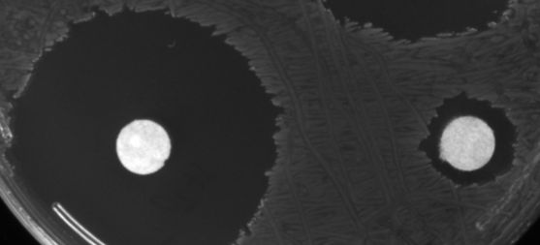
Hp katA and oxyR mutants
WT
ΔkatA
ΔoxyR
S. mitis
3% H2O2

Slide 12
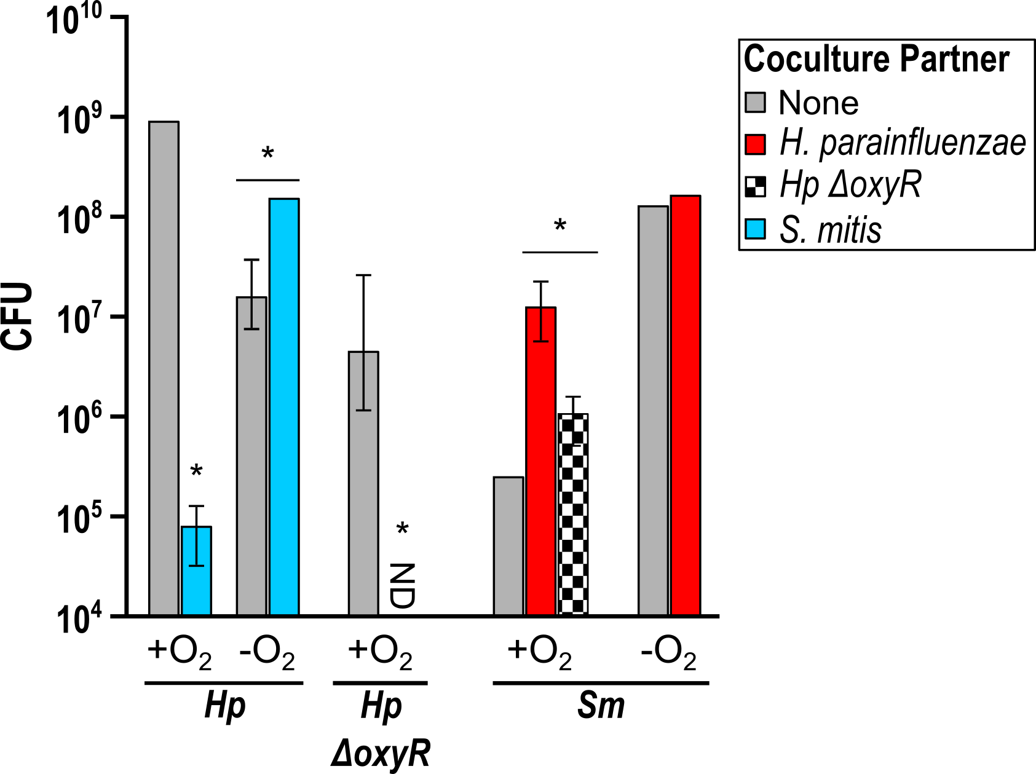
Coculture data
Hp ΔkatA had no difference from WT in any condition.

Slide 13
Hp oxidative stress response
Catalase is not the primary response to peroxide
We hypothesize other respiratory peroxidases
Investigation of the OxyR regulon is in progress

Slide 14
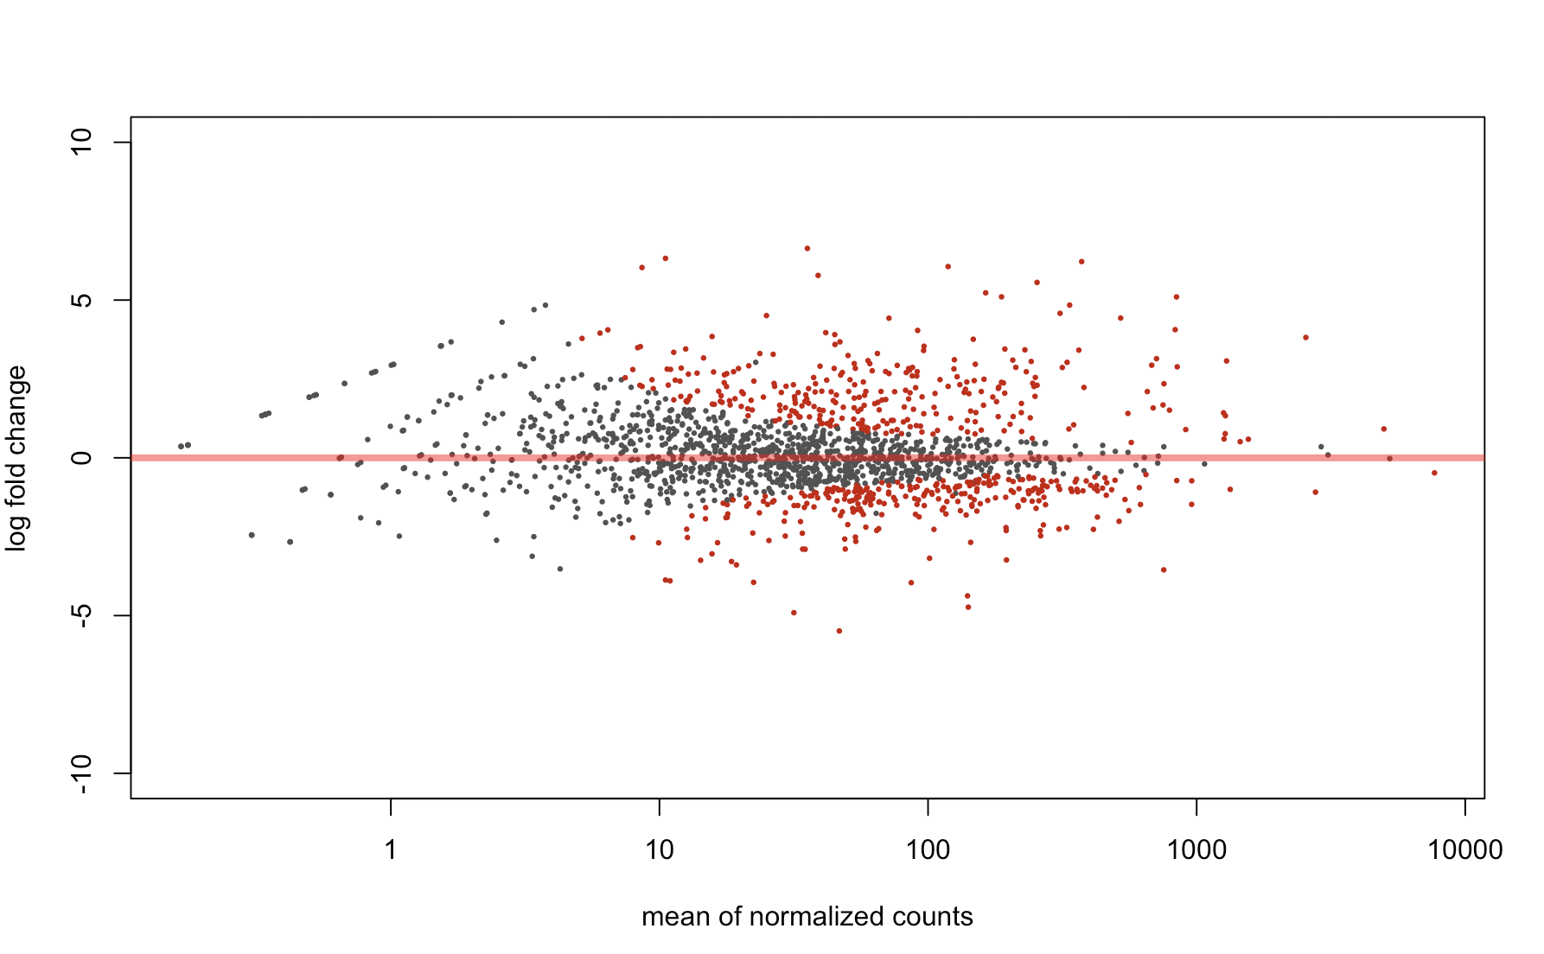
S. mitis gene expression with Hp
Increased expression of adhesins when Hp was present
Notes:
Theres a total of about 1800 and about 500 Are differentially expressed
example of the output we get from deseq2, in red are genes that are significantly differentially expressed.

Slide 15
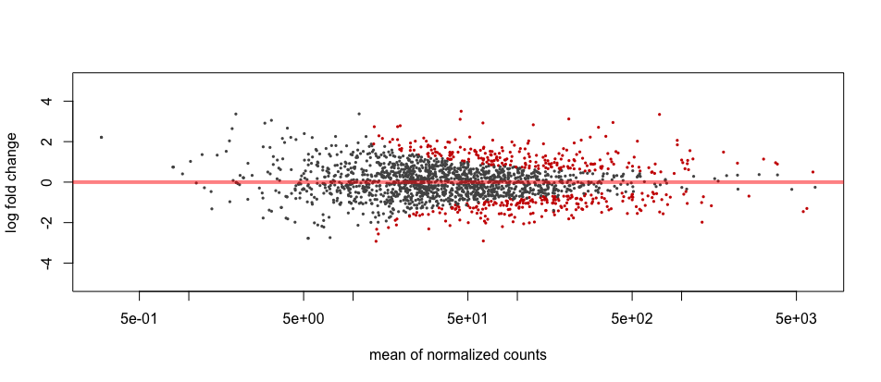
How does H. parainfluenzae respond to S. mitis aerobically?
Notes:
Can we get any clues
Hpara has almost 2000 genes, 350 differentially expressed

Slide 16
H. parainfluenzae aerobic response to S. mitis
11 fold increase in pilQ
3 fold increase in cas9
4 fold increase in tfoX
3 fold increase in comE
2 fold increase in comA
2.5 fold increase in hfq*
2.3 fold increase in mutS*
3 fold increase in dpo4
*Chen & Gottesman (2017)
Notes:
pilq, which is involved in competence
Tfox is a regulator of competence
Come and coma
So an increased expression of genes involved in competence
Competence pathway in hpara not well characterized but in some species antimicrobials can trigger competence
There is also increased expression of the crispr cas9 gene, which is widely considered to be the bacterial version of an adaptive immune response
Hfq chaperone- which some studies suggest has a role in stress response
mutS DNA mismatch repair protein
Paper late last night- hfq is able to exploit the MMR pathway to increase mutation rates in response to stress for adaptive mutagenesis
DNA pol 4-error prone
Overall it just looks like hpara may be eliciting a stress response of sorts

Slide 17
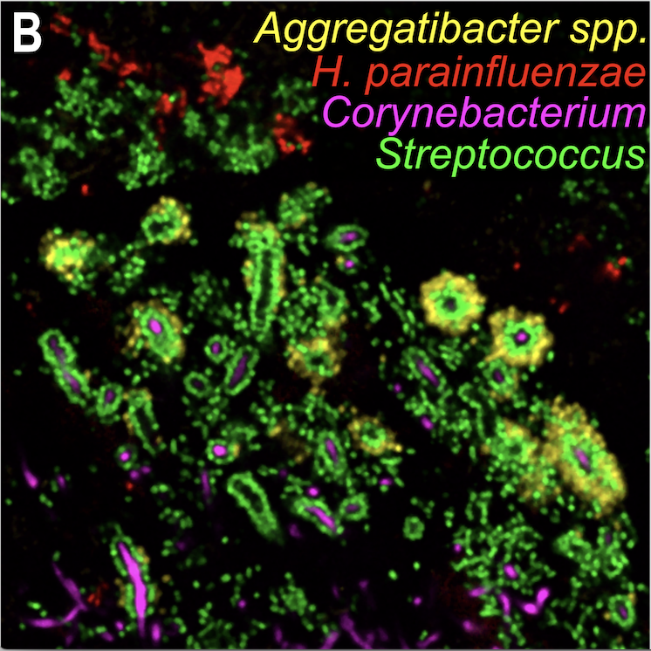
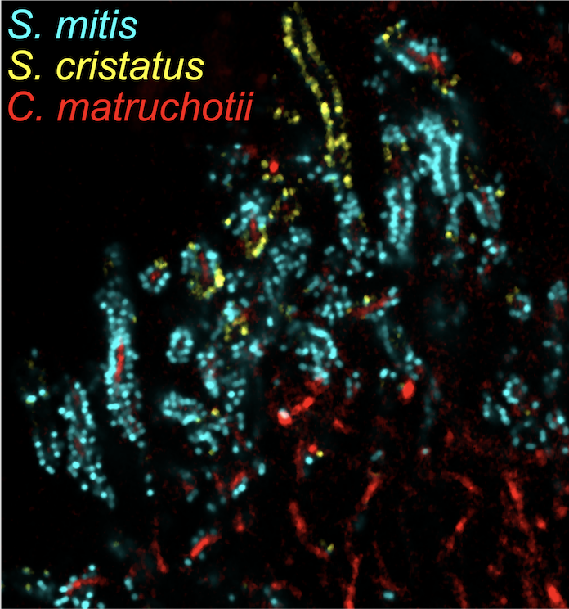
How does this apply to in vivo conditions?
Images courtesy of Dr. Jessica Mark-Welch
Notes:
Hpara, found adjacent to but excluded from these corncobs.
abundance of smitis in corncobs
From my data we know aerobically mitis kills hpara
Both hpara and mitis are found in the aerobic region of the headgehog
Presence of mitis in corncobs excludes hpara to periphery

Slide 18
Further work
Determining the OxyR regulon of Hp and mechanisms of peroxide resistance
Identifying attachment factor contribution to coaggregation and biofilm formation between Hp and S. mitis
Collaboration with J. Kim (URI-Chemistry)
  Using electrochemical detection systems on Streptococcus metabolites in situ
This proposed work is ~1/2 of our NIH R01 resubmssion (Friday)

Slide 19
Training
Dasith Perera – 3rd yr PhD student
  Performed the Hp – Sm coculture work
  Oversaw Adam and Joe during the summer
Adam Capwell – CMB Junior
  Performed much of the support work for experiments done here
Joe Honig – PharmD Junior
  Performed initial genetics work in H. parainfluenzae
Thais DePalma – 1st yr PhD student
  Will work with Howlett lab on a new collaborative study
Eric Almeida – 3rd yr PhD student
  Involved in other bacterial interactions with Hp

Slide 20
Teaching
Fall semesters – CMB201 “Medical Microbiology” 4 credits ~280 students
Spring semesters – CMB211 “Introductory Microbiology” 4 credits ~120 students
Developed CMB265G – Grand challenge “Science and Pseudoscience” 3 credits ~ 35 students
  Taught spring 2018, 2019 (planned)

Slide 21
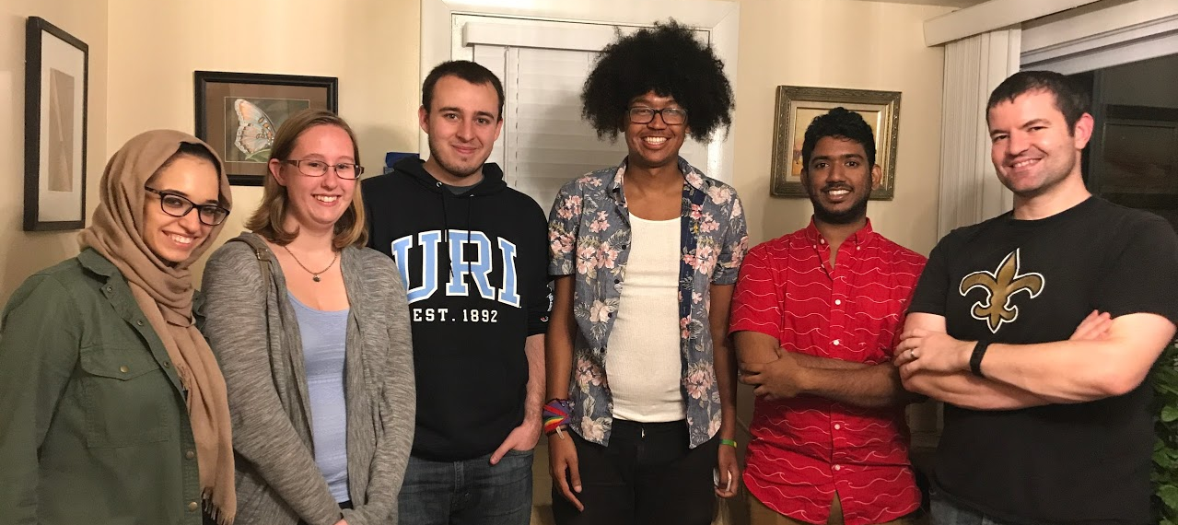




Acknowledgements
Graduate Students:
Eric Almeida
Dasith Perera
Thais DePalma
Funding:
RI Foundation Medical Research Fund
RI INBRE Early Career Award
Collaborators:
Marcelo Freire (Forsyth / Harvard)
Katherine Lemon (Forsyth / Harvard)
Jessica Mark Welch (U Chicago / MBL)
Jiyeong Kim (URI)
Undergraduate Students:
Adam Capwell
Shannon Oliver
Quintin DeRocha
Ben Hanson
Kaleigh Cloutier-LeBlanc

