Slide 1
Deciphering Kingella kingae RTX Toxin Regulation
Matthew M. Ramsey PhD
University of Rhode Island
Kingston, RI

Slide 2
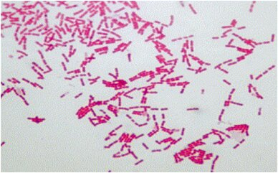
Kingella kingae
Gram-negative β- proteobacteria
Neisseriaceae family
β-hemolytic, oropharynx colonizing organism
1.95 Mb genome, ~2013 genes

Slide 3
K. kingae virulence
Part of the HACEK group of endocardial pathogens
Expresses a singular RTX toxin, essential for virulence
Has type-IV pili
Has (so far) 4 distinct capsule varieties

Slide 4
K. kingae infection
>95% of infections occur in ages 6-48 months
Found to be a frequent cause of ‘culture-negative bone infections of unknown origin’
Causes distal osteoarticular, septic arthritis, osteomyelitic and endocardial infections
Several child-care center outbreaks observed within the decade
  In one incident, 73% of children tested positive for Kk carriage, 28% colonized at any given time (n=48).

Slide 5
K. kingae infection
Amongst carriers, infection presents anywhere from 0.1-20% of the time.
  This is skewed upward due to outbreaks within daycare centers
  ~1/100,000 children ages 1-5y
β-lactam resistance has been observed
Oropharynx colonization precedes infection, isolates from distal infection sites are clonal to the oropharynx
  This is a polymicrobial colonization site

Slide 6
Global hypothesis
Does the adjacent microbiota influence K. kingae colonization and virulence?

Slide 7
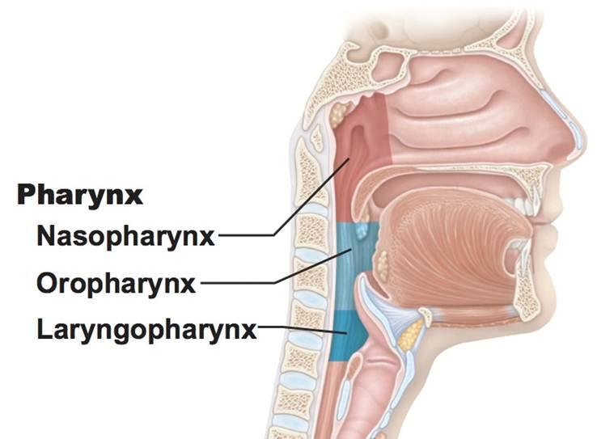
Who are Kk’s neighbors?
Genera include:
  Streptococcus
  Neisseia
  Veillonella
  Haemophilus
  Moraxella
  Rothia
We will use Haemophilus parainfluenzae and Streptococcus mitis as model interacting species

Slide 8
Specific Aims
Aim 1. Identification of regulators of type-IV pili and rtx expression in K. kingae
Aim 2. Identification of genes required for K. kingae in vivo survival and attachment

Slide 9
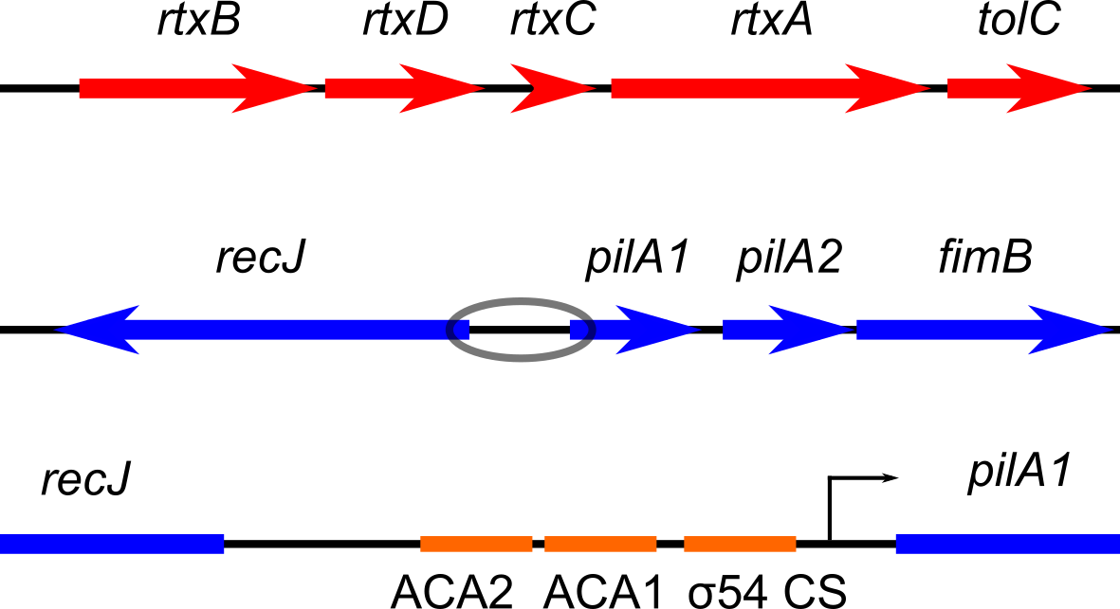
What is known about Kk virulence factor regulation?
Type-IV pili are necessary for full epithelial cell adhesion
Type-IV pili are regulated by the PilR/S two component system
They are also regulated by RpoN / σ54
ACA1/2 are PilR binding sites found at 27 other places on the genome

Slide 10
What is known about Kk virulence factor regulation?
rtx regulation is completely uninvestigated in Kk
σ54 and PilR co-regulate rtx expression in Dichelobacter nodosus

Slide 11
Summary
K. kingae is a regular part of the pediatric oropharyngeal microbiota
Transmission seems easy. Infection is rare, but manifests in clusters
Symptoms can be quite severe
Toxin regulation has been uninvestigated

Slide 12
Aim 1. Identification of regulators of type-IV pili and rtx expression in Kk
Hypothesis: PilR and σ54 regulate rtx expression and may be influenced via adjacent microbiota
Experiment: delete σ54 (RpoN) and PilR encoding genes and quantify hemolytic activity
Experiment: measure transcriptomes of above mutants
Experiment: generate promoter:reporter fusions for rtx and pilA1 expression and determine activity changes in response to host microbiota

Slide 13
Aim 1 outcomes
We will determine if σ54 and/or PilR impact RTX-dependent hemolytic activity
We will identify the regulon for PilR and σ54 via transcriptome analysis
We will determine if other microbes influence the expression of pilA1 or rtx

Slide 14
Aim 1 Data
We first had to establish coculture conditions with Kk and oropharynx organisms
We utilized rich medium (BHI-Y + hemin, NAD+) and BHI-Sheeps blood
Initial defined medium experiments have not been successful
We used the abundant oropharynx microbes Streptococcus mitis and Haemophilus parainfluenzae for mono vs cocultures

Slide 15
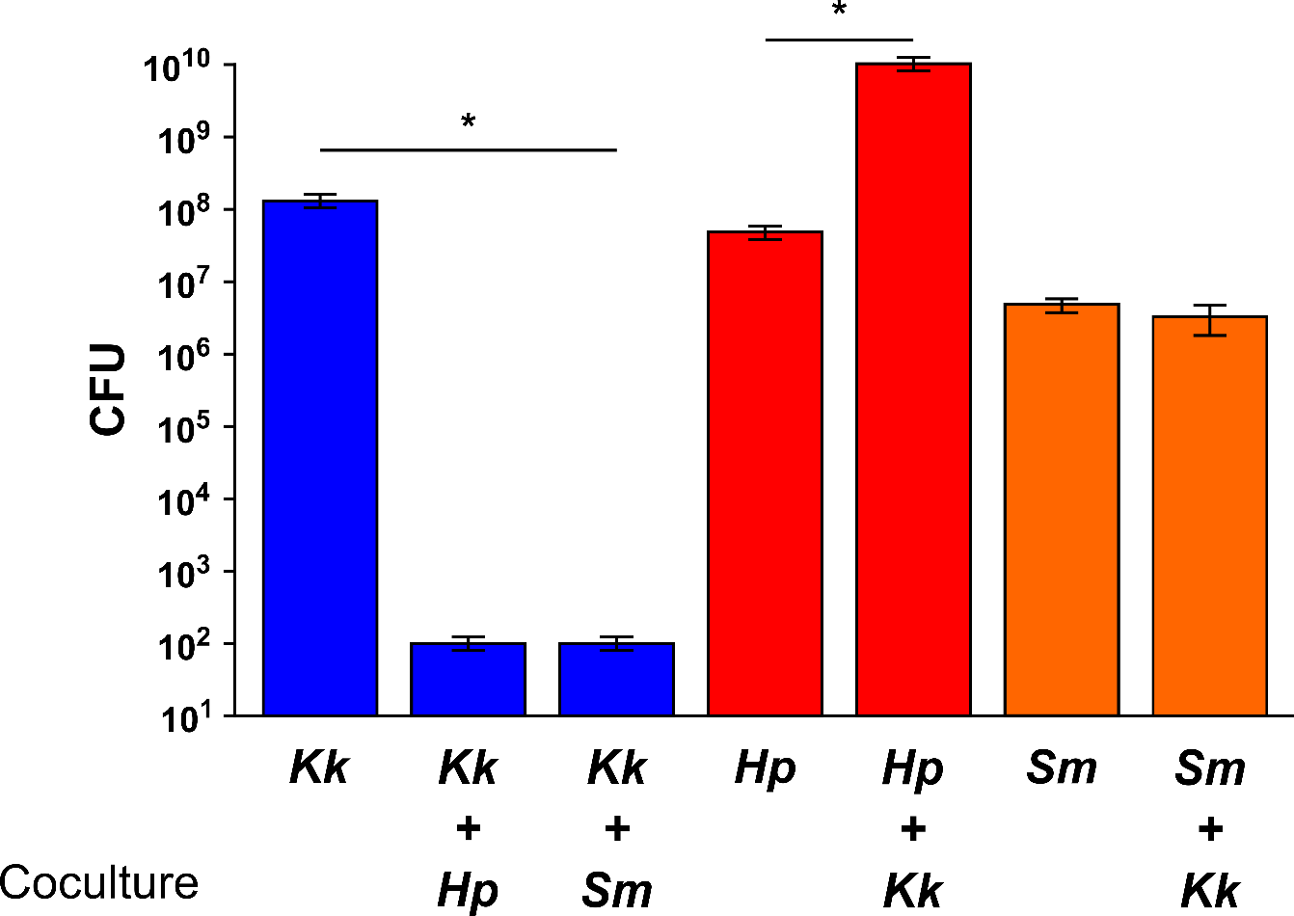
BHI-YHN coculture data

Slide 16
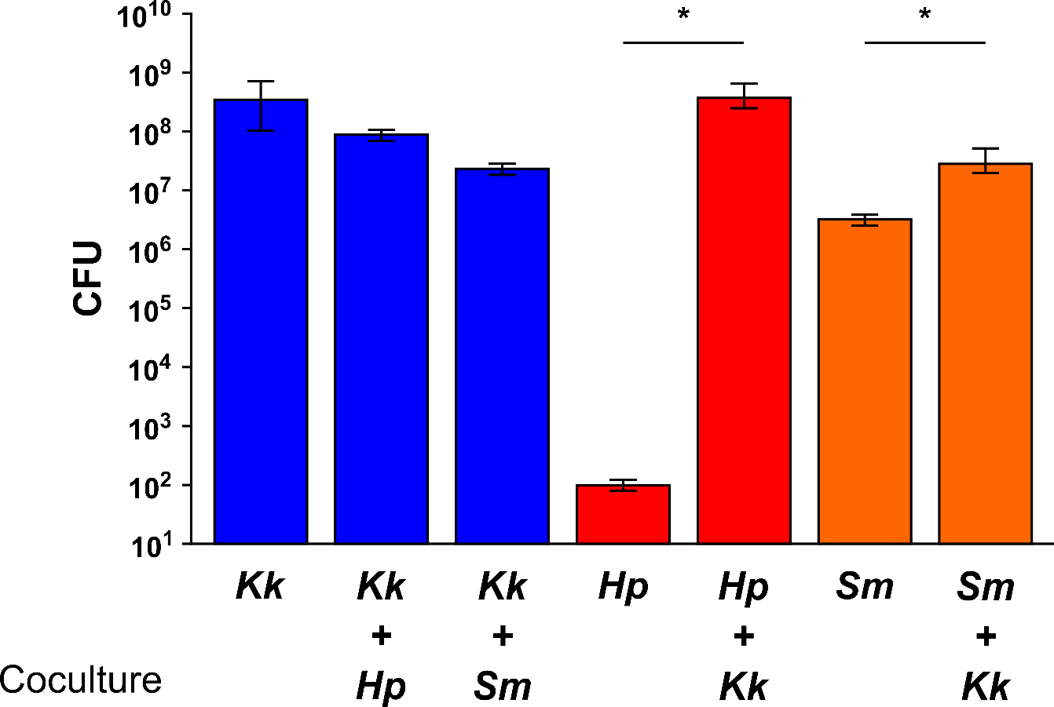
BHI-Blood coculture data

Slide 17
Discussion
The presence of catalase in blood likely protects Kk from peroxide killing by S. mitis
We have no explanation yet for Kk lack of survival with H. parainfluenzae on amended BHI
Kk enhances the growth of both Sm and Hp on blood and the growth of Hp on amended BHI
  Hp coculture growth on blood is likely assisted by Kk hemolytic activity

Slide 18
rpoN deletion
We created a deletion construct, replacing rpoN with a kanamycin resistance cassette
Initial tests showed no change in hemolytic activity vs the wild-type
We next sought to generate a promoter:reporter fusion for rtx expression to see if regulation was more subtle

Slide 19
rtx issues
Our strain seems to have split the rtx operon into two separate fragments
Regulation is more complex, which portion is regulated, which is constitutive?
rtxC
rtxA
tolC
rtxB
rtxD
rtxC

Slide 20
New strain of K. kingae
We have procured two new strains of K. kingae
Via PCR and sequencing we have determined that strain ATCC 23332 contains the rtx operon in the canonical structure
We are currently generating rpoN and rtxA deletions in this strain

Slide 21
Moving on
We elected to further test coculture interactions with H. parainfluenzae and S. mitis
These interactions are also of great importance in the oral plaque microbiome

Slide 22
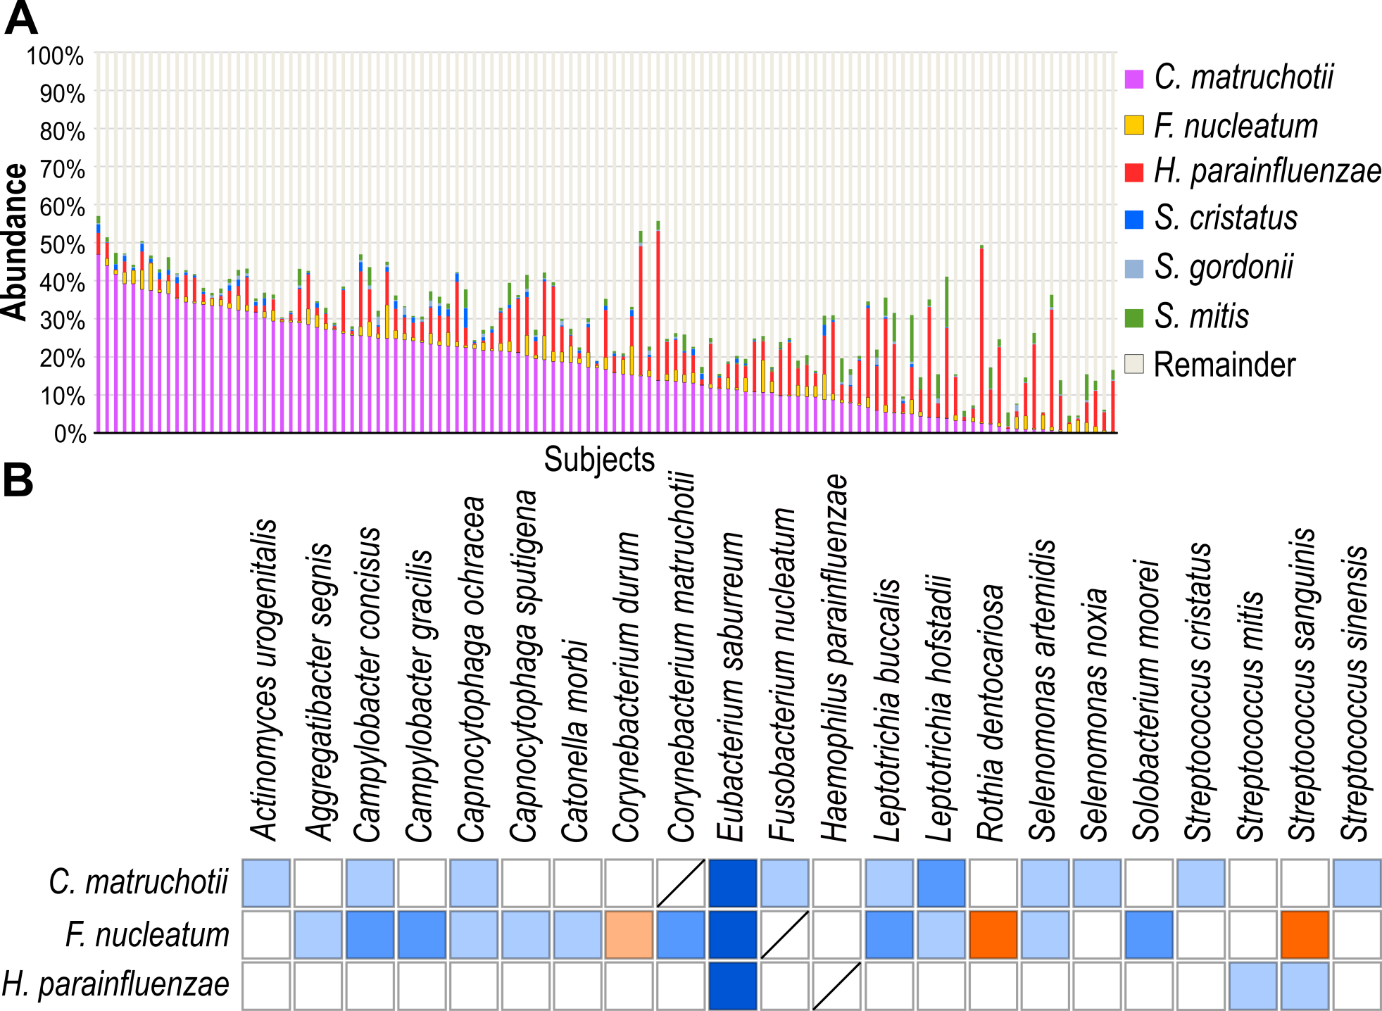

Slide 23
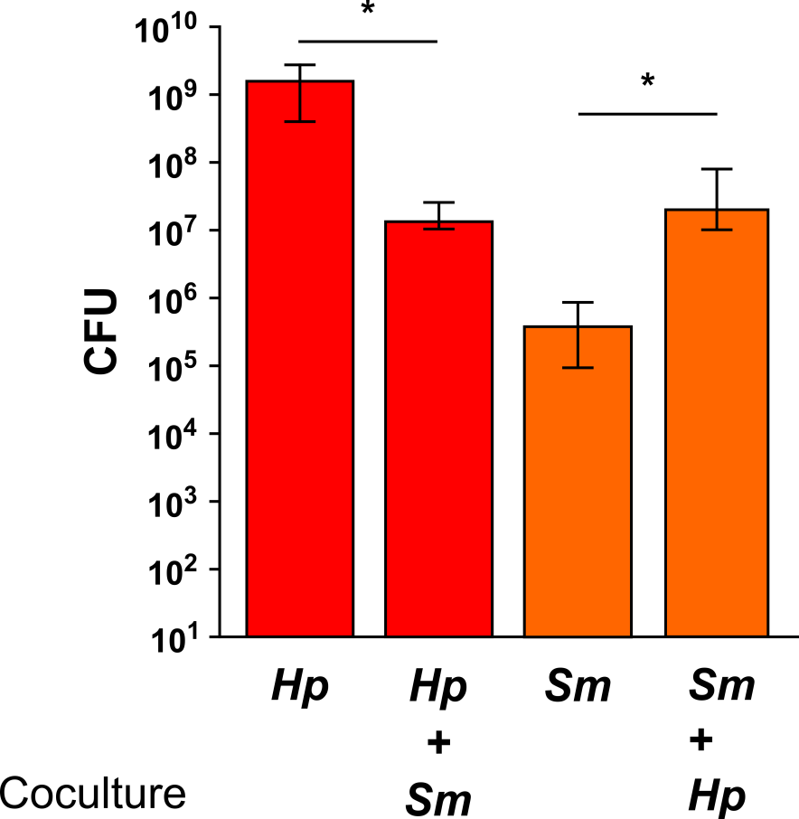
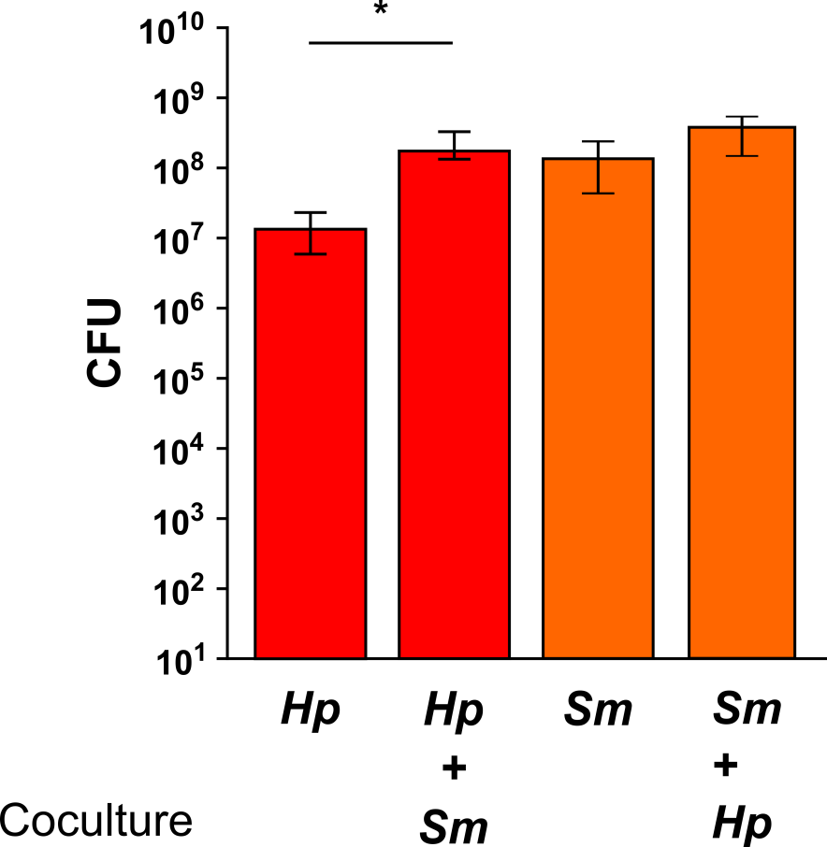
Coculture data
Aerobic
Anaerobic

Slide 24
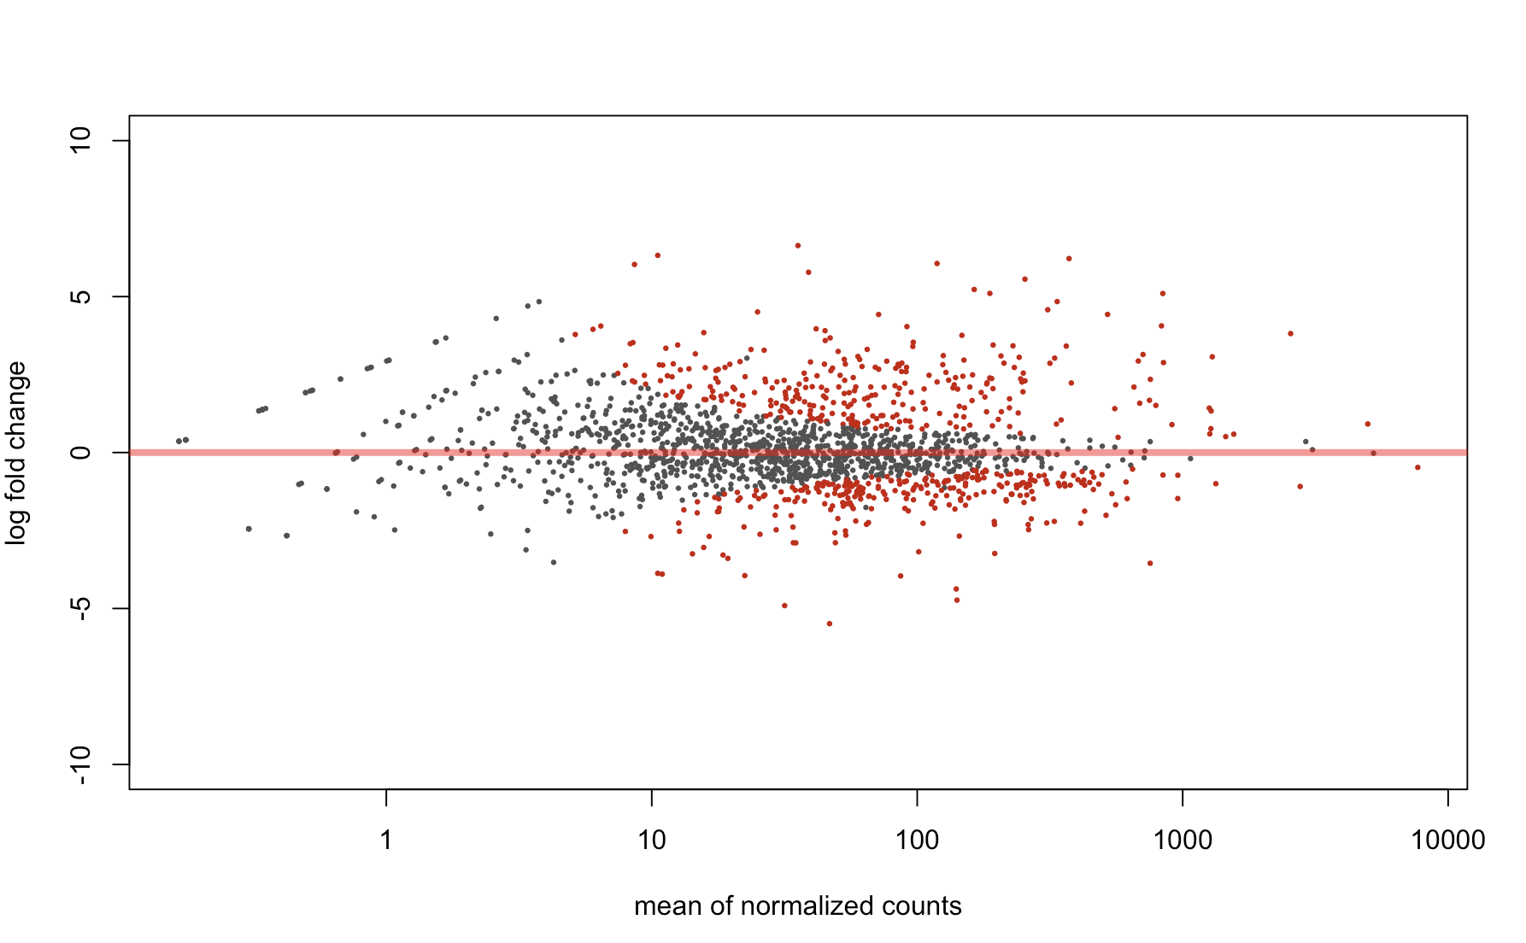
S. mitis gene expression aerobically vs anaerobically
45 fold increase in bacteriocin exporter aerobically
Notes:
Theres a total of about 1800 and about 500 Are differentially expressed
example of the output we get from deseq2, in red are genes that are significantly differentially expressed.

Slide 25
Bacteriocin involvement in
H. parainfluenzae elimination?
Antimicrobial peptides that inhibit competing strains and species
Streptococcus bacteriocin production coupled with competence (Wang & Dawid, 2018)
30 fold increase in comB aerobically
15 fold increase in comC aerobically
Notes:
Bacteriocin production in mitis itself is not well characterized
increased expressed of comb and comc

Slide 26
Hypothesis: Bacteriocin production by S. mitis responsible for killing of
H. parainfluenzae
(and possibly K. kingae)

Slide 27
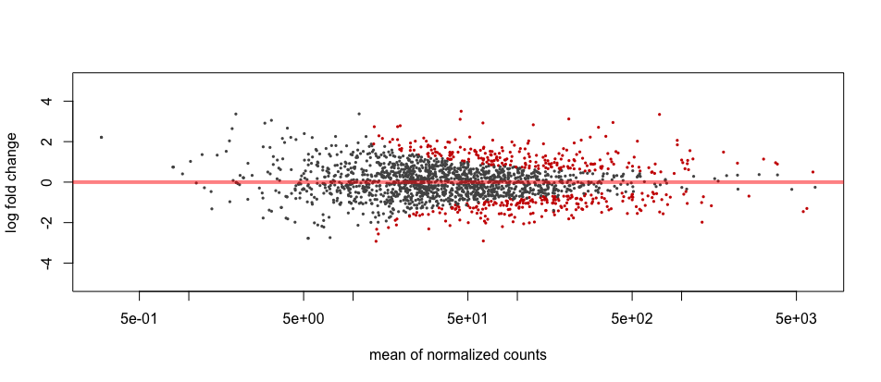
How does H. parainfluenzae respond to S. mitis aerobically?
Notes:
Can we get any clues
Hpara has almost 2000 genes, 350 differentially expressed

Slide 28
H. parainfluenzae aerobic response to S. mitis
11 fold increase in pilQ
3 fold increase in cas9
4 fold increase in tfoX
3 fold increase in comE
2 fold increase in comA
2.5 fold increase in hfq*
2.3 fold increase in mutS*
3 fold increase in dpo4
*Chen & Gottesman (2017)
Notes:
pilq, which is involved in competence
Tfox is a regulator of competence
Come and coma
So an increased expression of genes involved in competence
Competence pathway in hpara not well characterized but in some species antimicrobials can trigger competence
There is also increased expression of the crispr cas9 gene, which is widely considered to be the bacterial version of an adaptive immune response
Hfq chaperone- which some studies suggest has a role in stress response
mutS DNA mismatch repair protein
Paper late last night- hfq is able to exploit the MMR pathway to increase mutation rates in response to stress for adaptive mutagenesis
DNA pol 4-error prone
Overall it just looks like hpara may be eliciting a stress response of sorts

Slide 29
How does this apply to in vivo conditions?

Slide 30
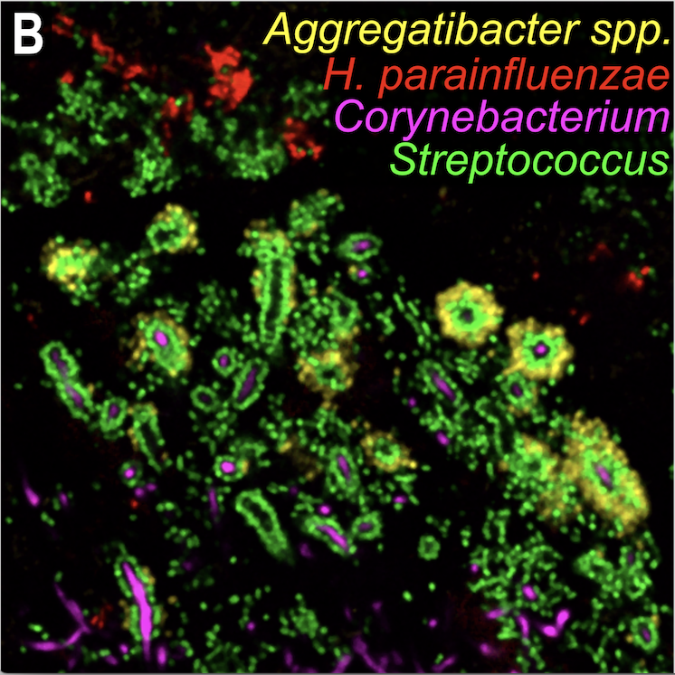
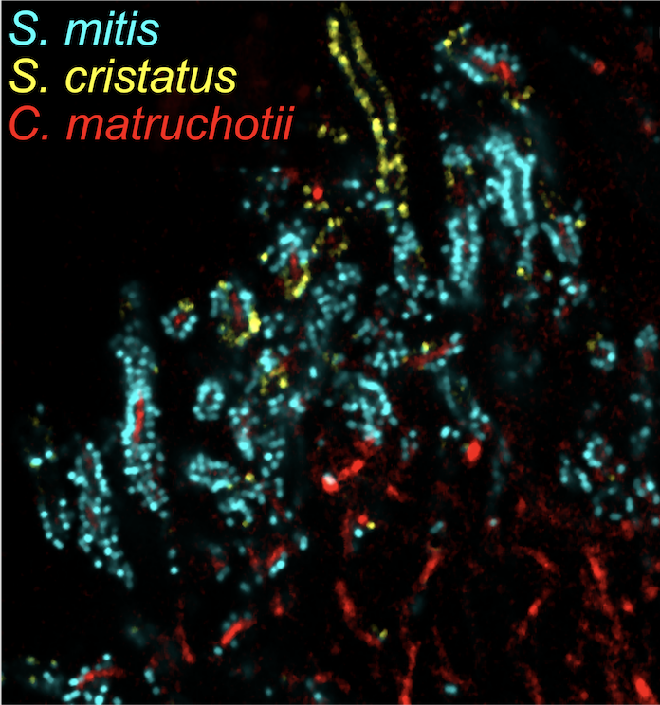
Images courtesy of Dr. Jessica Mark-Welch
Notes:
Hpara, found adjacent to but excluded from these corncobs.
abundance of smitis in corncobs
From my data we know aerobically mitis kills hpara
Both hpara and mitis are found in the aerobic region of the headgehog
Presence of mitis in corncobs excludes hpara to periphery

Slide 31
Work this year
We will perform mono vs coculture transcriptome measurements for K. kingae with H. parainfluenzae and S. mitis
  Along with transcriptomes for monoculture K. kingae rpoN and pilR mutants

Slide 32
Global hypothesis
Do the adjacent microbiota influence K. kingae colonization and virulence?
Type-IV pili are required for epithelial cell adherence; however, expression is likely to be modulated for Kk to circulate to distal sites during infection
How does Kk survive in the bloodstream?

Slide 33
Aim 2. Identification of genes required for Kk in vivo survival and attachment
Hypothesis: Genes in addition to type-IV pili are critical for attachment and other genes are necessary for complement lysis survival in the bloodstream
Experiment: Generate saturating Tn-Seq libraries to identify mutants that A) exhibit diminished attachment to epithelial cells and B) are sensitized to complement-mediated lysis

Slide 34
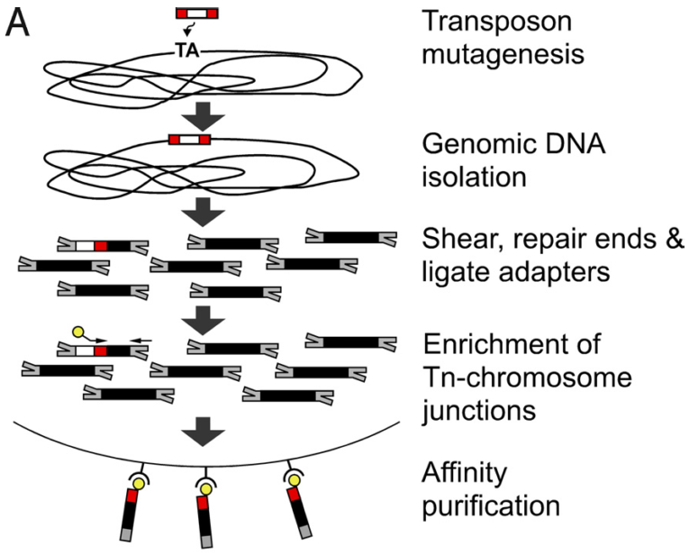
Tn-seq Library Generation
Single unique insertion
Grow in different conditions
Find which mutants are fit
Notes:
Reference
Cut affinity purification out
Ideally we get a single unique insertion per bacterium
We allow these bacteria to grow in different conditions
All mutants grow together in the same tube
We find which mutants are fit
Grown in co-culture
Which mutants survive
We ligate adaptors to shredded DNA
Most that have the adaptors don’t carry the Tn
We enrinch for Tn-chromosome junctions
Amplification enrichment of Tn-chromosome junctions
After -> illumina sequencing
Million of reads
We are generating mutants the exact same way but we are saturating library with Mariner
Goal is to get as close to a saturated library where all the TA are inserted
Each individual bacteria has a single unique insertion
All mutants are all together
What insertions are present grown in different conditions
High-throughput sequencing (Illumina)
ENRICH
This goes to Illumina high-throughput sequencing
Each bacteria should have a single unique insertion.
The goal is to make as much mutants as you can for the library

Slide 35
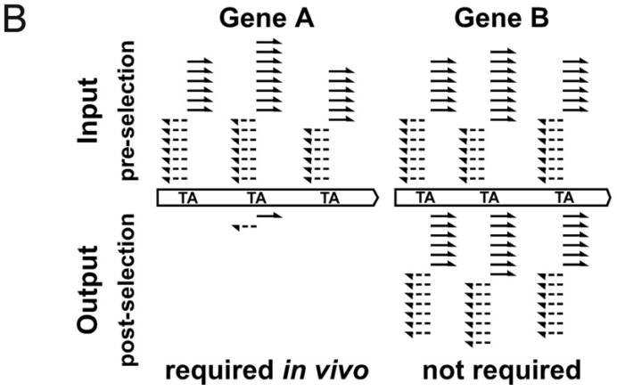
Alignment of Transposon Reads
# of reads correlates to the fitness of mutant
Gene A is conditionally essential
Stacy, Ramsey et al., AEM 2017
Notes:
Talk about the bacterial genome (reference)
If we have a saturating mariner library then every TA site on the chromosome can be filled by an insertion in the chromosome at any direction
The more unique insertions the better resolution we get per gene
This is why we need a lot of insertions
Aligning reads to bacterial chromosome
Good coverage with gene B
Number of reads corelates to the fitness of those mutants
Gene A becomes conditionally essential in co-cultures
Scale up process to entire genome
Determine essential genes for CM in different conditions that we will grow it in (co-culture)
Get rid of bottom labels and B
Now that we generated a saturated library
We align sequences to our reference genome
We look for amount of reads that align to genes and this will tell us if those mutants grew in those conditions
Mutants in gene B were not impaired for growth
Gene A had great coverage in our input library
In our ouput we had no copies of gene A
THESE ARE THE ILLUMINA SEQUENCES ALIGNED
THESE ARE FROM TWO DIFFERENT EXPERIMENTS
ANIMATE THE BOTTOM OUT
SCALING UP FROM THIS WE WOULD NEED OVER 100,000 UNIQUE INSERTIONS
BETTER QUALITY WITH MORE TA INSERTIONS
NUMBER OF ALIGNMENTS FOR EACH TA FOR EACH GENE GIVES YOU AN IMPRESSION OF FIT THAT ORGANISM IS

Slide 36
Aim 2 outcomes
We will identify Kk mutants that are diminished in epithelial cell attachment
We will identify Kk mutants that display increased sensitivity to complement lysis
We will identify Kk essential genes for in vitro growth

Slide 37
In Progress
We have generated a >10⁶ insertion mariner transposon library in H. parainfluenzae during this award
Identical conjugation methods have not been successful in Kk
We are attempting transformation via natural competency with a linearized form of our mariner delivery vector

Slide 38
Summary
This project will characterize rtx toxin regulation and identify any other type-IV pili regulatory factors
We will also identify any genes that assist in complement resistance
Future studies will include macrophage survival and/or evasion and immune responses to Kk

Slide 39
Training
Dasith Perera – 2nd yr PhD student
  Performed much of the H. parainfluenzae coculture work
  Tested several genetics tools in Kk
  Oversaw Adam and Joe during the summer
Adam Capwell – CMB Junior
  Performed much of the support work for experiments done here
Joe Honig – PharmD Junior
  Performed initial genetics work in H. parainfluenzae
Shannon Oliver – CMB Junior
  Is currently generating the H. parainfluenzae sequence libraries this summer (SURF)

Slide 40
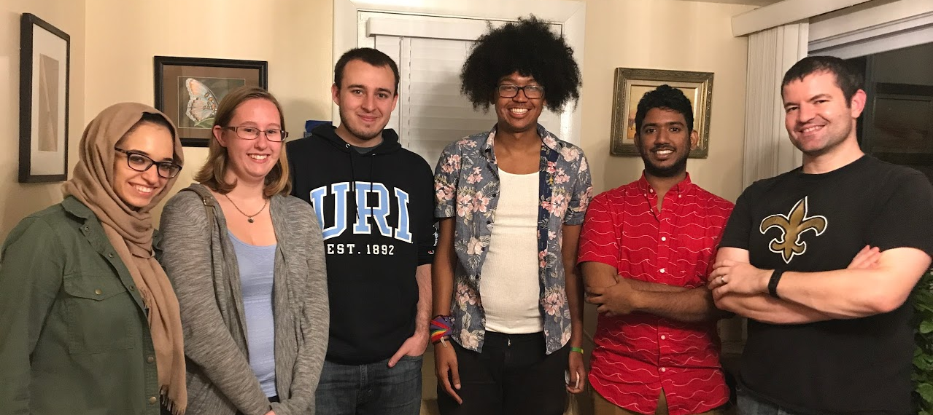




Acknowledgements
Graduate Students:
Eric Almeida
Dasith Perera
Funding:
RI Foundation Medical Research Fund
RI INBRE Early Career Award
Undergraduate Students:
Leen Alsalhi
Adam Capwell
Joe Honig
Shannon Oliver
Collaborators:
Marcelo Freire (Forsyth / Harvard)
Katherine Lemon (Forsyth / Harvard)
Jessica Mark Welch (U Chicago / MBL)

