Slide 1


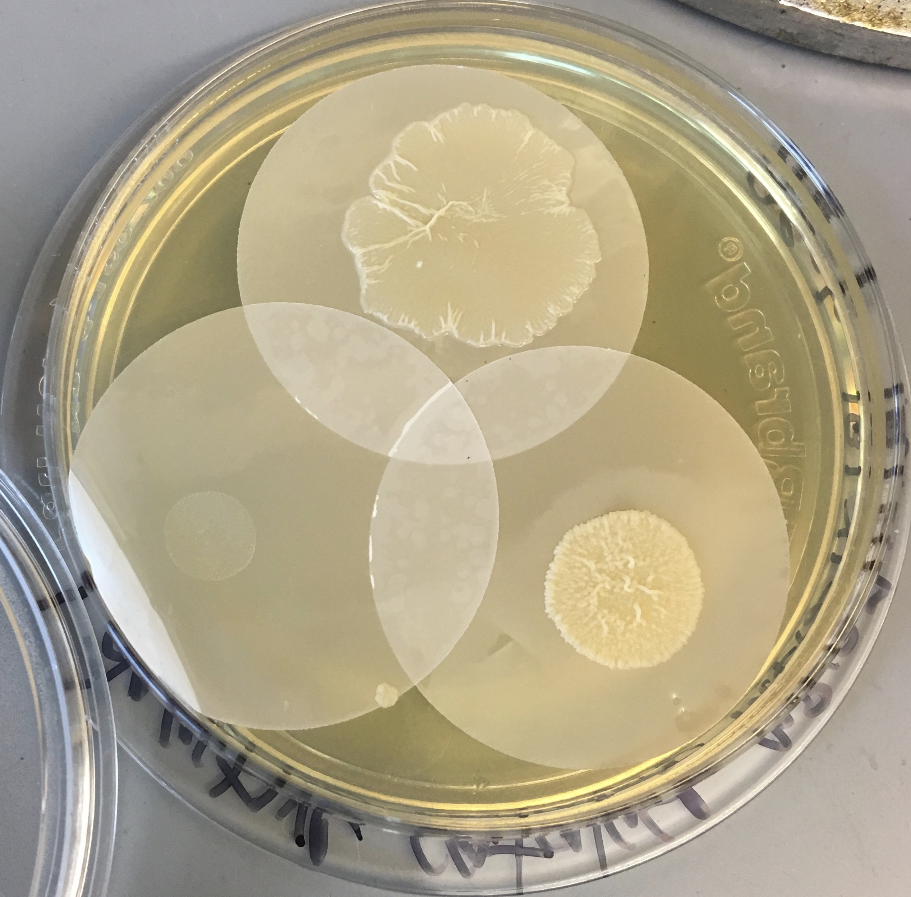
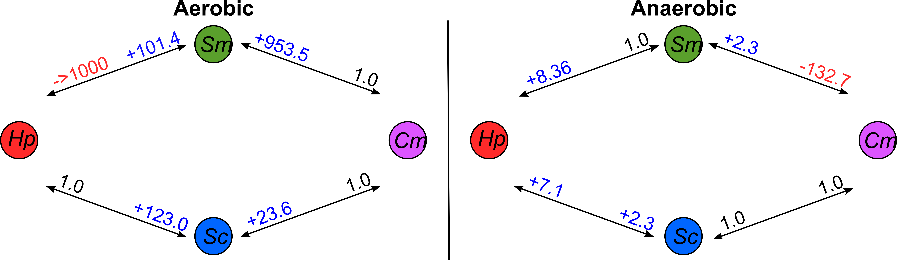
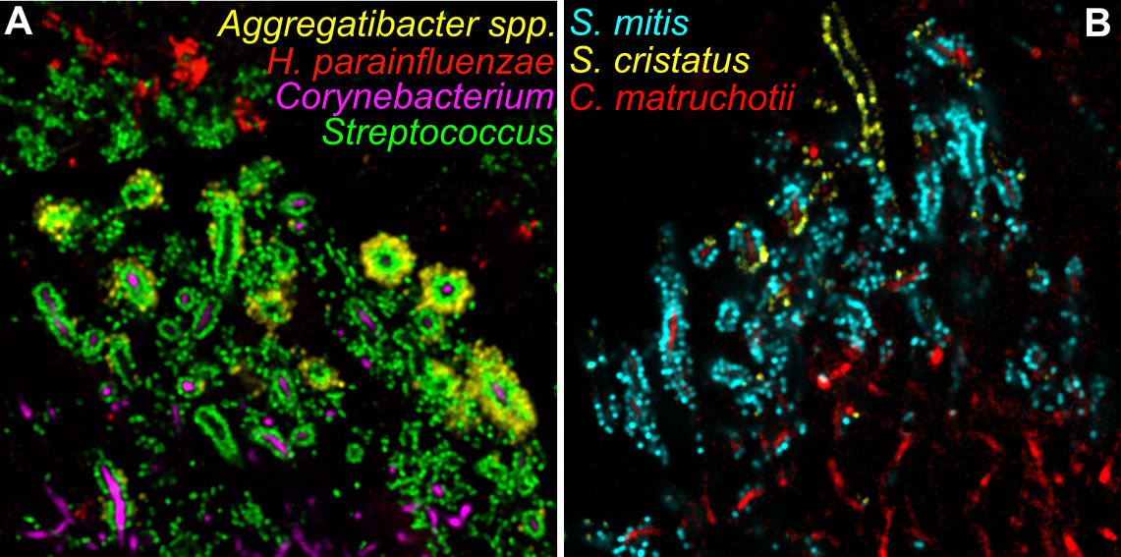
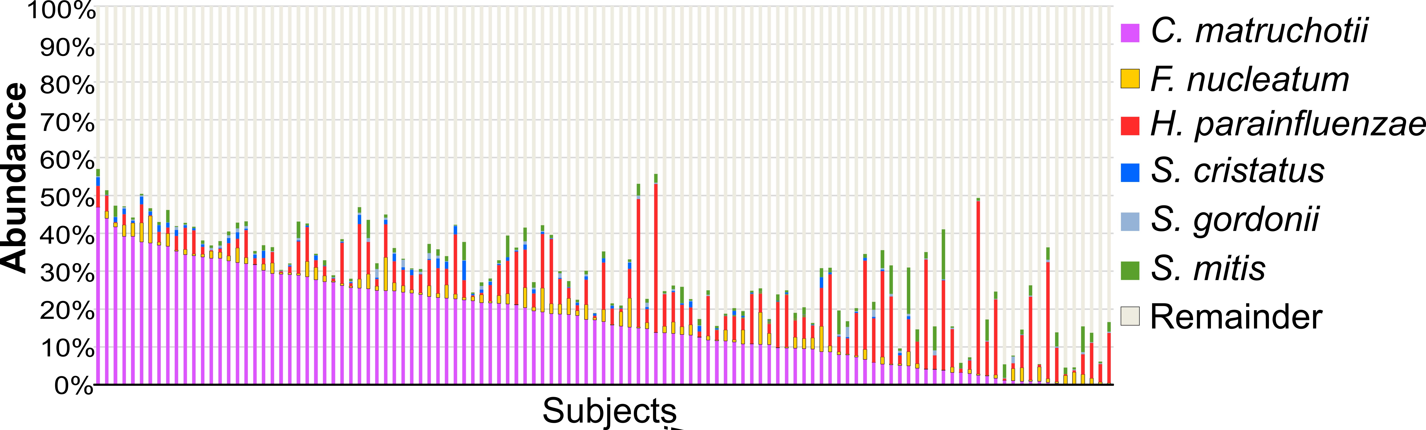


Identifying Mechanisms that Dictate Spatial Organization of the Human Oral Microbiota
Eric Almeida, Dasith Perera, Matthew Ramsey
University of Rhode Island, 45 Upper College Rd, Kingston, RI 02881
Abstract
Human supragingival plaque is a complex polymicrobial biofilm on the tooth surface above the gumline, comprised of ordered structures with spatial associations between specific bacterial taxa. In healthy subjects these communities harbor a low abundance of opportunistic pathogens whose numbers increase during oral disease. Our lab seeks to discover mechanistic interactions between healthy plaque microbiota to find ways to prevent or diminish growth and/or virulence of opportunistic pathogens. Recent microscopy and microbiome data has revealed that plaque structure is scaffolded by the abundant, filamentous Corynebacterium matruchotii bacterium decorated with Streptococcus species including S. mitis and S. cristatus. These data also indicate a high number of Haemophilus parainfluenzae adjacent to plaque structures and adhered to Streptococcus. Using a reductionist approach comparing mono vs cocultures we discovered that aerobically S. mitis and S. cristatus growth is stimulated by C. matruchotii and that S. mitis strongly inhibits H. parainfluenzae growth. Anaerobically, S. mitis inhibits C. matruchotii while enhancing H. parainfluenzae growth and these results can explain one facet of community structure as Streptococcus species only decorate C. matruchotii in the aerobic perimeter of plaque structures. Transcriptome (RNASeq) analyses of these cultures suggest that S. mitis-produced bacteriocin may suppress H. parainfluenzae growth aerobically but not anaerobically. C. matruchotii shows increased expression of lactate catabolism genes aerobically with Streptococcus but not anaerobically where its growth is inhibited. Together these findings may explain mechanisms underlying the spatial arrangement of these species in a polymicrobial community.
Results
Figure 4. Mono vs coculture data with H. parainfluenzae and C. matruchotii.
S. mitis (Sm), S. gordonii (Sg) and S. cristatus (Sc) were incubated in mono or coculture with either C. matruchotii (Cm) or H. parainfluenzae (Hp) aerobically, or anaerobically. Student’s t-test significant (n≥3, p ≤0.05) fold change CFU values of mono vs coculture are indicated as positive (blue) or negative (red). Values of 1.0 indicate no significant change observed.
Figure 5. Colony biofilm model for culturing.
Cells were grown on 0.2µm polycarbonate membranes at 37ºC aerobically and anaerobically in either mono or coculture. Cells were then enumerated and fold changes were calculated (Fig 4). Culturing of cells for RNASeq analysis (Table 1) was also carried out using this method.
Lactate gene expression by C. matruchotii in coculture with S. mitis aerobically
Conclusions
Fold Change | p-adj | CDS | Gene name | Description
4.38 | 6.24E-03 | 199 | lutA | (Fe-S)-binding protein
3.51 | 5.28E-04 | 200 | lutB | (Fe-S) cluster-binding protein
3.15 | 3.78E-03 | 201 | lutC | Lactate utilization protein C
Streptococcus growth substantially increases aerobically in the presence of C. matruchotii or H. parainfluenzae, hypothetically due to consumption of Streptococcus produced lactate.
H. parainfluenzae is excluded from ‘corncob’ structures hypothetically by S. mitis-produced bacteriocin whose export may be diminished when adjacent to C. matruchotii.
Figure 1: Model of the hedgehog structure of supragingival plaque.
C. matruchotii (magenta) filaments span the entire structure. The hedgehog interior is hypothesized to be anaerobic due to the presence of strict anaerobes. At the tips of most filaments a ‘corncob’ structure of cocci is formed, including S. cristatus (blue) and S. mitis (green), in direct contact with the C. matruchotii. H. parainfluenzae (red) appears to be excluded from these ‘corncob’ structures. Reproduced from Mark Welch, J. et al. (2016)².
.
Introduction
Many human oral diseases are marked by changes in oral microbiome composition. A majority of humans will suffer at least one type of oral disease, including periodontitis, which is a risk factor for other complications including heart disease¹. While the oral microbiomes for humans in health and disease has been well studied to date, much remains to be discovered about how individual species within this polymicrobial environment interact, and how this contributes to community stability and relates the onset of disease. Our lab seeks to characterize interactions between healthy oral polymicrobial communities so we might understand how their interactions may preserve ‘healthy’ communities.
Microscopy of healthy supragingival plaque (SUP) has revealed a spatial arrangement of microbes into a reproducible structure like a ‘hedgehog’ with ‘corncobs’ consisting of the filamentous Corynebacterium matruchotii and Streptococcus species (Figure 1)². The hedgehog hypothetically possesses an oxygen gradient decreasing from the perimeter, due to the presence of strict anaerobes at the interior. Also hypothesized is that Streptococcus species at the perimeter produce H₂O₂ and lactate from oxygen and host-provided carbohydrate. Other genera are arranged in close proximity to C. matruchotii in a way that suggests that it may dictate or create a desirable environment for these microbes and have a role in the spatial arrangement of the plaque biofilm. Found adjacent (but excluded) from these ‘corncobs’ is Haemophilus parainfluenzae, a potential opportunistic pathogen at high abundance in SUP. We aim to determine the mechanistic relationships between species found in SUP, here examining C. matruchotii and H. parainfluenzae, to help elucidate what governs the spatial arrangement of these species and potentially whether these relationships influence the abundance of opportunistic pathogens found in the healthy plaque. We hypothesize that C. matruchotii aids Streptococcus survival by actively detoxifying the environment through catalase production (removal of reactive oxygen species) and cross-feeding of metabolites, such as lactate (removal of acid stress), allowing these species to thrive in close proximity. We have also observed that H. parainfluenzae similarly enhances the growth of Streptococcus and are examining a potential mechanism for its exclusion from the hedgehog structure by S. mitis.
Bacteriocin gene expression by S. mitis aerobically
Future Work
Fold Change | p-adj | CDS | Gene name | Description
30.03 | 4.23E-11 | 969 |  | Bacteriocin exporter
44.86 | 9.73E-15 | 970 |  | Bacteriocin secretion accessory protein
Determine if S. mitis-produced bacteriocin is responsible for H. parainfluenzae inhibition.
Determine necessity of lactate utilization by C. matruchotii and H. parainfluenzae for coculture with streptococci.
Determine the transcriptional regulator of the lutABC operon in C. matruchotii.
Use transposon mutagenesis to identify essential genes in C. matruchotii and H. parainfluenzae in the presence of Streptococcus species.
Stress responses induced in H. parainfluenzae when cocultured with S. mitis aerobically
Fold Change | p-adj | CDS | Gene name | Description
11.32 | 3.11E-10 | 24 | pilQ/hofQ | Type IV pilus secretin
6.89 | 0.002 | 731 | pilC/hofC | Type IV assembly protein
4.22 | 1.15E-14 | 322 | tfox | Transcriptional regulator of competence
2.85 | 0.001 | 507 | comE | Competence protein/ Response regulator
2.28 | 0.03 | 28 | comA | Competence protein/ Response regulator
2.35 | 1.27E-07 | 1745 | hfq | RNA chaperone
2.13 | 0.03 | 240 | mutS | DNA mismatch repair protein
Works cited
1. Humphrey, Linda L., et al. (2008) ‘Periodontal Disease and Coronary Heart Disease Incidence: A Systematic Review and Meta-Analysis’, J. Gen. Intern. Med., pp. 2079-2086. doi:10.1007/s11606-008-0787-6.
2. Mark Welch, J. et al. (2016) ‘Biogeography of a human oral microbiome at the micron scale’, PNAS, pp. 791–800. doi:10.1073/pnas.1522149113.
3. Eren AM, et al. (2014) ‘Oligotyping analysis of the human oral microbiome’, PNAS, pp. 2875-2884. doi:10.1073/pnas.1409644111.
4. Chai, Y., et al. (2009) ‘A Widely Conserved Gene Cluster Required for Lactate Utilization in Bacillus Subtilis and Its Involvement in Biofilm Formation’, J. Bact., pp. 2423–2430., doi:10.1128/jb.01464-08.
5. Wholey W-Y, et al. (2016) ‘Coordinated Bacteriocin Expression and Competence in Streptococcus pneumoniae Contributes to Genetic Adaptation through Neighbor Predation’, PLoS Pathog, doi:10.1371/journal.ppat.1005413.
Table 1: Key findings of transcriptome analyses of pairwise interactions.
RNASeq of mono and coculture samples under both aerobic and anaerobic conditions was performed via Illumina sequencing. Reads were aligned to genomes via Bowtie2. HtSeq was used to assign reads to coding sequences and DESeq2 was used to carry out a differential expression analyses. Bacteria were grown in mono or cocultures spotted onto 0.2µm-pore sterile polycarbonate membranes on solid agar medium (Fig. 5).
A. In coculture with S. mitis, C. matruchotii differentially expressed 24 genes over 2-fold, shown here are: lutA, lutB, and lutC. The lutABC operon has been shown to be highly conserved in many bacteria and allows for the utilization of lactate as a carbon and energy source⁴. Directly upstream of the operon is lctP which encodes l-lactate permease and is constitutively expressed. Identical results were observed in coculture with S. cristatus.
B. RNAseq data from S. mitis monocultures reveal increased expression of a bacteriocin exporter and bacteriocin secretion accessory protein aerobically compared to anaerobically. This expression stays high in the presence of H. parainfluenzae. Interestingly, in the presence of C. matruchotii this expression is significantly reduced. Bacteriocin production in some Streptococcius species has previously been documented to aid in reduction of species that compete for the same niche⁵.
C. H. parainfluenzae demonstrates increased expression of genes involved in competence and type IV pili formation in coculture with S.mitis. There is also an increased expression of genes implicated in mutagenesis (hfq and mutS). These are hypothetically due to increased stress due to oxidative or bacteriocin-produced stress by S. mitis and were not upregulated in coculture with S. cristatus.
Figure 2: Species level FISH of ‘corncobs’ within supragingival plaque.
A. C. matruchotii (magenta) filaments forms ‘corncobs’ with Streptococcus (green). H. parainfluenzae (red) appears to be excluded from these ‘corncob’ structures but is found associated with Streptococcus.
B. The ‘corncob’ structures consist of C. matruchotii (red) that are closely associated with S. cristatus (yellow) and S. mitis (blue).
(Images courtesy of Dr. Jessica Mark Welch, MBL, Woods Hole, MA)
Acknowledgements
Research was supported in part by the Institutional Development Award (IDeA) Network for Biomedical Research Excellence from the National Institute of General Medical Sciences of the National Institutes of Health under grant # P20GM103430.
RNASeq libraries were constructed and sequenced at the Broad Institute of MIT and Harvard by the Microbial ‘Omics Core and Genomics Platform, respectively. The Microbial ‘Omics Core also provided guidance on experimental design and conducted preliminary analysis for all RNASeq data.
We thank Drs. Jessica Mark Welch, Gary Borisy, and Katherine Lemon for their many valuable suggestions and advice.
Leen Alsahi, Adam Capwell, Joe Honig and Shannon Oliver assisted with media and culture work in this project for which we are grateful.
Figure 3. Relative sequence abundance for oral species of interest.
Relative microbiome sequence abundance of C. matruchotii and other species of interest. This represents total % read abundance for 117 subjects from the Human Microbiome Project (HPM) data for supragingival plaque. V1-V3 16S sequences were assigned species-level analysis via Oligotyping³.

