Slide 1
Deciphering Kingella kingae colonization and infection
Matthew M. Ramsey PhD
University of Rhode Island
Kingston, RI

Slide 2
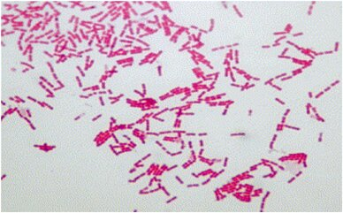
Kingella kingae
Gram-negative β- proteobacteria
Neisseriaceae family
β-hemolytic, oropharynx colonizing organism
1.95 Mb genome, ~2013 genes

Slide 3
K. kingae virulence
Part of the HACEK group of endocardial pathogens
Expresses a singular RTX toxin, essential for virulence
Has type-IV pili
Has (so far) 4 distinct capsule varieties

Slide 4
K. kingae infection
>95% of infections occur in ages 6-48 months
Found to be a frequent cause of ‘culture-negative bone infections of unknown origin’
Causes distal osteoarticular, septic arthritis, osteomyelitic and endocardial infections
Several child-care center outbreaks observed within the decade
  In one incident, 73% of children tested positive for Kk carriage, 28% colonized at any given time (n=48).

Slide 5
K. kingae infection
Amongst carriers, infection presents anywhere from 0.1-20% of the time.
  This is skewed upward due to outbreaks within daycare centers
  ~1/100,000 children ages 1-5y
β-lactam resistance has been observed
Oropharynx colonization precedes infection, isolates from distal infection sites are clonal to the oropharynx

Slide 6
Summary
K. kingae is a regular part of the pediatric oropharyngeal microbiota
Early immunity is passive from maternal IgG and children develop it again by the age of 5
Transmission seems easy. Infection is rare, but manifests in clusters
Symptoms can be quite severe

Slide 7
Global hypothesis
Does the adjacent microbiota influence K. kingae colonization and virulence?

Slide 8
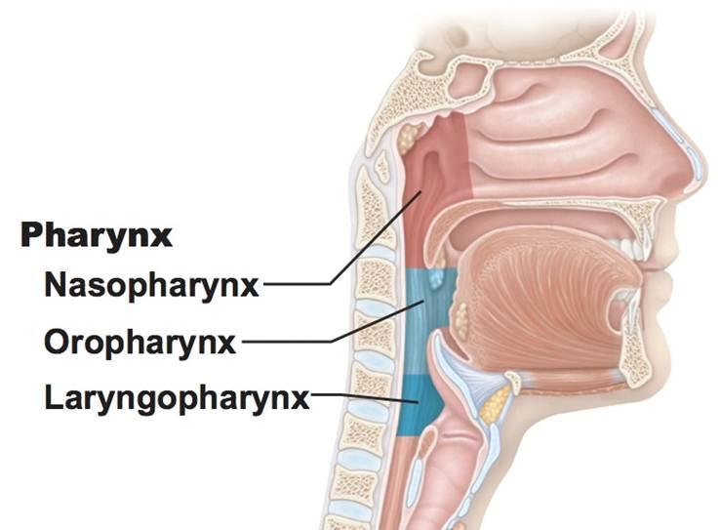
Who are Kk’s neighbors?
Genera include:
  Streptococcus
  Neisseia
  Veillonella
  Haemophilus
  Moraxella
  Rothia

Slide 9
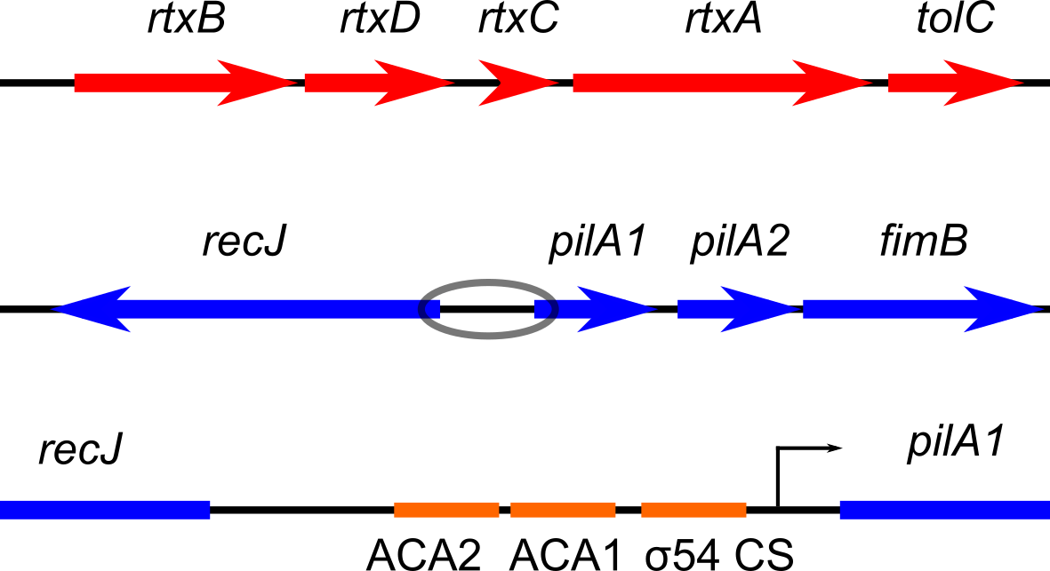
What is known about Kk virulence factor regulation?
Type-IV pili are necessary for full epithelial cell adhesion
Type-IV pili are regulated by the PilR/S two component system
They are also regulated by RpoN / σ54
ACA1/2 are PilR binding sites found at 27 other places on the genome

Slide 10
What is known about Kk virulence factor regulation?
rtx regulation is completely uninvestigated in Kk
σ54 and PilR co-regulate rtx expression in Dichelobacter nodosus

Slide 11
Aim 1. Identification of regulators of type-IV pili and rtx expression in Kk
Hypothesis: PilR and σ54 regulate rtx expression and may be influenced via adjacent microbiota
Experiment: Test promoter-reporter fusions for rtx and pilA1 activity in a transposon mutant library background
Experiment: Test fusion activity in mono vs coculture with oropharyngeal microbes
Experiment: Quantify transcription of ΔpilR and Δσ54 mutants vs wild-type

Slide 12
Aim 1 outcomes
We will identify mutants that lack promoter activity for rtx and pilA1 expression
We will identify the regulon for PilR and σ54 via transcriptome analysis
We will determine if other microbes influence the expression of pilA1 or rtx

Slide 13
Global hypothesis
Does the adjacent microbiota influence K. kingae colonization and virulence?
Type-IV pili are required for epithelial cell adherence; however, expression is likely to be modulated for Kk to circulate to distal sites during infection
How does Kk survive in the bloodstream?

Slide 14
Aim 2. Identification of genes required for Kk in vivo survival and attachment
Hypothesis: Genes in addition to type-IV pili are critical for attachment and other genes are necessary for complement survival in the bloodstream
Experiment: Generate saturating Tn-Seq libraries to identify mutants that A) exhibit diminished attachment to epithelial cells and B) are sensitized to complement-mediated lysis

Slide 15
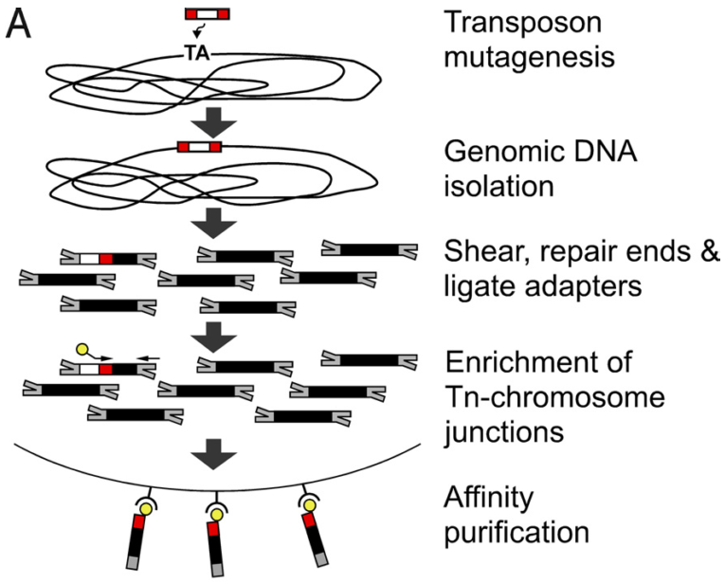
Tn-seq Library Generation
Single unique insertion
Grow in different conditions
Find which mutants are fit
Notes:
Reference
Cut affinity purification out
Ideally we get a single unique insertion per bacterium
We allow these bacteria to grow in different conditions
All mutants grow together in the same tube
We find which mutants are fit
Grown in co-culture
Which mutants survive
We ligate adaptors to shredded DNA
Most that have the adaptors don’t carry the Tn
We enrinch for Tn-chromosome junctions
Amplification enrichment of Tn-chromosome junctions
After -> illumina sequencing
Million of reads
We are generating mutants the exact same way but we are saturating library with Mariner
Goal is to get as close to a saturated library where all the TA are inserted
Each individual bacteria has a single unique insertion
All mutants are all together
What insertions are present grown in different conditions
High-throughput sequencing (Illumina)
ENRICH
This goes to Illumina high-throughput sequencing
Each bacteria should have a single unique insertion.
The goal is to make as much mutants as you can for the library

Slide 16
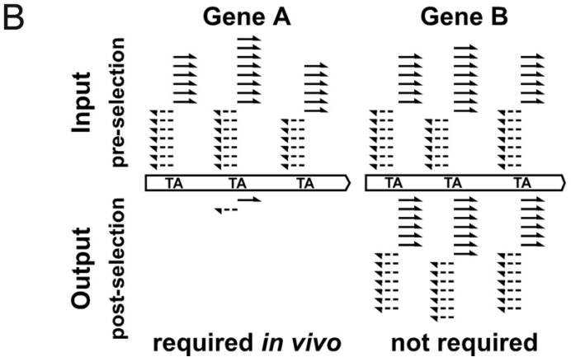
Alignment of Transposon Reads
# of reads correlates to the fitness of mutant
Gene A is conditionally essential
Stacy, Ramsey et al., AEM in review 2017
Notes:
Talk about the bacterial genome (reference)
If we have a saturating mariner library then every TA site on the chromosome can be filled by an insertion in the chromosome at any direction
The more unique insertions the better resolution we get per gene
This is why we need a lot of insertions
Aligning reads to bacterial chromosome
Good coverage with gene B
Number of reads corelates to the fitness of those mutants
Gene A becomes conditionally essential in co-cultures
Scale up process to entire genome
Determine essential genes for CM in different conditions that we will grow it in (co-culture)
Get rid of bottom labels and B
Now that we generated a saturated library
We align sequences to our reference genome
We look for amount of reads that align to genes and this will tell us if those mutants grew in those conditions
Mutants in gene B were not impaired for growth
Gene A had great coverage in our input library
In our ouput we had no copies of gene A
THESE ARE THE ILLUMINA SEQUENCES ALIGNED
THESE ARE FROM TWO DIFFERENT EXPERIMENTS
ANIMATE THE BOTTOM OUT
SCALING UP FROM THIS WE WOULD NEED OVER 100,000 UNIQUE INSERTIONS
BETTER QUALITY WITH MORE TA INSERTIONS
NUMBER OF ALIGNMENTS FOR EACH TA FOR EACH GENE GIVES YOU AN IMPRESSION OF FIT THAT ORGANISM IS

Slide 17
Aim 2 outcomes
We will identify Kk mutants that are diminished in epithelial cell attachment
We will identify Kk mutants that display increased sensitivity to complement lysis
We will identify Kk essential genes for in vitro growth

Slide 18
Previous data on oral and nasopharynx microbiota interactions

Slide 19
Aggregatibacter
actinomycetemcomitans
Streptococcus gordonii
Aa
Sg
Gram negative
Facultative anaerobe
Pathogen
Gram positive
Facultative anaerobe
Commensal

Slide 20
Necessary for in vivo coinfection
Lactate
X
Aa
Sg
OxyR
H₂O₂
KatA
ApiA
Contributes to immune resistance
Ramsey et al., PLoS Pathog 2011
Ramsey et al., PNAS 2009
Liu, Ramsey et al., PNAS 2010

Slide 21
Summary
S. aureus
alone
S. aureus +
Corynebacterium spp.
AIP-1
AIP-1
Virulence
Factors
?
Antibacterial proteins
Exotoxins
Protein A (Spa)
Cell attachment
Protein A (Spa)
Cell attachment
Antibacterial proteins
Exotoxins
Ramsey et al., Frontiers Micro 2016
Notes:
[]read diggle paper again re AIP as public good in Sau
[]Cst exploiting Sau public good – acting like a cheater
[]Could the mixed infection with Coryne actually promote chronicity while inhibiting invasion & bacteremia?

Slide 22
Summary
This project will characterize rtx toxin regulation and identify any other type-IV pili regulatory factors
We will also identify any genes that assist in complement resistance
Future studies will include macrophage survival and/or evasion and immune responses to Kk

Slide 23







The Whiteley Lab
Kelli Palmer
Stacie Brown
Lauren Warren
Peter Jorth
Holly Huse
Greg Palmer
Aishwarya Korgaonkar
Aimee Wessels
Collaborators
Kendra Rumbaugh (Texas Tech)
Marcelo Freire (Forsyth/ HSDM)
Gary Borisy (Forsyth)
Jessica Mark-Welch (MBL)
The Lemon Lab
Lindsey Bomar
Isabel Fernandez Escapa
Matthew Ramsey
Jennifer Spagnolo
Silvio Brugger
Megan Lambert
Brian Klein
The Ramsey Lab
Eric Almeida
Dasith Pererra
Funding:
NIDCR F31 DE019995
NIAID F32 AI102498
RI Foundation Medical Research Fund

