Slide 1
Identifying molecular mechanisms of interspecies interactions within the microbiome
Matthew M. Ramsey, PhD
The Forsyth Institute
Cambridge, MA
Notes:
20pt font for all references.

Slide 2
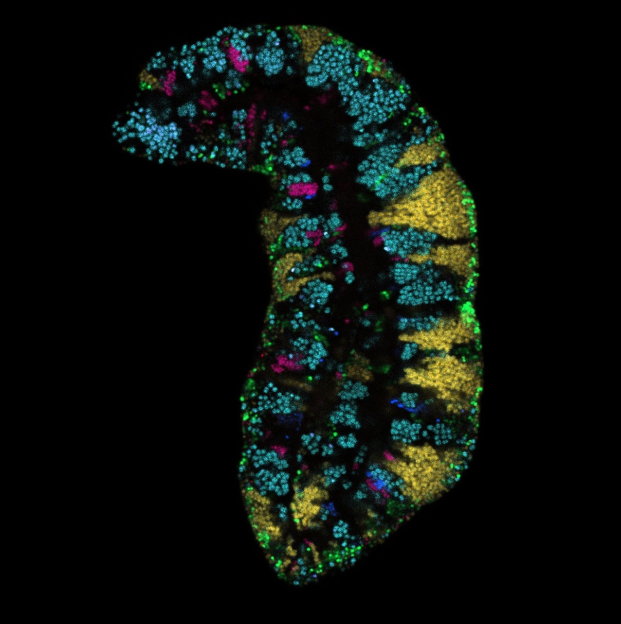
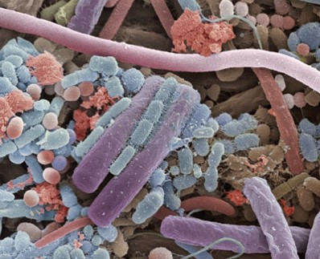
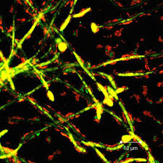
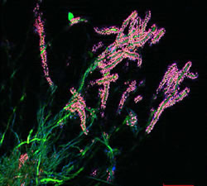
Polymicrobial communities are common
Pocketdentistry.com
c/o Dr. Gary Borisy
Notes:
Bacteria in nature rarely live alone. Their behavior in mixed populations suggests their role.
These interactions may dictate microbiome composition and/or function in health and disease

Slide 3

Talk Outline
Identifying molecular interactions in polymicrobial infections
  Human periodontal infection
  Human skin chronic infection
Future Work
  Commensal interactions
  Hybrid community interactions

Slide 4
A top down view of a complex community
Metabolites
or Signals
Synergy
Antagonism
Notes:
It’s key to hit the transition here from this big-picture concept to the fact that polymicrobial infections are one example of such complex microbial networks
You may need another slide to make the transition smooth, it’s hard to tell from just your slides.

Slide 5
A reductionist approach to reveal interactions
in vitro
“omics” approaches
molecular mechanisms
extrapolate to in vivo
Notes:
It’s key to hit the transition here from this big-picture concept to the fact that polymicrobial infections are one example of such complex microbial networks
You may need another slide to make the transition smooth, it’s hard to tell from just your slides.

Slide 6
A reductionist approach to reveal interactions within a complex network
Notes:
It’s key to hit the transition here from this big-picture concept to the fact that polymicrobial infections are one example of such complex microbial networks
You may need another slide to make the transition smooth, it’s hard to tell from just your slides.

Slide 7
Microbial interactions in polymicrobial infections
Many infections are polymicrobial
Pathogen–Pathogen
Pathogen–Commensal
Commensal–Commensal
Notes:
Sepsis is often monomicrobial so NOT a good example for this audience, as are many abscesses. You need better examples for point 1, e.g., diabetic foot infections, traumatic wound infections, periodontitis.

Slide 8
How to identify potential interactions to study in the lab?
Hypothesize interactions based on...
  high relative abundance (probability)
  co-isolation
  statistical correlation
  co-localization
Notes:
I animated this, so that you can make each point and build towards co-localization.
I changed the order, since I am thinking you’ll want to mention the pros and cons for each of these approaches, as well as the increasing degree of difficulty experimentally.

Slide 9
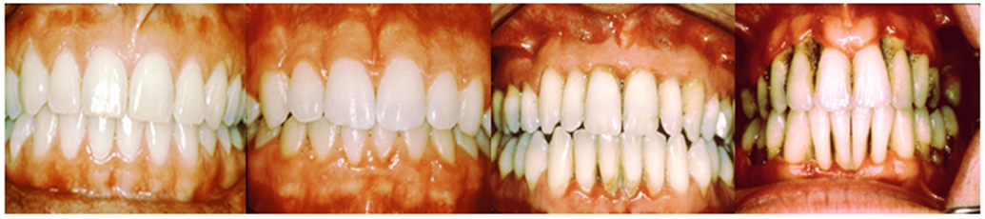
Acute Periodontitis
Complex polymicrobial infection
Healthy plaque transitions to a Gram-negative anaerobe-rich variety
A risk factor for heart disease
www.oramd.com
Notes:
Add images of gingivitis then Perio

Slide 10
Aggregatibacter
actinomycetemcomitans
Streptococcus gordonii
Aa
Sg
Gram negative
Facultative anaerobe
Pathogen
Gram positive
Facultative anaerobe
Commensal

Slide 11
Necessary for in vivo coinfection
Lactate
X
Aa
Sg
OxyR
H₂O₂
KatA
ApiA
Contributes to immune resistance
Detoxifies mM concentrations in <10 um distances
Ramsey et al., PLoS Pathog 2011
Ramsey et al., PNAS 2009
Liu, Ramsey et al., PNAS 2010

Slide 12
Talk Outline
Identifying molecular interactions in polymicrobial infections
  Human periodontal infection
  Human skin chronic infection
Future Work
  Commensal interactions
  Hybrid community interactions

Slide 13
Diabetic foot ulcer infections (DFIs)
Chronic polymicrobial infections
  Superficial wounds progress to non-healing, infected ulcerations
  Precedes amputation
S. aureus is a common pathogen
Commensal Corynebacterium
  C. striatum, C. amycolatum
New approaches needed for prevention and treatment
Gardner S et al. (2013) Diabetes
Citron DM et al. (2007) J. of Clin. Micro

Slide 14
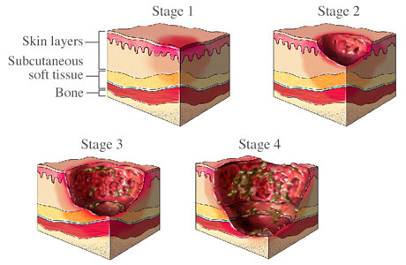
www.gluxus.com

Slide 15
Corynebacterium
striatum
Staphylococcus
aureus
Cst
Sau
Gram positive
Benign commensal
Understudied
Gram positive
Invasive pathogen
Commensal as well
agr Quorum Sensing

Slide 16
agr and Virulence
O
AIP-1
M
S
I
F
Y
S
T
C
D
Exotoxins
Hemolysin
Degradation enzymes
Adhesion factors
Notes:
Animate bottom section in 2 steps
“Virulence” and “Colonization” aside from each arrow as well.

Slide 17
The S. aureus agr system plays a critical role in pathogenesis
Commensal
Pathogen
agr OFF
Adhesion / evasion
agr ON
Virulence factor production
Notes:
Does the data support agr OFF in colonization.
Any point in including the cell density info since that is all in vitro?

Slide 18
S. aureus modulates extracellular virulence factor production
Commensal
Pathogen
agr OFF
Adhesion / evasion
agr ON
Virulence factor production
Notes:
Does the data support agr OFF in colonization.
Any point in including the cell density info since that is all in vitro?

Slide 19
Human Skin Interactions
Corynebacterium and Staphylococcus aureus
Positive correlation in diabetic foot wound infections
These species also overlap in the healthy human nasal cavity
Gardner et al. (2013) Diabetes

Slide 20
Hypothesis
C. striatum and S. aureus directly interact with each other
Notes:
Say this and only write the hypothesis. Otherwise the slide is very busy with next that distracts from your key point, which is the hypothesis.
S. aureus and Corynebacterium striatum
are co-isolated from DFIs
These species also overlap on colonized human skin

Slide 21
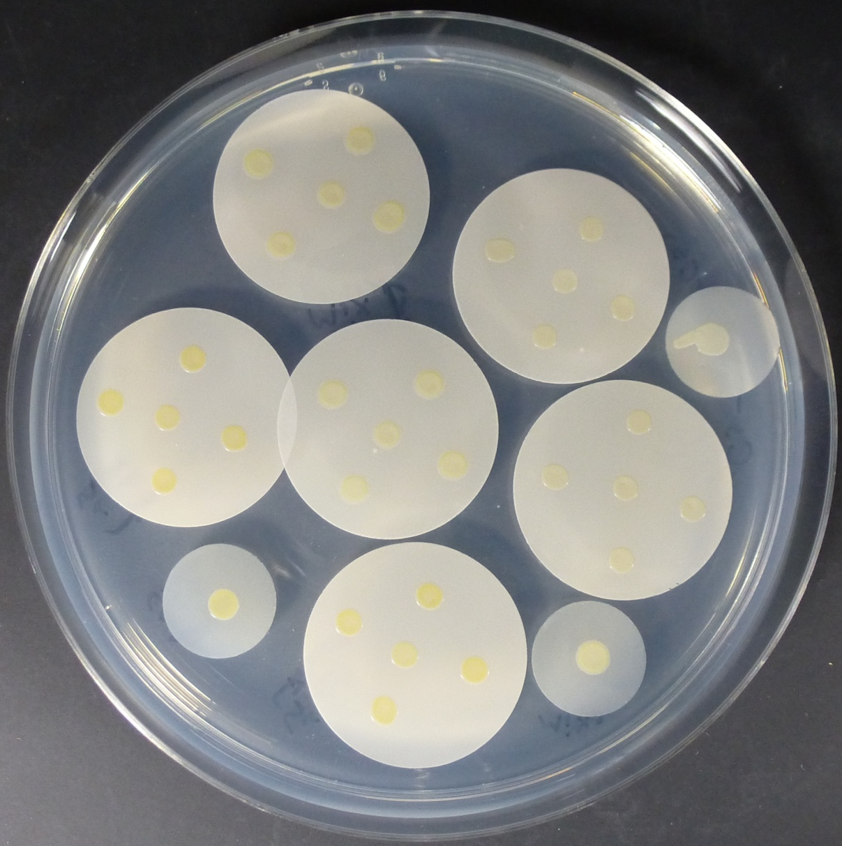
S. aureus-C. striatum coculture assay
C. striatum
5 x 10⁶
S. aureus JE2
5 x 10⁵
Mixed inoculum
Notes:
Color coded and animated labels for mono / cocultures here

Slide 22
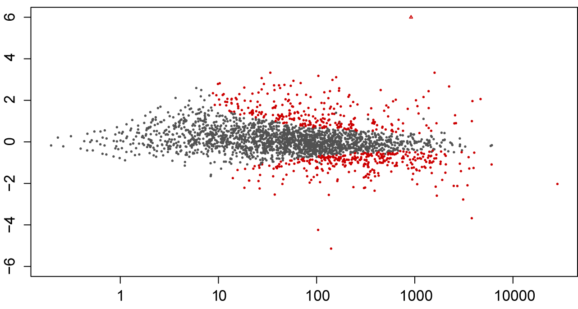
Cocultivation with C. striatum induces broad changes in S. aureus transcription
log₂ fold change
mean expression

Slide 23
S. aureus agr regulon is repressed in coculture with C. striatum
~50% of the genes differentially expressed belonged to the agr regulon
Most genes involved in virulence were repressed
Many cell surface proteins and genes involved in adherence were induced

Slide 24
Hypothesis
S. aureus quorum sensing decreases in response to C. striatum

Slide 25
Summary
All Corynebacterium spp. tested inhibit S. aureus agr QS activity
Other S. aureus agr types are inhibited
Purifying and identifying inhibitor in collaboration

Slide 26
Hypothesis
C. striatum induces S. aureus commensal behavior
S. aureus agr null mutants display decreased virulence

Slide 27
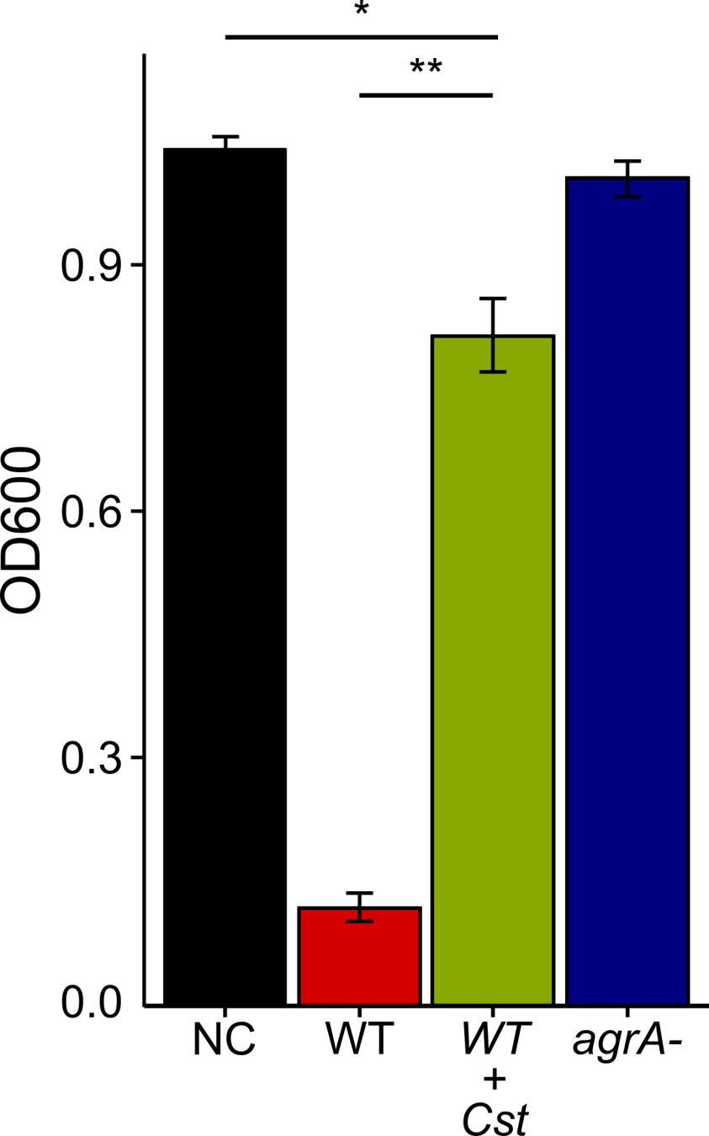
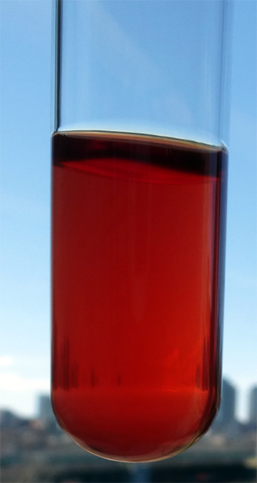
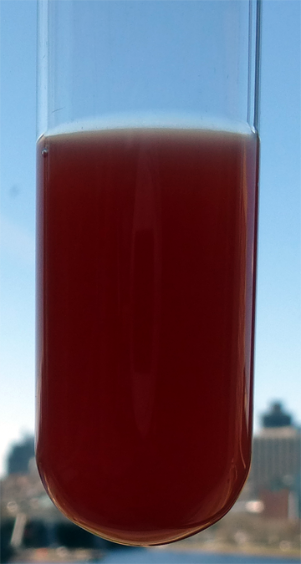
S. aureus hemolysis is inhibited by C. striatum
WT
WT+Cst
*p < 0.05, **p < 0.01 n = 8

Slide 28
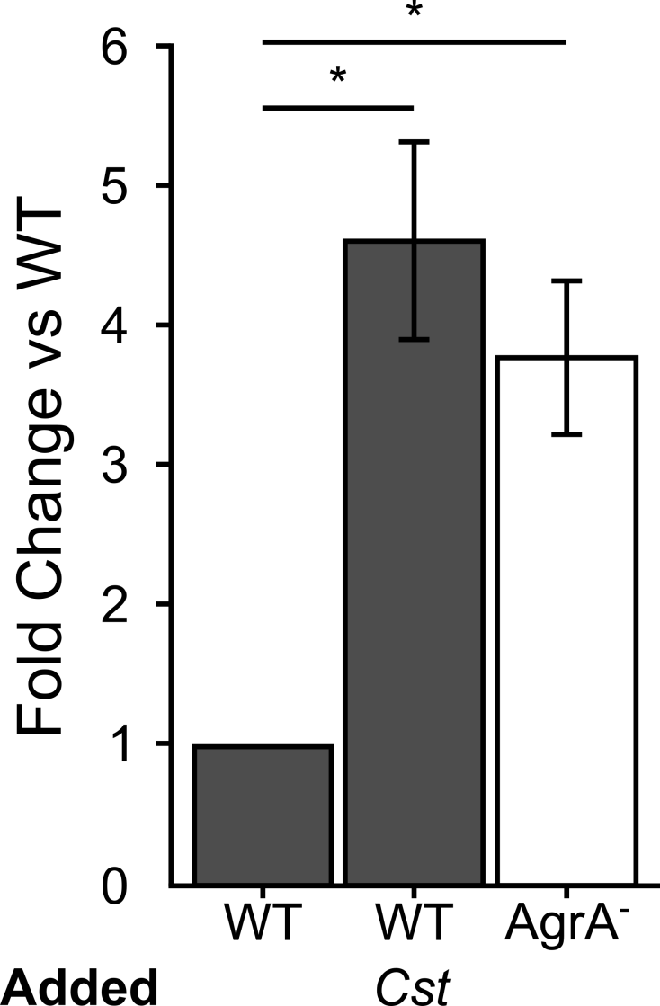
S. aureus epithelial cell attachment

Slide 29
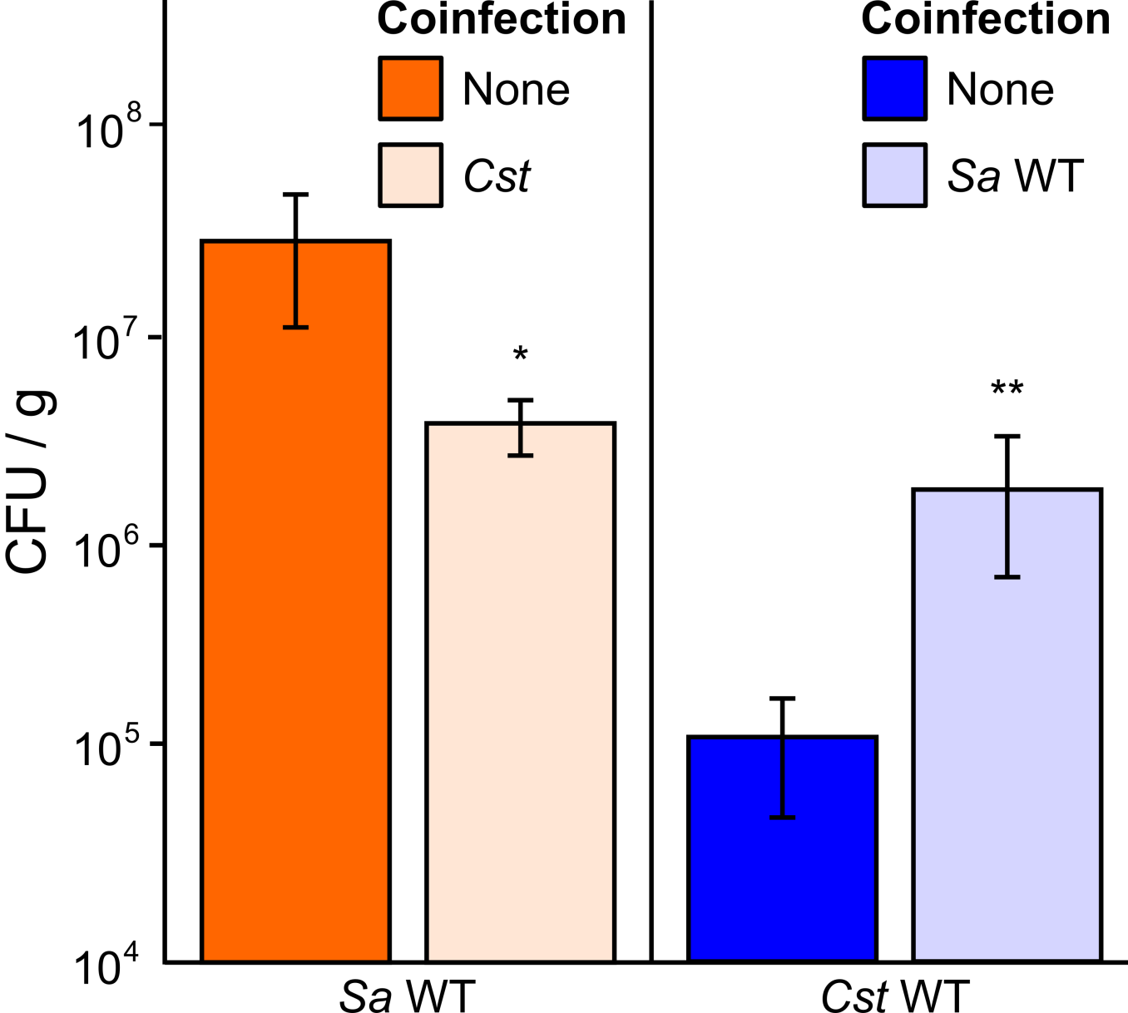
Mouse subcutaneous abscess infection
Survival of C. striatum increases in abscesses with wild-type S. aureus
Survival of wild-type S. aureus decreases in abscesses with C. striatum

Slide 30
What about nasal colonization?
in vitro coculture
shared between conditions
cap†
clfB
isdA
met*
oatA
opp*
sbnC
spa
eap
psm*
?
Krismer et al. PLoS Path. 2014
Burian et al. JID. 2010
Burian et al. PLoS One 2010
Kiser et al. InI. 1999
Nasal colonization
Notes:
Make bigger img, get rid of bullet points, remove non overlap gene names

Slide 31
S. aureus colonization
Commensal
Pathogen
agr OFF
Colonization
Elevated attachment
agr ON
Invasion
Notes:
Animate through all 3 types of sau growth here.

Slide 32
S. aureus pathogenesis
Commensal
Pathogen
agr OFF
Colonization
Elevated attachment
agr ON
Invasion
Extracellular virulence factors
Notes:
Animate through all 3 types of sau growth here.

Slide 33
Chronic infection in diabetic foot wounds
Commensal
Pathogen
Chronic infection
agr OFF
Colonization
agr ON
Invasion
Poor circulation
Poor immune function
Notes:
Animate through all 3 types of sau growth here.

Slide 34
Talk Outline
Identifying molecular interactions in polymicrobial infections
  Human periodontal infection
  Human skin chronic infection
Future Work
  Commensal interactions
  Hybrid community interactions

Slide 35
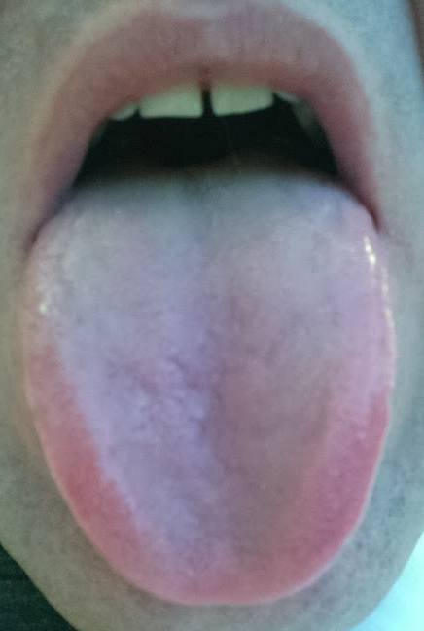
Human Tongue Dorsum
Microbiota overlaps with other oral sites
High bacterial species diversity
High biomass
Microbiota varies in halitosis

Slide 36
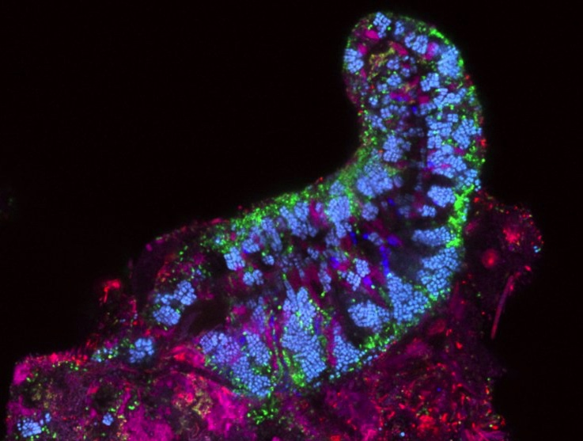
Tongue Dorsum
Streptococcus
Rothia
Veillonella
Neisseriaceae
Prevotella
TM7
20 microns

Slide 37
Tongue Dorsum Data
Human Microbiome Project (HMP) tongue dorsum data from 77 subjects
16S rRNA gene V1-V3 region
Notes:
Combine with next slide
2. Healthy participants are subjects and not patients.

Slide 38
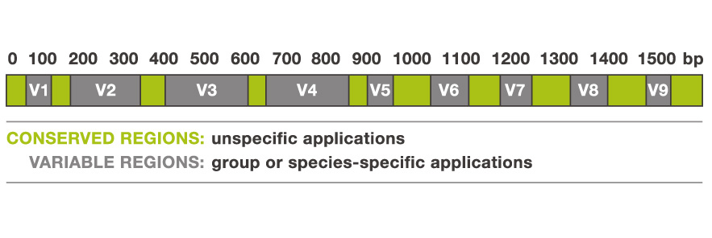
The bacterial 16S rRNA gene
Alimetrics.com
Notes:
Combine with previous slide

Slide 39
Selecting species level interactions
Often, for clinical relevance we need to get to species level
Oligotyping can identify at 98.5%
  Species adequate
    Depends on 16S Variable regions sequenced
    Depends on sequence database used
Eren M, et al (2015) ISME
Eren M, et al (2014) PNAS
Eren M, et al (2013) Met. Eco. and Evo.
Notes:
The statement about oligotyping is not exactly true. Oligotyping + HOMD can identify sequences at 98.5%.
Need to ad spacing between different points to enhance readability

Slide 40
Correlation based interactions
Positive and negative correlations can be calculated between different species
Account for multiple comparisons
  False discovery rate
http://huttenhower.sph.harvard.edu/ccrepe
Notes:
You will need to explain what each of these things are simply and clearly.

Slide 41
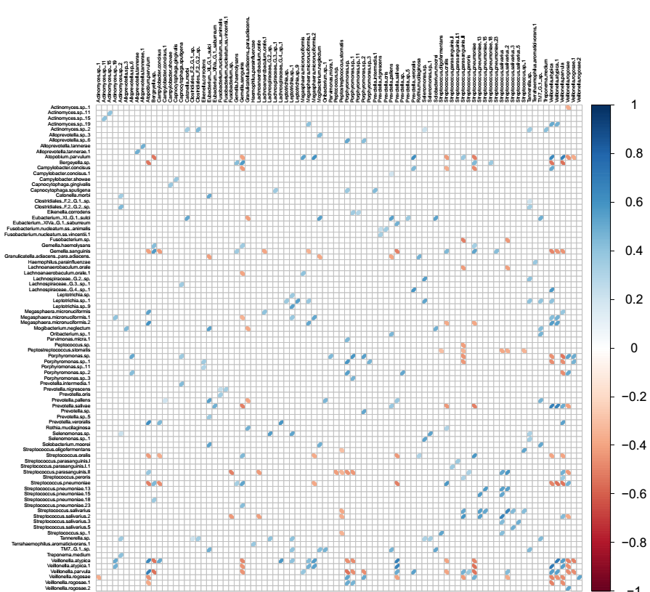
Species
vs
Species
Notes:
WHAT IS THIS?
You need to hit the transition to this exactly. AND... need some kind of title/label. Try having the bottom circle come up first and then adding the other 3.

Slide 42
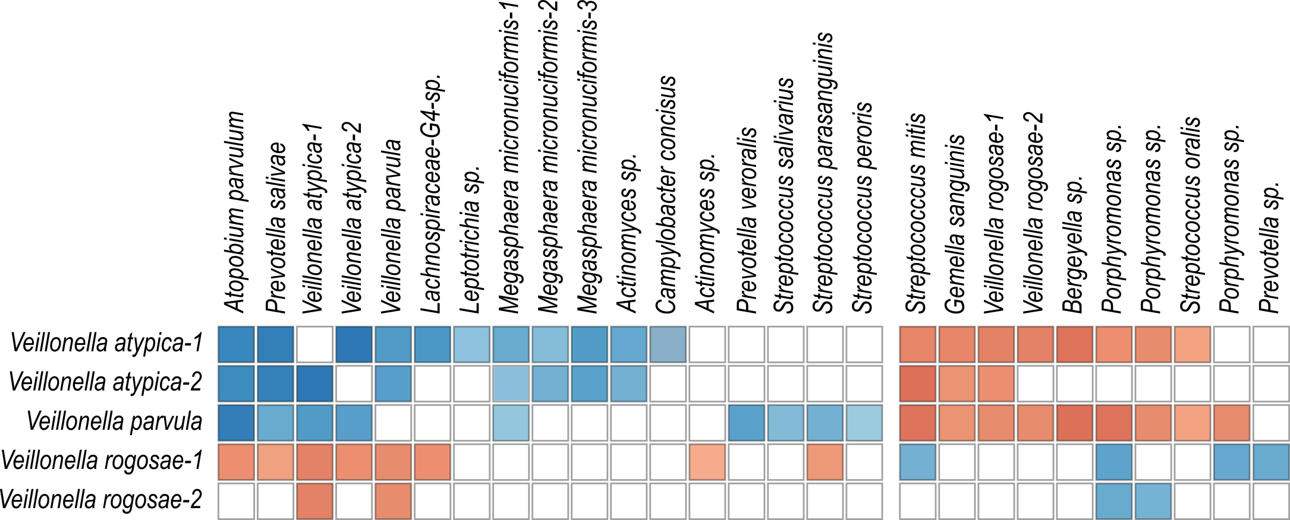
Hypothesis: Two distinct community types are present
Notes:
Condense strains into species.
‘Biomarkers”

Slide 43
Are these data indicative of multiple community types?

Slide 44
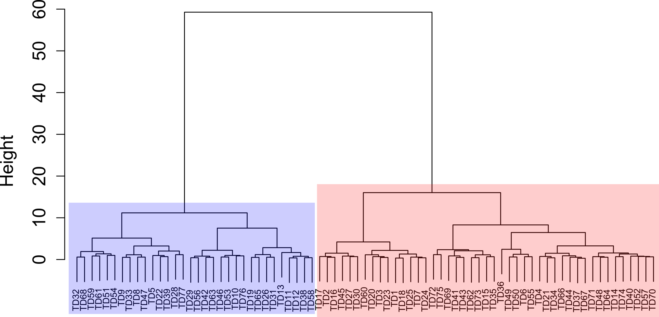
There are at least two community types
Who is in each group?

Slide 45
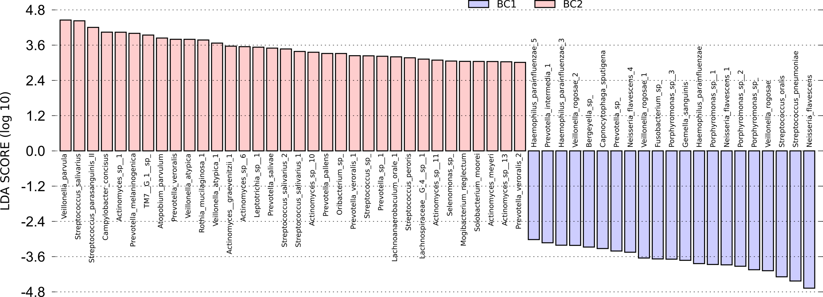
Who is enriched in each group?
Use Linear Discriminate Analysis Effect Size, (LEfSe) to measure associations
Segata et al. Genome Biol. 2011

Slide 46
Veillonella interspecies interactions
Notes:
Add the community boxes back to this.
Add a title with the bottom line.

Slide 47
Veillonella interspecies interactions
What metabolic differences exist between V. rogosae versus V. parvula / V. atypica?
Reannotated the genomes of V. parvula DSM 2008 and V. rogosae JCM15642
  Genomes similar in size
Notes:
Clean up / find better title here

Slide 48
Genome comparisons generate new hypotheses re: interaction mechanisms
V. rogosae
V. parvula
Ni/Fe Hydrogenase
At least 1 phage
Histidine biosynthesis
Vitamin B12
CRISPR system
Catalase

Slide 49
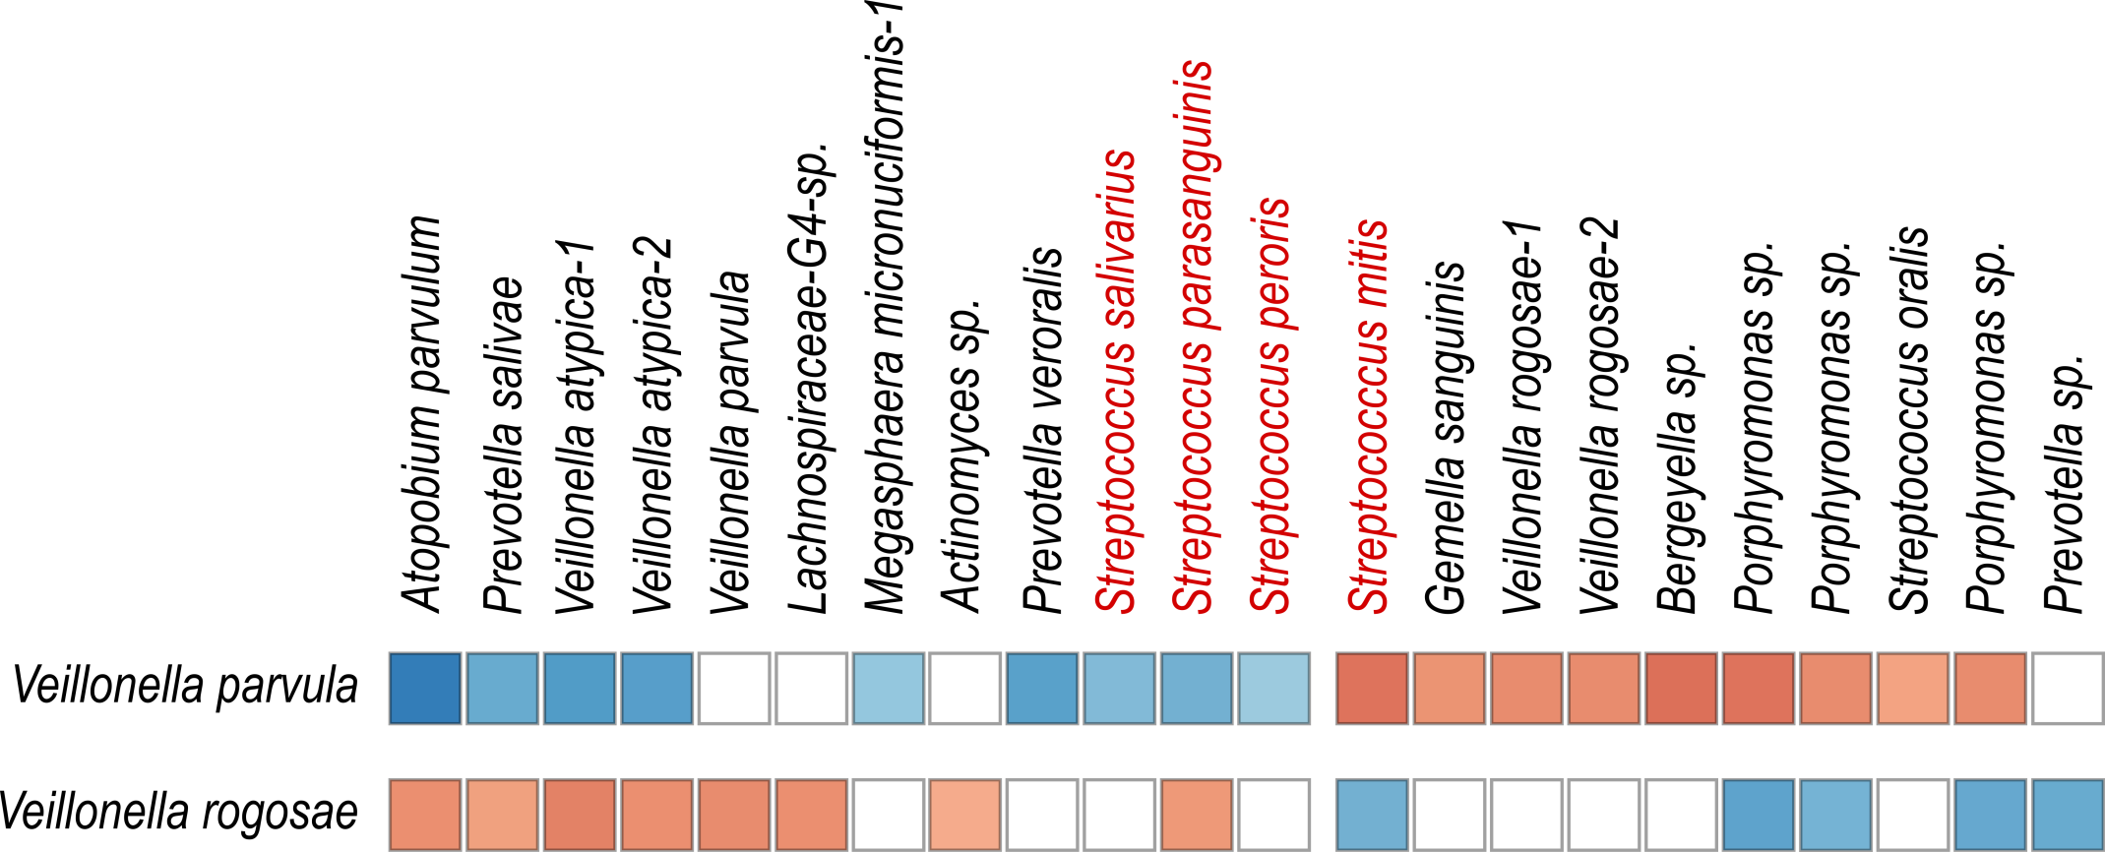
Streptococcus -Veillonella interactions

Slide 50
Summary
Correlations let us hypothesize about community structure
These data inform species pair selection for mono- vs. coculture studies
Immediately testable hypotheses

Slide 51
Talk Outline
Identifying molecular interactions in polymicrobial infections
  Human periodontal infection
  Human skin chronic infection
Future Work
  Commensal interactions
  Hybrid community interactions

Slide 52
Diabetic foot ulcer infections (DFIs)
Chronic polymicrobial infections
Microbiota is variable
  Most attention given to major pathogens
  Many studies have identified potential oral taxa
Diabetics are 3x more likely to develop periodontal infections
Notes:
[]add references!

Slide 53
Isolated infection flora is diverse
Many genera that contain oral species are present in DFIs
These include: Prevotella, Porphyromonas, Fusobacterium, Streptococcus and many more
Bowler et al. (1999) Int. J. Derm.
Dowd et al. (2008) PLoS One
Gardner et al. (2013) Diabetes
Citron et al (2007) J. of Clin. Micro
Notes:
Fix this, minimize, add Dowd and Bowler Data

Slide 54
Are oral species present in DFIs in a meaningful context?

Slide 55
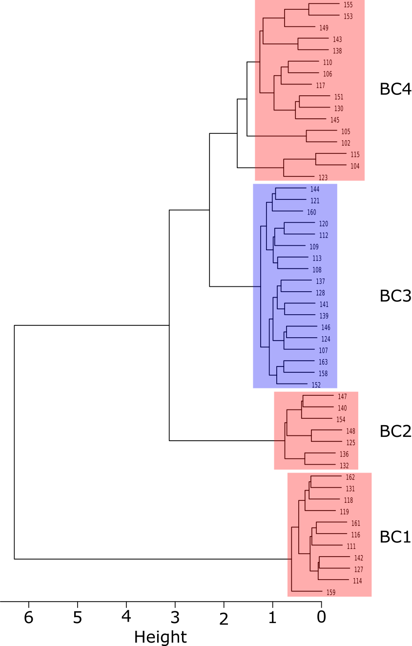
52 patients
~160 species, 83 genera
4 clusters determined by Bray-Curtis dissimilarity
Cluster 3 (18 patients) enriched in anaerobes / oral taxa

Slide 56
Many oral species were present at relative abundances similar to those observed in oral studies
Non-oral species in the same genera were also often present

Slide 57
Two Hypotheses
Oral bacteria autoinfect DFIs within individuals
Oral
?
“Hybrid Community”
Oral bacteria maintain molecular mechanistic relationships with non-oral microbes in DFIs
?
Oral

Slide 58
Why do this?
Proving autoinfection might allow for better containment / hygeine practices
Identification of conserved mechanistic relationships in oral bacteria highlight necessary pathways for in vivo survival that can be exploited

Slide 59
Summary
Oral species are enriched in a subset of DFIs
Oral species appear to form “hybrid communities” with non-oral DFI residents

Slide 60
Mechanistic detail of a complex community
Metabolites
or Signals
Notes:
It’s key to hit the transition here from this big-picture concept to the fact that polymicrobial infections are one example of such complex microbial networks
You may need another slide to make the transition smooth, it’s hard to tell from just your slides.

Slide 61
Conclusion
Reductionist approaches reveal molecular mechanisms
These can influence the transition from health to disease
Will reveal targets and therapeutics to prevent infection
Notes:
3-5 conceptual slides at the end. Focus on organisms response in monoculture not equivalent to coculture, respond both to host and respond to microbial community.

Slide 62





The Whiteley Lab
Kelli Palmer
Stacie Brown
Lauren Warren
Peter Jorth
Holly Huse
Greg Palmer
Aishwarya Korgaonkar
Aimee Wessels
The Lemon Lab
Lindsey Bomar
Isabel Fernandez Escapa
Matthew Ramsey
Jennifer Spagnolo
Silvio Brugger
Megan Lambert
Brian Klein
Collaborators
Kendra Rumbaugh (Texas Tech)
Marcelo Freire (Forsyth)
Markus Hardt (Forsyth)
Funding:
NIDCR F31 DE019995
NIAID F32 AI102498

Slide 63
Ccrepe
Spearman’s Rank, or:
Diamond’s Checkerboard Score
Benjimani, Yuketeli Hochberg q-value adjustment for FDR
Ccrepe can be modified for other correlation statistics and output

Slide 64
Clustering analysis
Test by Hierarchal Clustering Analysis (HCA)
  Bray-Curtis Dissimilarity, Ward’s minimum variance method
This is done on all 77 patient samples
  Can be done with Horn / Morisita, Jaccard etc
  Bootstrapping available

Slide 65
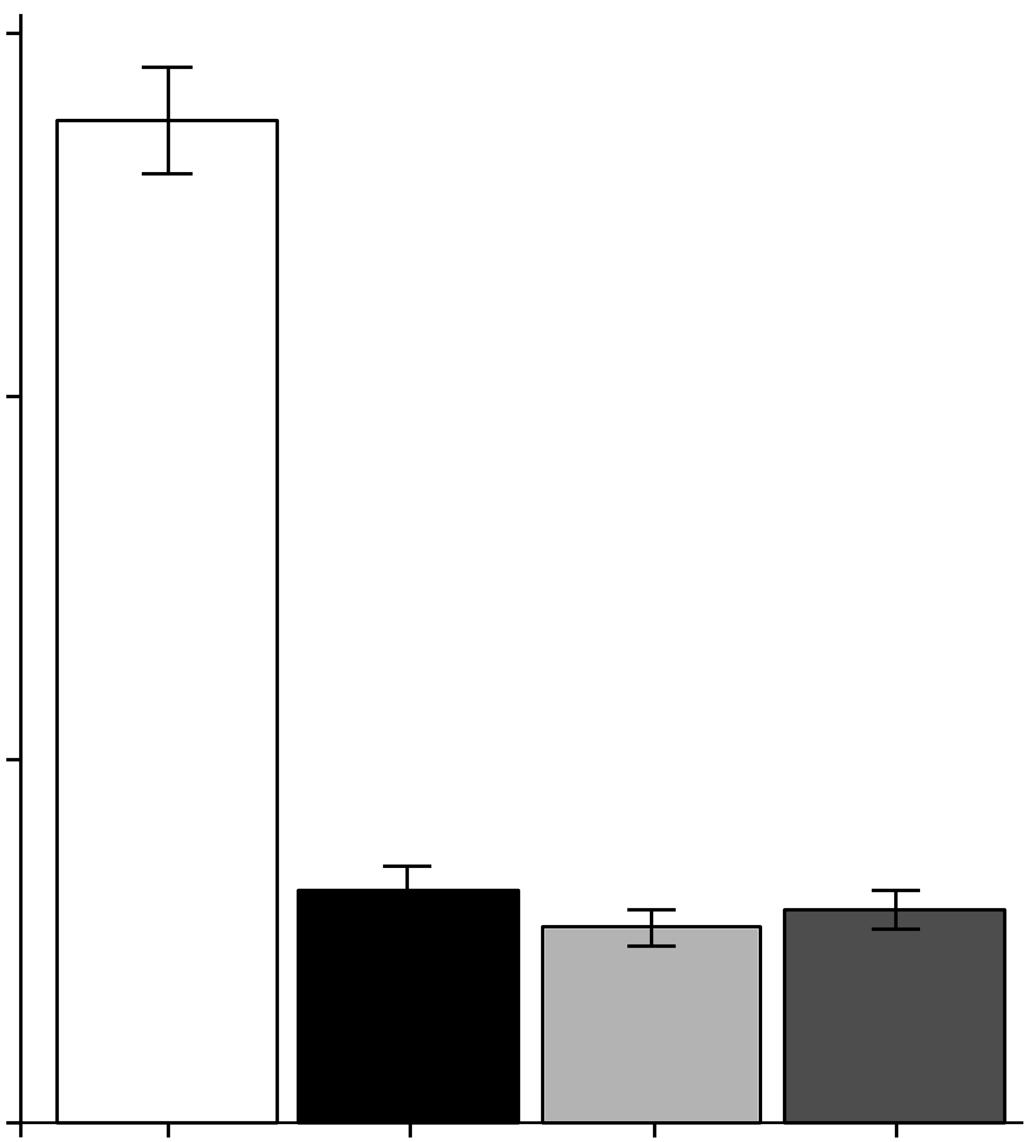
C. striatum (Cst) cell-free conditioned medium inhibits S. aureus AIP-1 signaling
30000
20000
Luminescence
10000
0
BHI
medium
CFCM
Cst
<3kDa
<3kDa
heat
AIP-1 +
n ≥ 3
Notes:
BHI

Slide 66
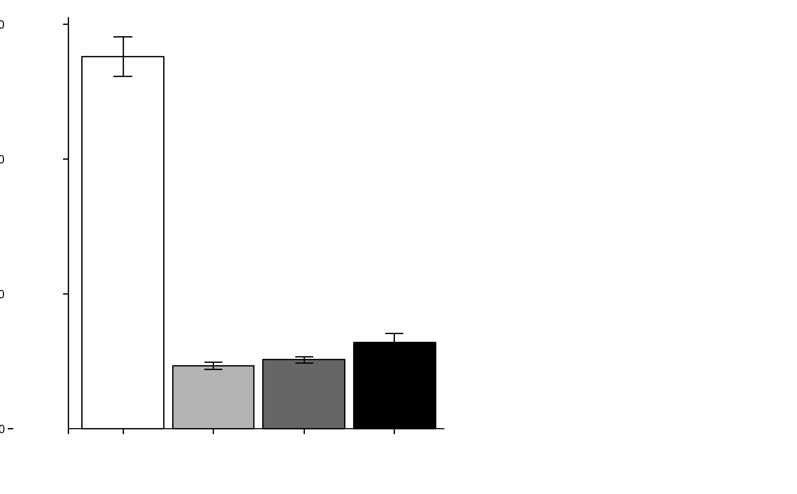
CFCM from other Corynebacterium spp. also interfere with AIP-1 signaling
30000
medium = BHI
Cam = C. amycolatum
Cgl = C. glutamicum
Cst = C. striatum
20000
Luminescence
10000
0
AIP-1 +
medium
Cam
Cgl
Cst
n ≥ 3
Notes:
AIP-1 produced in E. coli
Pre-mix w/ Coryne CFCM for 2 hours then add to S. aureus reporter strain
S. aureus RN4220 ∆agr::ermB P3agr_luxABDCE + pArC/agrA (cmR) / ROJ143
Ink_Cst_Cam_Cst_CFCM_AIP1inhibition.png

Slide 67
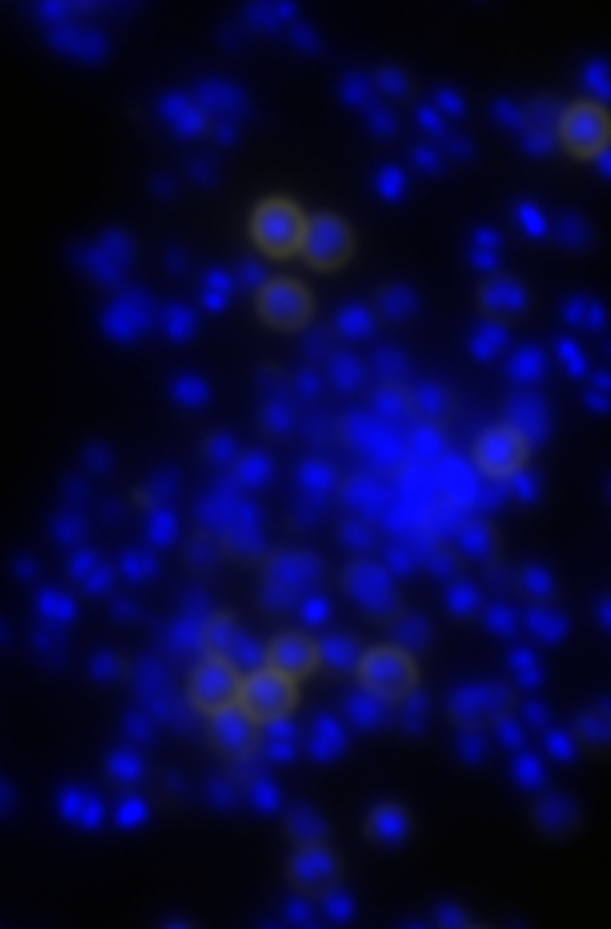
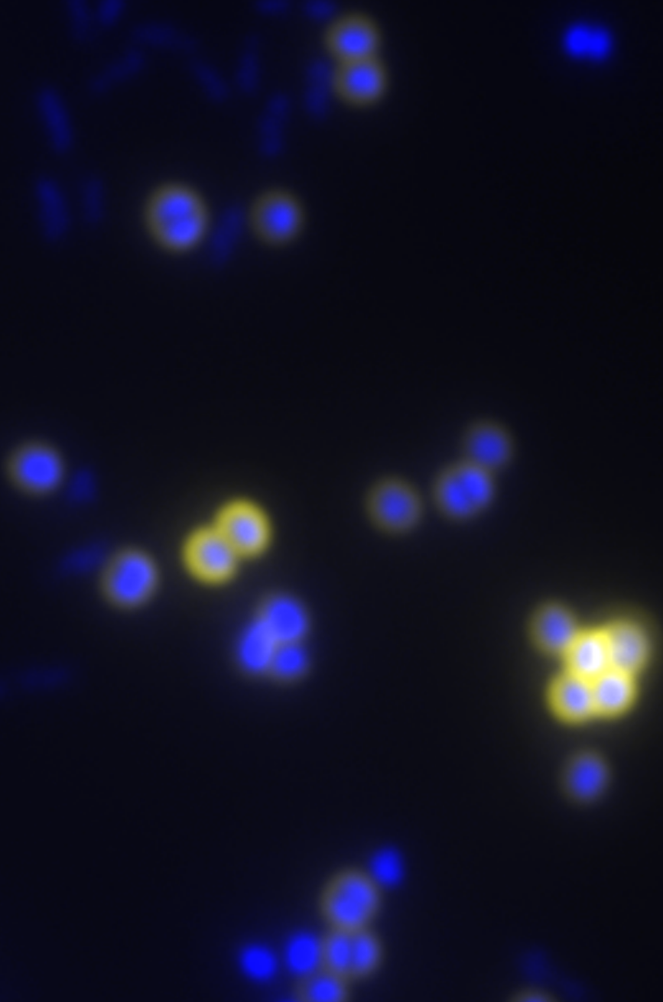
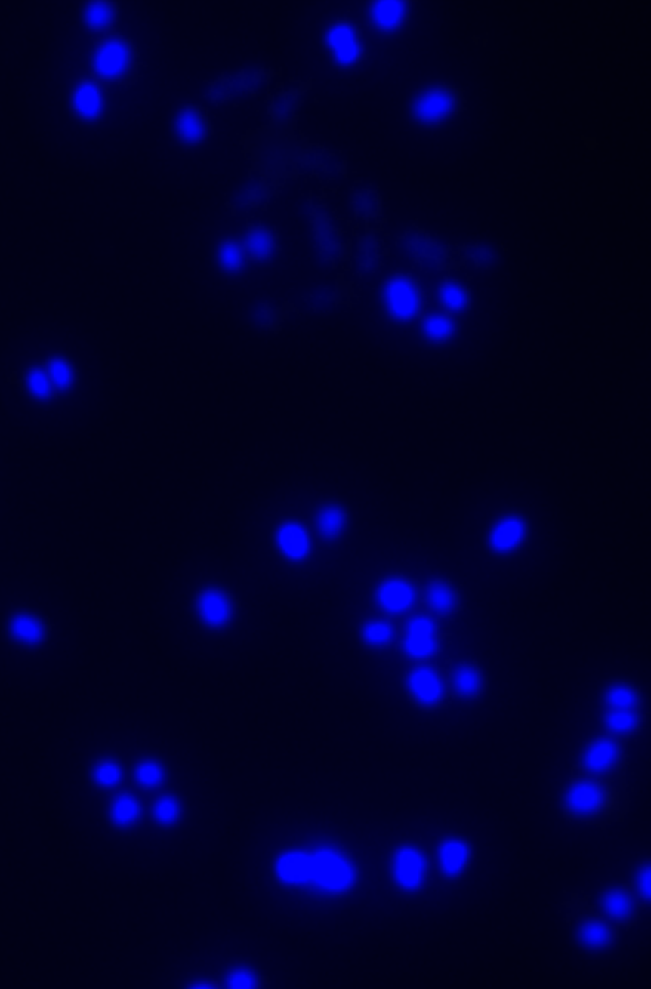
Protein A is increased on S. aureus cells grown in coculture with C. striatum
Cells stained with DAPI
Antibody-stained Protein A
Sau mono
Sau + Cst
Δspa + Cst
4%
59%
n.d.
n=3
Notes:
DAPI was the nuclear stain, FITC was the Spa stain. Images were taken at 1000x magnification under identical exposure settings. Image analysis and counts in each color channel were performed with ImageJ under identical settings for each image to generate the ‘E’ figure above.
P=<0.001 for the figure and these were from a biological n=2.
WT-monoA.png
WT-mixB.png
Spa-mixB.png
+++

Slide 68
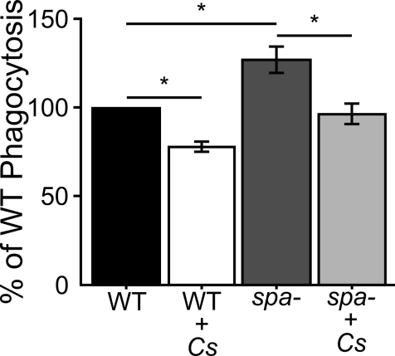
C. striatum inhibits S. aureus phagocytosis
*p < 0.05, n = 4

Slide 69
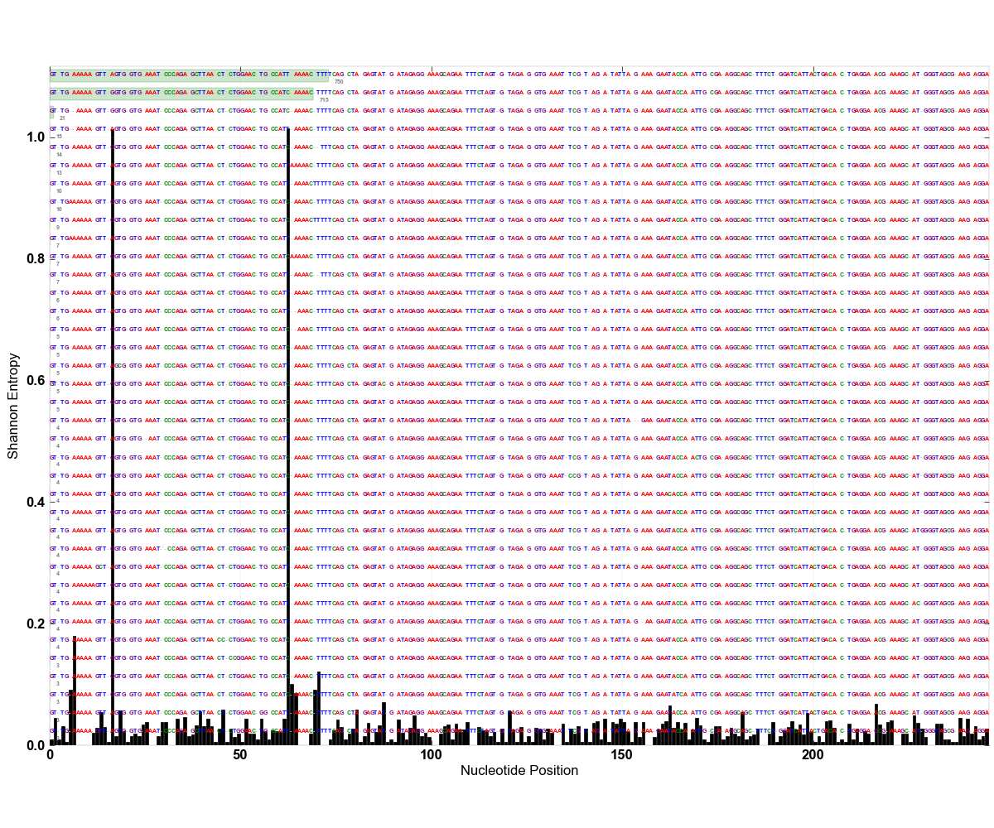

Slide 70
Identity | LDA (log10)
Anaerococcus | 4.49
lactolyticus | 3.75
vaginalis | 4.06
Atopobium | 3.80
parvulum | 3.06
Bacteroides | 4.47
ureolyticus | 3.86
Dialister | 3.55
propionifaciens | 3.07
Fusobacterium | 4.25
periodonticum | 3.79
Haemophilus | 4.02
parainfluenzae | 3.24
Peptoniphilus | 4.14
asacchyrolyticus | 3.25
HOT836 | 3.28
indolicus | 3.94
Peptostreptococcus | 4.29
anaerobius | 4.26
Porphyromonas | 4.59
bennonis | 3.87
somerae | 4.31
Prevotella | 4.02
bergensis | 3.20
buccalis | 3.29
corporis | 3.28
loescheii | 3.22
nigrescens | 3.41
Solobacterium | 4.06
moorei | 3.40
Many oral taxa (yellow) are present
Relative abundances were not significantly different than those in diabetic oral samples

Slide 71
Relative Abundance Comparison
Identity |  | DFI BC3 | DB Perio | Perio | DFI | Identity | DFI BC3 | DB Perio | Perio | DFI
Actinomyces |  | 0.91 | 1.10 | 0.06 | 0.13 | Parvimonas | 1.56 | 0.33 | 0.04 | 0.38
Bacteroides |  | 4.76 | 0.04 | 0.24 | 0.08 | micra | 1.56 | 0.29 | 0.04 | 0.38
Capnocytophaga |  | 0.33 | *2.58 | 0.95 | *0.00 | Peptococcus | 0.04 | 0.24 | *0.00 | *0.00
Corynebacterium |  | 11.73 | *1.63 | *0.00 | 5.24 | Porphyromonas | 7.01 | 14.82 | 21.55 | *0.32
Delftia |  | 0.13 | 0.07 | 0.03 | 0.34 | Prevotella | 1.91 | *24.17 | *29.32 | 0.38
acidovorans |  | 0.13 | 0.07 | 0.03 | 0.34 | loescheii | 0.07 | 0.28 | *0.00 | *0.00
Dialister |  | 0.36 | 0.19 | 0.14 | *0.00 | melaninogenica | 0.80 | 0.51 | 0.71 | 0.02
Eikenella |  | 0.03 | 0.17 | 0.17 | 0.23 | nigrescens | 0.46 | 4.00 | 3.39 | *0.00
corrodens |  | 0.03 | 0.17 | 0.17 | 0.23 | Propionibacterium | 1.06 | 1.39 | 0.20 | 2.67
Fusobacterium |  | 3.19 | 6.80 | 3.04 | 0.05 | Pseudomonas | 1.37 | 0.23 | *0.00 | 0.72
nucleatum.ss.polymorphum |  | 0.28 | 1.76 | 0.77 | 0.02 | Rothia | 0.94 | 0.16 | 0.39 | 0.21
nucleatum.ss.vincentii |  | 0.10 | 0.94 | 2.39 | 0.02 | Streptococcus | 8.51 | *0.55 | *0.47 | 11.92
periodonticum |  | 1.30 | 0.71 | 0.24 | *0.00 | mitis | 1.38 | 0.55 | 0.11 | 0.79
Haemophilus |  | 0.26 | 0.49 | *0.00 | *0.01 | Veillonella | 0.10 | 0.31 | 0.12 | 0.29
Lachnospiraceae |  | 0.33 | 0.46 | 0.10 | 0.07 | parvula | 0.10 | 0.31 | 0.12 | 0.29
Neisseria |  | 0.33 | *1.15 | 0.76 | 0.32
elongata |  | 0.22 | 0.37 | 0.24 | 0.04
Values in red are significantly different from BC3, p <0.05

Slide 72
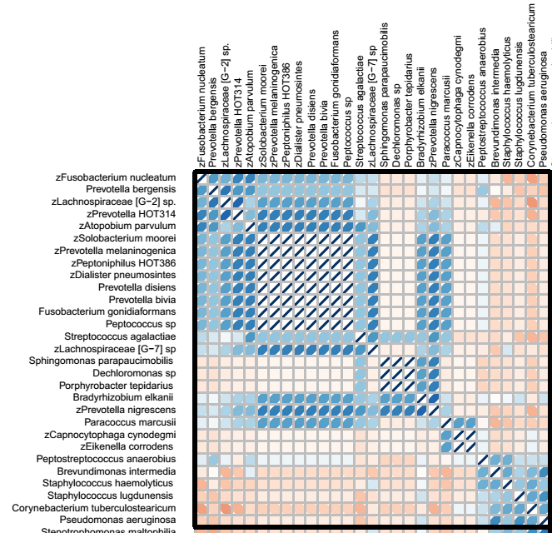

Slide 73
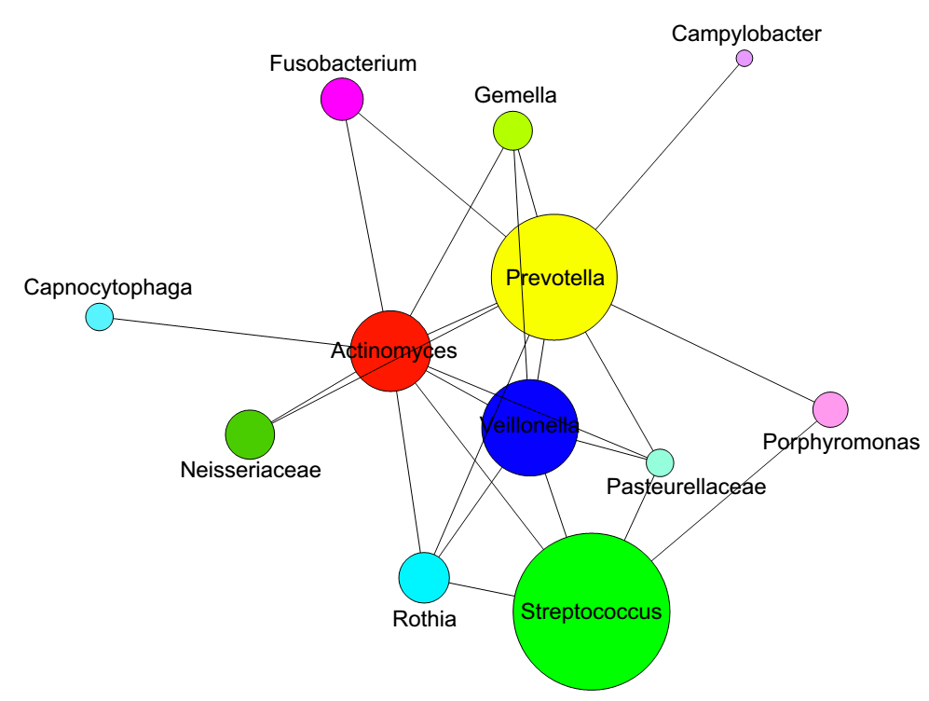
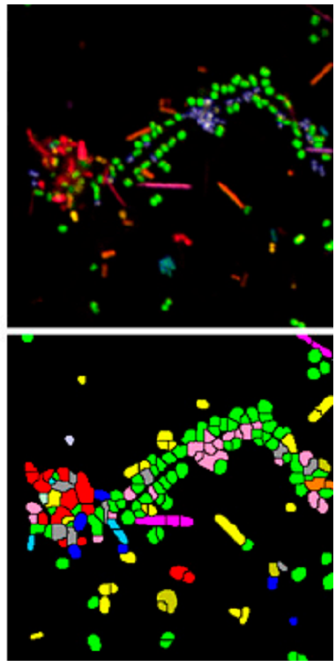
CLASI-FISH
2011. Valm, Borisy, PNAS.

Slide 74
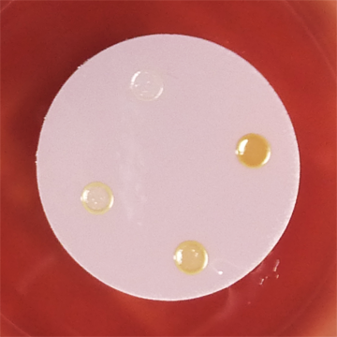
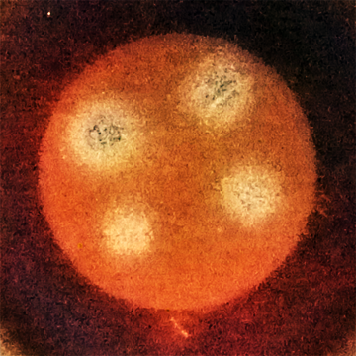
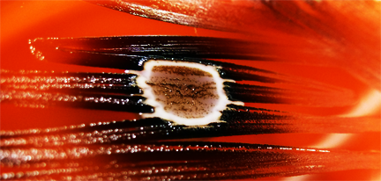
Testing Putative Interactions
Interactions can be found between oral or oral and non-oral bacteria
After establishing coculture based on growth properties we utilize RNASeq and TnSeq approaches

