Slide 1
Identifying molecular mechanisms of interspecies interactions within the microbiome
Matthew M. Ramsey, PhD
The University of Rhode Island
Kingston, RI
Notes:
20pt font for all references.

Slide 2
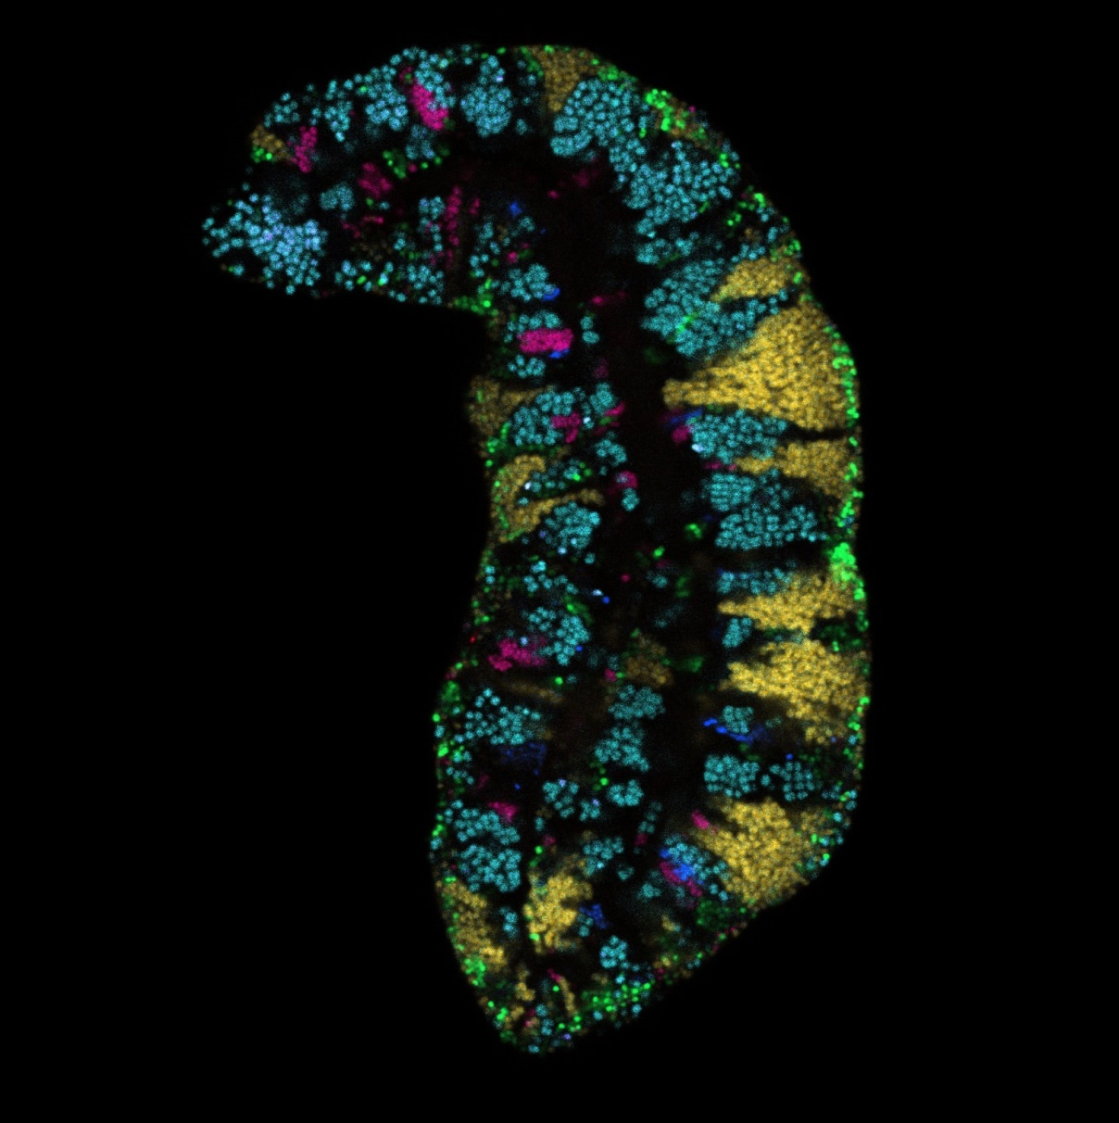
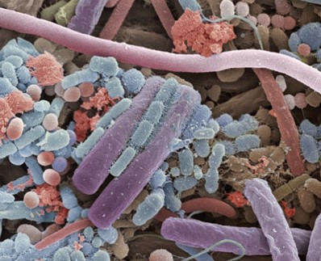
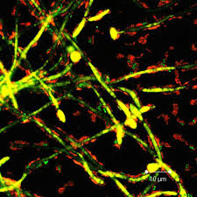
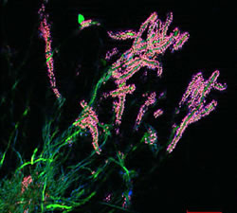
Polymicrobial communities are common
Pocketdentistry.com
c/o Dr. Gary Borisy
Notes:
Bacteria in nature rarely live alone. Their behavior in mixed populations suggests their role.
These interactions may dictate microbiome composition and/or function in health and disease

Slide 3
A top down view of a complex community
Metabolites
or Signals
Synergy
Antagonism
Notes:
It’s key to hit the transition here from this big-picture concept to the fact that polymicrobial infections are one example of such complex microbial networks
You may need another slide to make the transition smooth, it’s hard to tell from just your slides.

Slide 4
A reductionist approach to reveal interactions
in vitro
“omics” approaches
molecular mechanisms
extrapolate to in vivo
Notes:
It’s key to hit the transition here from this big-picture concept to the fact that polymicrobial infections are one example of such complex microbial networks
You may need another slide to make the transition smooth, it’s hard to tell from just your slides.

Slide 5
A reductionist approach to reveal interactions within a complex network
Notes:
It’s key to hit the transition here from this big-picture concept to the fact that polymicrobial infections are one example of such complex microbial networks
You may need another slide to make the transition smooth, it’s hard to tell from just your slides.

Slide 6
This approach is generalized.
If it can be cultured, this can be used to generate data from any multispecies community.

Slide 7
Microbial interactions in polymicrobial infections
Many infections are polymicrobial
Pathogen–Pathogen
Pathogen–Commensal
Commensal–Commensal
Notes:
Sepsis is often monomicrobial so NOT a good example for this audience, as are many abscesses. You need better examples for point 1, e.g., diabetic foot infections, traumatic wound infections, periodontitis.

Slide 8
How to identify potential interactions to study in the lab?
Hypothesize interactions based on...
  high relative abundance (probability)
  co-isolation
  statistical correlation
  co-localization
Notes:
I animated this, so that you can make each point and build towards co-localization.
I changed the order, since I am thinking you’ll want to mention the pros and cons for each of these approaches, as well as the increasing degree of difficulty experimentally.

Slide 9
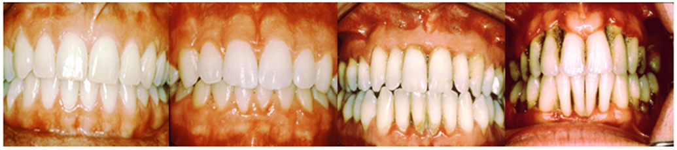
Acute Periodontitis
Complex polymicrobial infection
Healthy plaque transitions to a Gram-negative anaerobe-rich variety
A risk factor for heart disease
www.oramd.com
Notes:
Add images of gingivitis then Perio

Slide 10
Aggregatibacter
actinomycetemcomitans
Streptococcus gordonii
Aa
Sg
Gram negative
Facultative anaerobe
Pathogen
Gram positive
Facultative anaerobe
Commensal

Slide 11
Necessary for in vivo coinfection
Lactate
X
Aa
Sg
OxyR
H₂O₂
KatA
ApiA
Contributes to immune resistance
Detoxifies mM concentrations in <10 um distances
Ramsey et al., PLoS Pathog 2011
Ramsey et al., PNAS 2009
Liu, Ramsey et al., PNAS 2010

Slide 12
How to identify potential interactions to study in the lab?
Hypothesize interactions based on...
  high relative abundance (probability)
  co-isolation
  statistical correlation
  co-localization
Notes:
I animated this, so that you can make each point and build towards co-localization.
I changed the order, since I am thinking you’ll want to mention the pros and cons for each of these approaches, as well as the increasing degree of difficulty experimentally.

Slide 13


Gary Borisy PhD
Senior Scientist
The Forsyth Institute. Cambridge, MA
Jessica Mark Welch PhD
Associate Scientist
Marine Biology Lab / University of Chicago. Woods Hole, MA

Slide 14
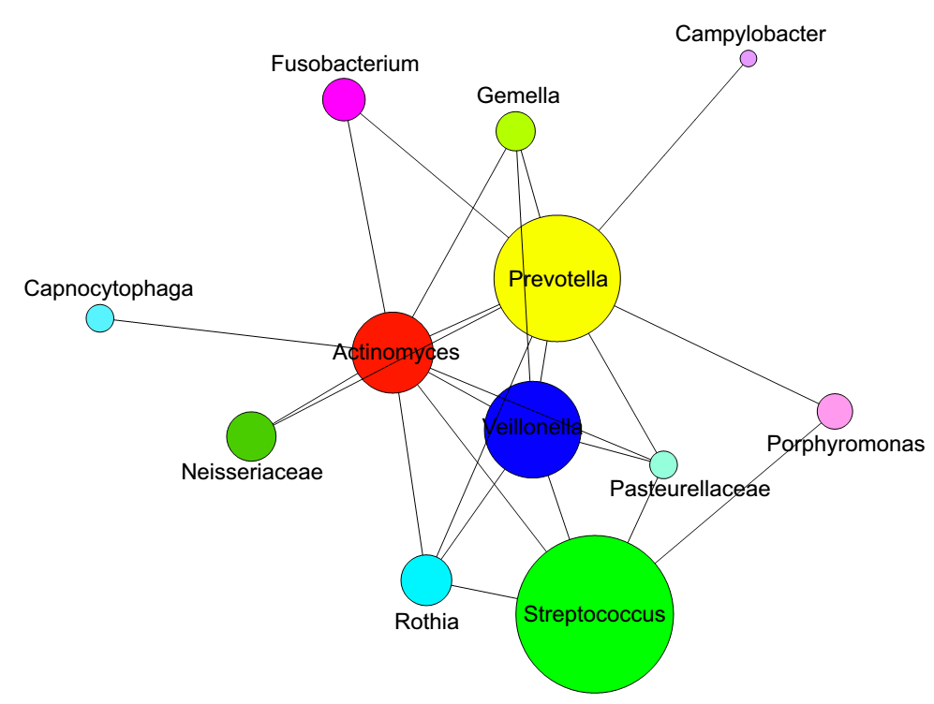
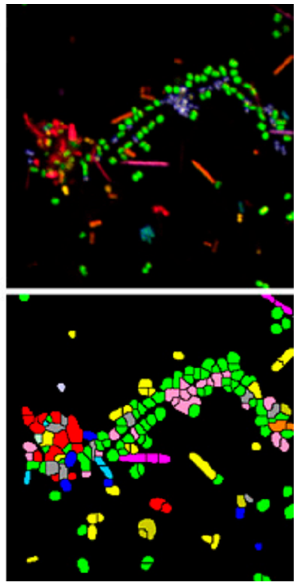
Combinatorial labelling and Spectral Imaging (CLASI)-FISH
2011. Valm, Borisy, PNAS.
2016. Welch, Borisy, PNAS.

Slide 15
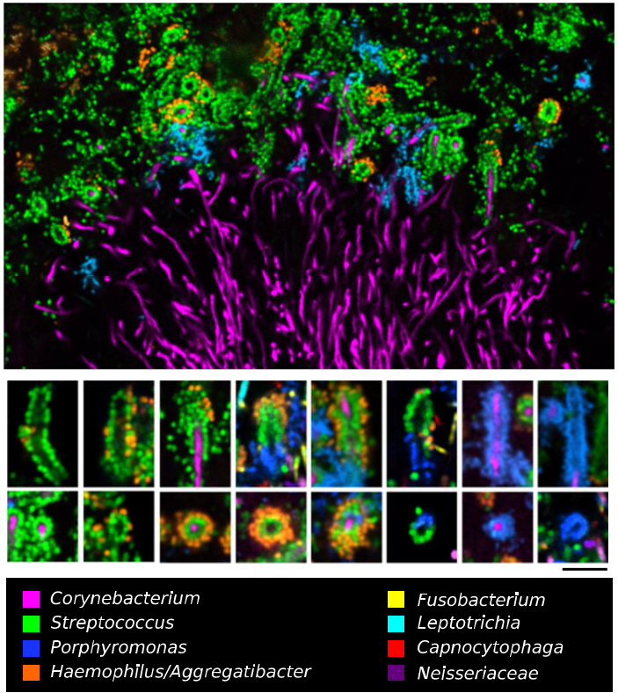

Slide 16
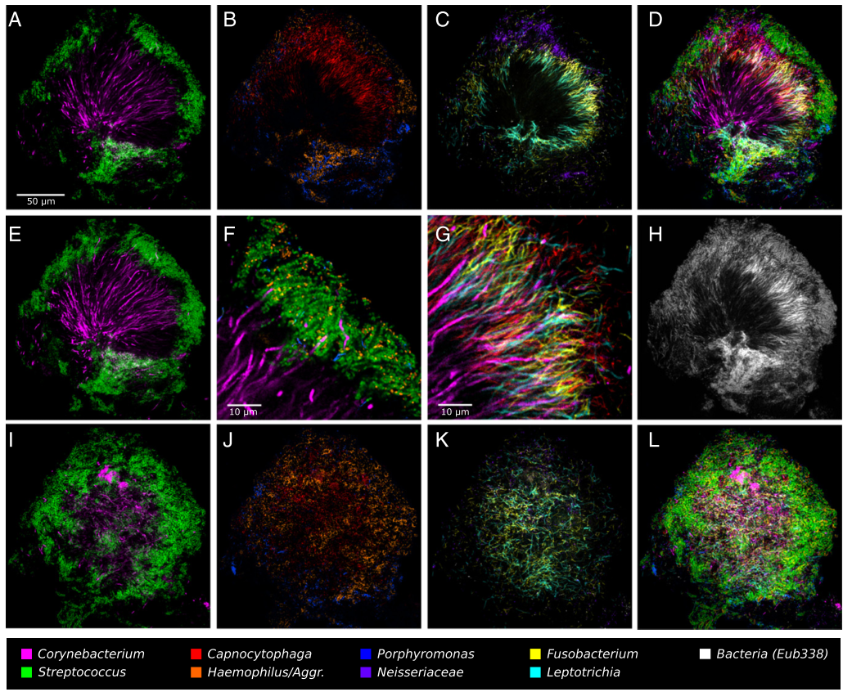

Slide 17
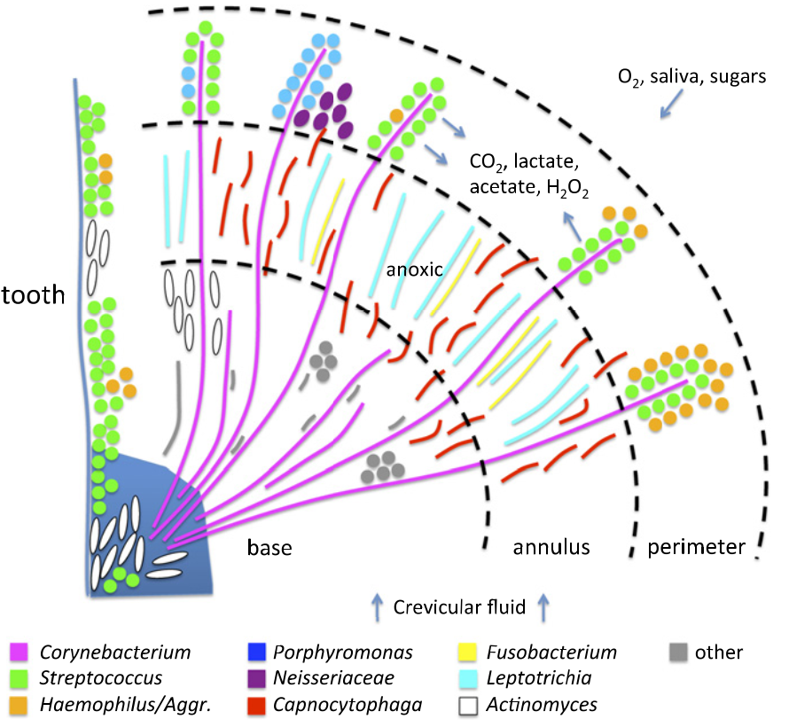
‘Hedgehog’ metabolism

Slide 18
CLASI-FISH limitations
Not (yet) species specific
Not high-throughput
Requires specialized instrumentation
Can we take advantage of high-throughput sequencing based data?

Slide 19
Supragingival Plaque Data
Human Microbiome Project (HMP) Supragingival plaque data
16S rRNA gene V1-V3 region (n=77)
16S rRNA gene V3-V5 region (n=148)
Full assembly metagenomic data (n=117)
Used for species level identification
Notes:
Combine with next slide
2. Healthy participants are subjects and not patients.

Slide 20
Microbiome data correlations
Positive and negative correlations can be calculated between different species
Account for multiple comparisons
  False discovery rate
http://huttenhower.sph.harvard.edu/ccrepe
Notes:
You will need to explain what each of these things are simply and clearly.

Slide 21
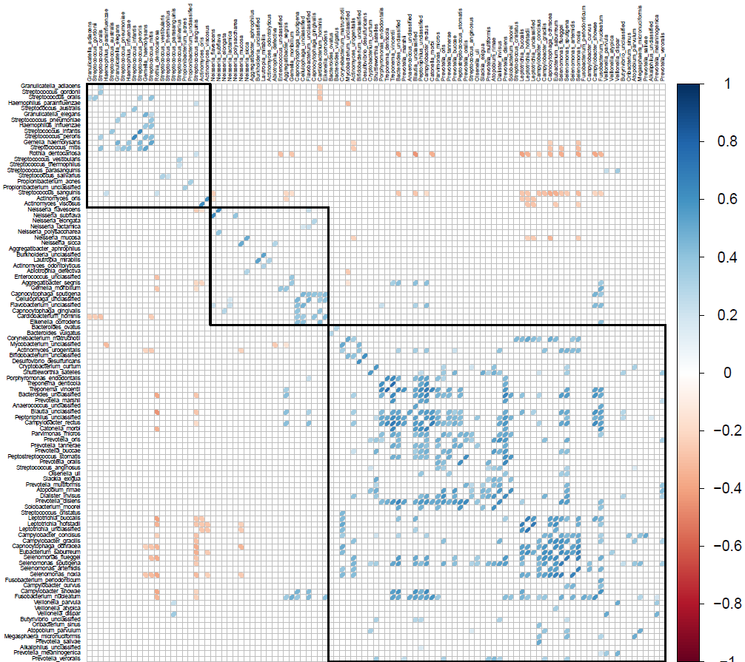

Slide 22
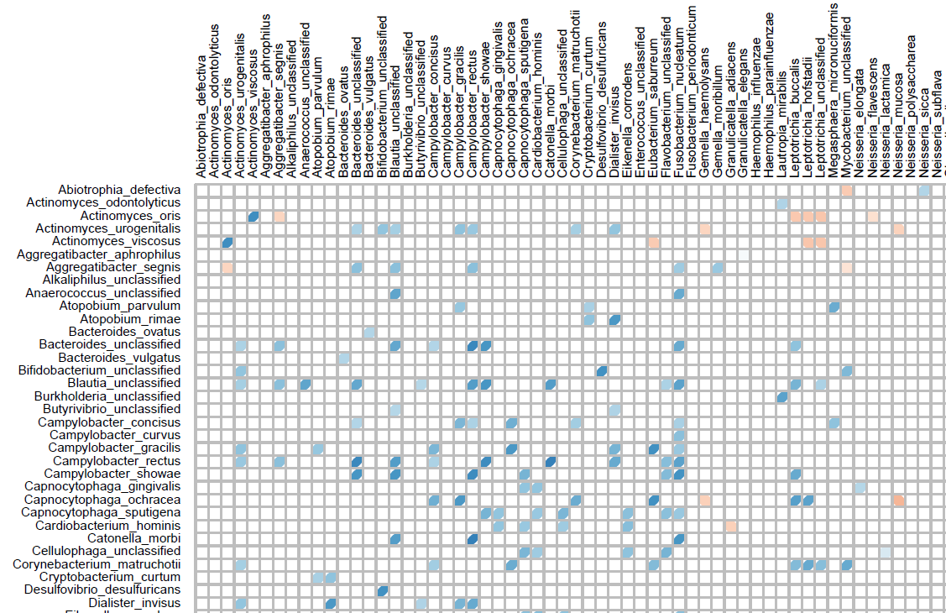

Slide 23
Corynebacterium matruchotii interactions with other species in each zone
  CLASI-FISH
C. matruchotii metabolite-mediated interactions in each zone
  RNASeq / metabolite analysis
C. matruchotii physical interactions with each species
  Biofilm assays / TnSeq

Slide 24
Why should you care?
‘Healthy’ plaque can contain opportunistic pathogens
Do their numbers grow as a niche opens?
What niches are available or absent?

Slide 25






The Whiteley Lab
Kelli Palmer
Stacie Brown
Lauren Warren
Peter Jorth
Holly Huse
Greg Palmer
Aishwarya Korgaonkar
Aimee Wessels
Collaborators
Kendra Rumbaugh (Texas Tech)
Marcelo Freire (Forsyth)
Gary Borisy (Forsyth)
Jessica Mark-Welch (MBL)
The Lemon Lab
Lindsey Bomar
Isabel Fernandez Escapa
Matthew Ramsey
Jennifer Spagnolo
Silvio Brugger
Megan Lambert
Brian Klein
Funding:
NIDCR F31 DE019995
NIAID F32 AI102498

Slide 26
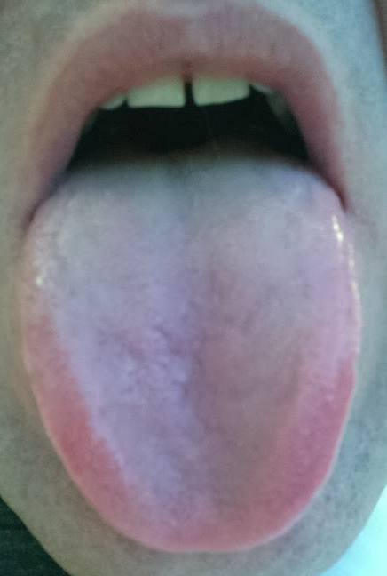
Human Tongue Dorsum
Microbiota overlaps with other oral sites
High bacterial species diversity
High biomass
Microbiota varies in halitosis

Slide 27
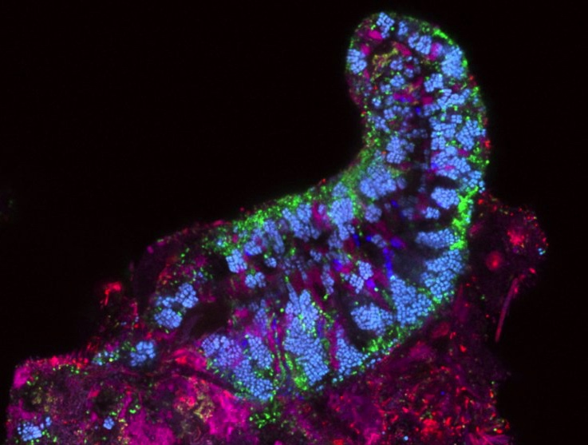
Tongue Dorsum
Streptococcus
Rothia
Veillonella
Neisseriaceae
Prevotella
TM7
20 microns

Slide 28
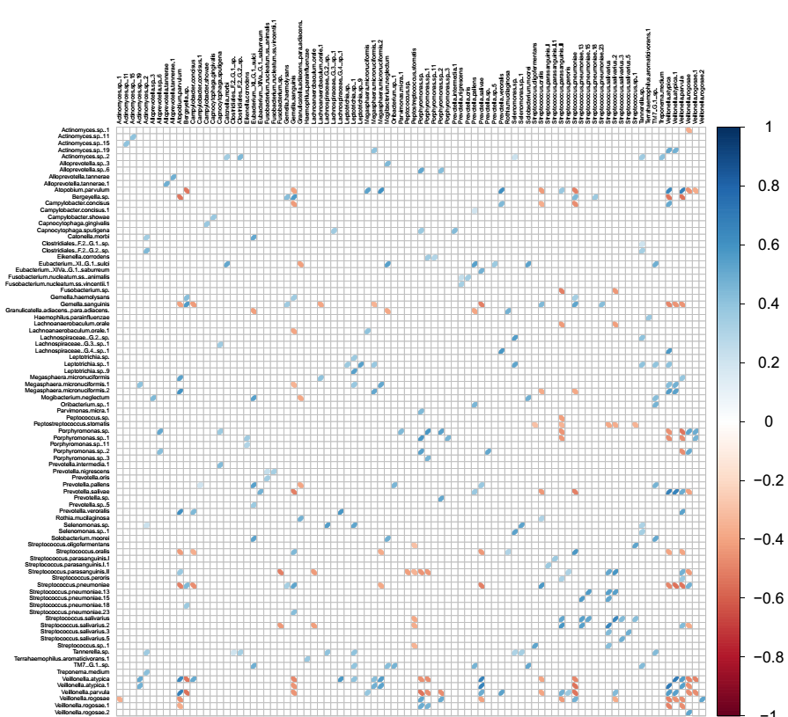
Species
vs
Species
Notes:
WHAT IS THIS?
You need to hit the transition to this exactly. AND... need some kind of title/label. Try having the bottom circle come up first and then adding the other 3.

Slide 29
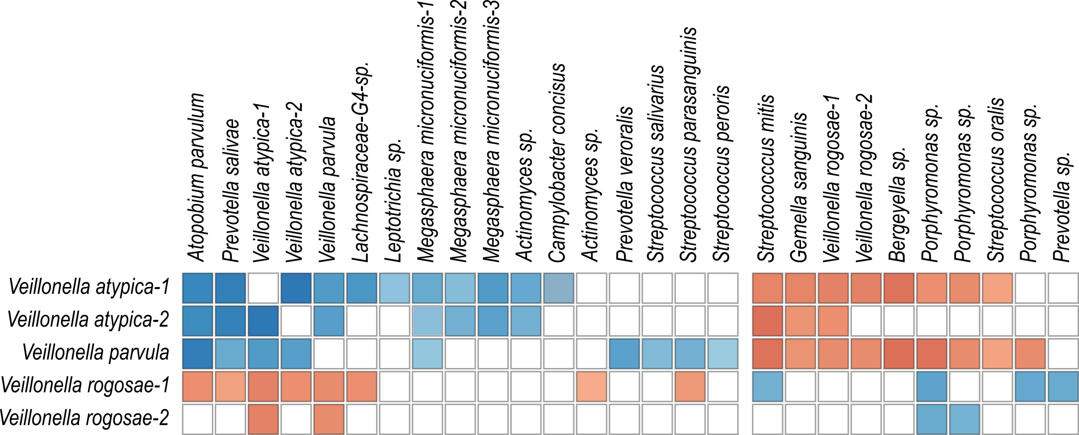
Hypothesis: Two distinct community types are present
Notes:
Condense strains into species.
‘Biomarkers”

Slide 30
Are these data indicative of multiple community types?

Slide 31
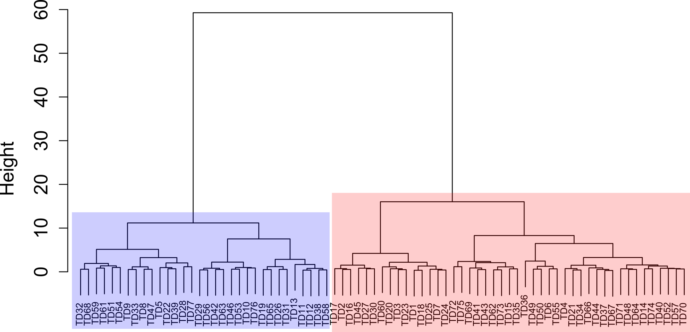
There are at least two community types
Who is in each group?

Slide 32
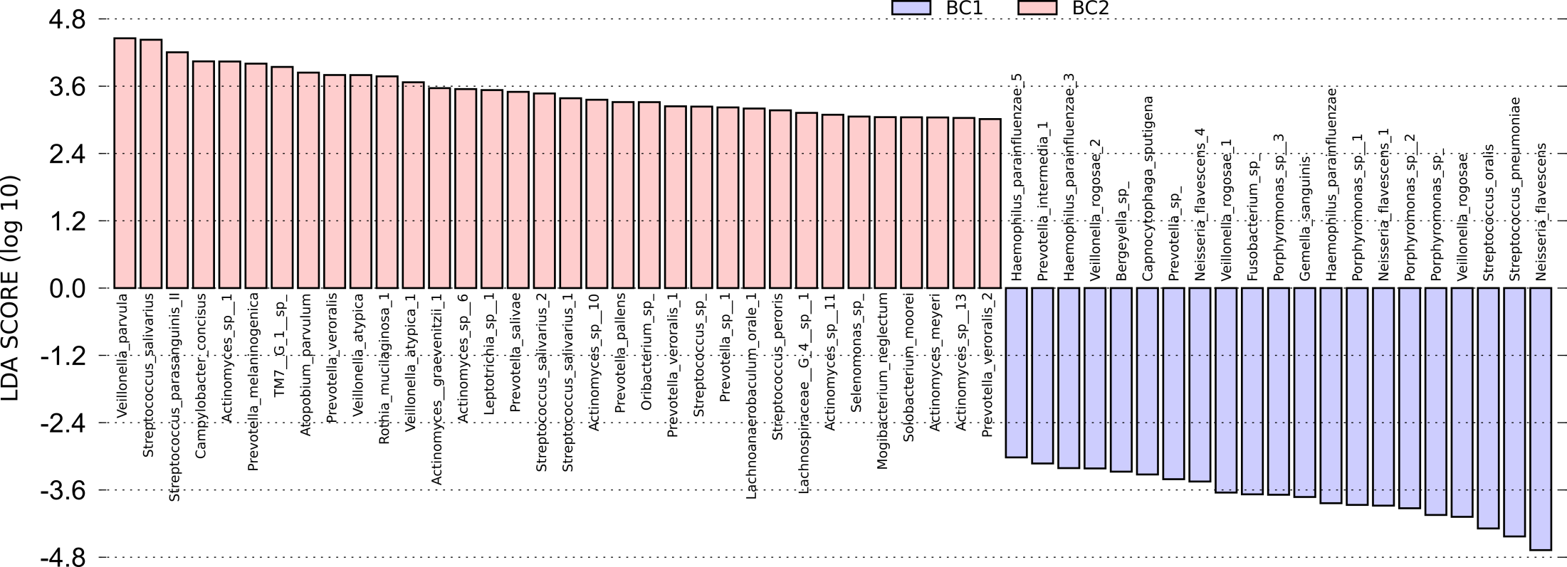
Who is enriched in each group?
Use Linear Discriminate Analysis Effect Size, (LEfSe) to measure associations
Segata et al. Genome Biol. 2011

Slide 33
Veillonella interspecies interactions
Notes:
Add the community boxes back to this.
Add a title with the bottom line.

Slide 34
Veillonella interspecies interactions
What metabolic differences exist between V. rogosae versus V. parvula / V. atypica?
Reannotated the genomes of V. parvula DSM 2008 and V. rogosae JCM15642
  Genomes similar in size
Notes:
Clean up / find better title here

Slide 35
Genome comparisons generate new hypotheses re: interaction mechanisms
V. rogosae
V. parvula
Ni/Fe Hydrogenase
At least 1 phage
Histidine biosynthesis
Vitamin B12
CRISPR system
Catalase

Slide 36
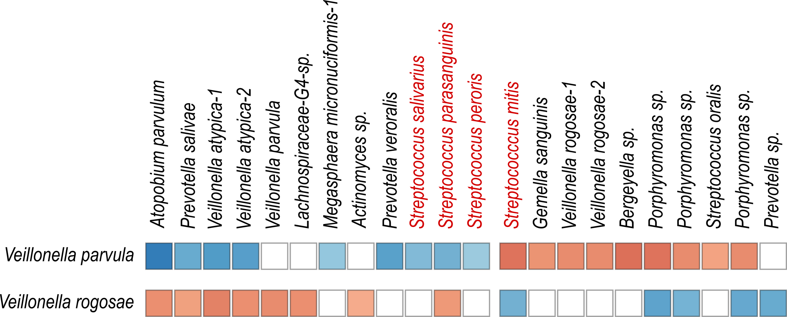
Streptococcus -Veillonella interactions

Slide 37
Summary
Correlations let us hypothesize about community structure
These data inform species pair selection for mono- vs. coculture studies
Immediately testable hypotheses

Slide 38

Talk Outline
Identifying molecular interactions in polymicrobial infections
  Human periodontal infection
  Human skin chronic infection
Future Work
  Commensal interactions
  Hybrid community interactions

Slide 39
Diabetic foot ulcer infections (DFIs)
Chronic polymicrobial infections
Microbiota is variable
  Most attention given to major pathogens
  Many studies have identified potential oral taxa
Diabetics are 3x more likely to develop periodontal infections
Notes:
[]add references!

Slide 40
Isolated infection flora is diverse
Many genera that contain oral species are present in DFIs
These include: Prevotella, Porphyromonas, Fusobacterium, Streptococcus and many more
Bowler et al. (1999) Int. J. Derm.
Dowd et al. (2008) PLoS One
Gardner et al. (2013) Diabetes
Citron et al (2007) J. of Clin. Micro
Notes:
Fix this, minimize, add Dowd and Bowler Data

Slide 41
Are oral species present in DFIs in a meaningful context?

Slide 42
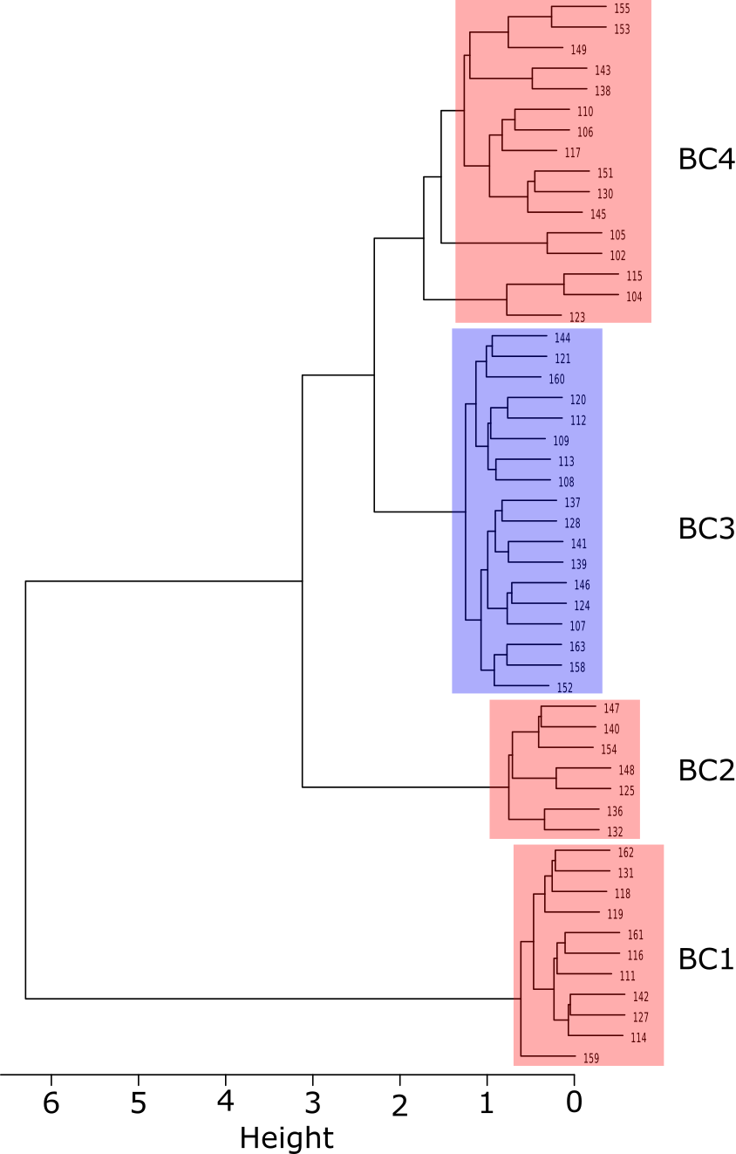
52 patients
~160 species, 83 genera
4 clusters determined by Bray-Curtis dissimilarity
Cluster 3 (18 patients) enriched in anaerobes / oral taxa

Slide 43
Many oral species were present at relative abundances similar to those observed in oral studies
Non-oral species in the same genera were also often present

Slide 44
Two Hypotheses
Oral bacteria autoinfect DFIs within individuals
Oral
?
“Hybrid Community”
Oral bacteria maintain molecular mechanistic relationships with non-oral microbes in DFIs
?
Oral

Slide 45
Why do this?
Proving autoinfection might allow for better containment / hygeine practices
Identification of conserved mechanistic relationships in oral bacteria highlight necessary pathways for in vivo survival that can be exploited

Slide 46
Summary
Oral species are enriched in a subset of DFIs
Oral species appear to form “hybrid communities” with non-oral DFI residents

Slide 47
A reductionist approach to reveal interactions
in vitro
Notes:
It’s key to hit the transition here from this big-picture concept to the fact that polymicrobial infections are one example of such complex microbial networks
You may need another slide to make the transition smooth, it’s hard to tell from just your slides.

Slide 48
Mechanistic detail of a complex community
Metabolites
or Signals
Notes:
It’s key to hit the transition here from this big-picture concept to the fact that polymicrobial infections are one example of such complex microbial networks
You may need another slide to make the transition smooth, it’s hard to tell from just your slides.

Slide 49
Conclusion
Reductionist approaches reveal molecular mechanisms
These can influence the transition from health to disease
Will reveal targets and therapeutics to prevent infection
Notes:
3-5 conceptual slides at the end. Focus on organisms response in monoculture not equivalent to coculture, respond both to host and respond to microbial community.

Slide 50
Ccrepe
Spearman’s Rank, or:
Diamond’s Checkerboard Score
Benjimani, Yuketeli Hochberg q-value adjustment for FDR
Ccrepe can be modified for other correlation statistics and output

Slide 51
Clustering analysis
Test by Hierarchal Clustering Analysis (HCA)
  Bray-Curtis Dissimilarity, Ward’s minimum variance method
This is done on all 77 patient samples
  Can be done with Horn / Morisita, Jaccard etc
  Bootstrapping available

Slide 52
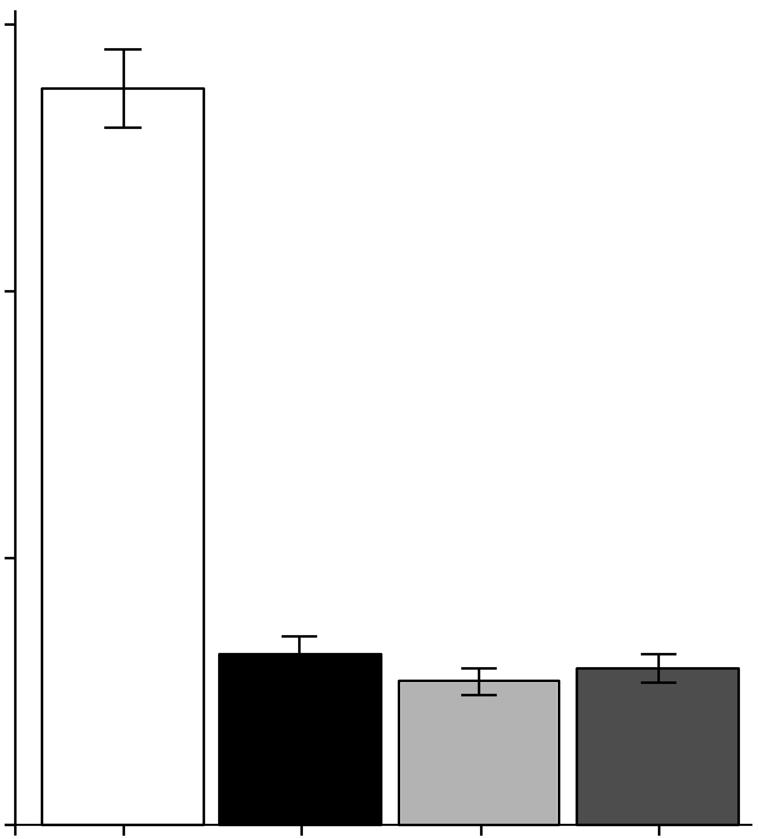
C. striatum (Cst) cell-free conditioned medium inhibits S. aureus AIP-1 signaling
30000
20000
Luminescence
10000
0
BHI
medium
CFCM
Cst
<3kDa
<3kDa
heat
AIP-1 +
n ≥ 3
Notes:
BHI

Slide 53
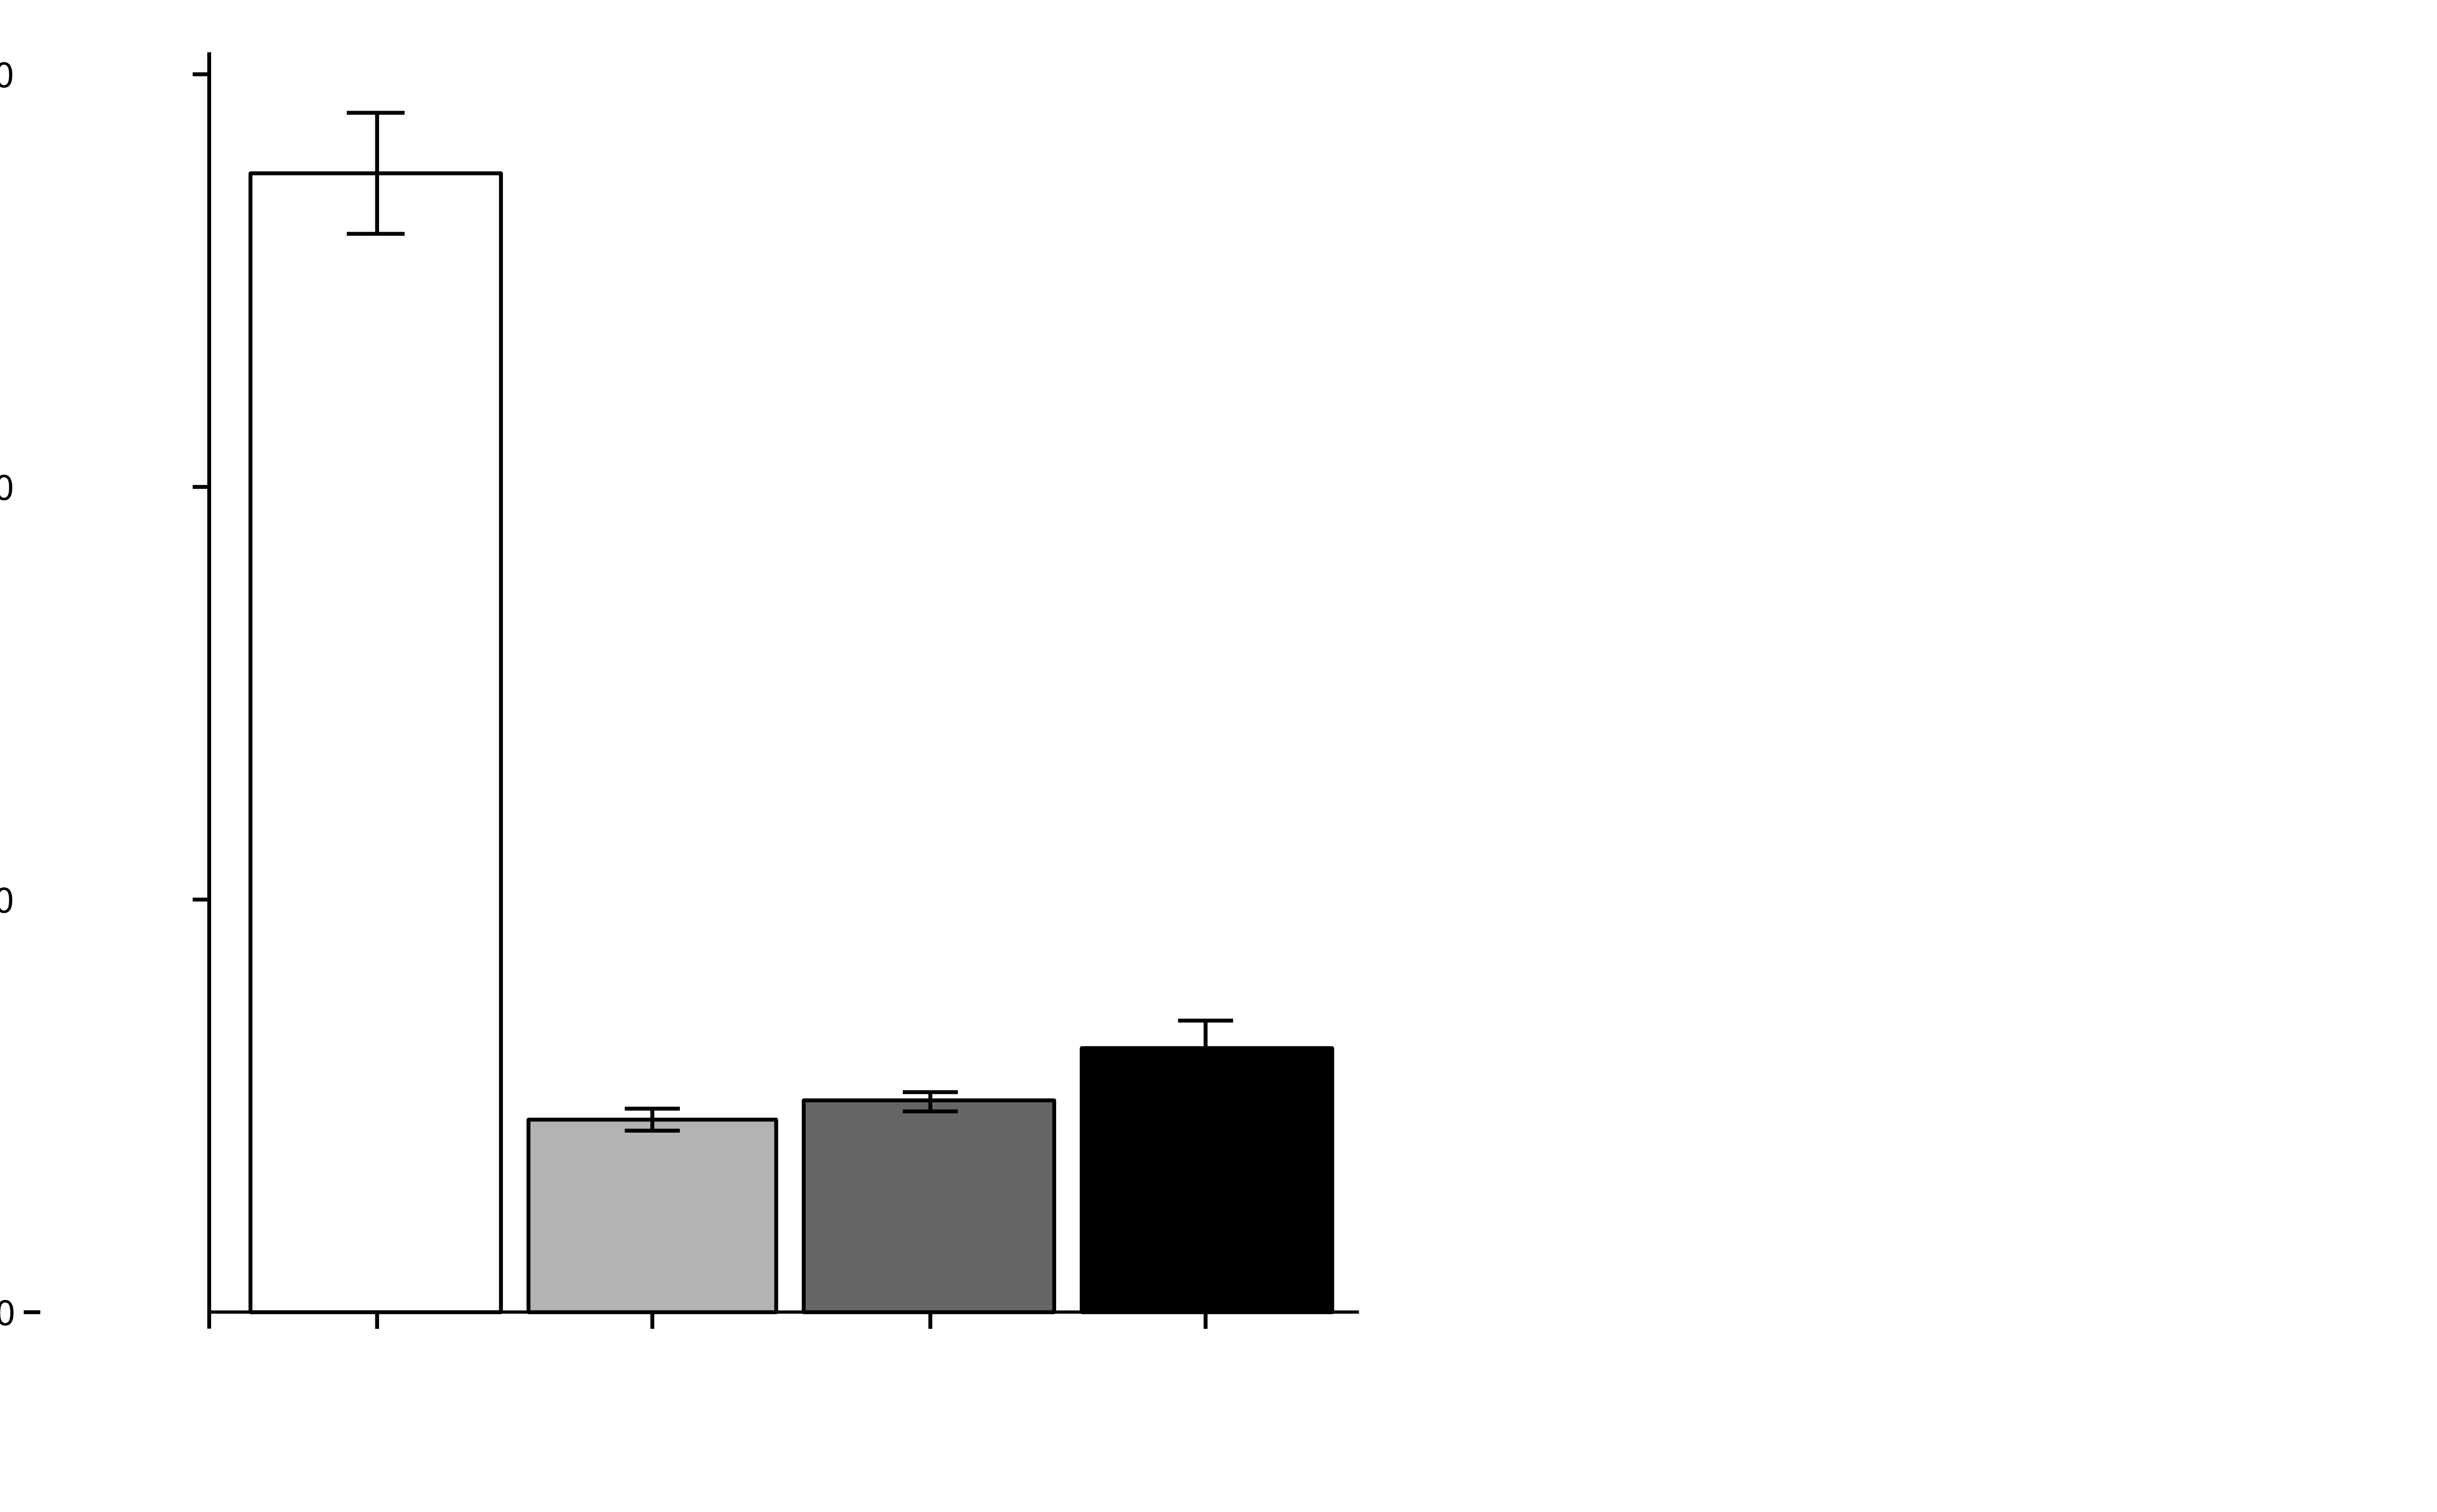
CFCM from other Corynebacterium spp. also interfere with AIP-1 signaling
30000
medium = BHI
Cam = C. amycolatum
Cgl = C. glutamicum
Cst = C. striatum
20000
Luminescence
10000
0
AIP-1 +
medium
Cam
Cgl
Cst
n ≥ 3
Notes:
AIP-1 produced in E. coli
Pre-mix w/ Coryne CFCM for 2 hours then add to S. aureus reporter strain
S. aureus RN4220 ∆agr::ermB P3agr_luxABDCE + pArC/agrA (cmR) / ROJ143
Ink_Cst_Cam_Cst_CFCM_AIP1inhibition.png

Slide 54
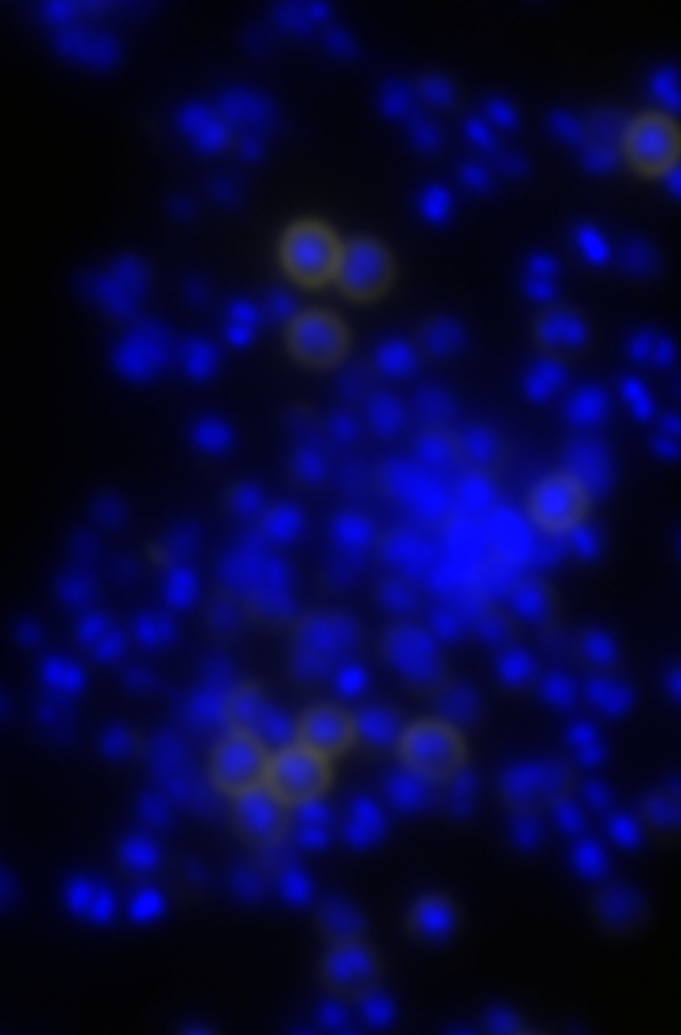
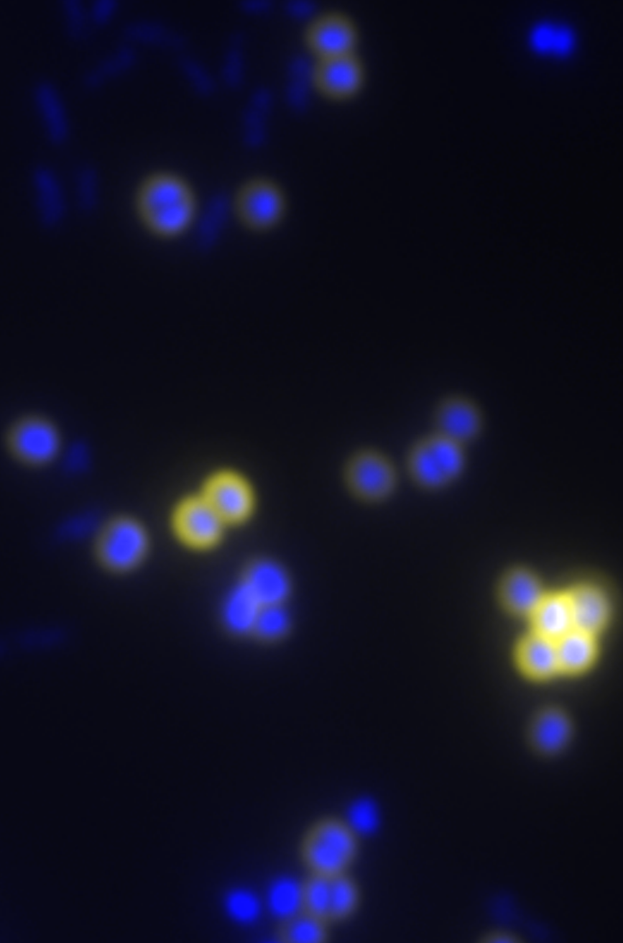
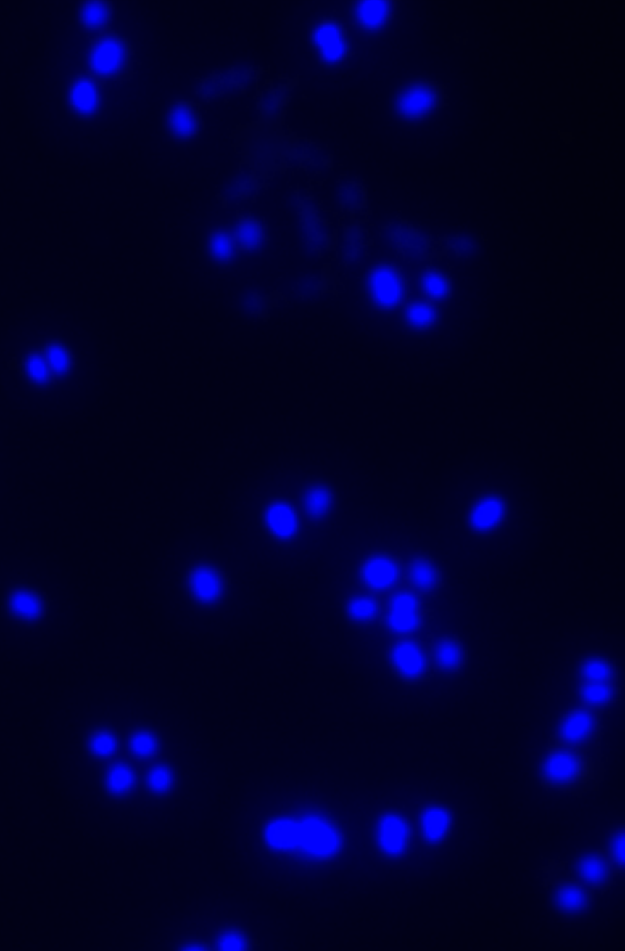
Protein A is increased on S. aureus cells grown in coculture with C. striatum
Cells stained with DAPI
Antibody-stained Protein A
Sau mono
Sau + Cst
Δspa + Cst
4%
59%
n.d.
n=3
Notes:
DAPI was the nuclear stain, FITC was the Spa stain. Images were taken at 1000x magnification under identical exposure settings. Image analysis and counts in each color channel were performed with ImageJ under identical settings for each image to generate the ‘E’ figure above.
P=<0.001 for the figure and these were from a biological n=2.
WT-monoA.png
WT-mixB.png
Spa-mixB.png
+++

Slide 55
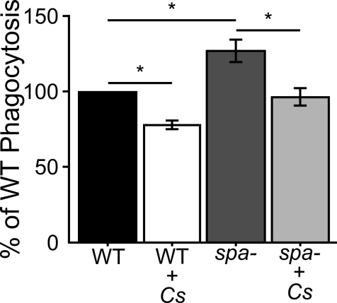
C. striatum inhibits S. aureus phagocytosis
*p < 0.05, n = 4

Slide 56
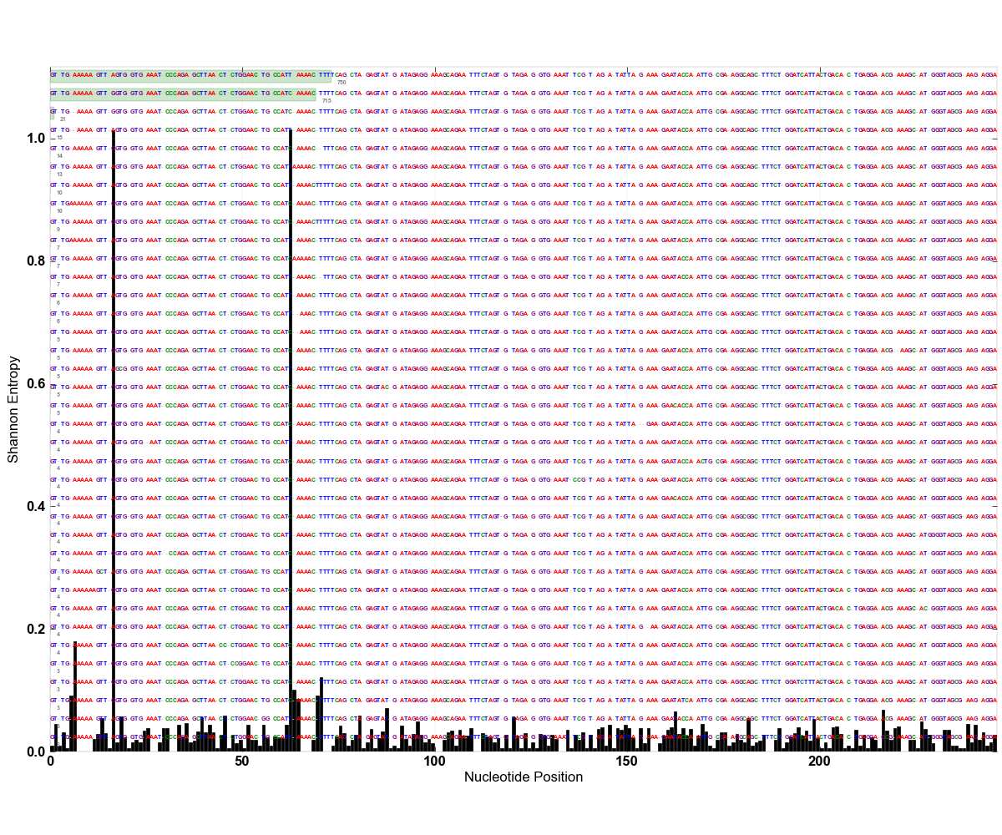

Slide 57
Identity | LDA (log10)
Anaerococcus | 4.49
lactolyticus | 3.75
vaginalis | 4.06
Atopobium | 3.80
parvulum | 3.06
Bacteroides | 4.47
ureolyticus | 3.86
Dialister | 3.55
propionifaciens | 3.07
Fusobacterium | 4.25
periodonticum | 3.79
Haemophilus | 4.02
parainfluenzae | 3.24
Peptoniphilus | 4.14
asacchyrolyticus | 3.25
HOT836 | 3.28
indolicus | 3.94
Peptostreptococcus | 4.29
anaerobius | 4.26
Porphyromonas | 4.59
bennonis | 3.87
somerae | 4.31
Prevotella | 4.02
bergensis | 3.20
buccalis | 3.29
corporis | 3.28
loescheii | 3.22
nigrescens | 3.41
Solobacterium | 4.06
moorei | 3.40
Many oral taxa (yellow) are present
Relative abundances were not significantly different than those in diabetic oral samples

Slide 58
Relative Abundance Comparison
Identity |  | DFI BC3 | DB Perio | Perio | DFI | Identity | DFI BC3 | DB Perio | Perio | DFI
Actinomyces |  | 0.91 | 1.10 | 0.06 | 0.13 | Parvimonas | 1.56 | 0.33 | 0.04 | 0.38
Bacteroides |  | 4.76 | 0.04 | 0.24 | 0.08 | micra | 1.56 | 0.29 | 0.04 | 0.38
Capnocytophaga |  | 0.33 | *2.58 | 0.95 | *0.00 | Peptococcus | 0.04 | 0.24 | *0.00 | *0.00
Corynebacterium |  | 11.73 | *1.63 | *0.00 | 5.24 | Porphyromonas | 7.01 | 14.82 | 21.55 | *0.32
Delftia |  | 0.13 | 0.07 | 0.03 | 0.34 | Prevotella | 1.91 | *24.17 | *29.32 | 0.38
acidovorans |  | 0.13 | 0.07 | 0.03 | 0.34 | loescheii | 0.07 | 0.28 | *0.00 | *0.00
Dialister |  | 0.36 | 0.19 | 0.14 | *0.00 | melaninogenica | 0.80 | 0.51 | 0.71 | 0.02
Eikenella |  | 0.03 | 0.17 | 0.17 | 0.23 | nigrescens | 0.46 | 4.00 | 3.39 | *0.00
corrodens |  | 0.03 | 0.17 | 0.17 | 0.23 | Propionibacterium | 1.06 | 1.39 | 0.20 | 2.67
Fusobacterium |  | 3.19 | 6.80 | 3.04 | 0.05 | Pseudomonas | 1.37 | 0.23 | *0.00 | 0.72
nucleatum.ss.polymorphum |  | 0.28 | 1.76 | 0.77 | 0.02 | Rothia | 0.94 | 0.16 | 0.39 | 0.21
nucleatum.ss.vincentii |  | 0.10 | 0.94 | 2.39 | 0.02 | Streptococcus | 8.51 | *0.55 | *0.47 | 11.92
periodonticum |  | 1.30 | 0.71 | 0.24 | *0.00 | mitis | 1.38 | 0.55 | 0.11 | 0.79
Haemophilus |  | 0.26 | 0.49 | *0.00 | *0.01 | Veillonella | 0.10 | 0.31 | 0.12 | 0.29
Lachnospiraceae |  | 0.33 | 0.46 | 0.10 | 0.07 | parvula | 0.10 | 0.31 | 0.12 | 0.29
Neisseria |  | 0.33 | *1.15 | 0.76 | 0.32
elongata |  | 0.22 | 0.37 | 0.24 | 0.04
Values in red are significantly different from BC3, p <0.05

Slide 59
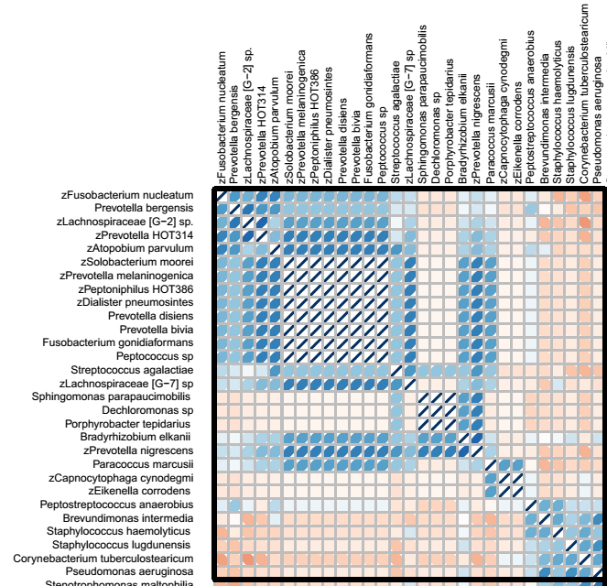

Slide 60
CLASI-FISH
2011. Valm, Borisy, PNAS.

Slide 61
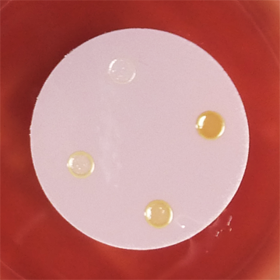
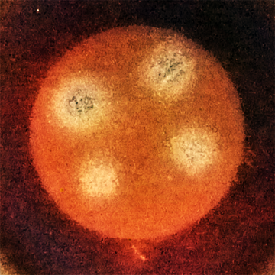
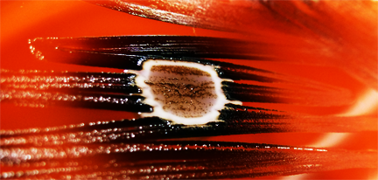
Testing Putative Interactions
Interactions can be found between oral or oral and non-oral bacteria
After establishing coculture based on growth properties we utilize RNASeq and TnSeq approaches

