Slide 1
Bacterial interspecies interaction mechanisms within the microbiome
Matthew M. Ramsey, PhD
CELS / CMB
Notes:
20pt font for all references.

Slide 2
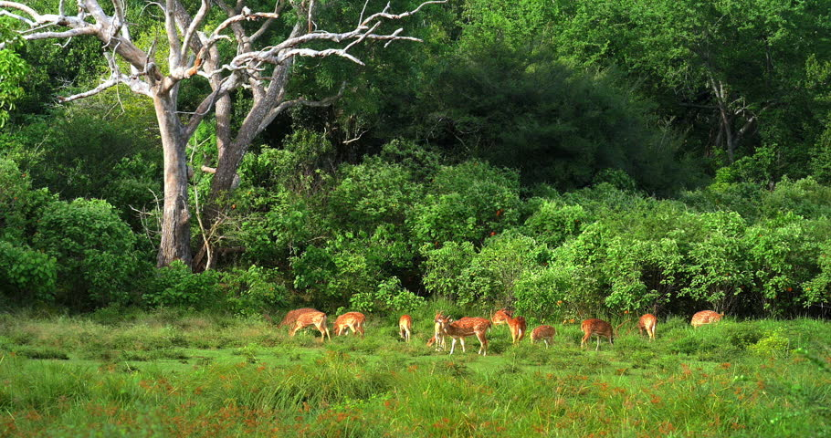
Current Microbiome Standard
13 Odocoileus (deer)
3 tree Genus X
2 tree Genus Y
17 shrub Genus X
2 shrub Genus Y
125 grass Genus X
27 grass Genus Y
4 bird Genus X
5 bird Genus Y
What hypotheses could you generate from a list?

Slide 3
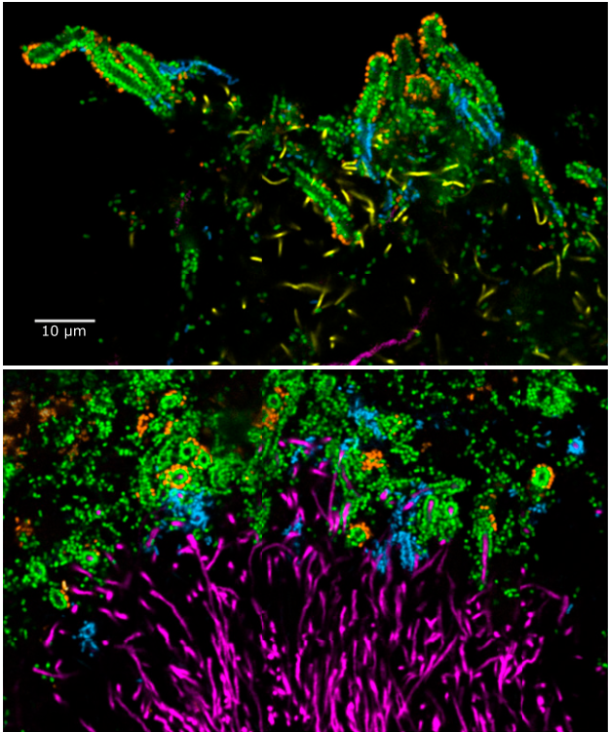
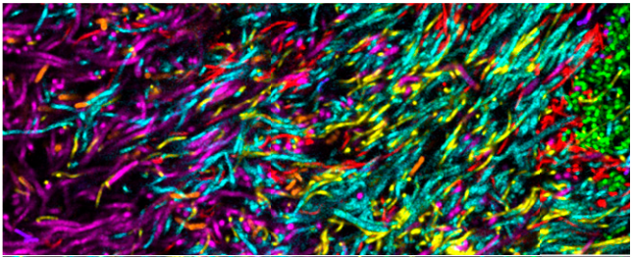
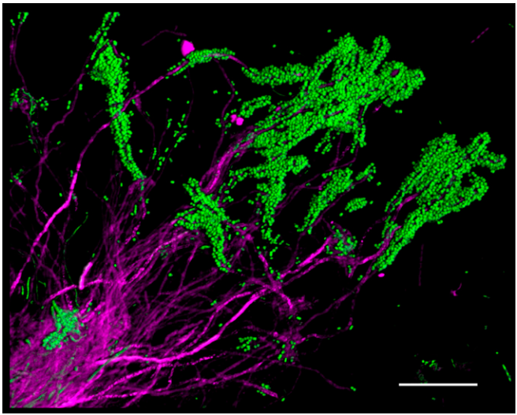
Human oral plaque
c/o Jessica Mark Welch

Slide 4
Current standard in microbiome data
Notes:
It’s key to hit the transition here from this big-picture concept to the fact that polymicrobial infections are one example of such complex microbial networks
You may need another slide to make the transition smooth, it’s hard to tell from just your slides.

Slide 5
A top down view of a complex community
Metabolites
or Signals
Synergy
Antagonism
Notes:
It’s key to hit the transition here from this big-picture concept to the fact that polymicrobial infections are one example of such complex microbial networks
You may need another slide to make the transition smooth, it’s hard to tell from just your slides.

Slide 6
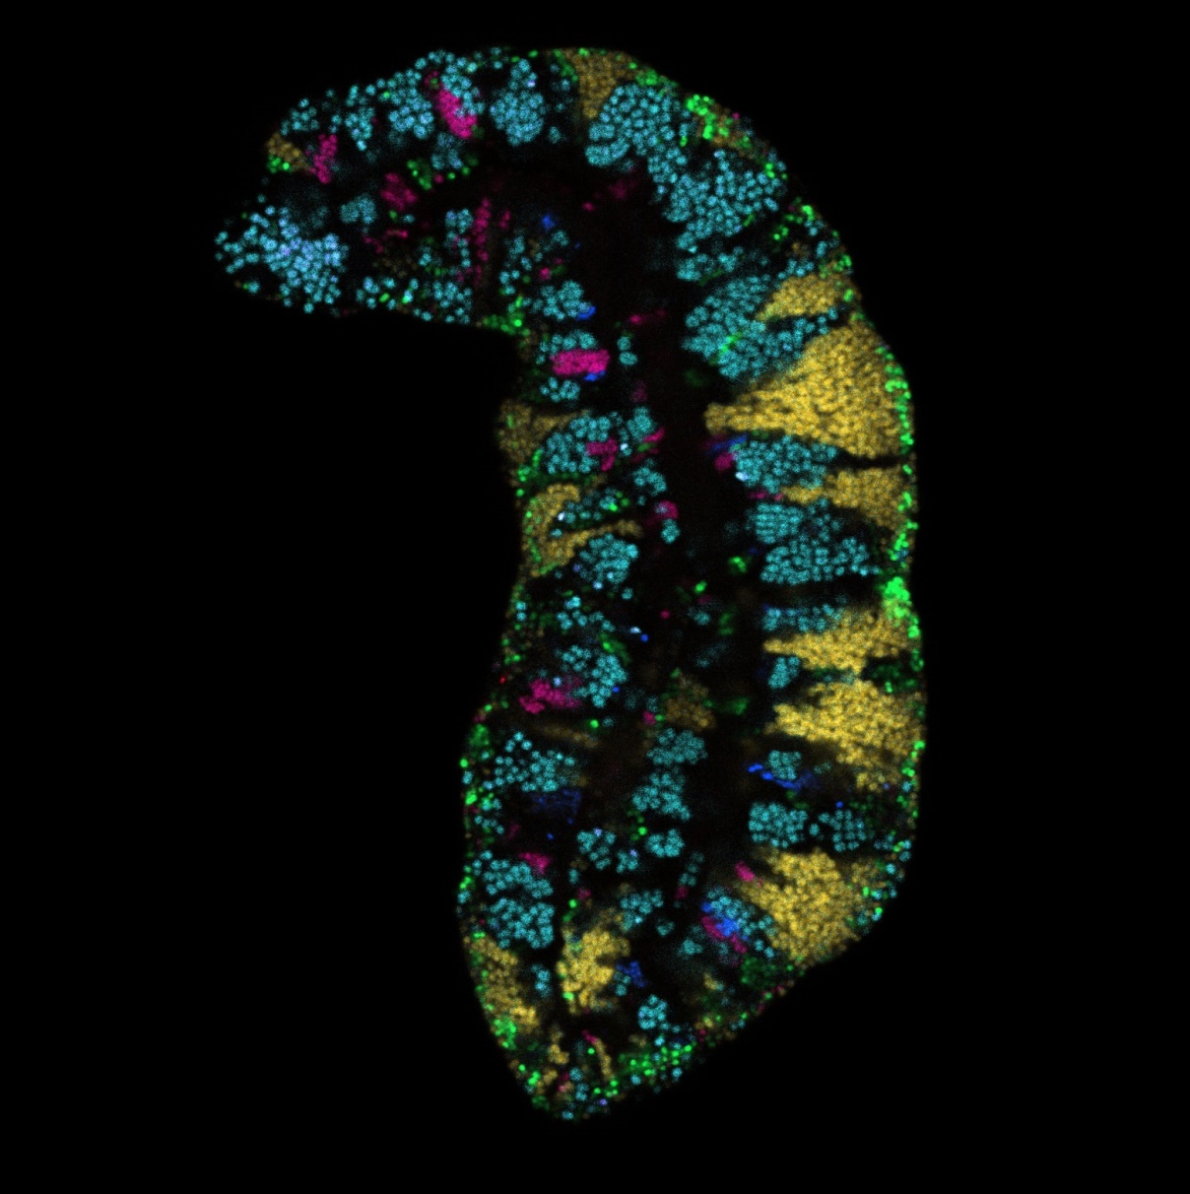
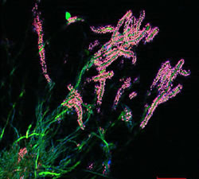
Ordered arrangements of different taxa
Pocketdentistry.com
c/o Dr. Gary Borisy
Notes:
Bacteria in nature rarely live alone. Their behavior in mixed populations suggests their role.
These interactions may dictate microbiome composition and/or function in health and disease

Slide 7
What can these interactions tell us about the community?
Which are important?

Slide 8
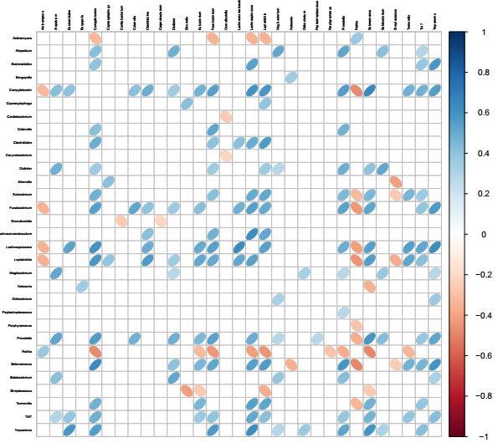

Slide 9
A reductionist approach to reveal interactions
in vitro
“omics” approaches
molecular mechanisms
extrapolate to in vivo
Notes:
It’s key to hit the transition here from this big-picture concept to the fact that polymicrobial infections are one example of such complex microbial networks
You may need another slide to make the transition smooth, it’s hard to tell from just your slides.

Slide 10
A reductionist approach to reveal interactions within a complex network
Notes:
It’s key to hit the transition here from this big-picture concept to the fact that polymicrobial infections are one example of such complex microbial networks
You may need another slide to make the transition smooth, it’s hard to tell from just your slides.

