Slide 1
An Unexpected Finding in the Serum of Type II Diabetics
Dasith Perera
Matthew Ramsey Lab
University of Rhode Island

Slide 2
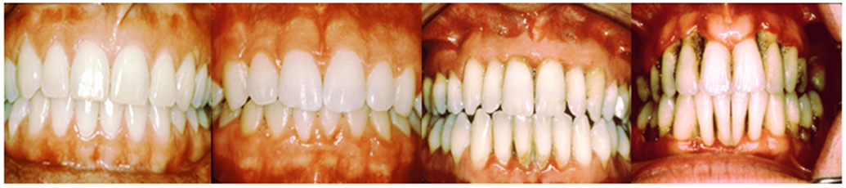
Type II Diabetics and Oral disease
Type II diabetes affects 9.7% of Americans (CDC, 2017)
  Growing worldwide
Diabetics have 3x risk of periodontitis
  Acute Periodontitis: A risk factor for heart disease
  Translocation of oral bacteria associated with stroke and heart disease
Hypothesis: Greater translocation of oral bacteria into blood of Type II diabetics with Periodontitis

Slide 3
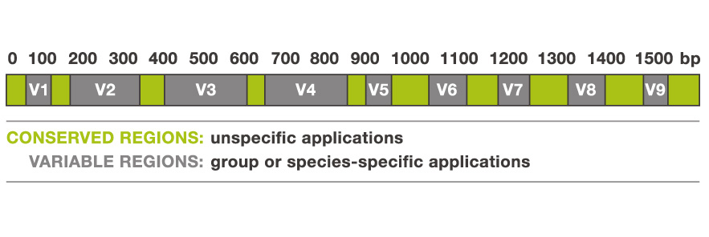
Experimental design
Serum samples from:
  20 healthy subjects
  41 Type II diabetics
    21 with Periodontitis
    20 without Periodontitis
Amplification of V1-V3 region of 16s rRNA
Notes:
28-79 years of age

Slide 4
Challenges
Serum is a low microbial biomass sample
  Even reagents contain contaminating DNA
  Contaminating DNA can be a major contributor
    DNA from reagents ≈ DNA from samples
Controls are important
  No-template controls during extraction
  PCR controls
  Mock Community DNA
Carry out Contaminant subtraction

Slide 5
Hypothesis:
Greater translocation of oral bacteria into blood of Type II diabetics with Periodontitis
Hypothesis:
Greater translocation of oral bacteria into blood of Type II diabetics with Periodontitis
What other information can we get from these data?

Slide 6
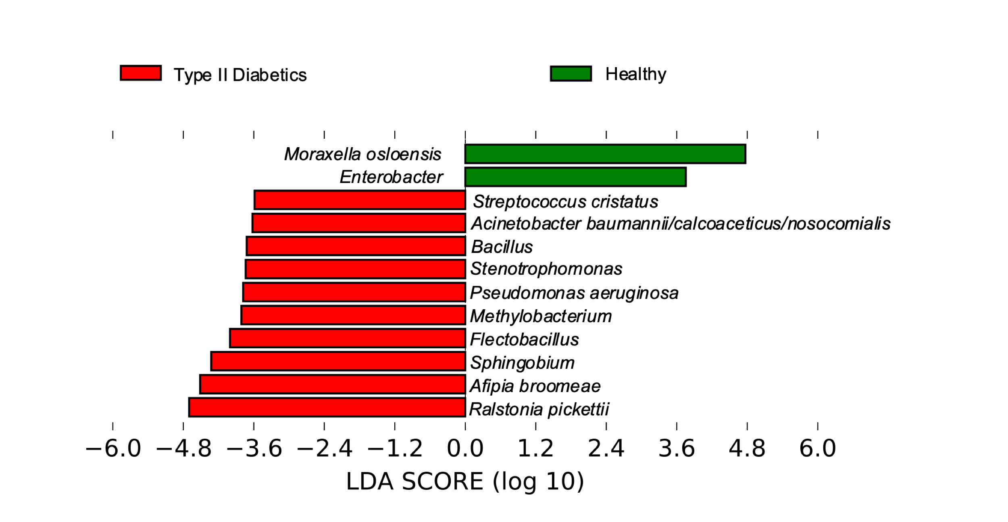
Type II diabetics vs Healthy

Slide 7
Acinetobacter baumanni-calcoaceticus complex (ABC)
 | Type II Diabetic (N=41) | Healthy (N=20)
ABC positive samples | 13 | 1
Abundance | 31.7% | 5%
ABC complex
  A. baumannii
  A. calcoaceticus
  A. nosocomialis
  A. pitti
A. baumannii is an emerging pathogen
  Almost exclusively found in clinical settings
Diabetics increased risk of developing A. baumannii infection (Luo et al., 2012; CDC, 2010)
Subjects in this study show no symptoms of infection
Blood glucose level = 209mg/dL

Slide 8
How do we differentiate between species of the ABC complex?
27F
ABC-F
519R
ABC-R
16s rDNA
A. baumannii
GA C C G G G C T G T T GG G A T A C GA TC G C ATTCAG AC GT .
A. nosocomialis
GA C C G C C G A A C A AA T G C G G AG CT C T GAGAAT AC GT .
A. calcoaceticus
AT T T A C C G T A C A AA T G C G G AG CT C T GAGAAT CT AG .
A. pittii
AT T T A C C G T A C A AA T G C G G AG CT C T GAGAAT CT AG .
Created clone libraries using ~1.3kb region of 16srDNA
If we screen 10 clones from a sample do we hit the ABC complex?
  Which species is present?

Slide 9
Screen summary
Group | ABC % based on V1-V3 | Clones Sequenced | ABC Species
Type II Diabetic | 7.3 | 4 | A. baumannii
Type II Diabetic | 1.2 | 2 | A. baumannii
Type II Diabetic | 1.2 | 10 | -
Type II Diabetic | 0.8 | 10 | -
Type II Diabetic | 0.7 | 10 | A. baumannii
Type II Diabetic | 0.4 | 4 | A. baumannii
Type II Diabetic | 0.3 | 9 | A. baumannii
Type II Diabetic | 0.3 | 10 | -
Healthy | 0 | 10 | -
Healthy | 0 | 10 | -
Control | 0 | 10 | -
Control | 0 | 10 | -
Found A. baumannii in
  5/8 ABC+ samples
  0/4 ABC- samples

Slide 10
Conclusions and future directions
First report of A. baumannii asymptomatically in type II diabetics
~32% of type II diabetics appear to carry A. baumannii
  Do individuals that test positive for A. baumannii have signs of subclinical septicemia?
    ABC+ individuals showed highest overall proinflammatory markers based on cytokine profile (pending statistical analysis)
Carry out longitudinal study with larger sample size

Slide 11
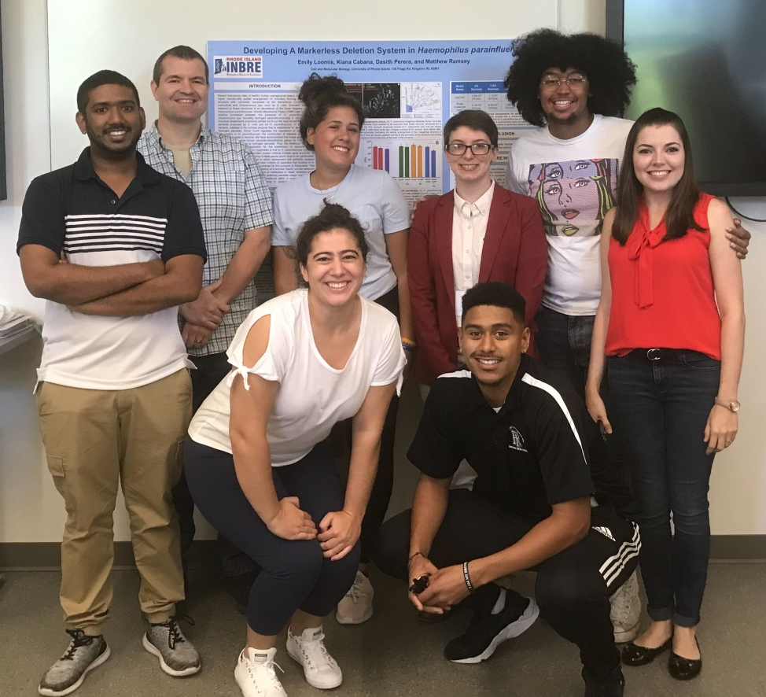



Acknowledgements
M. Ramsey Lab
Dr. Matthew Ramsey
Ben Hanson
Eric Almeida
Thais Palma
Kaileigh Cloutier-Leblanc
Kiana Cabana
Emily Loomis
RI- GSC
Janet Atoyan
J. Craig Venter Institute
Dr. Marcelo Freire
Sarah Kleinstein
R01DE027958
P20GM103430

Slide 12
Oral taxa in serum

Slide 13
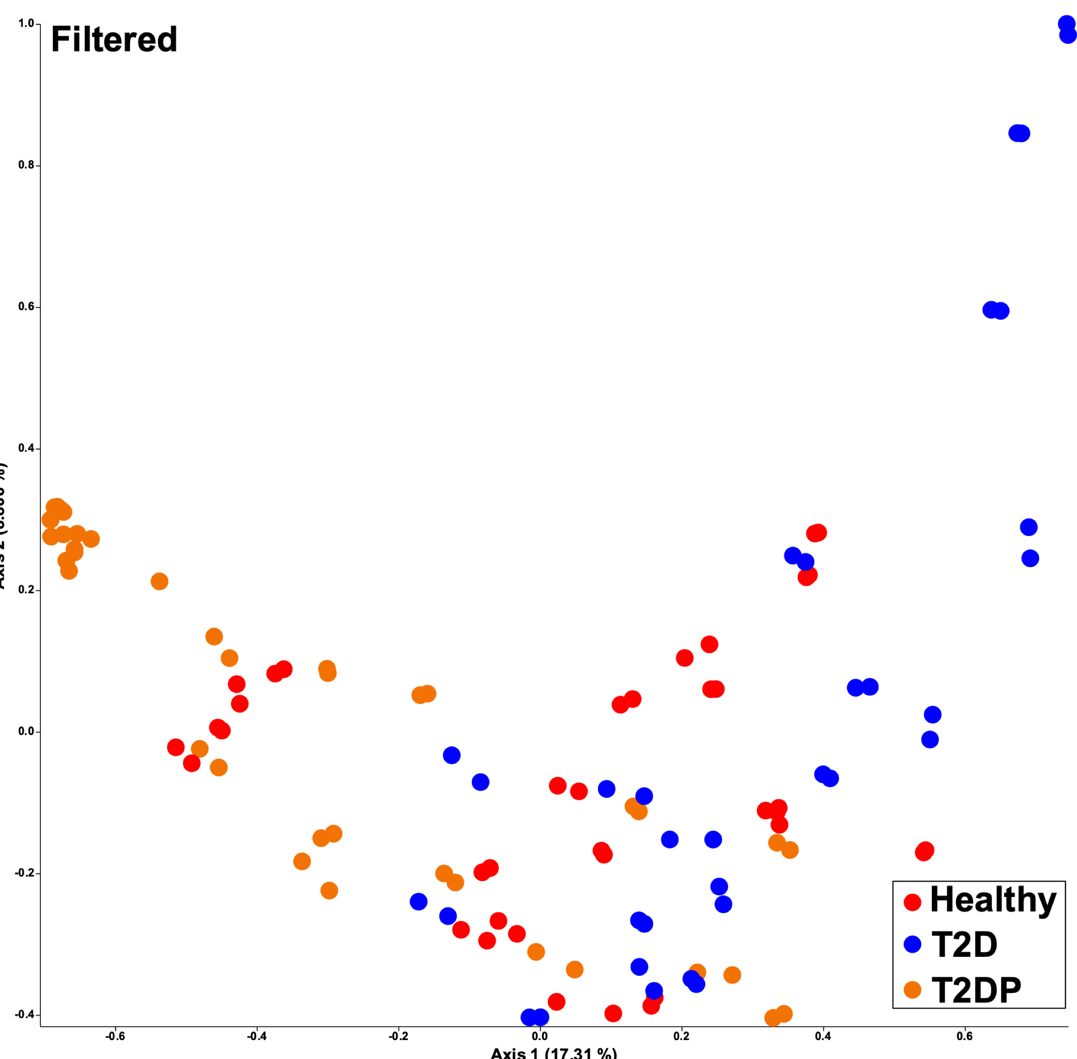

Slide 14
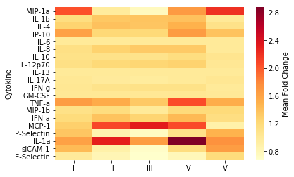
I - Diabetic/Healthy
II - ABC+/ABC-
III - ABC+ Diabetic/ABC- Diabetic
IV - ABC+ Diabetic/Healthy
V - ABC- Diabetic/Healthy

