Slide 1
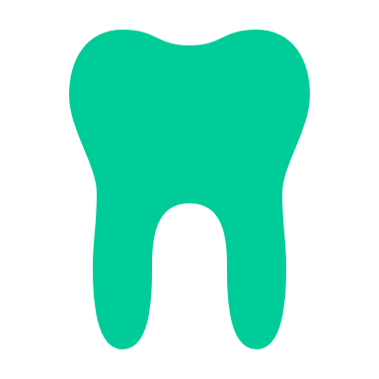
Dental caries as an infectious disease
Fata Moradali
Oral Immunology & Infectious Diseases
University of Louisville School of Dentistry

Slide 2
Learning Objectives
After this lecture, you should be able to:
Describe caries as a complex bacterial disease
Describe some mechanisms and examples by which cariogenic bacteria cause caries
Describe microbial co-occurrence in caries
Describe some factors strongly influencing caries development

Slide 3
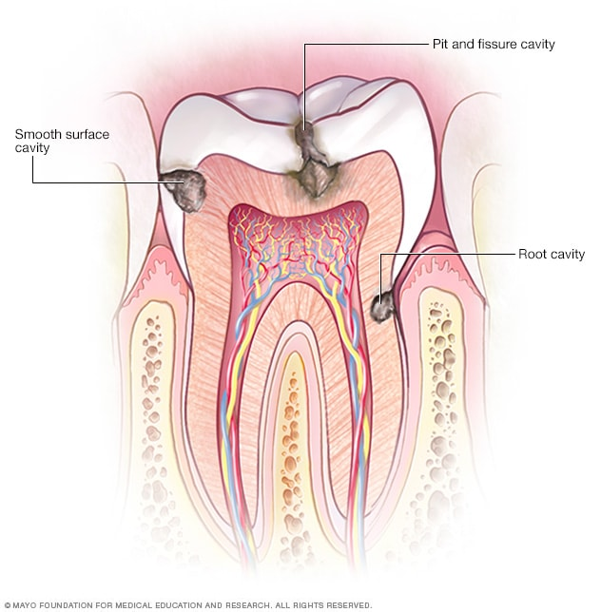
Caries is a Multi-factorial Disease:
The Caries Triad
Host Factors
Genetics
Plaque
Microbial Biofilm
CARIES
Environment
Dietary Factors

Slide 4
The Microbial Component of Caries
Plaque
Microbial Biofilm
Host Factors
&
Teeth
CARIES
Environment
Dietary Factors

Slide 5
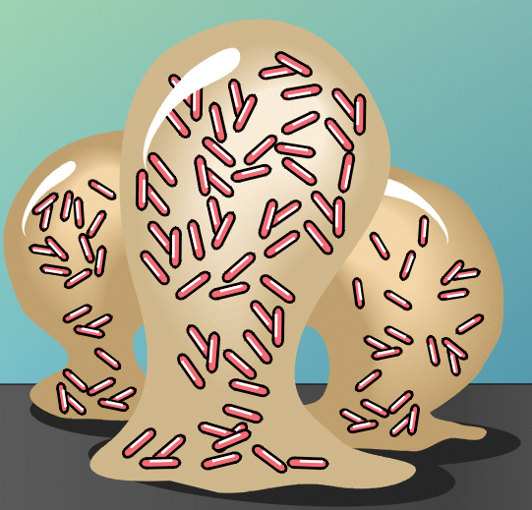
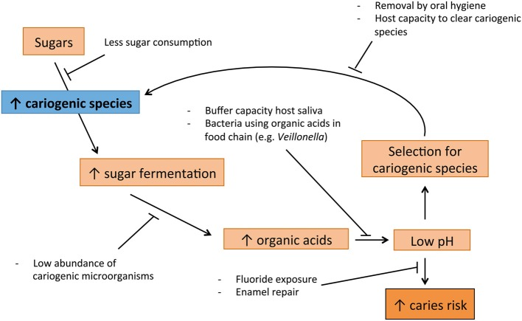
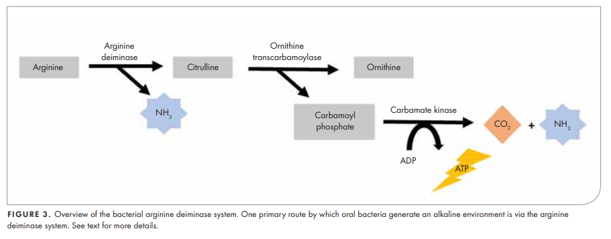
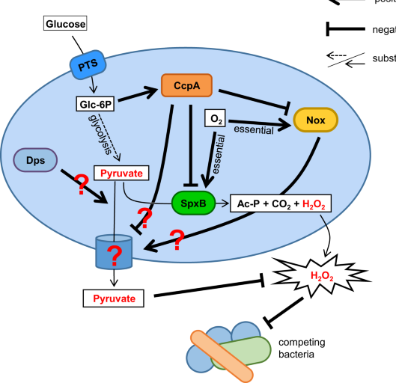
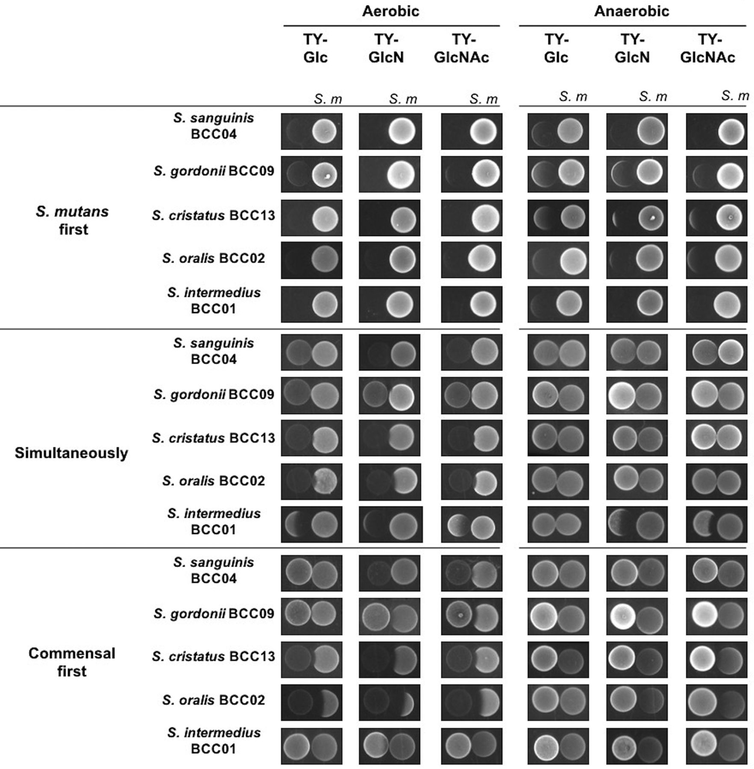
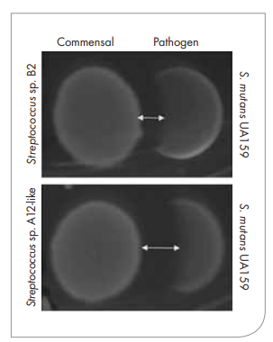
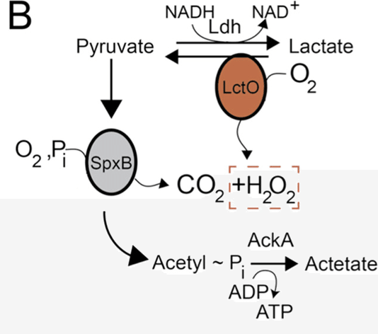
Feedbacks in the Dental Plaque
S. salivarius, Actinomyces naeslundii, certain oral haemophili
Urea + H₂O 2NH₃ + CO₂
Urease
Oral arginolytic bacterial communities; the arginine deiminase system
S. gordonii, S. sanguinis, etc.
Amino sugars
H₂O₂ generation: Pyruvate Oxidase (Pox) pathway
S. oralis
S. mutans
S. oralis
S. mutans
(S. mutans lacks spxB)
O₂
CO₂
GlcN
GlcNAc
GlcN
GlcNAc
Glucosamine (GlcN)
N-acetylglucosamine (GlcNAc)

Slide 6
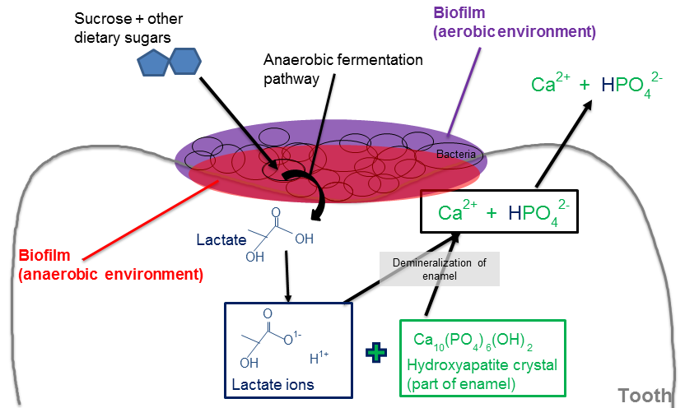
Caries is a microbially-mediated disease
The primary pathogen associated with caries is Streptococcus mutans although the community context is important, and some other organisms may also cause caries
S. mutans efficiently produces organic acids as a product of its metabolism of carbohydrates
High levels of organic acids (particularly lactic acid) lower the pH of the oral cavity
The solubility of hydroxyapatite (enamel and dentin) is greater under acidic conditions

Slide 7
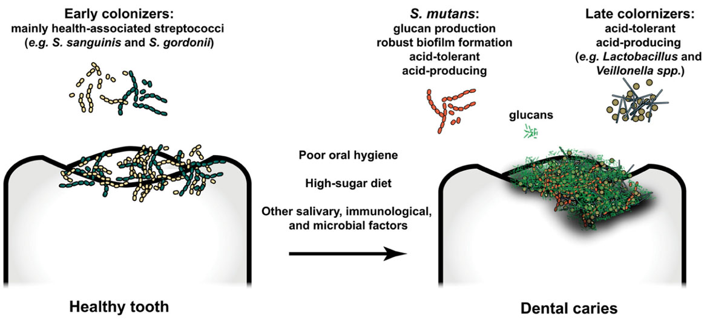
S. mutans is an acidophile; it thrives in acidic environments that are lethal to many other oral organisms
Acid-sensitive bacteria
S. mitis,
S. sanguinis,
S. gordonii
Highly acidogenic & aciduric (acid-tolerant)
S. mutans

Slide 8
The Caries Triad
Host Factors
Genetics
Plaque
Microbial Biofilm
CARIES
Environment Factors
Dietary Components

Slide 9
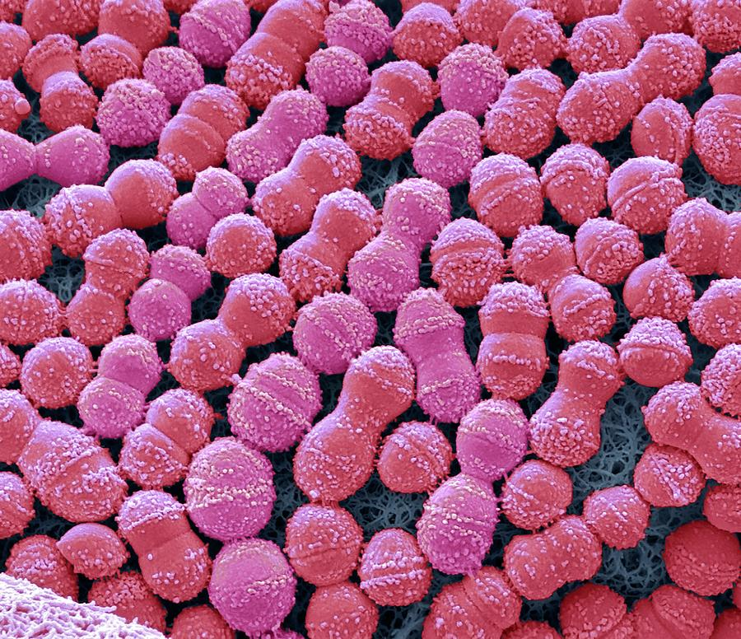
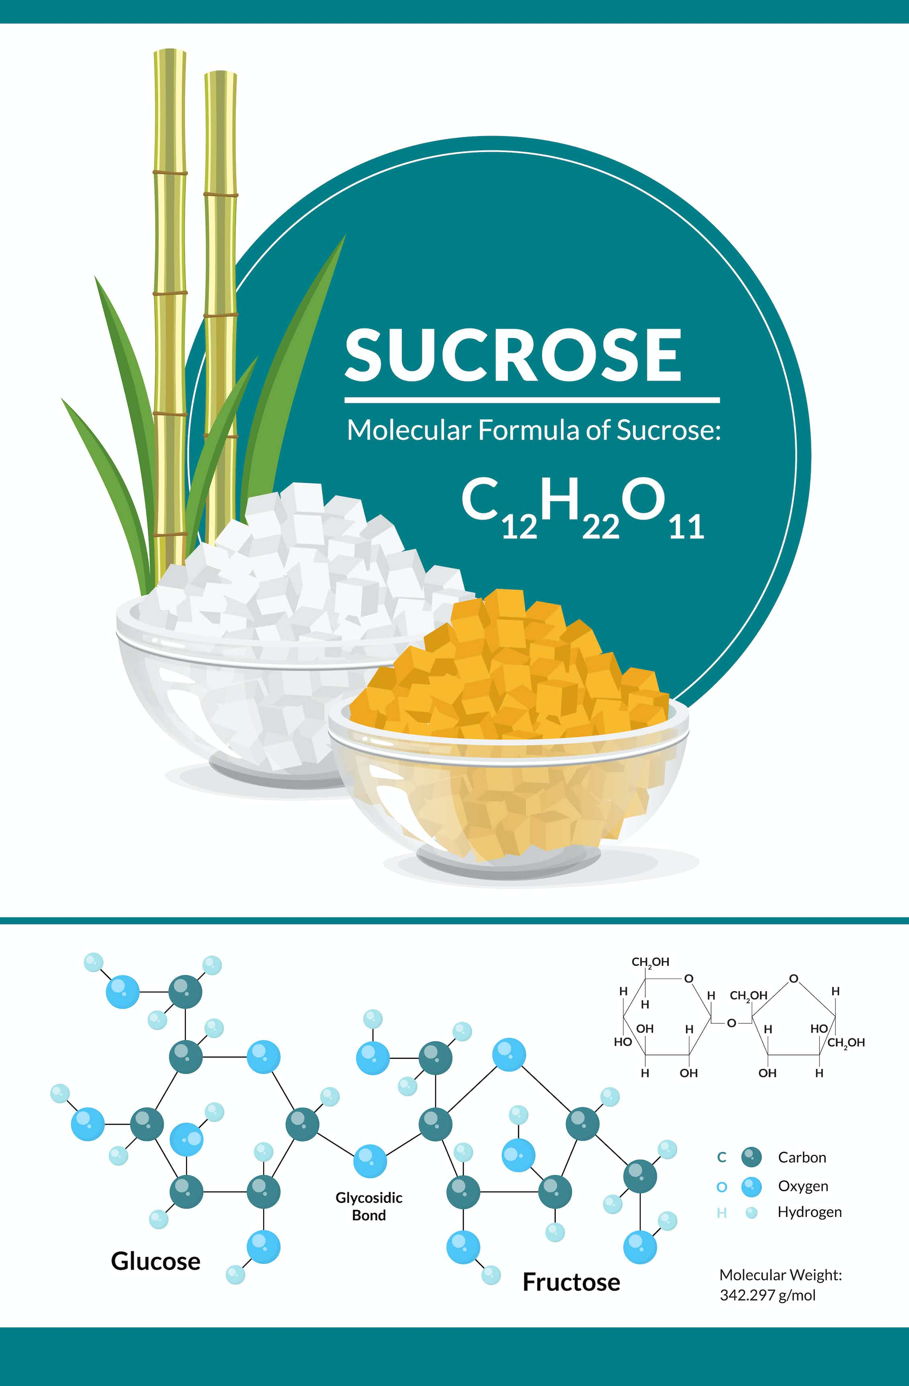
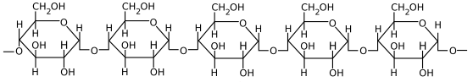
S. mutans
Lactic acid
Bacteriocins
Glucans & Fructans
(Glucansucrase)
Reduce the pH of the local
environment
Kills acid-intolerant organisms
Kills other bacteria
Reduces competition
for niche
Attract more
S. mutans cells

Slide 10
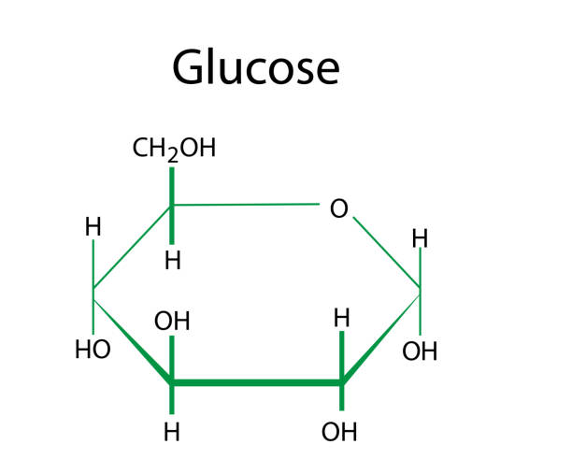
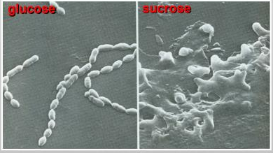
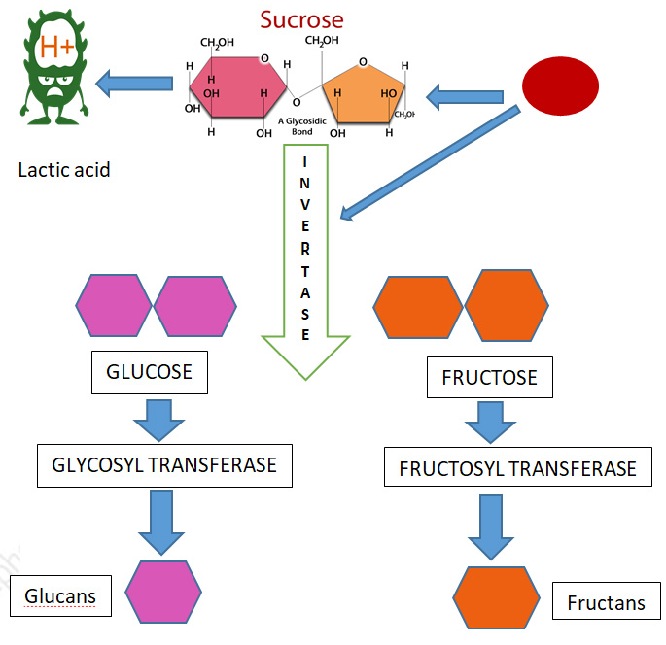
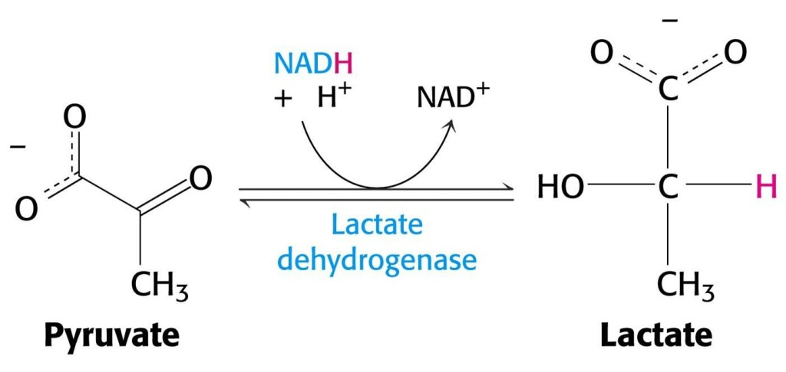
S. mutans Metabolism and Caries
S. mutans utilizes mono- and disaccharides for energy production via glycolysis
Only sucrose is used for producing polymeric matrix in biofilm
Glucose
Fructose
2) Glycolysis provides substrates for various fermentation pathways, but the production of lactic acid is the most significant
3) Other fermentation pathways can produce butyrate, propionate, acetate or alcohols. Rates of production are slower; not as strong as lactate.

Slide 11
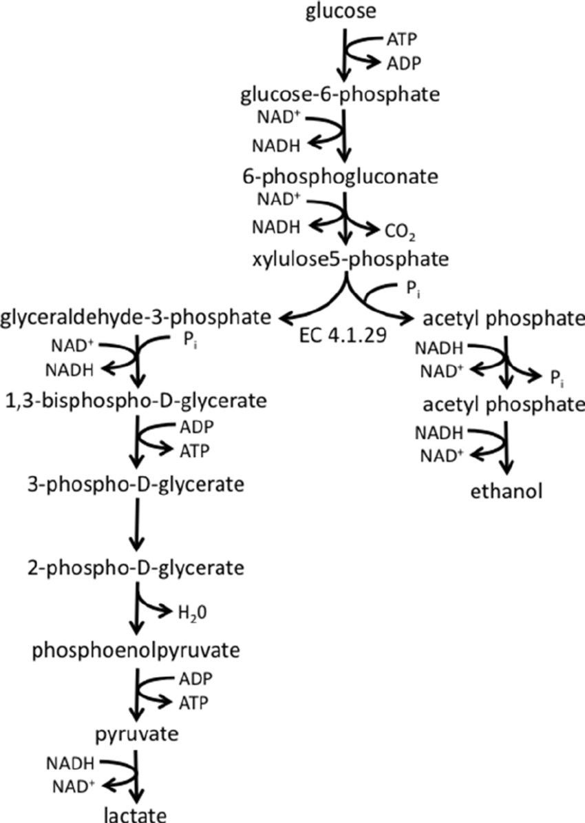
Sucrose, the Ideal Cariogenic Substrate
Sucrose is rapidly metabolized, both intracellularly and extracellularly by S. mutans to produce glucose and fructose
S. mutans
High glucose levels reduce the expression of metabolic pathways that utilize other simple sugars. Catabolite repression
Thus, when glucose is present, it is preferentially metabolized and induces a state of homofermentation

Slide 12
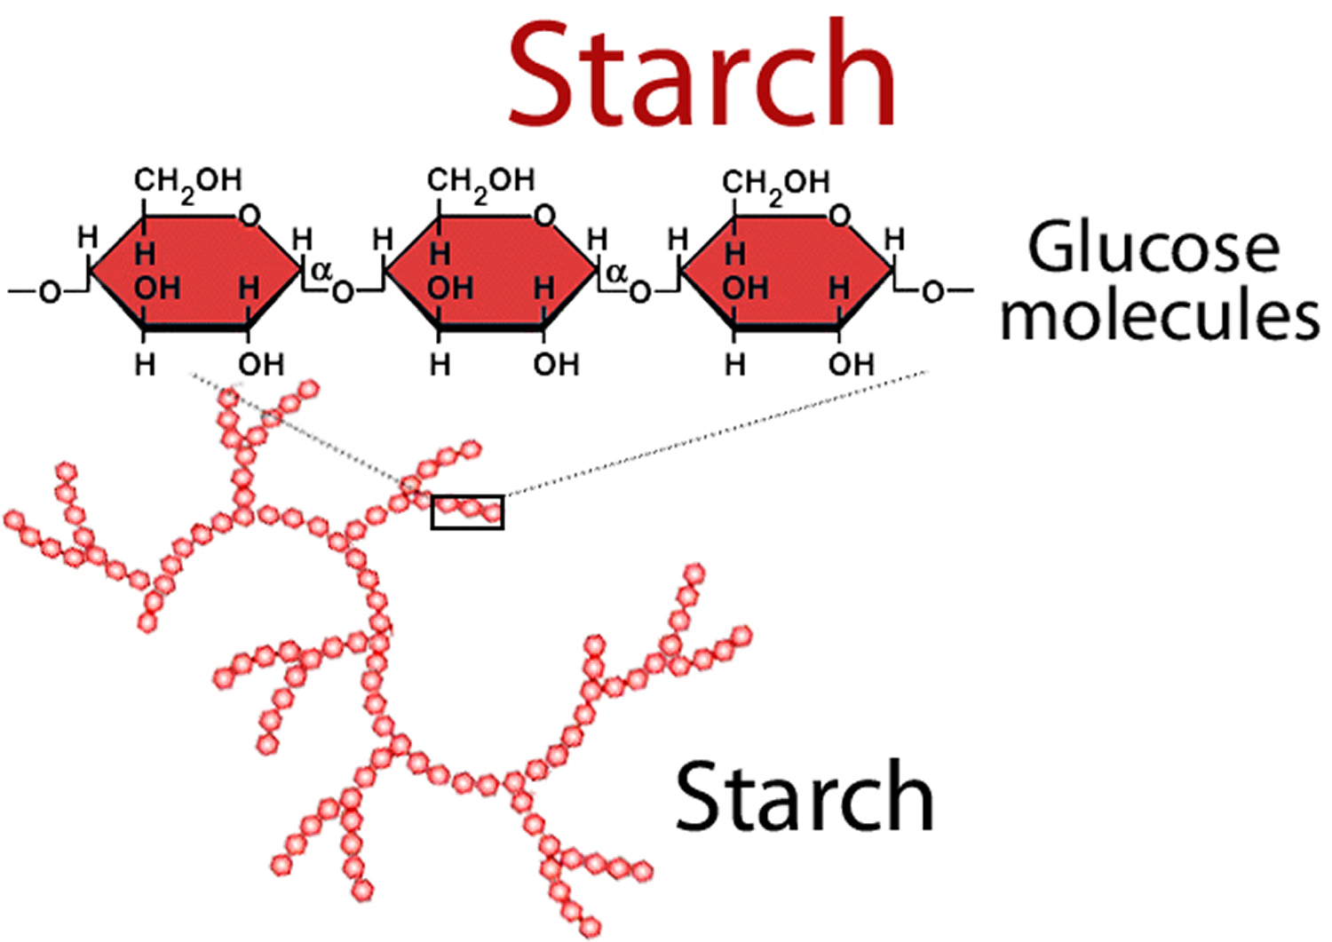
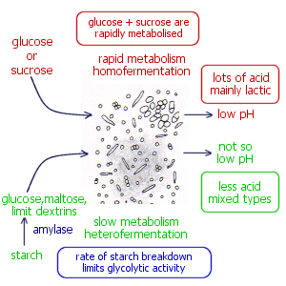
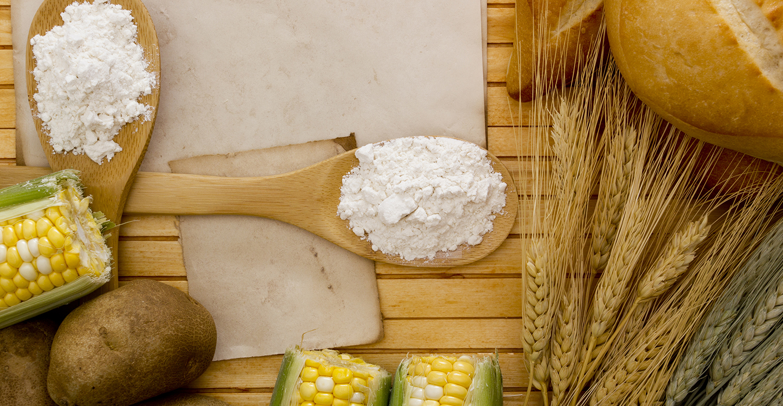
Metabolism of complex carbohydrates like starch generates less lactate than the metabolism of sucrose since rate of glycolysis is limited by the rate of starch digestion

Slide 13
Matrix Carbohydrates Contribute to Caries
1) S. mutans secretes enzymes that utilize sucrose to produce extracellular polymeric glucans and fructans.
fructosyltransferase
sucrose ------------------→ fructan + glucose
glucosyltransferase
sucrose ------------------→ glucan + fructose
2) Glucans and fructans provide:
Extracellular stores of carbohydrates for S. mutans (e.g., glucans or fructans cleaved by dextranase or fructanase to yield glucose or fructose, respectively)
Promote attachment of additional S. mutans cells to plaque
Protect attached S. mutans from antimicrobial effects of saliva

Slide 14
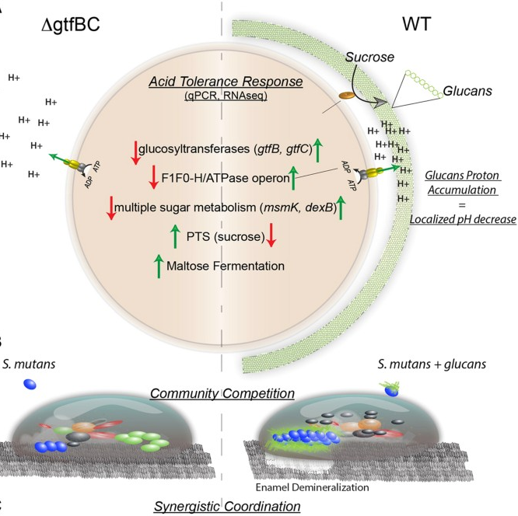
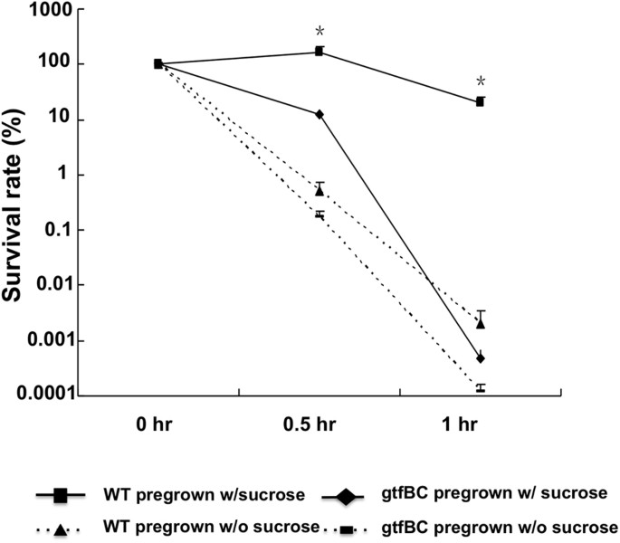
Insoluble glucans:
Display proton-concentrating ability (proton enrichment)
Up-regulate genes involved in acid tolerance response
pH 2.8
Scientific Reports volume 5, Article number: 18015 (2016)

Slide 15
Are other organisms caries pathogens?
S. mutans is found in most but not all subjects with caries.
Levels of S. mutans vary depending on the stage of the disease.
Lactobacilli can be present in high numbers in advanced cavitated lesions.
Molecular diagnostic approaches identified the following as predominant members of the cariogenic biofilm:
Scardovia wiggsiae (high levels even in absence of S. mutans)
Streptococcus cristatus
Viellonella parvula (metabolizes lactate)

Slide 16
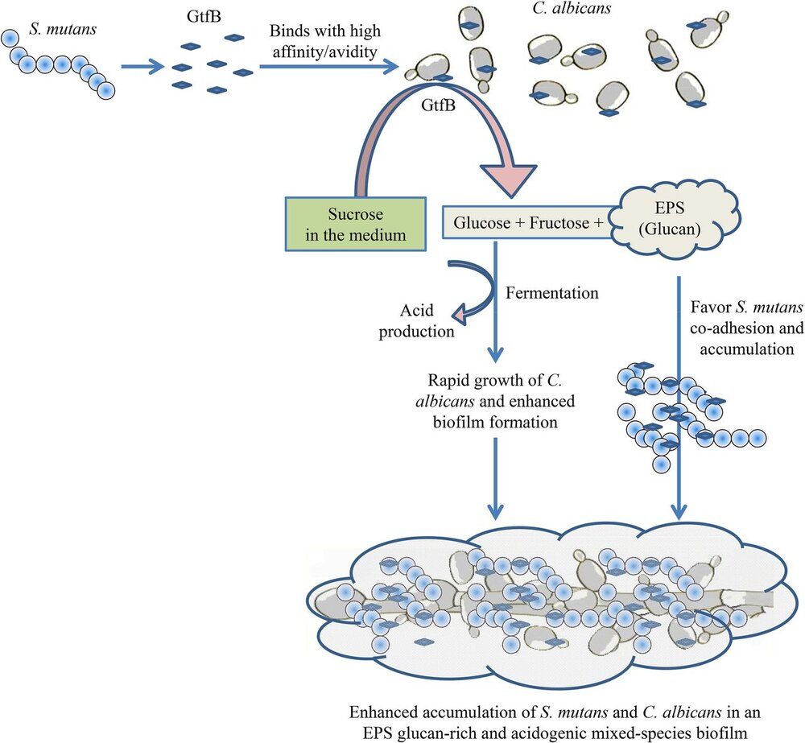
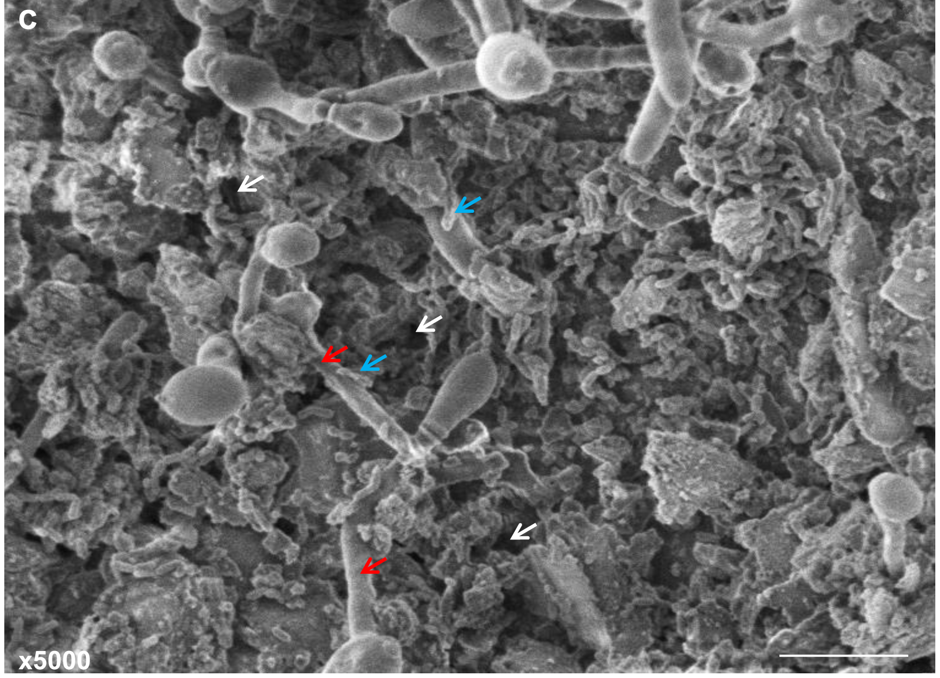
A role for fungi?
High levels of Candida and S. mutans are found in biofilms in children with early childhood caries (ECC), but rarely in healthy children.
Candida and S. mutans form a synergistic relationship;
GtfB produces glucan matrix which facilitates colonization of the tooth by both organisms.
Candida induces the production of GtfB which binds to fungal surface.

Slide 17
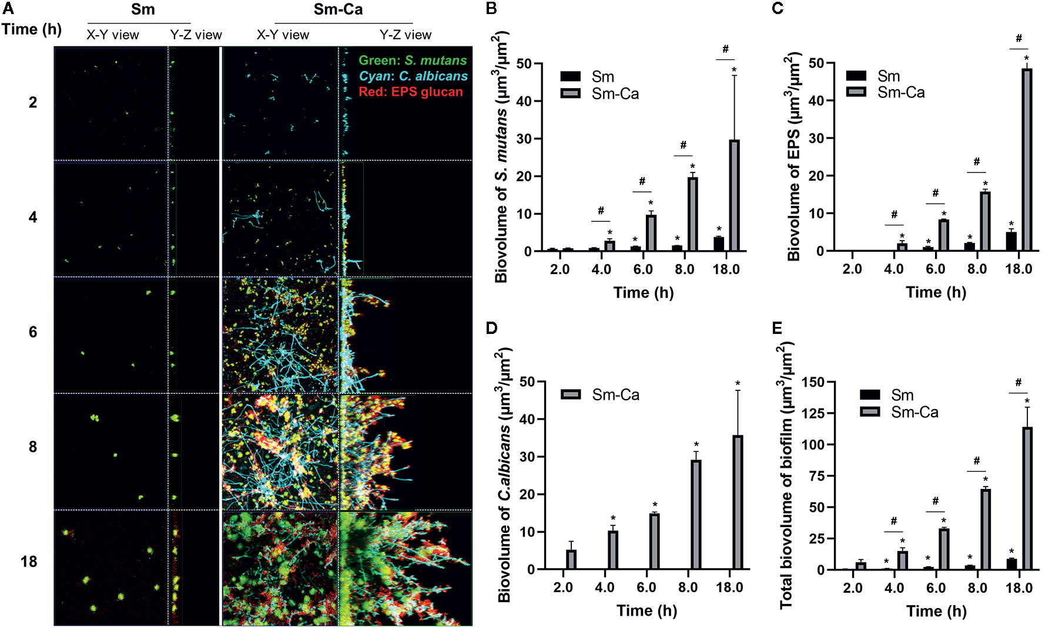
Synergism of Streptococcus mutans and Candida albicans Reinforces Biofilm Maturation and Acidogenicity in Saliva
Front. Cell. Infect. Microbiol., 19 February 2021

Slide 18
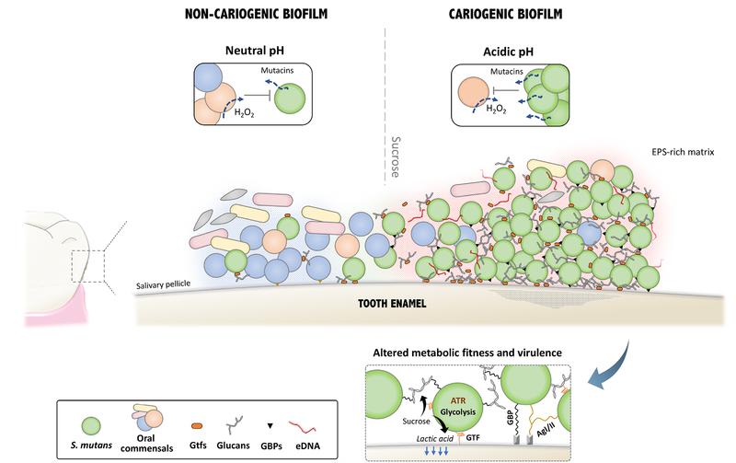
The Matrix Hypothesis
The main role of S. mutans may be to facilitate the development of the cariogenic biofilm through the production of extracellular matrix, which generates an environment that promotes the colonization and growth of other acidophiles, possibly at the eventual expense of S. mutans itself.

Slide 19
The Caries Triad
Plaque
Microbial Biofilm
Host Factors
Genetics
CARIES
Environment
Dietary Factors

Slide 20
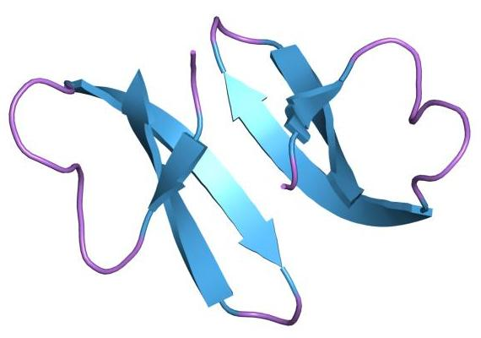
α-Defensins and Caries
α-defensins are small, cystiene-rich, cationic peptides produced by neutrophils and ductal cells of the submandibular salivary gland.
Several distinct α-defensin peptides exist in saliva (e.g., HNP1,2,3)
Median concentration in saliva is in the ug/ml range
H₂N-DCYCRIPACIAGERRYGTCIYQGRLWAFCC-COOH

Slide 21
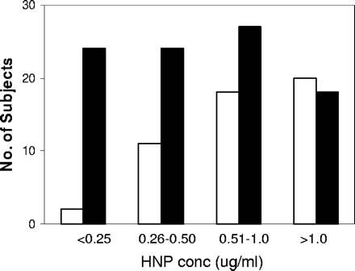
HNP-3 levels and caries
Tao et al. Salivary antimicrobial peptide expression and dental caries
experience in children. Antimicrob. Ag. Chemother. 49:3883-3888.
- study of 149 middle school children to examine correlation of salivary concentrations of hnp3 and β-defensin 3 with caries.
Black box = high caries score
White box = low caries score

Slide 22
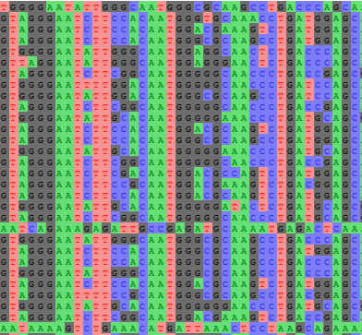
Defensin Expression and SNPs
High α-defensin correlates with reduced caries
High β-defensin expression arises from point mutations in the defensin gene promoter, at position –44 and –20.
These point mutations are referred to as single nucleotide polymorphisms (SNPs)
α-defensin gene single nucleotide polymorphism

Slide 23
Salivary components that possess anti-microbial activities
Lysozyme
Lactoferrin
Glycoprotein340 (gp340)
small cystiene-rich peptides (e.g., defensins)
Individual heterogeneity of these components represents one mechanism contributing to susceptibility to disease.
Glycoprotein340 (gp340) Aggregates Bacteria
+ gp340
Clearance from
oral cavity
High levels of gp340 in saliva correlates with resistance to caries
Caries resistant study population exhibited 2-fold greater gp340 activity
than caries susceptible individuals

Slide 24
The Caries Triad
Host Factors
Genetics
Plaque
Microbial Biofilm
CARIES
Environment Factors

Slide 25

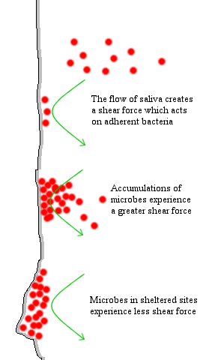
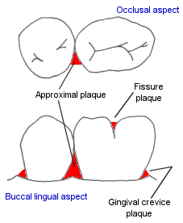
Salivary Flow Modulates Growth of Dental Plaque

Slide 26
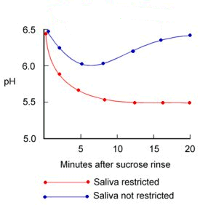
Effect of Salivary Flow on Plaque pH

Slide 27
Summary
1) Caries is a complex bacterial disease - S. mutans is strongly associated with disease because this organism can rapidly metabolize simple sugars to produce lactate. Other organisms also associated with disease.
2) Caries is strongly influenced by dietary sucrose - sucrose promotes homofermentation; also feeds into the synthesis of the carbohydrate matrix produced by S. mutans.
3) Genetics influence susceptibility to caries - affects composition of saliva and host defense mechanisms.
4) Caries is modulated by saliva and other buffering systems - buffers in saliva and in plaque itself can neutralize acid produced by S. mutans;
saliva also contains antimicrobial components; low salivary flow is associated with high risk for caries.

Slide 28
Take-home message
To prepare yourselves for the exams, review definitions, categorizations, meanings of specific terms, examples, key mechanisms, and concepts. Be prepared for at least one question that requires analytical skills to explain the concept, definition, or mechanism represented by a graph or figure.
Examples…
1) Refer to the provided figure and explain how the Ecological Plaque Hypothesis explains dental caries.
2) How you answer this email: "Hi there, I'm a bit concerned about my child having severe early childhood caries compared to their peers. I heard something about bacteria and fungi working together like a team in their mouths. Can you help me understand why my child's dental situation is different? What's this teamwork of bacteria and fungi doing, that causes his dental health differently than other kids?"

