Slide 1

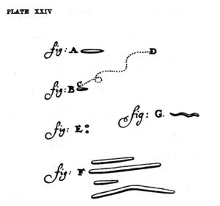
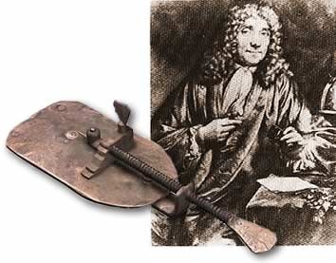

OIID 600
February 24, 2025
Bacterial Succession and Immune Evasion
David A. Scott
Oral Immunology and Infectious Diseases
Leeuwenhoek's drawings of bacteria in the human mouth. Published 1684.
Image: Primary source unknown.

Slide 2
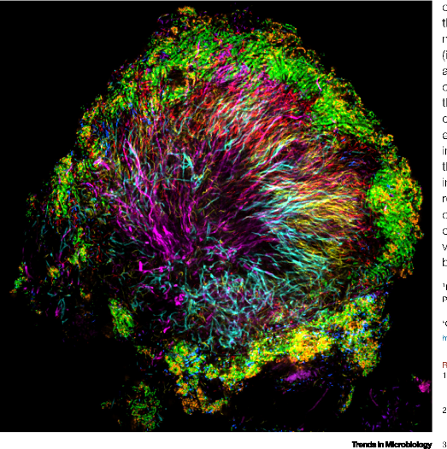
Changes in periodontal microbiome
(convention)
Health ………………… Disease
Gram +ve Gram –ve
Aerobic / Facultative Anaerobic
Hundreds of species / Diversity
strains increases
Commensals Commensals & opportunistic
pathogens
Image credit: Steven Wilbert & Gary Borisy, Forsyth Institute

Slide 3
Why does bacterial succession occur?
(i) Change in available ligands for adhesion
YES
Early colonizers
e.g. Actinomyces naesludii
fimbriae adhering to proline-rich proteins
present in salivary pellice
NO
No early colonizers
Fusobacterium nucleatum adhesion
E.g., Li et al, Infection & Immunity, 1999

Slide 4
(ii) Changing oxygen tensions
Aerobes
Facultative /
Aerotolerant
Anaerobes
Decreasing oxygen
Respiration of primary colonizers > CO₂ production
E.g., Diaz & Vam, J Dent Res, 2019
(iii) Changing local nutrient supply
NO
YES
isobutyrate
thiamine
+ isobutyrate
+ thiamine
T. denticola
growth
Fusobacterium
E.g., Bian et al, J Bacteriol, 2011; ter Steeg & der Hoeven, Antonie van Leeuwenhoek, 1990

Slide 5
(iv) Changing local nutrient supply
YES
YES
+ succinate
succinate
P. gingivalis
growth
T. denticola
E.g., Kin et al, J Oral Microbiol, 2020
(v) Change in host metabolism
YES
YES
+ estradiol &
progesterone
estradiol &
progesterone
P. gingivalis
growth
Pregnancy
E.g., Massoni et al, Sci Rep, 2019

Slide 6
(vi) Change in virulence properties
YES
NO
O₂
Anoxic
Aa
Leukotoxin production
E.g., Kolodrubetz et al, Res in Microbiol, 2010
(vii) Change in synergistic opportunities
YES
+H₂O₂
NO
P. gingivalis
Aa (KatA)
Streptococcus
sanguinis
E.g., Zhu et al, Sci Rep, 2019

Slide 7
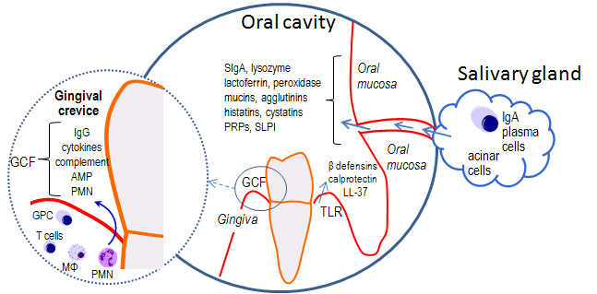
The Immune System from the Oral Perspective
Image: Primary source unknown.

Slide 8
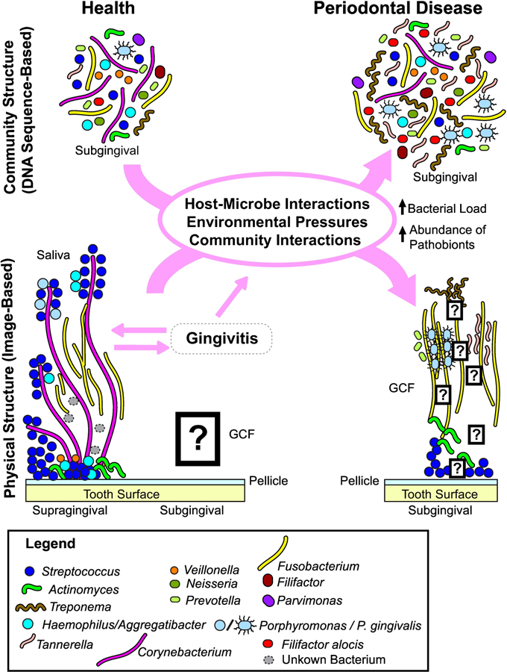
Host-pathogen interactions in the periodontium
A group of dysbiotic subgingival, largely anaerobic bacteria co-existing within a dynamic biofilm community initiate and propagate periodontal diseases.
Image: Valm, J Mol Biol, 2019

Slide 9
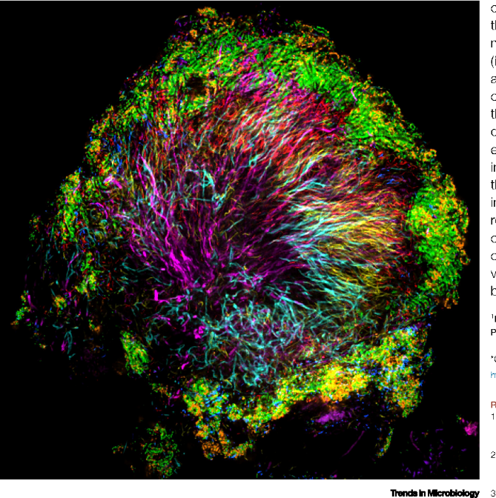
Requirements for pathogens to attach, grow, and persist
1. Adherence and colonization
2. Acquisition of essential growth nutrients
3. Cooperation with other bacteria
4. Resistance, evasion, subversion of host defenses
Image credit:
Steven Wilbert & Gary Borisy,
Forsyth Institute
Impairment of host defenses through immune subversion by key periodontal pathogens can benefit companion species that lack similar strategies but share the same subgingival niche.

Slide 10
THE
IMMUNE RESPONSE
IN
PERIODONTAL TISSUES

Slide 11
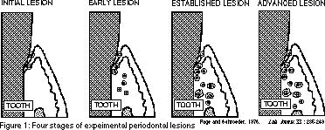
PAGE and SHROEDER, 1976…..immune cells
gingivitis
periodontitis

Slide 12
Initial lesion:
Few neutrophils at the junctional epithelium, which migrate into the gingival sulcus.

Slide 13
(ii) Early lesion:
Within 4-7 days, neutrophils continue to increase in numbers in the periodontal pocket.
Lymphocytes (T- and B-cells) infiltrate into the periodontal connective tissues.

Slide 14
(iii) Established lesion:
After 14 days, neutrophil infiltration of the pocket is intense.
Antibody-producing B-cells are apparent.

Slide 15
(iv) Advanced lesion:
Bone destruction is evident.
There is ulceration of the pocket epithelium.
B-cells predominate in the connective tissue.
Neutrophils predominate in the gingival crevice and at the epithelium.

Slide 16
Neutrophils are the first immune cells to arrive to meet the bacterial challenge and are present in large numbers at all stages of disease.

Slide 17
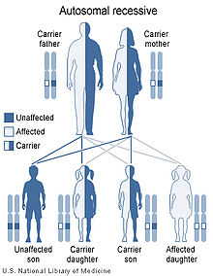
A functional innate immune system is required for periodontal protection
Papillon-Lefevre syndrome:
Cathepsin C (dipeptidyl peptidase I) deficiency
Cathepsin C regulates neutrophil function
Leukocyte Adhesion Deficiency:
- β2 integrin (CD18) deficiency
- CD18 required for leukocyte diapedesis

Slide 18
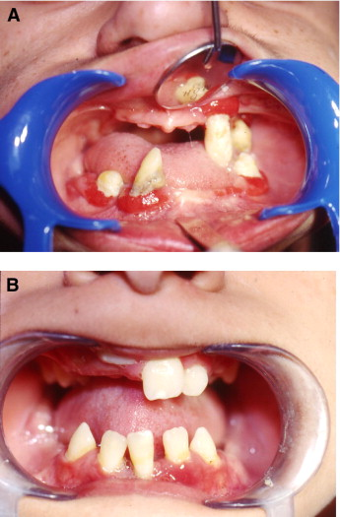
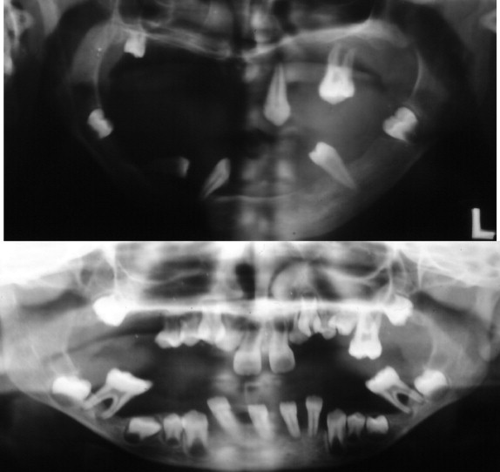
Periodontal manifestations of Papillon-Lefevre syndrome.
C
D
Scott & Krauss, Frontiers in Oral Biology, 2012.
  Cathepsin C deficiency

Slide 19
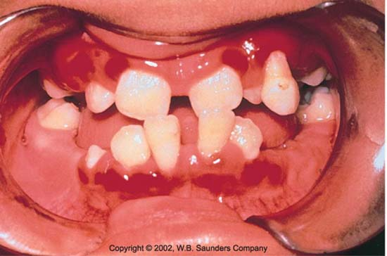
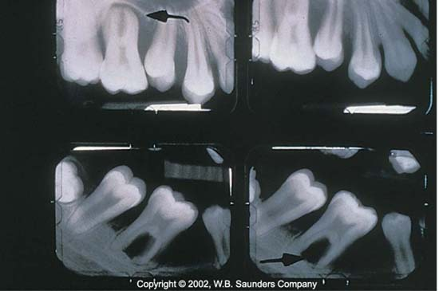
Periodontal manifestations of Leukocyte Adhesion Deficiency I (LAD1).
  Diapedesis is minimal as adhesion cascade compromised.

Slide 20
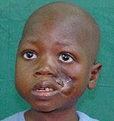
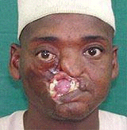
Noma (cancrum oris)
- A fusospirochetal infection in immunocompromised
- Develops from a periodontal infection
- Other microbes may be implicated also
- 500,000 cases / year in Africa
-90% fatal when untreated
www.facingafrica.org
A disease of the POOR

Slide 21

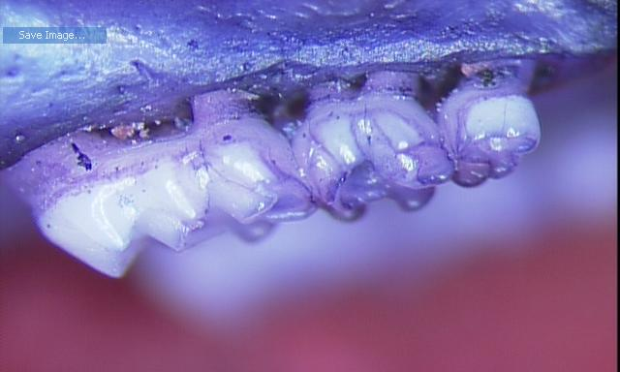
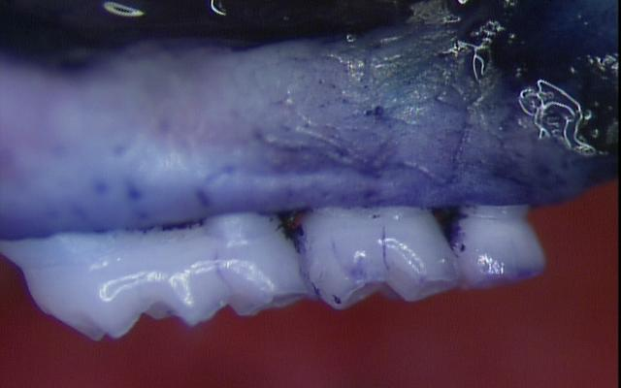
Yet, an uncontrolled inflammatory response drives periodontitis
Adamowicz et al, Mol Med, 2012
Scott lab, Mol Med, 2012
GSK3β signaling is key to the control of pro-inflammatory cytokines
Mice were orally infected with P. gingivalis with and without a GSK3β inhibitor

Slide 22
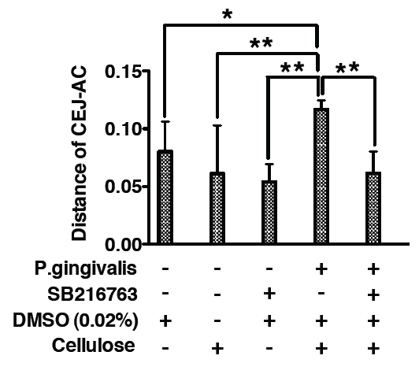
Immune driven disease: Inhibition of GSK3β abrogates bacterial-induced periodontitis
GSK3β signaling is key to the control of pro-inflammatory cytokines.
Mice were orally infected with P. gingivalis with and without a GSK3β inhibitor (SB216763).
SB216763 blocks pro-inflammatory cytokine production and bone loss.
Adamowicz et al, Mol Med, 2012

Slide 23
How do oral pathogens subvert the innate immune system?

Slide 24
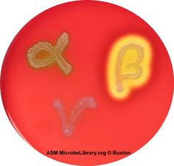
Hemolysis
Aa
Pg
S. pyogenes
S. pneumoniae
Partial
Complete
Non-hemolytic
S. salivarius
Acquisition of essential iron

Slide 25
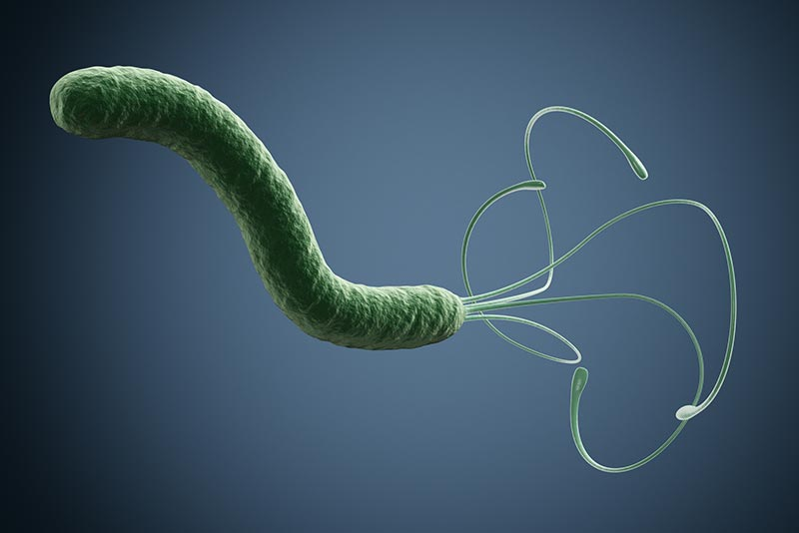
The VacA ( ) cytotoxin of Helicobacter pylori
H. pylori causes gastric ulcers
H. pylori found in subgingival plaque
VacA interferes with the process of antigen presentation
VacA helps H. pylori evade the adaptive immune response
Image by lucadp/iStock
E.g., Molinari et al, J Exp Med, 1998

Slide 26
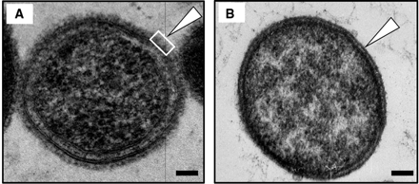
Capsules and S-layers
The S-layer of Tannerella forsythia, e.g., is an important virulence factor that attenuates the host immune response to this pathogen by blocking bacterial recognition by the innate immune system (TLRs).
Image: Index of /images/8/89 (kenyon.edu)
(A) T. forsythia ATCC 43037 wild-type cell
(B) S-layer-deficient T. forsythia ΔtfsAB mutant cell

Slide 27
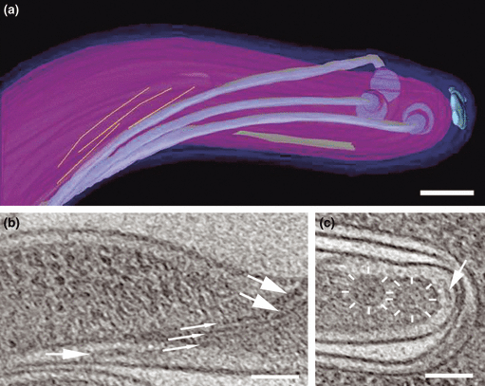
Periplasmic flagella
Cellular invasion
Tissue invasion
Highly antigenic flagella “hidden”
Rapid movement
Izard et al, J Struct Biol, 2008
Treponema denticola flagella

Slide 28
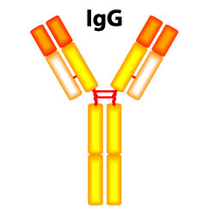
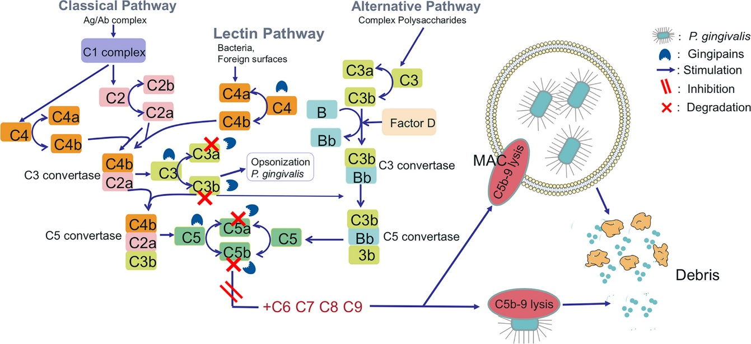
The proteases of P. gingivalis
P. gingivalis produces a wide array of proteolytic enzymes
These include proteases that can degrade:
Pg proteases degrade opsonins and, therefore, protect against humoral and innate immunity
Complement components
Image: prosci-inc.com
Image: Chopra et al, J Oral Microbiol, 2020
E.g., Vincents et al, FASEB J, 2011
E.g., Chopra et al, J Oral Microbiol, 2020

Slide 29
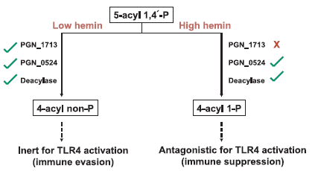
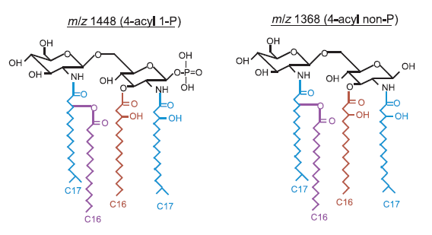
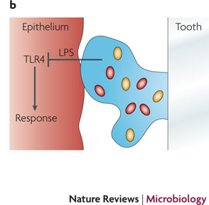
Disruption of TLR-signaling
P. gingivalis expresses an atypical LPS that competitively inhibits TLR4 activation.
This TLR4 antagonist:
Downregulates β-defensin expression in human gingival epithelia.
Inhibits epidermal growth factor (EGF)-dependent signaling that is involved in remodeling of the periodontal tissue matrix.

Slide 30
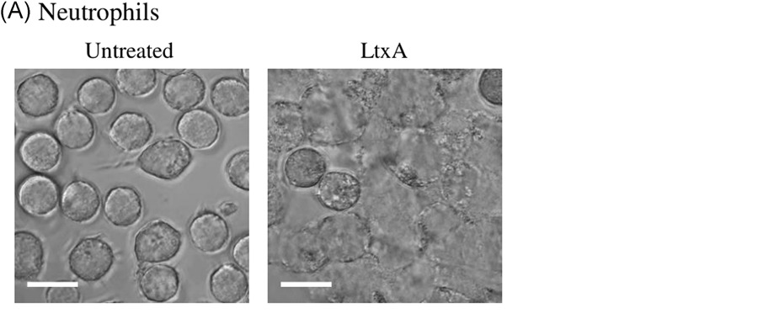
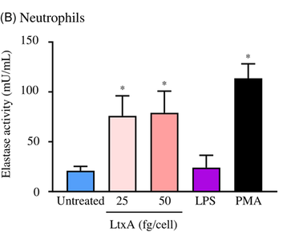
The leukotoxin of A. actinomycetemcomitans
Aa produces a potent leukotoxin
This toxin triggers cell death in both neutrophils and monocytes
Induces neutrophil elastase release
Therefore, the leukotoxin helps protect Aa against phagocytosis while promoting tissue destruction
Image: Chopra et al, J Oral Microbiol, 2020
Image: Chopra et al, J Oral Microbiol, 2020
E.g., Chopra et al, J Oral Microbiol, 2020

Slide 31
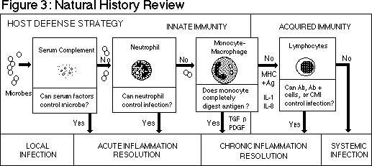
SUMMARY OF THE IMMUNE RESPONSE AGAINST
PERIODONTAL BACTERIA
RARE and / or TRANSIENT Remember
noma?
PAGE and SHROEDER, 1976

Slide 32
Key message
Periodontal pathogens have evolved in manners that allow them to not only survive the immune response but also exploit it in order to promote their own survival and causing periodontal tissue injury as result of collateral damage.

