Slide 1
Vitamin D and SARS-CoV-2
Gill Diamond, Ph.D.
Department of Oral Immunology and Infectious Diseases
University of Louisville School of Dentistry

Slide 2
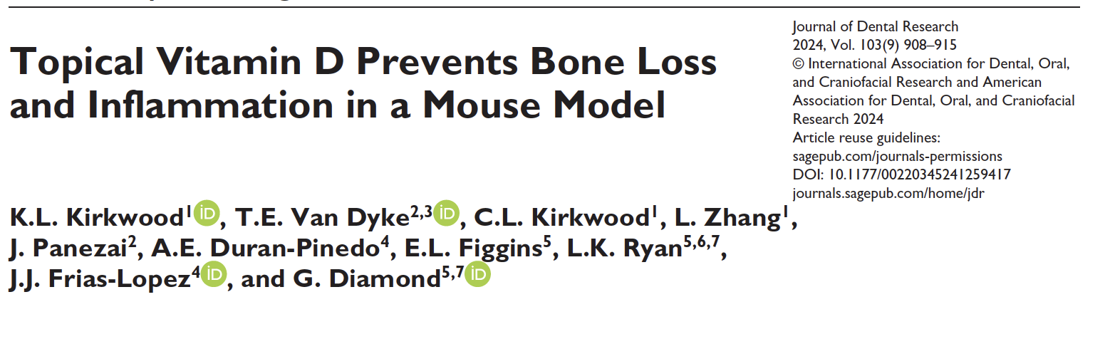
Vitamin D inhibits signs of periodontal disease in a mouse model
Topically applied, inactive vitamin D in a mouse ligature model led to:
Reduced bone loss
Reduced gingival inflammation
Increased mediators of resolution of inflammation
Health associated oral microbiome

Slide 3
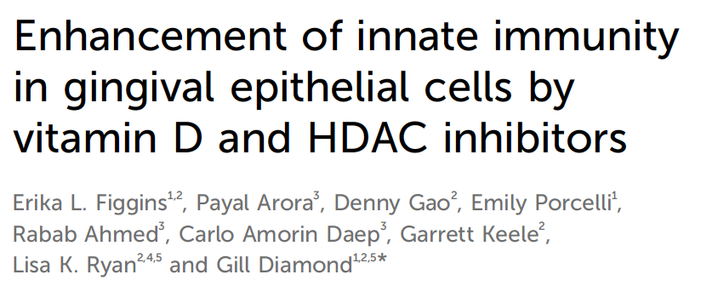
Vitamin D increases defense against bacterial and viral pathogens
A combination of Vitamin D and HDAC inhibitors in vitro led to decreased invasion of:
P. gingivalis
F. alocis
HSV-1

Slide 4
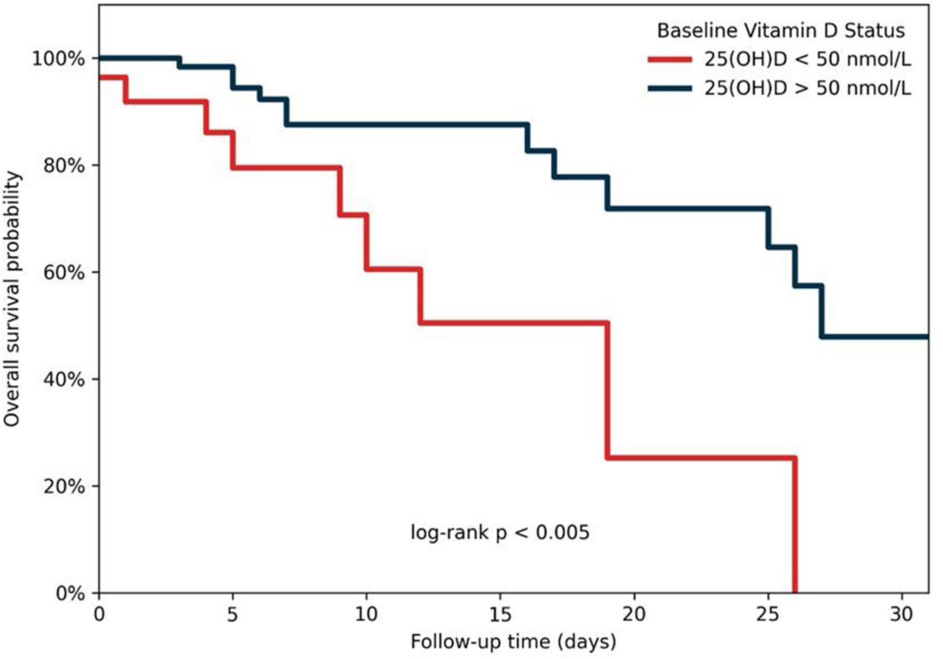
Vitamin D Deficiency and SARS-CoV-2
Vitamin D deficiency is associated with increased risk of upper respiratory tract infections, and vitamin D supplementation helps to prevent infection.
For SARS-CoV-2, vitamin D deficiency is correlated with worse outcomes in hospitalized patients.
Is vitamin D effective against SARS-CoV-2?
What are the mechanisms that vitamin D uses?
30-Day Survival Curve
Neves et al (2022), Clin Nutr ESPEN.
Notes:
Upper respiratory tract infection examples: Influenza, pneumonia, bronchitis…
50nmol/L = “VitD sufficient”
This is an observational study…limited research done to assess the effects of vitamin D on SARS-CoV-2 infection

Slide 5
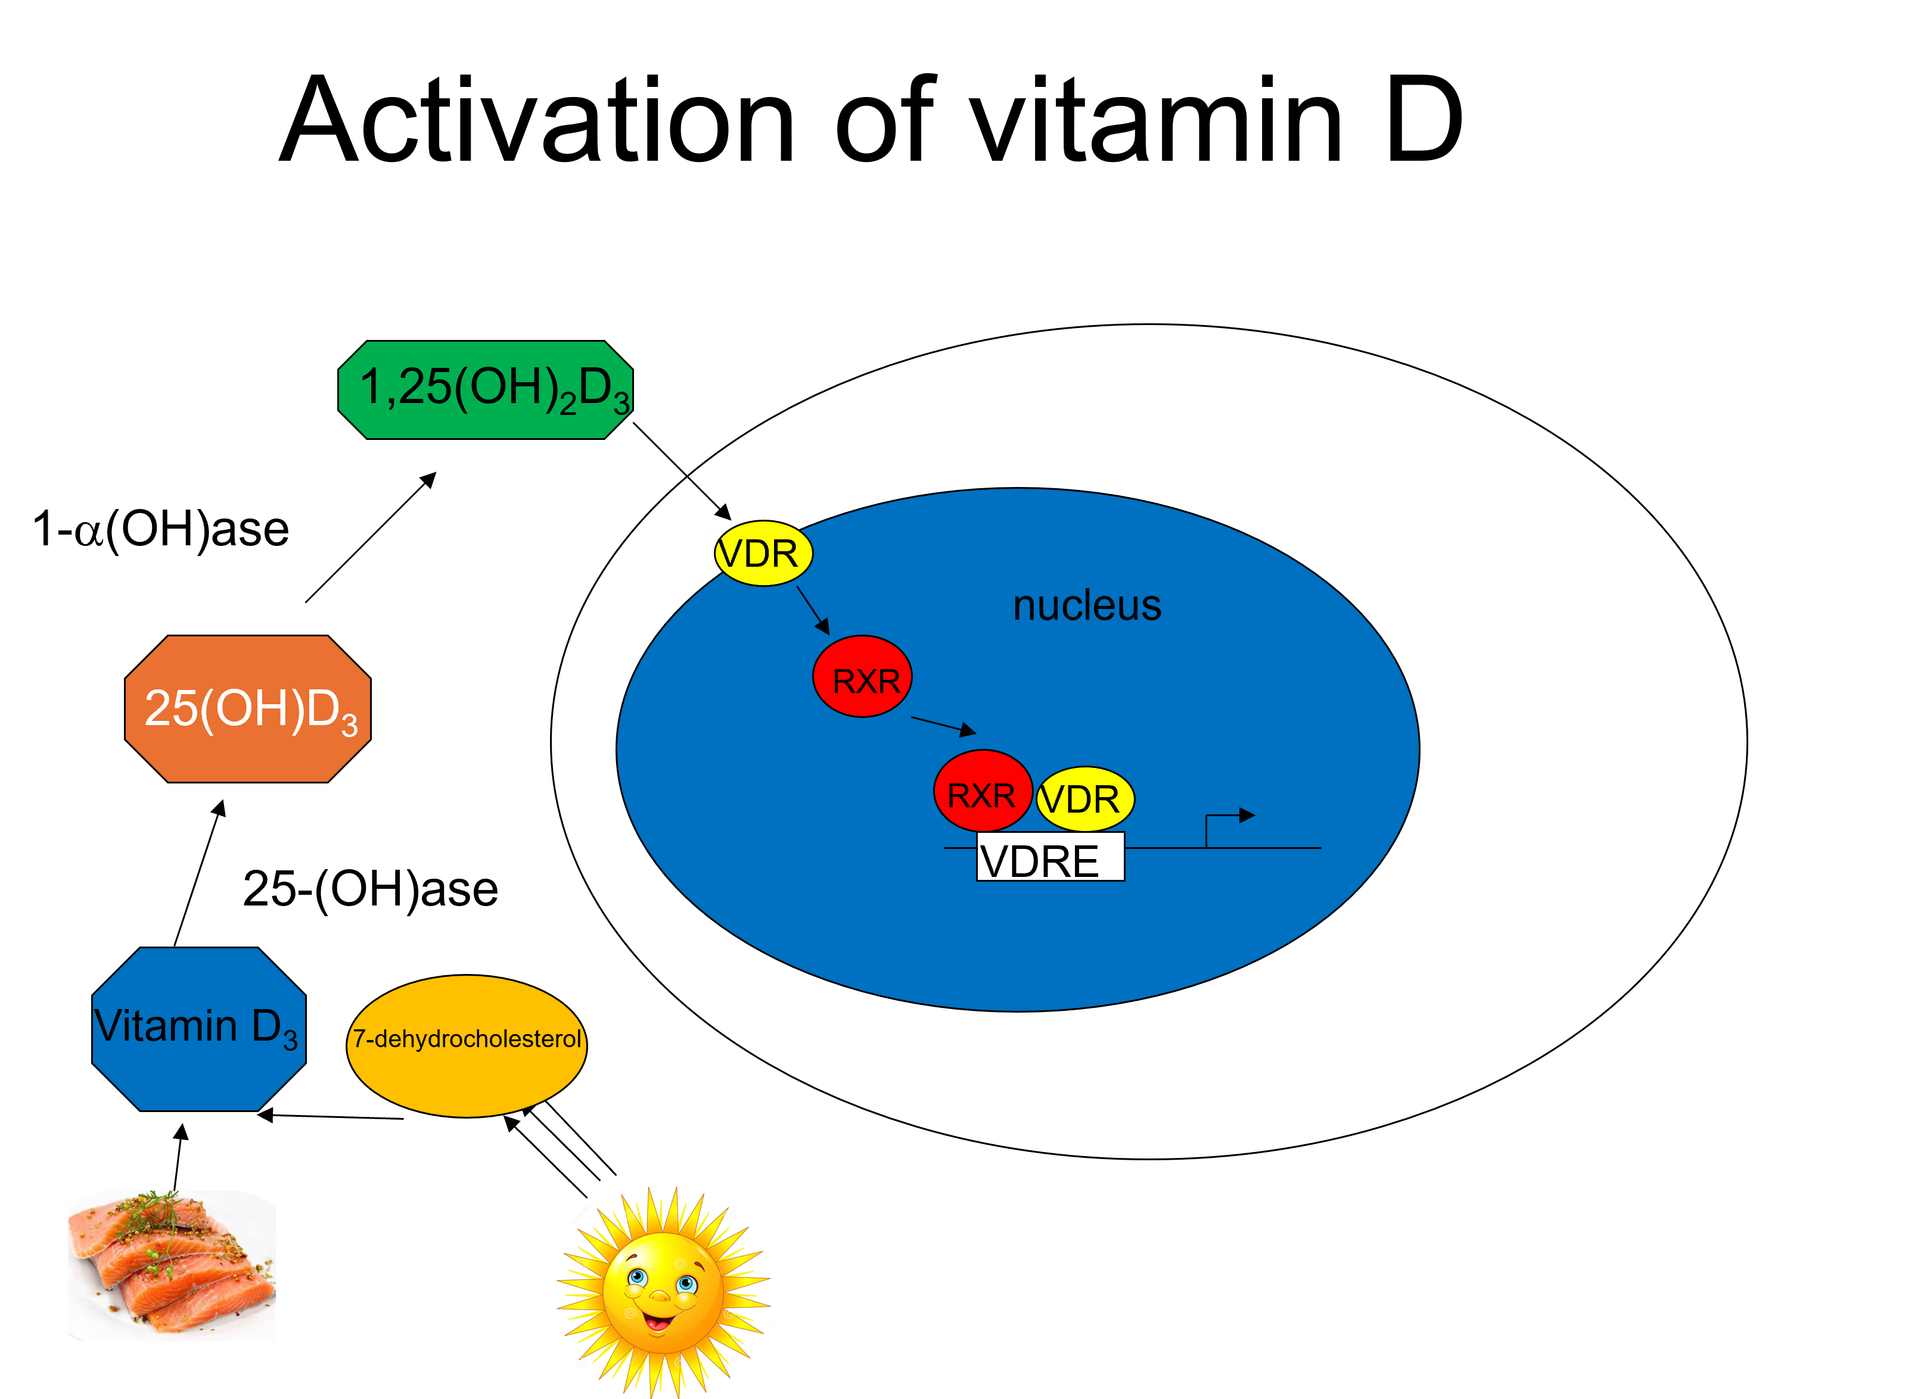
Vitamin D Biosynthesis and Activation
The inactive form of vitamin D (cholecalciferol) is generated through exposure to sunlight or diet.
Inactive vitamin D is then hydroxylated twice to generate active vitamin D (1,25(OH)₂D₃).
Vitamin D binds to the vitamin D receptor (VDR) in the cytoplasm, which is then translocated to the nucleus.
The VDR then combines with other receptors to bind with vitamin D response elements (VDREs) in genomic DNA to regulate gene expression.
Notes:
Whenever I say “vitamin D”, this is what I’m talking about.
In general the first hydroxylation is in the liver, and the second in the kidney.

Slide 6
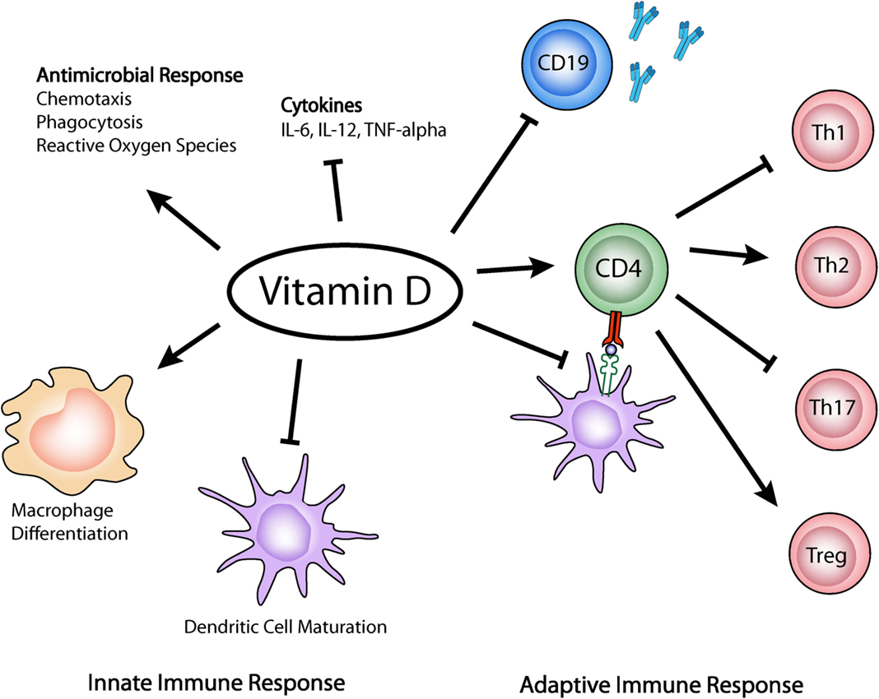
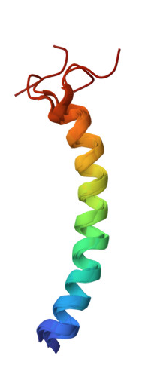
Vitamin D and the Immune Response
Vitamin D promotes antimicrobial clearance:
  Induces immune cell chemotaxis
  Supports phagocytic activity of macrophages
  Enhances antimicrobial peptide production
Vitamin D also inhibits inflammation:
  Supports T_{H}2 and T_{reg} differentiation
  Reduces proinflammatory cytokine production
Iruretagoyena et al (2015), Front Immunol.
Notes:
Whenever I say “vitamin D”, this is what I’m talking about.

Slide 7
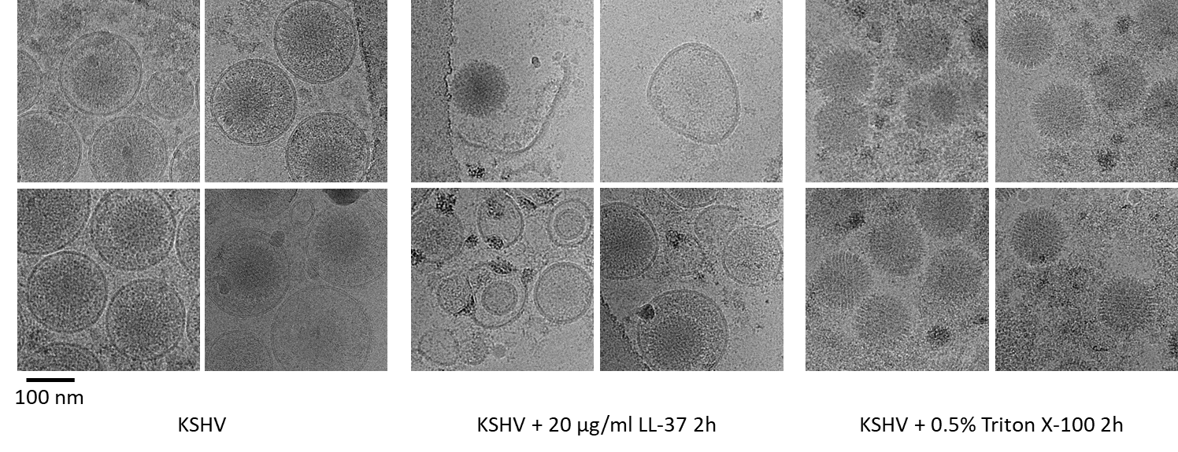
LL-37 disrupts viral envelopes
Control 20µg/ml LL-37
Brice et al., Antiviral Res., 158:25, 2018

Slide 8
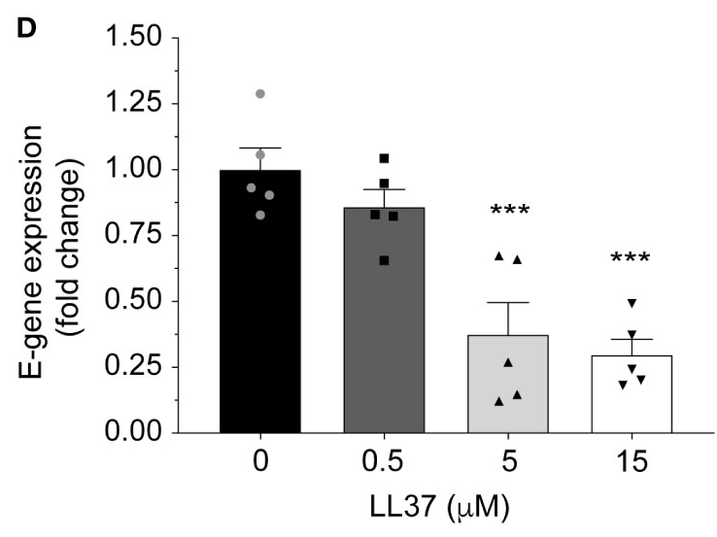
SARS-CoV-2 and LL-37
Vitamin D increases mRNA levels of CAMP, which leads to increased production of LL-37.
LL-37 is an antimicrobial peptide that binds and disrupts the viral membrane.
Previous studies have shown that co-incubation of LL-37 with SARS-CoV-2 for 3 hours significantly reduces viral infection in a reporter cell line.
Bhatt et al (2023), Front Immunol.
Notes:
3hr co-incubation

Slide 9
Vitamin D and SARS-CoV-2 Viral Entry
We examined the ability of vitamin D to block viral entry of SARS-CoV-2 into Calu-3 cells.
Calu-3 cells were pre-treated with EtOH control or 100nM 1,25(OH)₂D₃ for 24hr.
Media was either kept the same or changed to remove LL-37 from supernatants, and cells were infected with ΔORF3-E SARS-CoV-2 for 2hr.
  ΔORF3-E SARS-CoV-2 is replication-deficient but can enter Calu-3 cells.
Vitamin D significantly inhibits SARS-CoV-2 entry into cells, even without LL-37-containing supernatant.
*P < 0.05

Slide 10
Vitamin D and SARS-CoV-2 Viral Entry
We examined the ability of vitamin D to block viral entry of SARS-CoV-2 into Calu-3 cells.
Calu-3 cells were pre-treated with EtOH control or 100nM 1,25(OH)₂D₃ for 24hr.
Media was either kept the same or changed to remove LL-37 from supernatants, and cells were infected with ΔORF3-E SARS-CoV-2 for 2hr.
  ΔORF3-E SARS-CoV-2 is replication-deficient but can enter Calu-3 cells.
Vitamin D significantly inhibits SARS-CoV-2 entry into cells, even without LL-37-containing supernatant.
*P < 0.05

Slide 11
Contribution of LL-37 to cellular defense against SARS-CoV-2
Transfected cells with an siRNA specific to LL-37 or a scrambled control RNA
Treated cells with either vitamin D or ethanol control
Infected with SARS-CoV-2
Results:
Vitamin D reduces viral infection
LL-37 siRNA inhibits the reduction in the absence of vitamin D
Conclusion:
There is some contribution of LL-37 to the antiviral defense, but there are other mechanisms

Slide 12
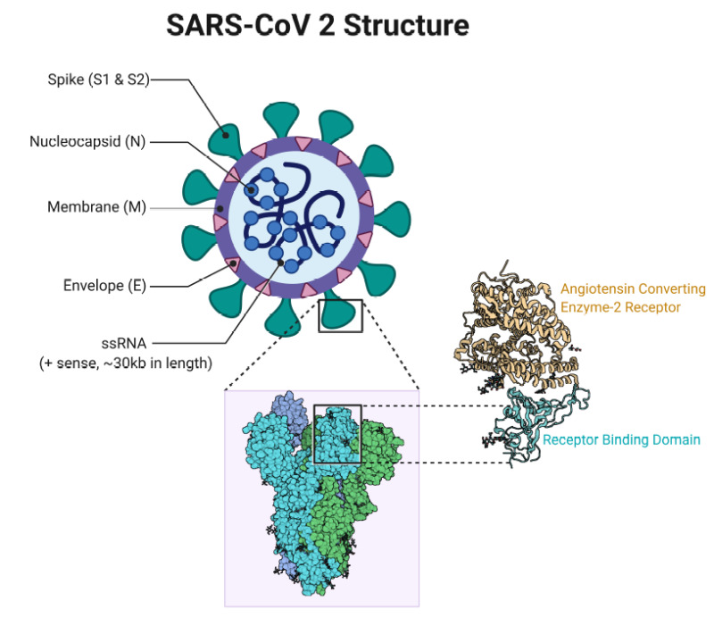
Can vitamin D inhibit infectivity of SARS-CoV-2?
Positive-sense, enveloped single-stranded RNA virus.
Characteristic Spike protein on the surface of the envelope
Viral entry is initiated when the SARS-CoV-2 spike protein binds to ACE2 on the surface of cells.
ACE2 is present on many different cell types in the body, which enables SARS-CoV-2 to infect a variety of tissues and cause systemic disease.
Rajnik et al (2021), StatPearls Publishing
Notes:
It causes COVID-19, primarily affecting the respiratory tract, and has led to the COVID-19 pandemic …
To enter a cell, SARS-CoV-2 first binds to ACE2 to initiate viral entry

Slide 13
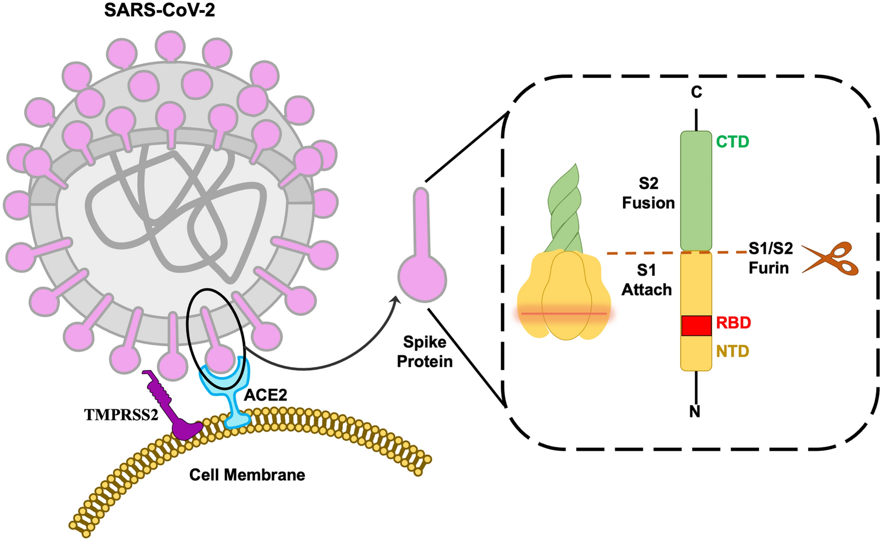
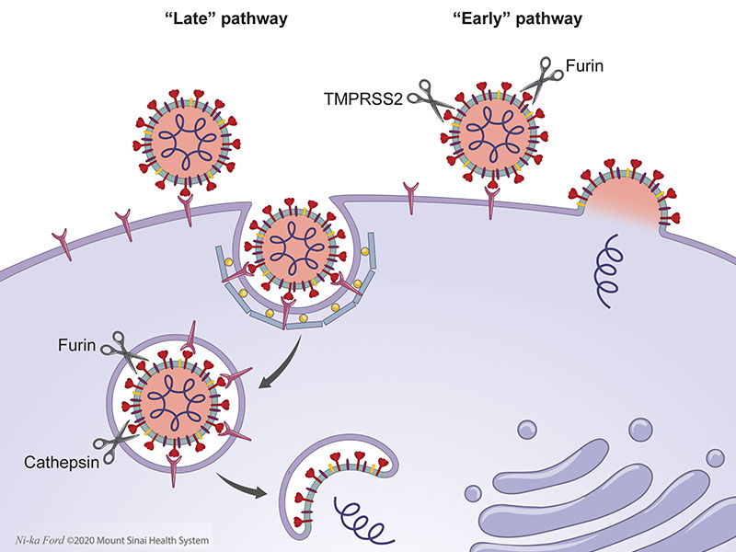
Entry of SARS-CoV-2 involves multiple pathways and factors
The Spike protein can bind directly to ACE2
  Leads to internalization into the endosome
A protease, Furin, cleaves the Spike protein
  Leads to direct membrane fusion and internalization of the viral mRNA
Rajnik et al (2021), StatPearls Publishing
Notes:
It causes COVID-19, primarily affecting the respiratory tract, and has led to the COVID-19 pandemic …
To enter a cell, SARS-CoV-2 first binds to ACE2 to initiate viral entry

Slide 14
Vitamin D and ACE2 Surface Levels
Previous work in our lab has linked vitamin D to altered mRNA levels of ACE, which is homologous to ACE2.
We investigated the impact of vitamin D in regulating cell surface levels of ACE2.
Calu-3 cells were treated with 100nM 1,25(OH)₂D₃ or EtOH control for 24hr.
Through flow cytometry, we found that the surface receptor levels of ACE2 was significantly decreased after treatment with vitamin D.
*P < 0.05

Slide 15
ACE2 Time Course and Dose-Response Studies
We next performed time course and dose-response studies to further assess the effects of vitamin D on ACE2.
Flow cytometric analysis reveals that ACE2 surface levels continue to be decreased for at least 3 days after inoculation and are significantly decreased in doses as low as 50nM.
*P < 0.05, **P < 0.01

Slide 16
Vitamin D and ACE2 mRNA Levels
Vitamin D acts primarily as a transcription factor to regulate gene expression.
We therefore examined the impact of vitamin D treatment on the mRNA levels of ACE2.
qRT-PCR analysis reveals vitamin D treatment does not affect ACE2 mRNA levels, regardless of dose or duration.
Notes:
Vitamin D binds to the Vitamin D receptor – binds to Vitamin D responsive elements in DNA → changes in gene expression

Slide 17
Vitamin D and Universal ACE2 Protein Levels
We next assessed total and intracellular protein levels of ACE2 after 24hr treatment with vitamin D.
ELISA and flow cytometric analysis confirm that ACE2 protein levels within Calu-3 cells universally decrease after treatment with vitamin D.
*P < 0.05
Notes:
We wanted to determine if these lower ACE2 levels are limited to the cell surface or if this is universal.

Slide 18
Vitamin D and Degradation of ACE2
Vitamin D also plays a role in protein degradation, which may explain its effects on ACE2 protein levels.
We examined whether vitamin D increases degradation of ACE2 through treatment with cycloheximide (CHX) to inhibit protein synthesis.
Through ELISA, we observed that cells treated with vitamin D leads to significantly increased protein degradation of ACE2 within 1hr after CHX treatment.
Vitamin D leads to reduction of ACE2 on target cells through increased degradation
**P < 0.01, ***P < 0.001

Slide 19
Vitamin D inhibits Furin expression
p=0.007

Slide 20
Conclusions and Future Directions
Vitamin D reduces ACE2 protein levels on Calu-3 cells, including on the cell surface.
This mechanism is done post-transcriptionally through enhancing degradation of ACE2.
  Could inhibit viral binding and entry
Vitamin D inhibits Furin mRNA levels in oral keratinocytes.
  Could inhibit viral membrane fusion and entry
Define the mechanism by which vitamin D acts to degrade ACE2 protein levels.
Study additional mechanisms of vitamin D that may lead to reduced SARS-CoV-2 infection.
Explore the efficacy of vitamin D as a therapeutic tool in a mouse model of infection.

Slide 21


Acknowledgments
Diamond Lab:
Denny Gao, M.S.
Erika Figgins, M.S.
Jim Walls
Braden Mulcahy
Emily Do
Dr. Lisa Ryan
Uriarte Lab:
Shikha Srivastava
Aruna Vashishta
Dr. Donghoon Chung
Funding: NIH: 1R01DE031928-01A1

